Slide 1
WELCOME TO KODEBLOOM’S FULL STACK DEVELOPMENT WEBMINAR

Slide 2
Introduction
What is Full Stack Development?
"Full stack development refers to the development of both front-end and back-end components of a web application."
"Full stack evelopers work on all layers of a web application, from the user interface to the database."

Slide 3
Layers of a Full Stack
Front-end (Client-side):
- User Interface (UI)
- User Experience (UX)
- Client-side logic
Back-end (Server-side):
- Server-side logic
- Database integration
- API integration
Database:
- Data storage
- Data retrieval

Slide 4
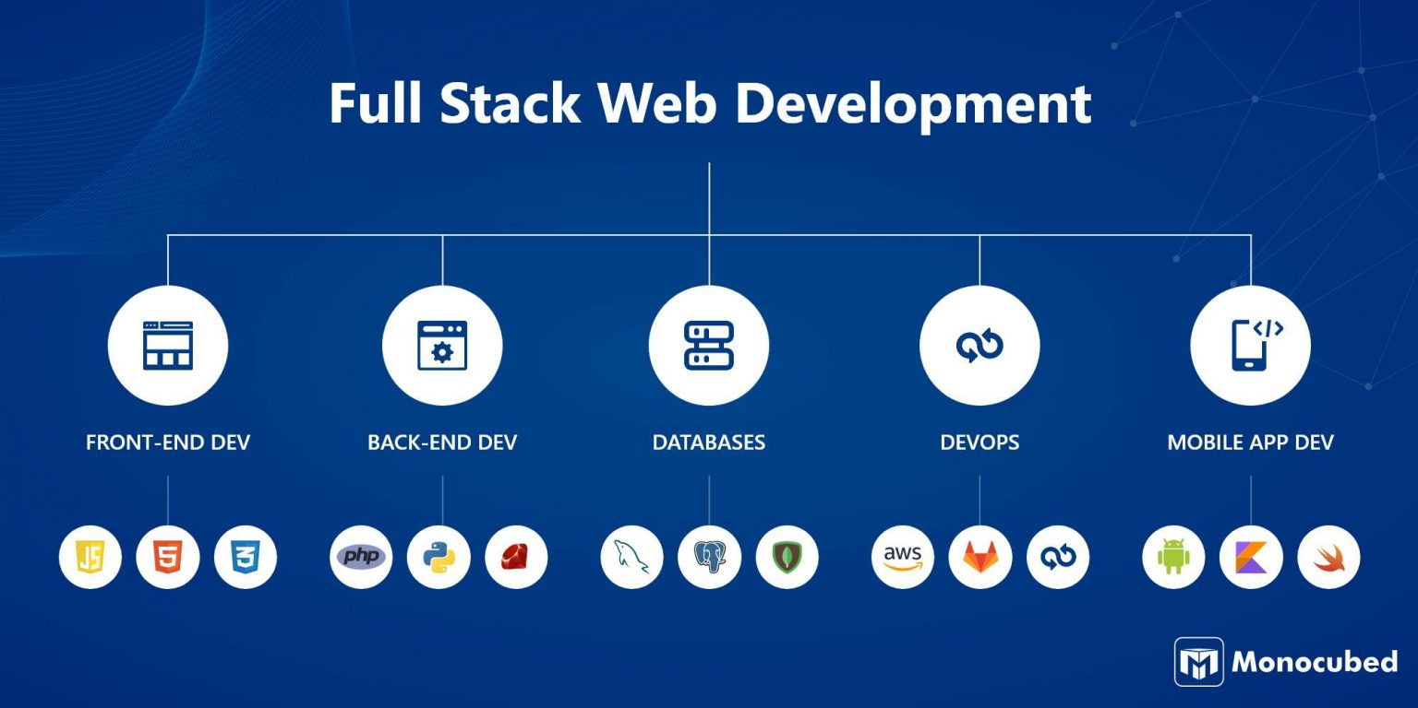
Full Stack Development Roadmap

Slide 5
Front-end Technologies
Programming languages:
- HTML/CSS
- JavaScript
Frameworks:
- React
- Angular
- Vue.js
Libraries:
- jQuery
- Bootstrap

Slide 6
Back-end Technologies
Programming languages:
- Java
- Python
- Ruby
Frameworks:
- Spring
- Django
- Ruby on Rails
Databases:
- MySQL
- MongoDB
- PostgreSQL

Slide 7
Databases
Types:
- Relational databases
- NoSQL databases
Database management systems:
- MySQL
- MongoDB
- PostgreSQL

Slide 8
Full Stack Development Process
Planning:
- Requirements gathering
- Project planning
Design:
- User interface design
- User experience design
Development:
- Front-end development
- Back-end development
- Database development
Testing:
- Unit testing
- Integration testing
- System testing
Deployment:
- Deployment to production
- Maintenance and updates

Slide 9
Front-End Tools
- Text Editor/IDE: VS Code, Sublime Text
- Browser: Google Chrome or Mozilla Firefox
- Frameworks: React.js, Angular, or Vue.js
- CSS Libraries: Bootstrap, Tailwind CSS

Slide 10
Back-End Tools
- Node.js and npm (Node Package Manager)
- Databases: MongoDB, MySQL, PostgreSQL
- Frameworks: Express.js, Django, Flask
- API Testing Tools: Postman

Slide 11
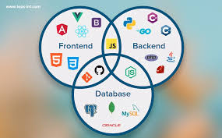
Environment Roadmap

Slide 12
Roadmap for Full Stack Development
1.Learn the Basics:
- HTML, CSS, JavaScript
2. Front-End Development:
- Frameworks: React, Angular, Vue.js
3. Back-End Development:
- Node.js, Django, Flask
4. Database Management:
- MySQL, MongoDB
5. Version Control:
- Git, GitHub
6. Deployment:
- Cloud Services: AWS, Heroku, Vercel

Slide 13
Setting Up the Environment
1. Install Code Editor:
- VS Code, Sublime Text
2. Install Node.js:
- Includes npm (Node Package Manager)
3. Set Up Version Control:
- Install Git and configure GitHub account
4. Database Setup:
- Install MySQL or MongoDB
5. Install Dependencies:
- Use npm or yarn for package management
6. Test Your Setup:
- Run a 'Hello World' project

