Slide 1

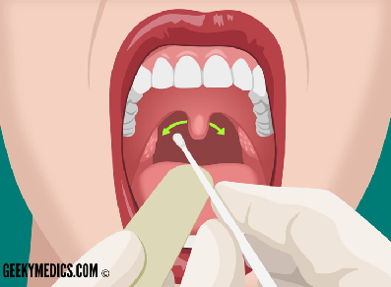
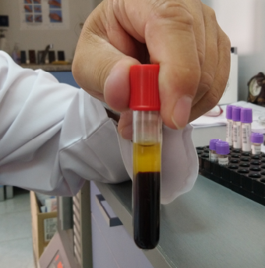
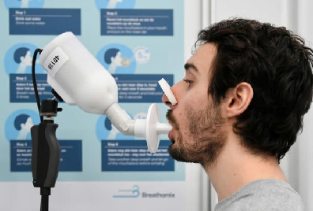
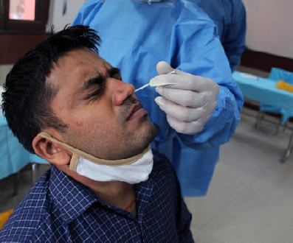
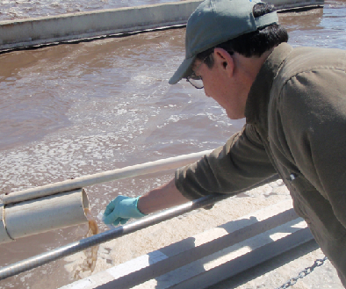
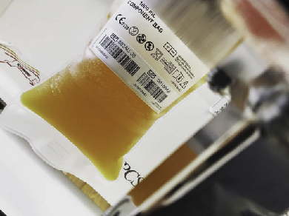

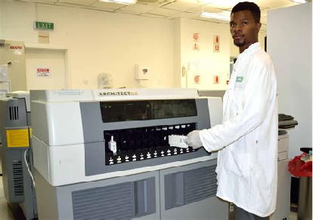
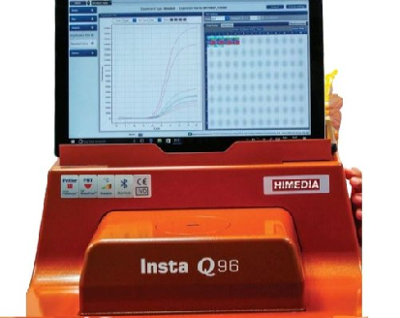
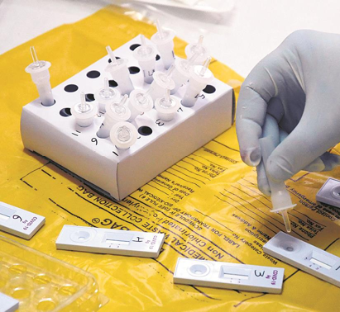
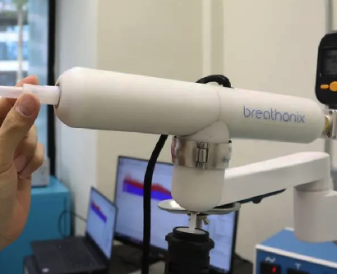
Question 1
Connect types of samples with type of test. (more than one match is possible)
www.forbes.com
agrilife.org
For example....
Serology
PCR-test
Spectrometry
RDT
25/05/2021

Slide 2



Question 1 - answer
Connect types of samples with type of test. (more than one match is possible)
www.forbes.com
agrilife.org
Serology
PCR-test
Spectrometry
RDT
25/05/2021

Slide 3
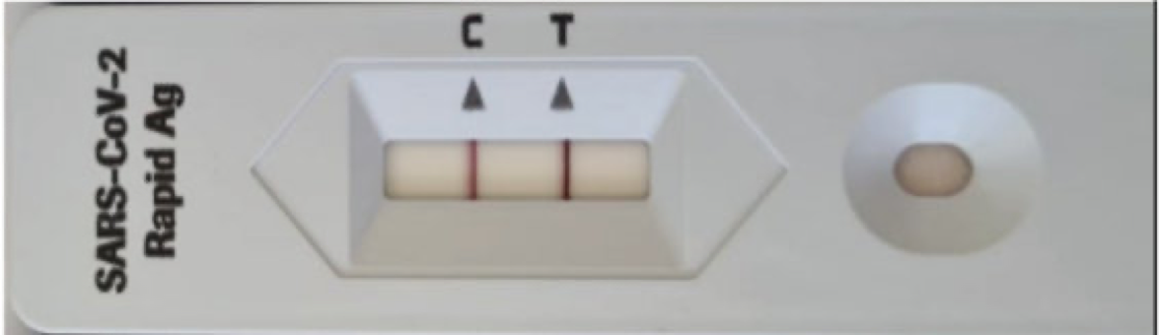
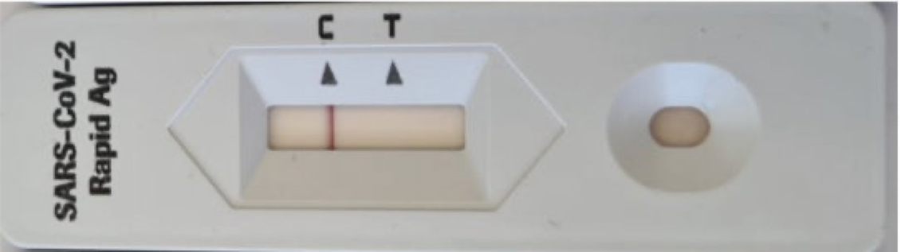
Question 2
1
Fill in the table:
'High' Covid-19
Person carrying SARS-CoV-2
No Covid-19
'Low' Covid-19
Yes
No
Total
Positive
Rapid test result
Negative
Total
True positives
True negatives
2
Calculate Sensitivity & Specificity
Sensitivity =
Total infected
x 100
Specificity =
Total non-infected
x 100
25/05/2021

Slide 4
Question 2 - answer
1
Fill in the table:
'High' Covid-19
Person carrying SARS-CoV-2
Non Covid-19 infected
'Low' Covid-19
Yes
No
Total
3 | 1 | 4
3 | 5 | 8
6 | 6 | 6
Positive
Rapid test result
Negative
Total
True positives
True negatives
2
3
5
Sensitivity =
Total infected
x 100
Specificity =
Total non-infected
x 100
Sensitivity =
x 100 = 50%
Specificity =
x 100 = 83%
6
6
25/05/2021

