Slide 1
PhonePe Pulse — Use Cases, Insights & Recommendations
Presented by
Priyadharshini M

Slide 2
Technologies Used
1. Data Extraction & Processing
Python for parsing JSON files from PhonePe Pulse dataset
Pandas for cleaning, transforming, and aggregating data
2. Database Management
MySQL for structured storage of multiple datasets
SQLAlchemy as ORM for seamless Python–MySQL integration
3. Visualization & Analysis
Plotly Express for interactive charts (line, bar, scatter, pie, choropleth)
Matplotlib for static chart exports
4. Dashboarding
Streamlit for building an interactive, real-time dashboard

Slide 3
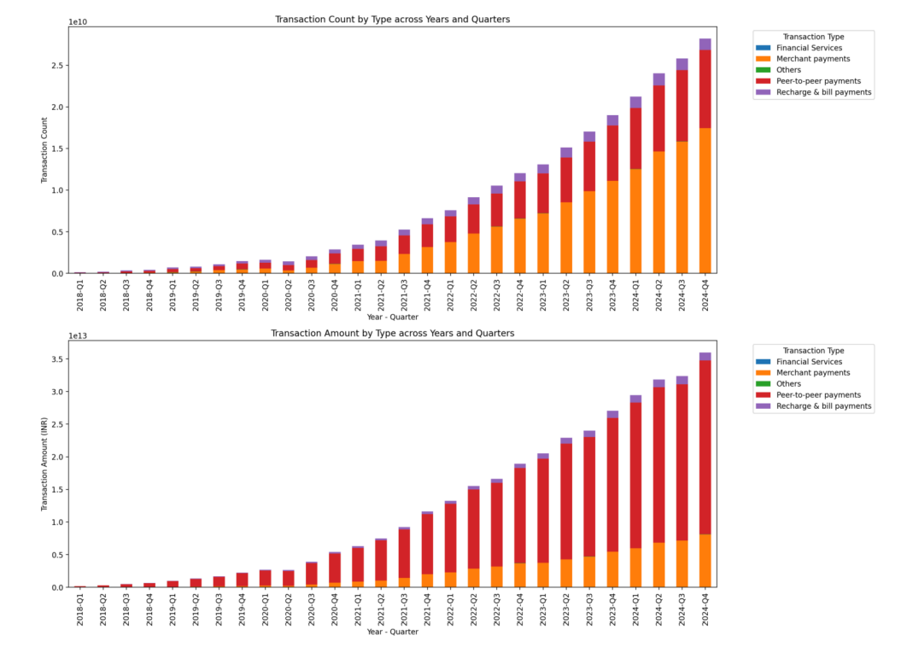
Decoding Transaction Dynamics on PhonePe Scenario

Slide 4
Key Insights
P2P dominates in both volume & value → strong adoption but over-dependence.
Merchant payments growing but far behind P2P → untapped daily-use potential.
Recharge & bill payments stable → near saturation, limited growth scope.
Financial services are negligible → huge underpenetrated opportunity.
Regional variations → metros strong, Tier-2/3 cities lagging.
Recommendations
Enhance the merchant ecosystem through cashback, loyalty, and SME partnerships.
Differentiate bill payments with auto-reminders, one-click pay, and bundling.
Promote financial services (micro-insurance, SIPs, gold savings) with education & trust campaigns.
Target Tier-2/3 cities with localized offers and merchant onboarding drives.
Enhance security communication to build confidence for financial adoption.
Leverage data for personalization → tailored nudges based on transaction history.

Slide 5
Insurance
Key Insights
Top States: Karnataka, Maharashtra, Tamil Nadu, Uttar Pradesh, and Telangana lead insurance adoption.
Top Districts: Bengaluru Urban, Pune dominate insurance transactions.
Urban Concentration: High activity in metro/urban districts suggests stronger digital insurance adoption in cities.
Strategic Recommendations
Expand Beyond Metros: Target Tier-2 & Tier-3 cities in North & East India with localized campaigns.
Awareness Campaigns: Focus on insurance literacy in low-engagement states using regional languages.
Data-Driven Personalization: Use transaction trends to cross-sell health, life, and vehicle insurance in high-performing districts.

Slide 6
User Registration
Key Insights
State Level: Registrations concentrated in a few states → rural/NE states lag.
District Level: Metros lead, but Tier-2 & Tier-3 cities show fastest growth.
Business Recommendations
Expand Underserved States → Awareness campaigns + govt. partnerships.
Tier-2/3 Focus → Merchant offers, regional partnerships (kirana, transport).
Seasonal Campaigns → Boost during festivals/salary cycles with bundled offers.
Trust & Access → Optimize for low-bandwidth + highlight security features

Slide 7
Engagement & Growth
Key Insights
Top States by Users: Maharashtra, Uttar Pradesh, Karnataka, Andhra Pradesh, Rajasthan.
High Engagement States: Meghalaya, Arunachal Pradesh, Mizoram, Ladakh, and Andaman & Nicobar.
Pattern Observed: Metro/urban hubs → high user base but moderate engagement.
Recommendations
Deepen Penetration in Large States
Target UP, Maharashtra, and Karnataka with localized offers & partnerships.
Nurture High-Engagement Regions
Leverage NE states & UTs as brand advocacy zones (case studies, referral programs).
Personalization Strategy
AI-driven regional campaigns (language, culture, payment categories).

Slide 8
Device Dominance
Key Insights
Top 3 Brands: Xiaomi (26%), Samsung (19%), Vivo (16%) – jointly driving >60% of app usage.
Mid-tier brands (Oppo, Realme): Steady adoption in Tier-2/3 regions, strong engagement in price-sensitive states.
Premium brands (Apple, OnePlus): High registrations but low engagement share (<4%) → underutilization.
Recommendations
Optimize for Top Brands: Prioritize app performance and feature stability on Xiaomi, Samsung, and Vivo. Boost Premium Engagement: Incentivize Apple & OnePlus users via loyalty rewards, premium UI/UX, fintech add-ons. Cross-device Analytics: Use device-specific engagement metrics to guide targeted marketing & app optimization.

