Slide 1
PhonePe Pulse — Use Cases, Insights & Recommendations
Presented by
Priyadharshini M

Slide 2
Technologies Used
1. Data Extraction & Processing
Python for parsing JSON files from PhonePe Pulse dataset
Pandas for cleaning, transforming, and aggregating data
2. Database Management
MySQL for structured storage of multiple datasets
SQLAlchemy as ORM for seamless Python–MySQL integration
3. Visualization & Analysis
Plotly Express for interactive charts (line, bar, scatter, pie, choropleth)
Matplotlib for static chart exports (for PPT)
4. Dashboarding
Streamlit for building an interactive, real-time dashboard

Slide 3
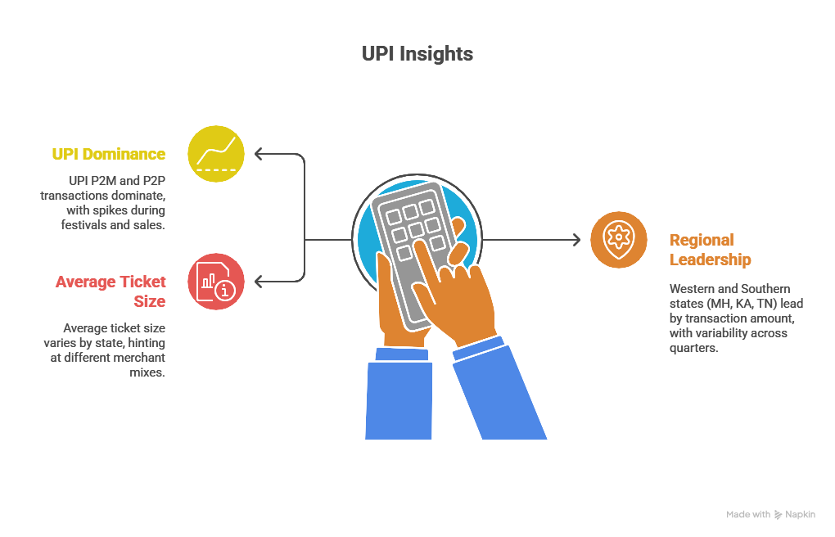
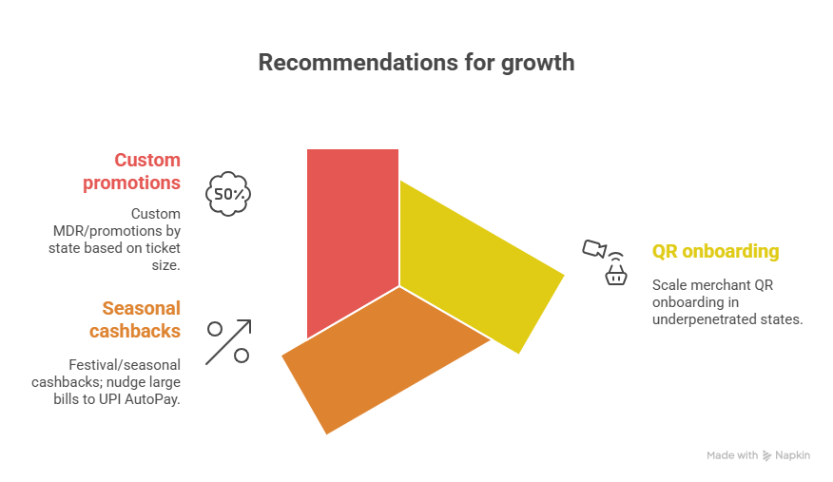
Transactions

Slide 4
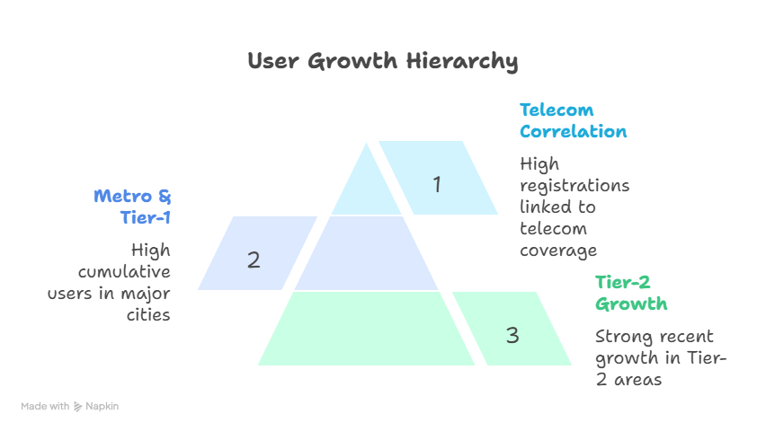
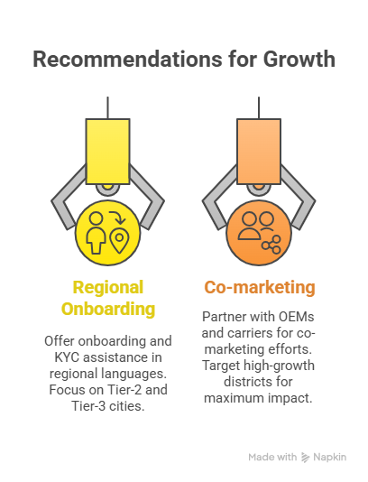
User Registrations

Slide 5
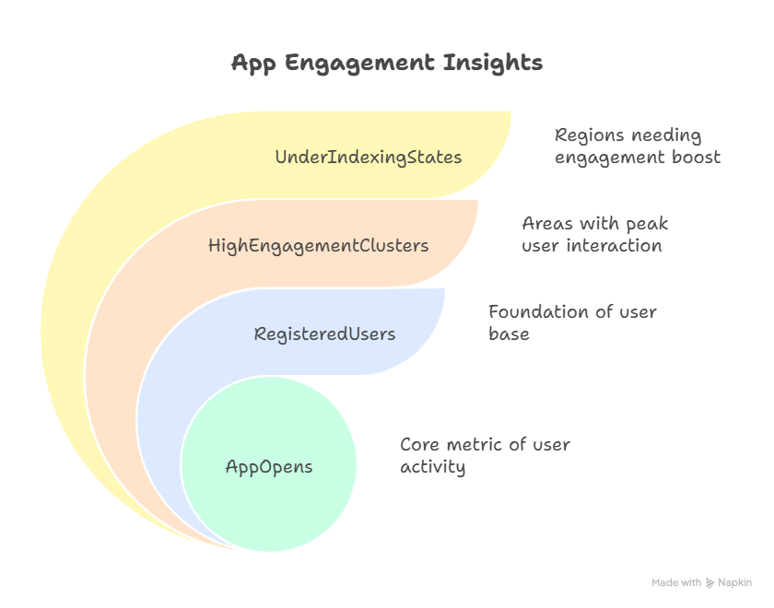
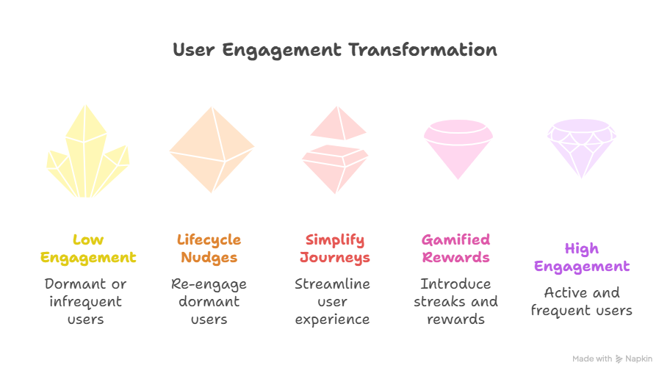
Engagement & Growth

Slide 6
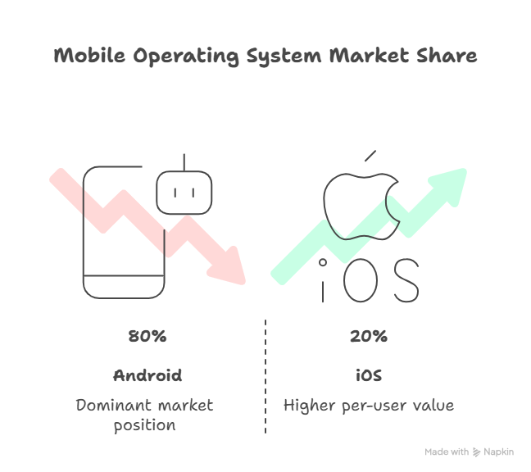
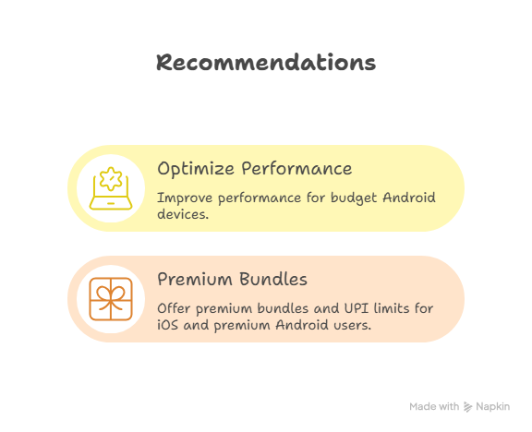
Device Dominance

Slide 7
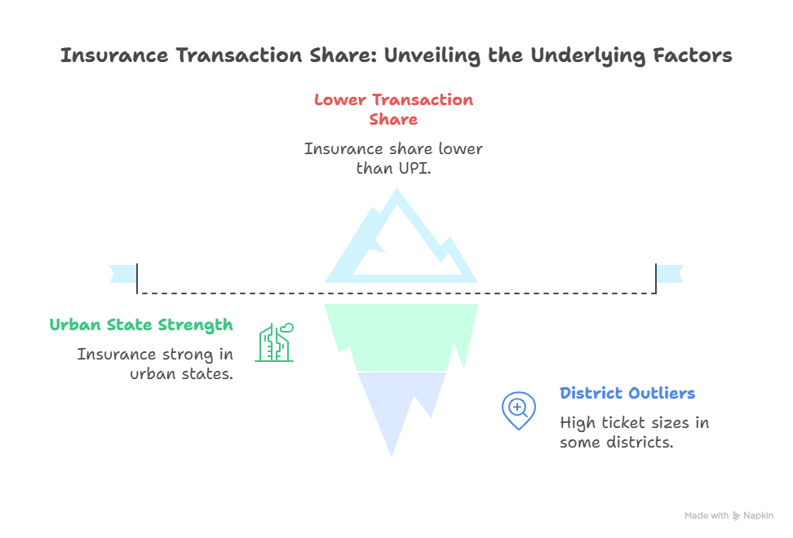
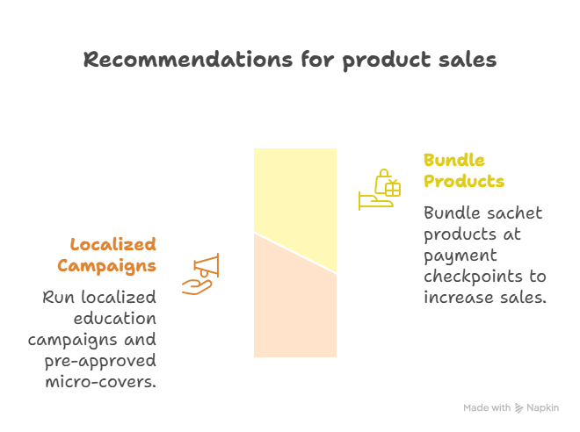
Insurance

Slide 8
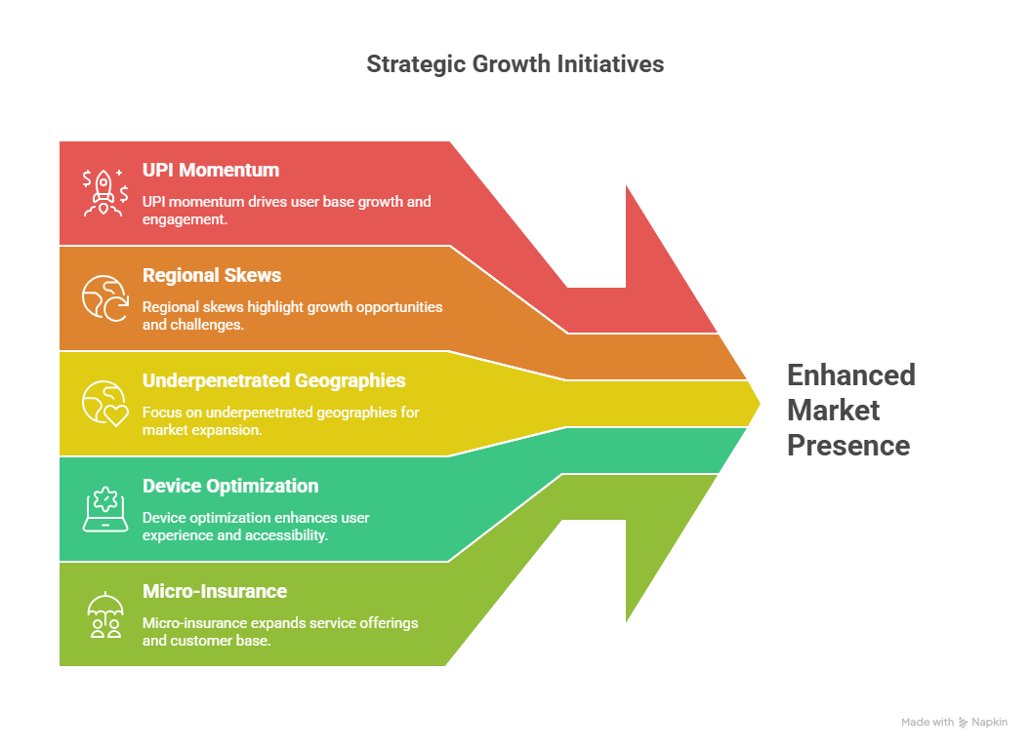
Conclusion

