Slide 1

PODHIGAI COLLEGE OF ENGINEERING AND TECHNOLOGY
NAME : RIYAZ S
REG NO : 511821104031
DEPT : BE-CSE
PROJECT SUBMISSION

Slide 2
KEYLOGGERS AND SECURITY
REG no : 511821104031
Name: Riyaz S

Slide 3
OUTLINE
○ Problem Statement (Should not include solution)
○ Proposed System/Solution
○ System Development Approach (Technology Used)
○ Algorithm & Deployment
○ Result (Output Image)
○ Conclusion
○ Future Scope
○ References

Slide 4


Slide 5
What is Keystroke logger?
A keylogger or keystroke logger/keyboard capturing is a form of malware or hardware that keeps track of and records your keystrokes as you type. It takes the information and sends it to a hacker using a command-and-control server.

Slide 6
WHAT IS SOFTWARE KEYLOGGER?
A software keylogger is put on a computer when the user downloads an infected application. Once installed, the keylogger monitors the keystrokes on the operating system you are using, checking the paths each keystroke goes through. In this way, a software keylogger can keep track of your keystrokes and record each one.

Slide 7
WHAT IS HARDWARE KEYLOGGER?
A regular hardware keylogger is used for keystroke logging by means of a hardware circuit that is attached somewhere in between the computer keyboard and the computer. It logs all keyboard activity to its internal memory which can be accessed by typing in a series of pre-defined characters.

Slide 8
PROBLEM STATEMENT
Example: Currently Rental bikes are introduced in many urban cities for the
enhancement of mobility comfort. It is important to make the rental bike available
and accessible to the public at the right time as it lessens the waiting time.
Eventually, providing the city with a stable supply of rental bikes becomes a major
concern. The crucial part is the prediction of bike count required at each hour for the
stable supply of rental bikes.

Slide 9

Eg : BIKE RENTEL

Slide 10
PROPOSED SOLUTION
○ The proposed system aims to address the challenge of predicting the required bike count at each hour to ensure a stable supply of rental bikes. This involves leveraging data
analytics and machine learning techniques to forecast demand patterns accurately. The solution will consist of the following components:
○ Data Collection:
○ Gather historical data on bike rentals, including time, date, location, and other relevant factors.
○ Utilize real-time data sources, such as weather conditions, events, and holidays, to enhance prediction accuracy.
○ Data Preprocessing:
○ Clean and preprocess the collected data to handle missing values, outliers, and inconsistencies.
○ Feature engineering to extract relevant features from the data that might impact bike demand.
○ Machine Learning Algorithm:
○ Implement a machine learning algorithm, such as a time-series forecasting model (e.g., ARIMA, SARIMA, or LSTM), to predict bike counts based on historical patterns.
○ Consider incorporating other factors like weather conditions, day of the week, and special events to improve prediction accuracy.
○ Deployment:
○ Develop a user-friendly interface or application that provides real-time predictions for bike counts at different hours.
○ Deploy the solution on a scalable and reliable platform, considering factors like server infrastructure, response time, and user accessibility.
○ Evaluation:
○ Assess the model's performance using appropriate metrics such as Mean Absolute Error (MAE), Root Mean Squared Error (RMSE), or other relevant metrics.
○ Fine-tune the model based on feedback and continuous monitoring of prediction accuracy.
○ Result:

Slide 11
SYSTEM APPROACH
The "System Approach" section outlines the overall strategy and methodology for developing and implementing
the rental bike prediction system. Here's a suggested structure for this section:
○ System requirements
○ Library required to build the model

Slide 12
ALGORITHM AND DEPLOYEMENT
○ In the Algorithm section, describe the machine learning algorithm chosen for predicting bike counts. Here's an example structure for this
section:
○ Algorithm Selection:
○ Provide a brief overview of the chosen algorithm (e.g., time-series forecasting model, like ARIMA or LSTM) and justify its selection based
on the problem statement and data characteristics.
○ Data Input:
○ Specify the input features used by the algorithm, such as historical bike rental data, weather conditions, day of the week, and any other
relevant factors.

Slide 13
ALGORITHM AND DEPLOYMENT
○ Training Process:
○ Explain how the algorithm is trained using historical data. Highlight any specific considerations or techniques employed, such as cross-
validation or hyperparameter tuning.
○ Prediction Process:
○ Detail how the trained algorithm makes predictions for future bike counts. Discuss any real-time data inputs considered during the
prediction phase.

Slide 14
RESULT
Present the results of the machine learning model in terms of its accuracy and
effectiveness in predicting bike counts. Include visualizations and comparisons
between predicted and actual counts to highlight the model's performance.

Slide 15
CONCLUSION
Summarize the findings and discuss the effectiveness of the proposed solution. Highlight any
challenges encountered during the implementation and potential improvements. Emphasize the
importance of accurate bike count predictions for ensuring a stable supply of rental bikes in urban
areas.

Slide 16
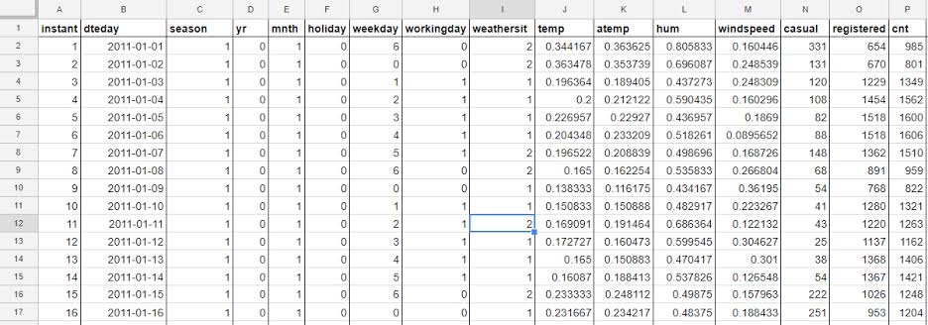
Eg : Bike Count Prediction

Slide 17
FUTURE SCOPE
Discuss potential enhancements and expansions for the system. This could include incorporating
additional data sources, optimizing the algorithm for better performance, and expanding the
system to cover multiple cities or regions. Consider the integration of emerging technologies such
as edge computing or advanced machine learning techniques.

Slide 18
TODAY TRENDING SCOPES
Security and privacy are key challenges for every computer user. While various security mechanisms, such as anti-virus, anti-spyware, updates and patches, are extensively applied, they cannot provide total security.
Software keyloggers represent a fast-growing class of malware.
Keylogging software records the user’s typed keystrokes and saves them to a log file, and is therefore capable of logging sensitive information such as passwords, usernames, PINs and so on.1
It can also record user activities such as online chat, capture screenshots, note URLs visited and more. Moreover, some keyloggers can upload the log file directly to attackers through remote connections.

Slide 19
REFERENCES
○ List and cite relevant sources, research papers, and articles that were
instrumental in developing the proposed solution. This could include academic
papers on bike demand prediction, machine learning algorithms, and best
practices in data preprocessing and model evaluation.

Slide 20
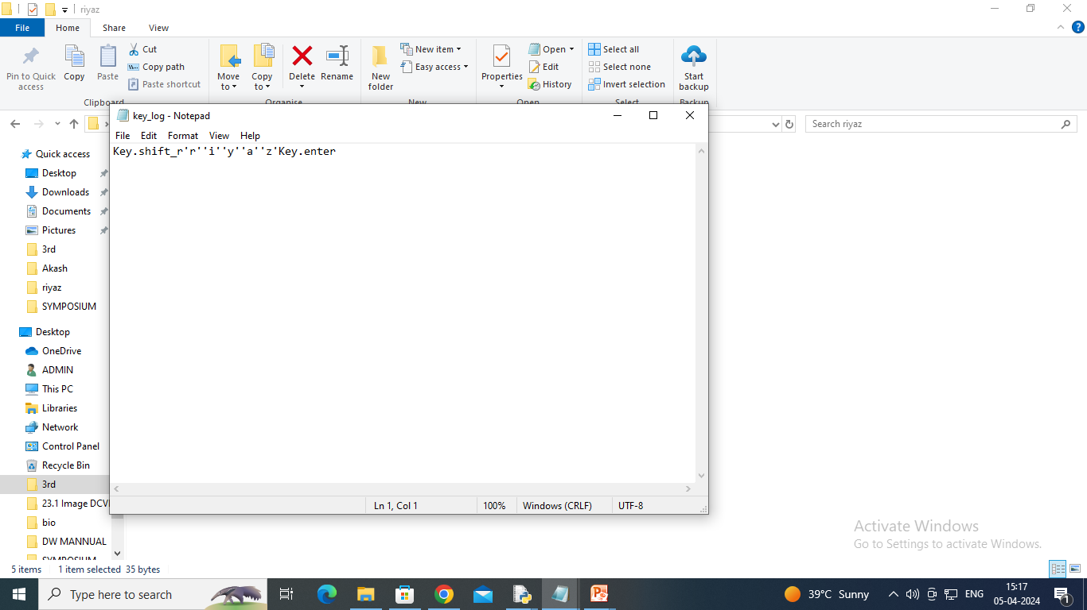
THANK YOU

