Slide 1
Azure Container Instances

Slide 2
What is Azure Container Instances?

Slide 3
Containers as a core Azure resource.

Slide 4
Why does that matter?
Today, containers never travel solo
Options include
Setup one or more VMs and manage them as container hosts
Deploy a container orchestrator service on VMs
Use containers as a packaging mechanism for a higher-level service
These options are often not ideal
Costly
Complicated to learn
Complicated to manage

Slide 5
Azure Container Instances Benefits
Fastest and easiest way to run a container in the cloud
No VM management
Per-second billing based on resource requirements (CPU + Memory)
Deploy images from DockerHub, Azure Container Registry, or any other Docker registry

Slide 6

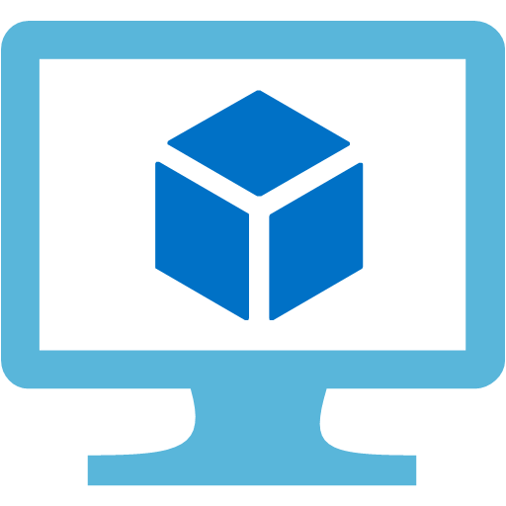
The ACI model: technical
Public IP: 40.85.154.240
Ports exposed: 80
Port 80
Port 5000
myacr.azurecr.io/app:v1
myacr.azurecr.io/sidecar:v1
acishare1
acishare2
ACI Container Group (hypervisor boundary)*
Azure VM
* Multi-container groups for Windows coming soon

Slide 7
The ACI model: billing
One-time charge for container creation: $0.0025
Per-second charge for CPU/memory requested:
1 vCPU core: $0.000013
1 GB memory: $0.000013
Examples:
Single container with 1 CPU/1 GB running for one month: $62.21
100 containers with 2 CPU/3 GB running for one hour each: $22.75

Slide 8
Common scenarios
Task automation
CI/CD agents
Small-scale batch processing
Simple web apps

Slide 9
But what if I need…
Auto-scaling
Rolling upgrades
Service discovery
Integrated load balancing
Affinity/anti-affinity
…

Slide 10
Then what you need is an orchestrator.

Slide 11
But I also want…
Fast startup
No VM management
Custom resource sizing
Per-second billing
…

Slide 12
Can you summarize all these container options for me?

Slide 13
Sure thing.
Service | Sweet spot
Azure Web Apps | Deploy scalable web apps and services using containers
Service Fabric | Build microservice applications packaged in containers
Azure Container Service | Use OSS orchestrators to manage containers across VMs
Azure Batch | Schedule large scale batch processes deployed in containers
Azure Container Instances | Run individual containers with no VM management

Slide 14
ACI: What you can do today
Run Linux and Windows containers
Custom CPU/memory (up to 4 CPU/8 GB memory)
Expose containers via public IP
Mount Azure files volumes for persistent storage
Set environment variables
Override the command line

Slide 15
Roadmap
Provide most standard container capabilities
Attach to an existing container
Copy files into/out of running containers
Enable ACI containers to do most things that VMs can do in Azure
Networking: Join a private vnet, sit behind an internal or external load balancer
Storage: Mount managed disks (Azure files is already available)
Invest in ACI Connector for more complex applications
Autoscaling, HA, rolling upgrades, load balancing, etc. will all be easier with an orchestrator
Developer tooling will also primarily target the orchestrator layer

Slide 16
Resources
Documentation
ACI Connector for Kubernetes
Feedback forum
Issues list

