Slide 1


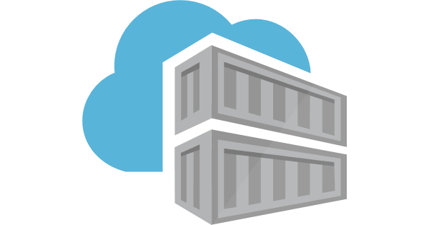
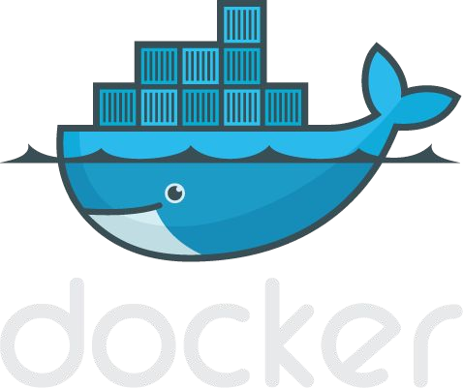
Introduction to Docker

Slide 2
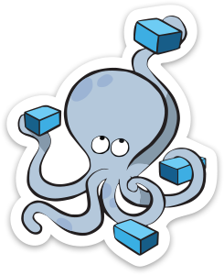
Agenda
Section 1:
What is Docker
What is Docker Not
Basic Docker Commands Dockerfiles
Section 2:
Anatomy of a Docker image Docker volumes
Section 4:
Docker compose / stacks
Demo

Slide 3
Section 1: What is Docker
Basic Docker Commands Dockerfiles

Slide 4
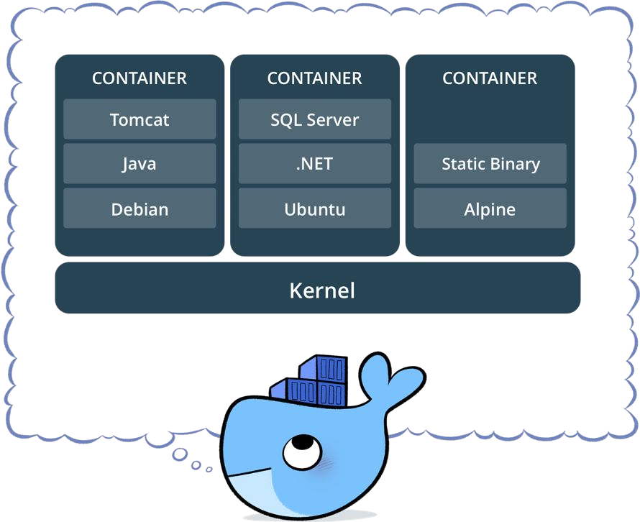
What is a container?
Standardized packaging for software and dependencies
Isolate apps from each other
Share the same OS kernel
Works for all major Linux distributions
Containers native to Windows Server 2016

Slide 5
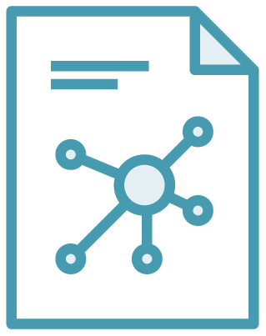

The Role of Images and Containers
Docker Image
Docker Container
Example: Ubuntu with Node.js and Application Code
Created by using an image. Runs your application.

Slide 6
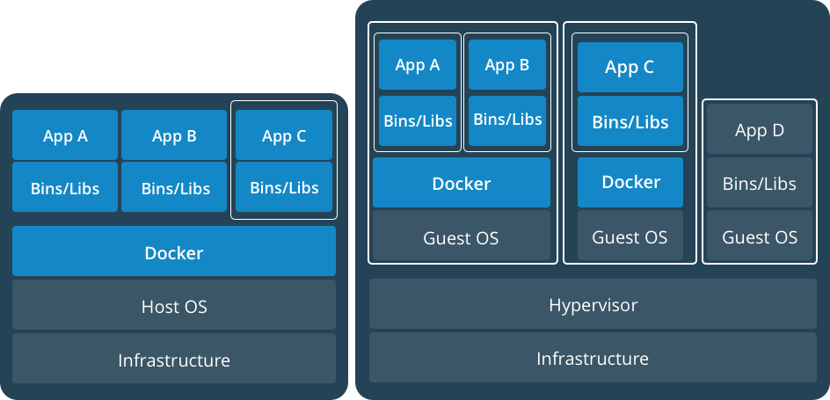
Docker Containers Versus Virtual Machines
App 1
App 2
Bins/Libs
Bins/Libs
Guest OS
Guest OS
App 1
App 2
Bins/Libs
Bins/Libs
Hypervisor
Docker Engine
Host Operating System
Host Operating System
Virtual Machines
Docker Containers

Slide 7
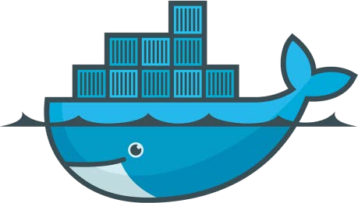
Lightweight, open, secure platform
Simplify building, shipping, running apps
What Is Docker?
Runs natively on Linux or Windows Server
Runs on Windows or Mac Development machines (with a virtual machine)
Relies on "images" and "containers"

Slide 8

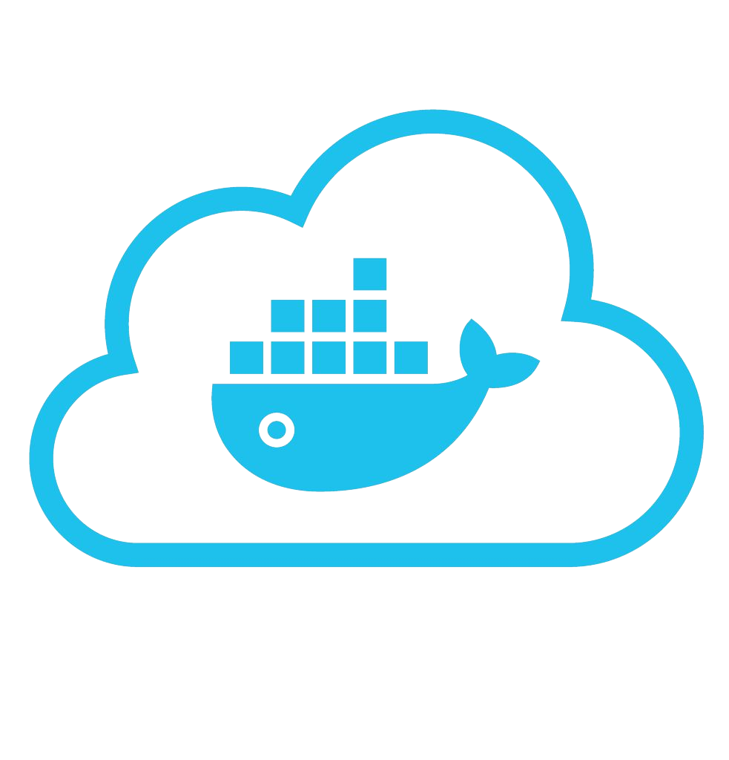










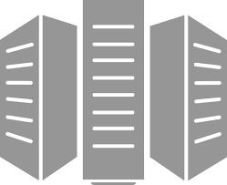



Using Docker: Build, Ship, Run Workflow
Developers IT Operations
BUILD
Development Environments
SHIP
Create & Store Images
RUN
Deploy, Manage, Scale

Slide 9




Some Docker vocabulary
Docker Image
The basis of a Docker container. Represents a full application
Docker Container
The standard unit in which the application service resides and executes
Docker Engine
Creates, ships and runs Docker containers deployable on a physical or virtual, host locally, in a datacenter or cloud service provider
Registry Service (Docker Hub(Public) or Docker Trusted Registry(Private))
Cloud or server based storage and distribution service for your images

Slide 10
Basic Docker Commands
$ docker image pull node:latest
$ docker image ls
$ docker container run –d –p 5000:5000 –-name node node:latest
$ docker container ps
$ docker container stop node(or <container id>)
$ docker container rm node (or <container id>)
$ docker image rmi (or <image id>)
$ docker build –t node:2.0 .
$ docker image push node:2.0
$ docker --help

Slide 11
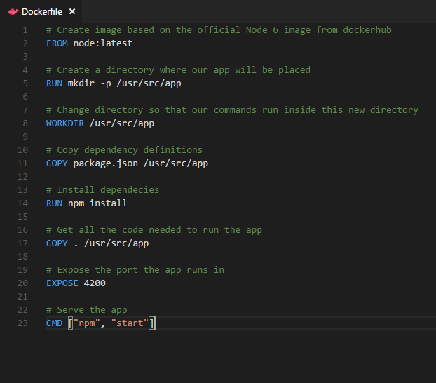
Dockerfile – Linux Example
Instructions on how to build a Docker image
Looks very similar to “native” commands
Important to optimize your Dockerfile
14

Slide 12
Section 2:
Anatomy of a Docker Container Docker Volumes
Volume Use Cases

Slide 13
Let’s Go Back to Our Dockerfile

Slide 14
Each Dockerfile Command Creates a Layer
…
EXPOSE
COPY
WORKDIR
RUN
FROM
Kernel

Slide 15
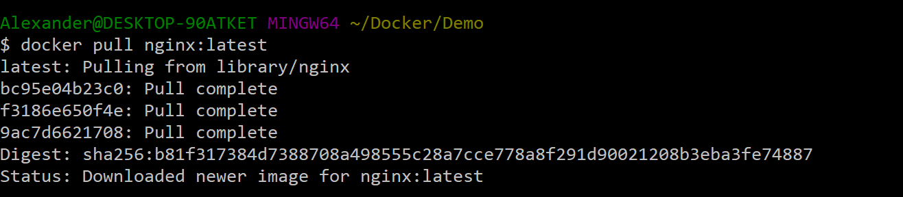
Docker Image Pull: Pulls Layers

Slide 16
Docker Volumes
Volumes mount a directory on the host into the container at a specific location
Can be used to share (and persist) data between containers
Directory persists after the container is deleted
Unless you explicitly delete it
Can be created in a Dockerfile or via CLI

Slide 17
Why Use Volumes
Mount local source code into a running container
docker container run -v $(pwd):/usr/src/app/ myapp
Improve performance
− As directory structures get complicated traversing the tree can slow system performance
Data persistence

Slide 18


