Slide 1
Welcome to Cosmos DB

Slide 2
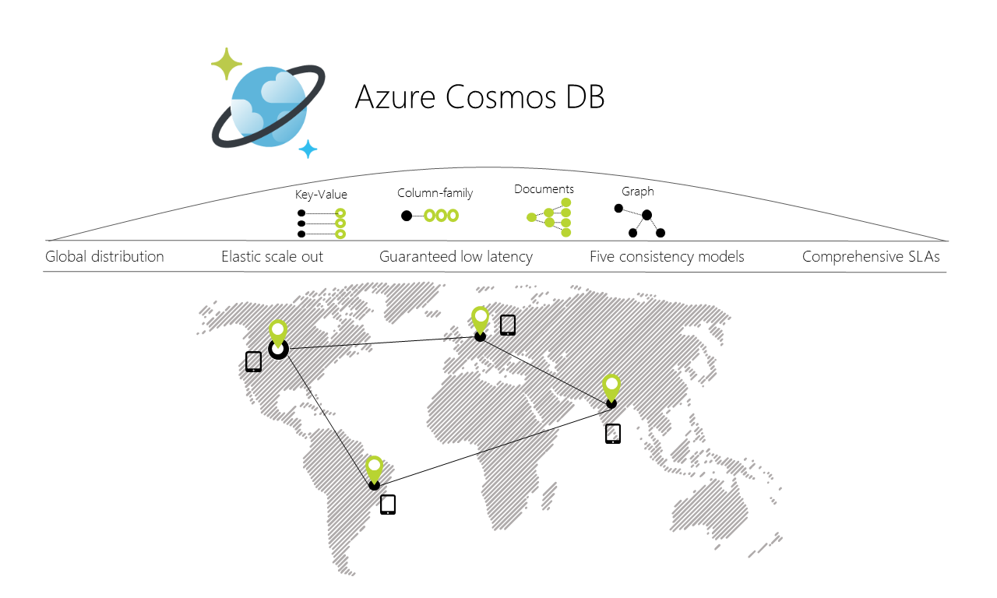
What is COSMOS?
Document
Graph
Key-value
Table
Column family
Relational

Slide 3
What is it’s consistency model?
Strong
Bounded Staleness
Session
Consistent Prefix
Eventual

Slide 5
How do you query it?
API
Gremlin API
MongoDB API
Schemaless JSON
Key Value Table API
Cassandra API
SQL Language
Select
Joins
Stored procs
Triggers

Slide 6
Uhhhh, how ???
Atom Record Sequence
Atoms consist of a small set of primitive types e.g. string, bool, number etc., records are structs and sequences are arrays consisting of atoms, records or sequences.
Natively it’s JSON, but with multiple projections to line up with the conceptual concepts of each of the APIs it supports.
API | Container is projected as … | Item is projected as …
DocumentDB SQL | Collection | Document
MongoDB | Collection | Document
Azure Table Storage | Table | Item
Gremlin | Graph | Node and Edge
https://azure.microsoft.com/en-us/blog/a-technical-overview-of-azure-cosmos-db

