Slide 3



Azure Solution Architecture : Where do we start?
Purpose
High level functional requirements – what does the solution need to do?
Success Criteria
What does the solution need to do to achieve the purpose.
How does it need to do it, including availability and non-functional requirements.
Stakeholders
Are there other (internal or external) customers involved with an SLA too?

Slide 4
Azure Solution Architecture : What do we consider?
Performance and Scalability
Governance, Manageability and Supportability
Service Specific Aspects
Dev, Test and Deployment (DevOps)
Availability and Resilience
Security and Identity
Business Objectives of the Solution
Pillars of Software Quality
Functional Aspects
Other General Observations
Cost Design

Slide 5
How to start
Start with simplicity and low overall cost
Add Tiering and Scalability
Add multi-region failover High Availability

Slide 6
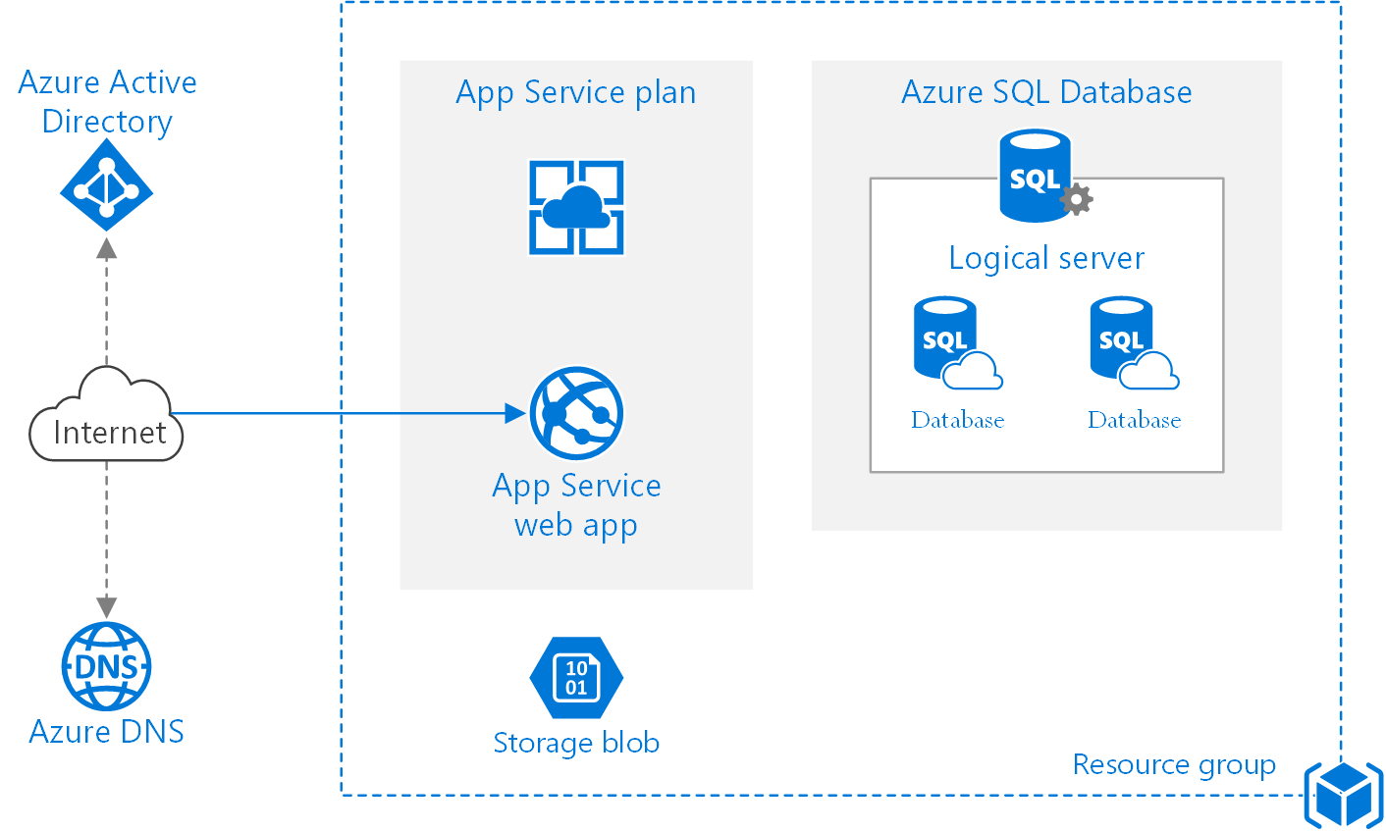
Web - simplicity and low overall cost

Slide 7
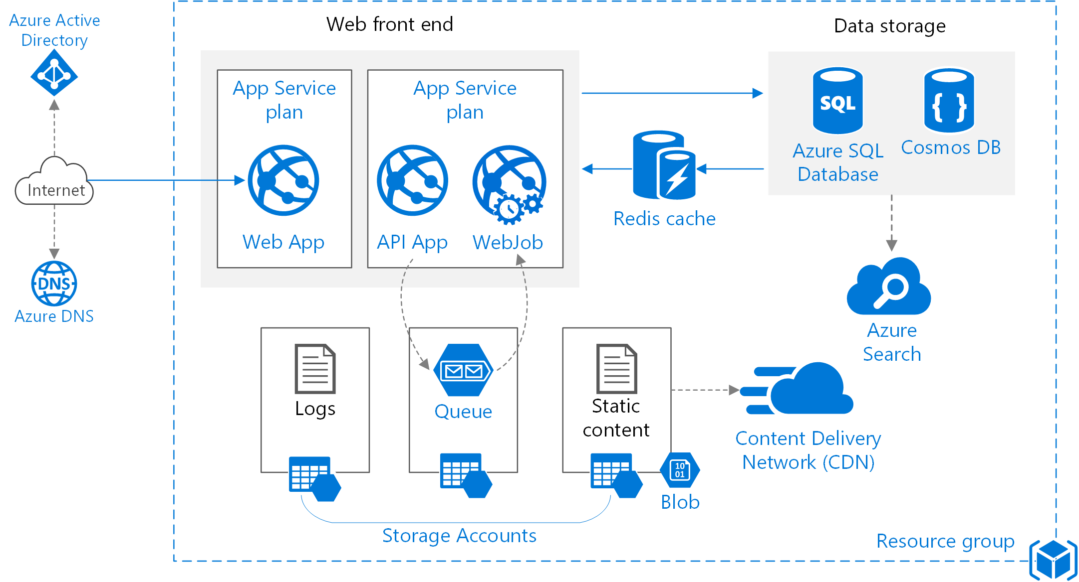
Web - Tiering and Scalability

Slide 8
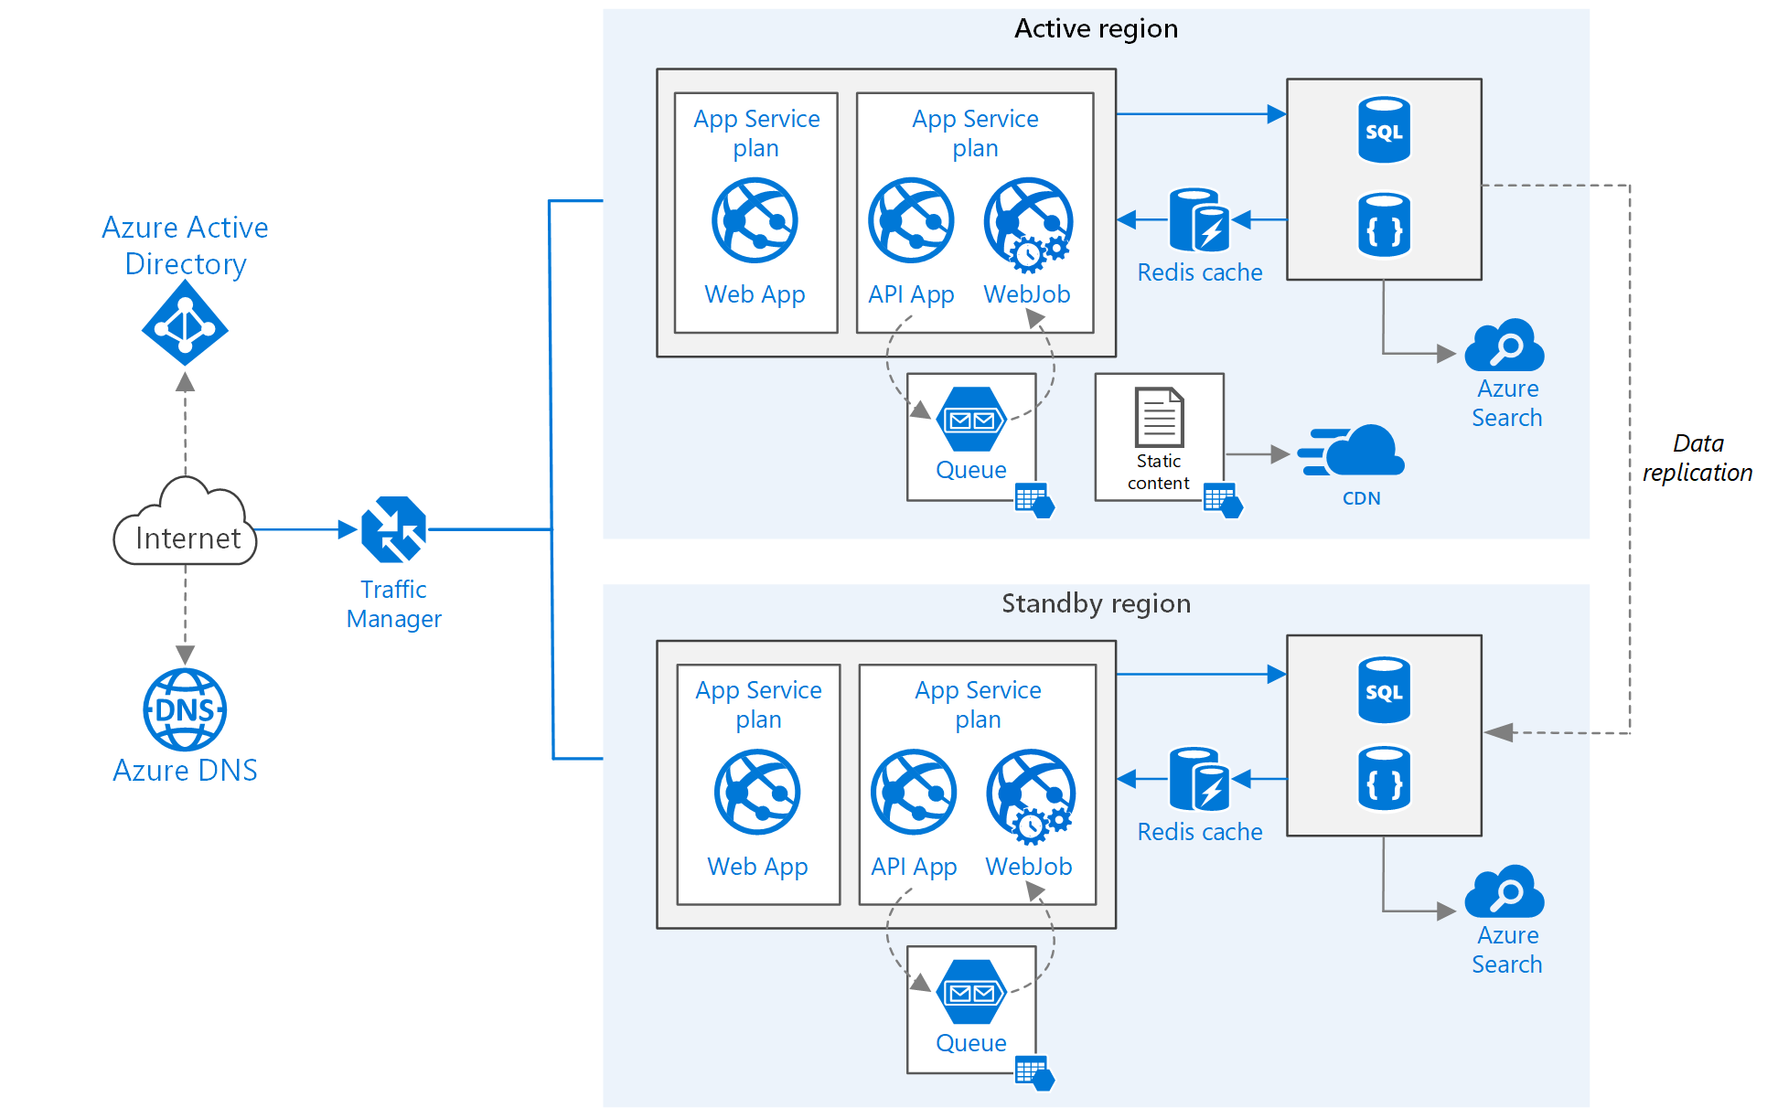
Web - multi-region failover High Availability

Slide 9
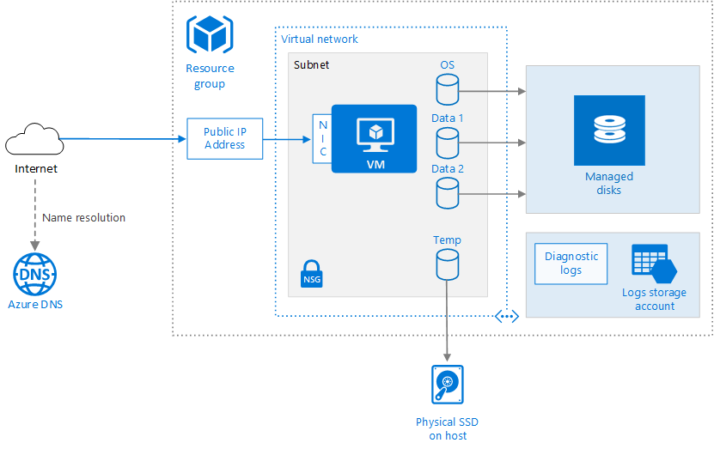
Infra - simplicity and low overall cost

Slide 10
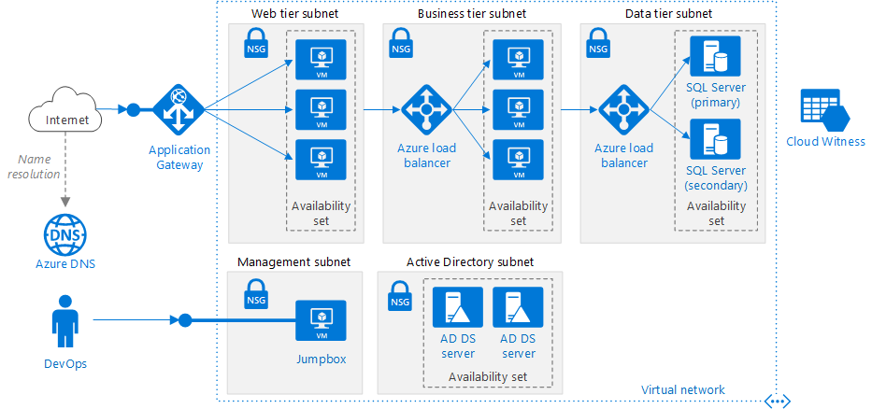
Infra - Tiering and Scalability

Slide 11
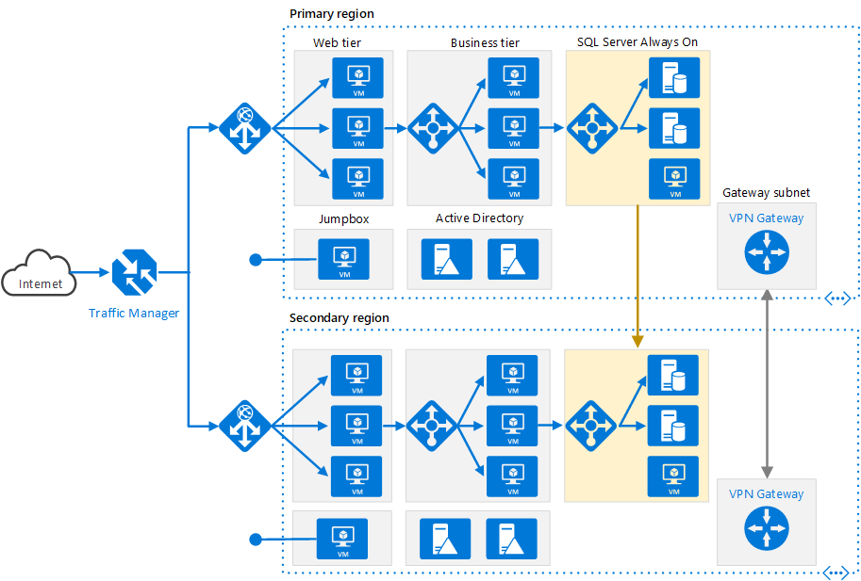
Infra - multi-region failover High Availability

Slide 12
What to do: General Good Practice
determine the budget and NFRs of the solution
understand the azure storage performance envelope
scale OUT, not UP

Slide 13
What to do: General Good Practice
architect to enable load testing
understand your architecture’s dependencies.
architect for business continuity & disaster recovery

Slide 14
What to do: Choose an Appropriate Compute Stack Understand your computational needs. Use platform features where possible to accelerate your implementation and reduce cost.
IaaS
PaaS
Serverless
Virtual Machines
VM Scale Set
Batch
AKS (Kubernetes)
Service Fabric
App Service
Functions
Logic Apps
Cloud Services
Container Instances
SF Mesh
Control
Agility
https://docs.microsoft.com/en-us/azure/architecture/guide/technology-choices/compute-decision-tree

Slide 15
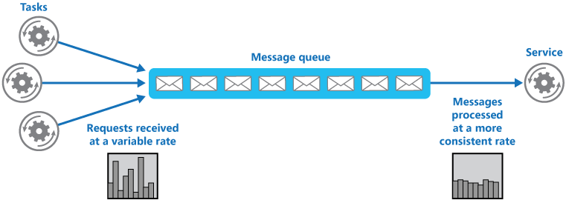
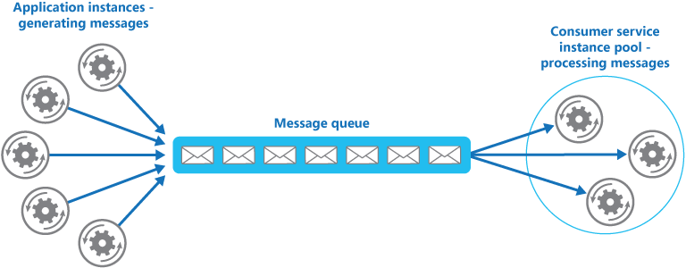
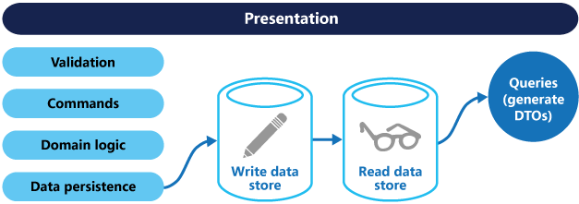
Application Patterns
Queue Based Load Leveling Pattern
Competing Consumers Pattern
Command Query Responsibility Separation Pattern

Slide 16
Scalability
“Scalability is the capability of a system, network, or process to handle a growing amount of work, or its potential to be enlarged in order to accommodate that growth”

Slide 17
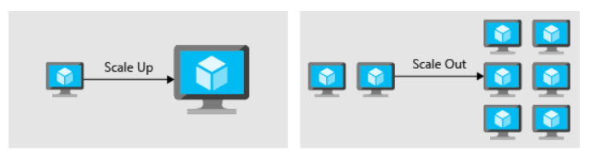
Scaling up and Out

Slide 18
Performance
Performance of storage
Performance of network
Performance of application

Slide 19
Strategies
Partitioning of data
Caching of data
Which type of data
Where
Autoscaling
Architecture decoupling
Which components
How
Monitoring

Slide 20
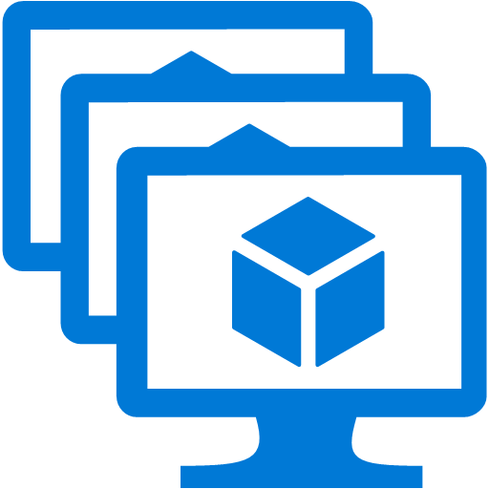
Virtual Machine Scale Sets (VMSS)
A set of VMs which are identical (cattle)
Deployed with configuration management techniques
Can be auto-scaled
Based off a common base image
Portal / ARM template
Configuration management

Slide 21
App Service Plan
Determines the number of server backing the app server
Determines the size of the servers
Helps in scaling up and out
Also helps in auto scaling based on criteria

Slide 22
What to avoid: Scalability
keep creating new instances of shared objects
share infra between qa and prod environments

Slide 23
Resiliency
“Resilience is the ability to provide and maintain an acceptable level of service in the face of faults and challenges to normal operation”

Slide 24
Resiliency
Resiliency
Cost / Complexity
RPO/RTO
Backup
Disaster recovery
High availability
RTO >> 0
RTO > 0
RTO = 0
Best For:
Data deletion
Data corruption
Legal, governance & compliance
Protection for unplanned failures
Don’t want to re-architect for HA
Don’t want the cost of HA
Large scale failures
Mission critical apps
New apps
Localized failures

Slide 25
Availability
Ability to handle failures
Provisions or ability to handle or absorb fluctuations in availability, load and temporary failures
Being online, available with acceptable performance

Slide 26
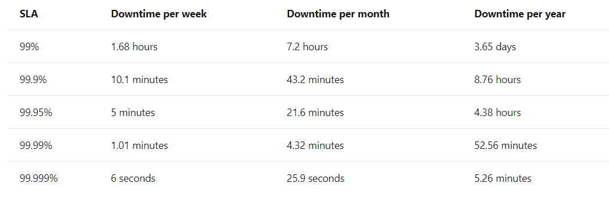
What is the SLA of the application

Slide 27
What are availability capability of applications
Evaluate all components of application
Check redundancy for them.
For redundant component, check if they can detect failure and may be auto heal
For single point of failures, look for impact if misconfigured, unreachable

Slide 28
Availability capabilities of dependent apps
Check for availability SLA of dependent apps
Ensure your SLA is not more stringent than apps SLA

Slide 29
What Azure provides
Availability sets
Availability zones
Load balancing
Traffic Manager
Application Gateway
Load balancer
Front Door
PaaS HA

Slide 30
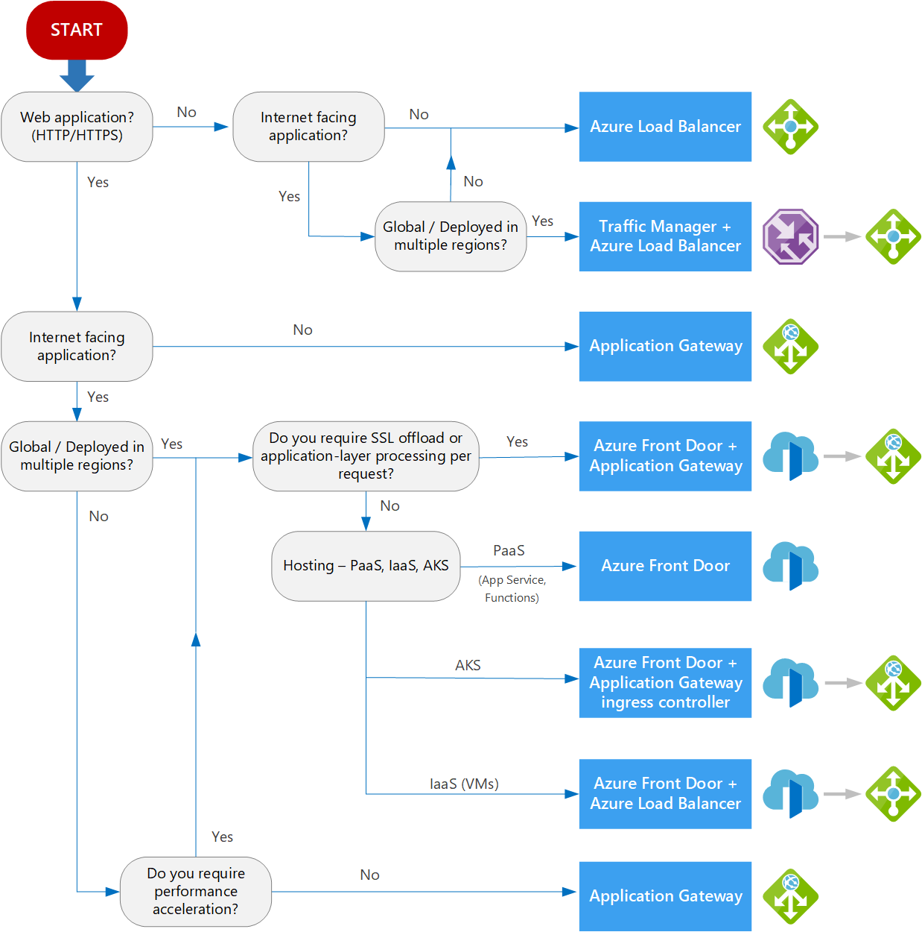

Slide 31
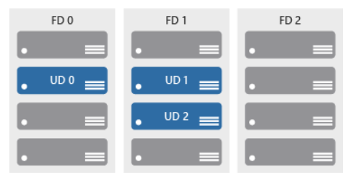
Availability Set
Update domain
Fault domain

Slide 32
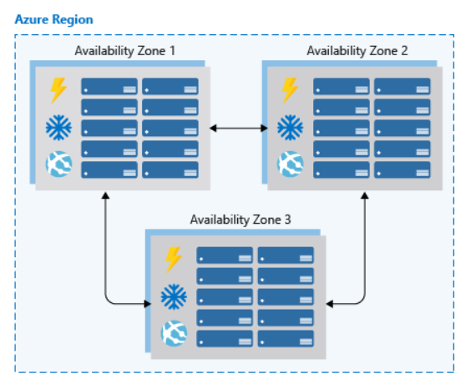
Availability Zones

Slide 33
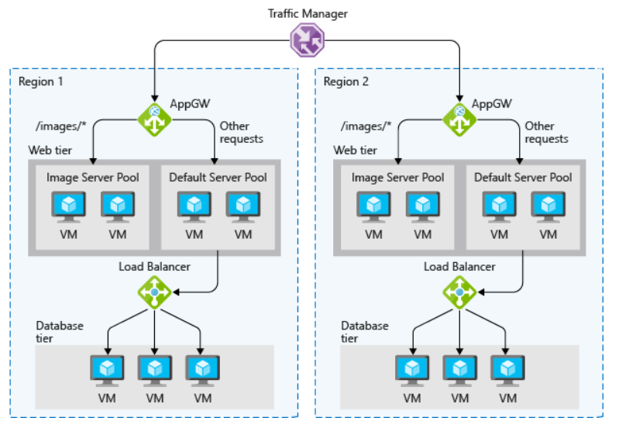
Load Balancing

Slide 34
Multi-region deployment
Active/Passive
Only one region online with DR failover
Active/Active
Round robin (all regions accept traffic)
Active performance
Many regions, user is routed to nearest

Slide 35

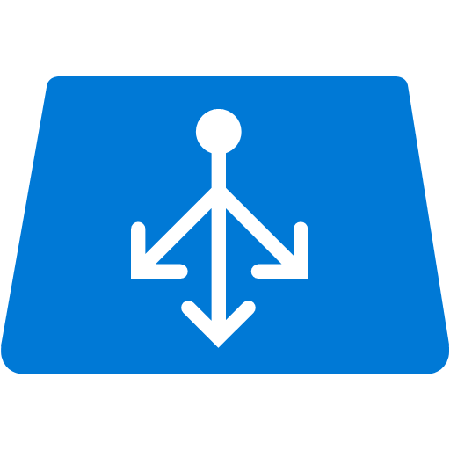

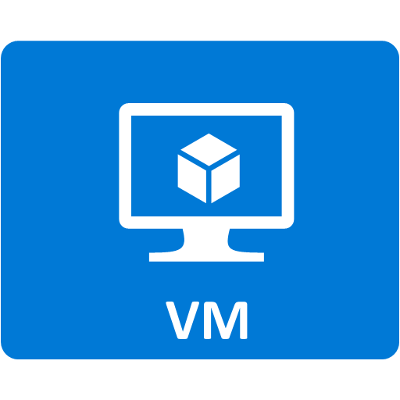
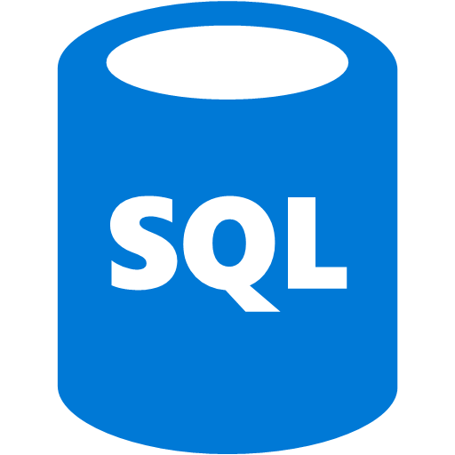
Multi-region deployment for OLTP (active/passive)
Front End
Availability
Set
Front End
Availability
Set
…
…
App
Availability
Set
App
Availability
Set
…
…
Distributed Cache
Distributed Cache
Database
Database
Async
Storage
(RA-GRS)
Storage
(RA-GRS)
Queue
Blobs
Queue
Blobs
West US (Primary)
East US (Secondary)

Slide 36

Multi-region deployment (active/active)
…
…
Front End
Availability
Set
Front End
Availability
Set
…
…
App
Availability
Set
App
Availability
Set
Distributed Cache
Distributed Cache
Database
Session
Consistency
Database
Storage
(RA-GRS)
Storage
(RA-GRS)
Queue
Blobs
Queue
Blobs
West US (Primary)
East US (Secondary)

Slide 37
PaaS HA
Azure SQL
Azure App Services
Azure Service Bus et al
Inbuilt HA

Slide 38
Disaster Recovery
Significant downtime and loss of data
e.g datacentre failures, region failure
Services should be up and running as part of recovering
Create a Disaster Recovery plan. Should be usable as manual to recover
Conduct a Risk assessment for every process that cannot tolerate loss
Determine objectives i.e. RPO and RTO

Slide 39
RTO and RPO
Will be filled during the class

Slide 40
What are part of recovery plan
Backups
Deployment methodology
Data replication
Process replication
Infrastructure

Slide 41
Data and Process Recovery
Azure Storage
Azure CosmosDB
Azure SQL Server
Process Recovery
Azure Site Recovery
Services specific features e.g CosmosDB, SQL
Testing the Recovery process

Slide 42
How can Microsoft Azure help?
Multi-region
Geo-redundancy
Hosting
Azure websites
Virtual Machines
Service Fabric
Data
SQL DB & Elastic DB
Redis Cache
DocumentDB
Blob & CDN

Slide 43
How can Microsoft Azure help?
Networking & Integration
Traffic Manager
Service Bus
Hybrid Connections
Security
Azure AD (AAD)
AAD B2C
MFA
Key Vault
Tools
TFS Online
Load Testing
Dev/Test Labs

Slide 44
Blobs
Scalable File storage
Three instances of data across a single data centre
Automatically load balances
Can be configured as Geo-Redundant with Read Only Access
Can create SMB Share
Access
Use Blob API (Private Blob)
Open public URL (Public Blob)
Public URL with SAS (Private Blob with Shared Access Signature)

Slide 45
Databases
Standard SQL
Scale Up
Threat Detection and Alerts
Automatic Tuning
Point in Time Restore
High On-Prem SQL Compatibility
Geo-Replication
Elastic Database
Scale Out
Sharding

Slide 46
Azure Websites
Platform as a Service
You only need to manage your application
Alerts and Monitoring
Manual or Auto scale
Web jobs
Good for backend processing
Can be scaled out separately
Multiple deployment slots
Staging
A-B testing
VIP swap
Easy to automate deployment
Supports Hybrid Connections

Slide 47
Traffic Manager
DNS based routing
Across data centres
Can handle a single total datacentre failure
Can access any service with public access
Non-Microsoft Clouds
Own hosting
Can be configured for
Priority (DR)
Weighted (Round Robin) – Can be used for gradual upgrade
Performance (Fastest)

Slide 48
CDN
Content Delivery Network
Integrates with Azure Blob Storage
Global Coverage – More than just Azure Data centre
Caches Blobs local to calling client
Integrates with Blobs with different URL

Slide 49
What to avoid: Resiliency
high sla, single-region deployment in azure
lack of strategy for resilience within services
ignore single points of failure, EVEN FOR LOW SLA

Slide 50
What to avoid: Availability and Disaster Recovery
no major incident response plan
no data reconciliation or consistency strategy
untestable dr / ha strategy

Slide 51
What to avoid: Deployment and DevOps
lack of continuous integration
lack of telemetry insight

Slide 52
What to avoid: Performance
lack of caching or use excessive caching of stale data
ignore the differences in cloud latency envelope

Slide 53
What to avoid: Anti-Patterns
busy database
Some customers prefer to offload business logic processing to a database server via stored procedures and functions.
This can cause it to spend a significant proportion of time running code, rather than responding to requests to store and retrieve data.
busy front end
Offloading resources to a background thread can improve foreground thread responsiveness.
But running lots of Resource-intensive background tasks in the same service boundary as the front end can increase the response times for user requests and cause high latency.
Select * from everywhere
Retrieving more data than needed for a business operation can result in unnecessary I/O overhead and reduce responsiveness.
Blocking i/o
A synchronous I/O operation blocks the calling thread while the I/O completes. The calling thread enters a wait state and is unable to perform useful work during this interval, wasting processing resources.

Slide 54

Trustworthy foundation
Security development lifecycle helps azure build more secure cloud services
Education
Process
Accountability
Administer and track security training
Guide product teams to meet SDL requirements
Establish release criteria & sign-off as part of FSR
Incident
Response (MSRC)
Training
Requirements
Design
Implementation
Verification
Release
Response
Ongoing Process Improvements

Slide 55


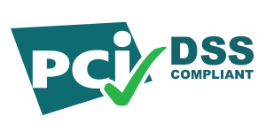
















Simplified compliance
Global
ISO/IEC 27001
SOC 1
SOC 2
PCI DSS L1 version 3
Cloud Security Alliance
Cloud Security Matrix
United States
FedRAMP
HIPAA
(Healthcare)
FIPS 140-2
Life Sciences GxP
Family Educational Rights & Privacy Act
Regional
European Union
Model Clause
United Kingdom
G-Cloud
China
Multi Layer Protection Scheme
China
CCCPPF
Singapore
Multi-Tier Cloud
Security
Australian Signals
Directorate I-RAP Assessment
Coming soon
Sarbanes Oxley
Criminal Justice
Information System
Defense Information
Systems Agency L2
ITAR
Defense Information
Systems Agency L3-5
ISO / IEC 27018

Slide 56
Trustworthy foundation
Assume breach helps identify and address threats before they impact customers
Prevent Breach
Assume breach identifies & addresses potential gaps
Scope ongoing live site testing of security response plans to drastically improve mean time to detection & recovery
Reduce exposure to internal attack (ensuring once inside, attackers do not have broad access)
Periodic environment post breach assessment & clean state
Threat model
Code review
Security testing
Assume Breach
War game exercises
Live site penetration testing
Centralized security
logging & monitoring

Slide 57
Shared responsibility
reduces security costs + Maintains Flexibility, access, & control
On-Premises
IaaS
PaaS
SaaS
Applications
Data
Users
Middleware
Operating System
Virtualization
Hardware
Networking
Physical Security
Customer
Microsoft

Slide 58
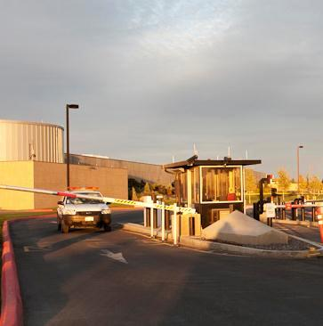
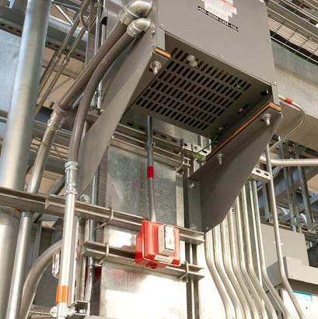
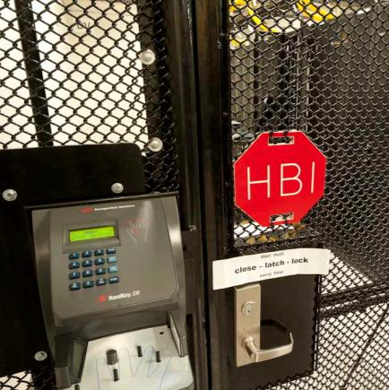
Physical data center security
Cameras
24X7 security staff
Barriers
Fencing
Alarms
Two-factor access control: Biometric readers & card readers
Security operations center
Seismic bracing
Days of backup power
Perimeter
Building
Computer room

Slide 59
Security
Infrastructure
protection
Network Protection
Data Protection
24-hour monitored physical security
Firewalls
Patch management
System monitoring and logging
Antivirus protection
Threat detection
Network Security Group
Virtual Networks
Site-to-site VPN
ExpressRoute
Data in transit
Data at rest
Data segregation

Slide 60
Virtual networks
AZURE:
Allows customers to create isolated virtual private networks
CUSTOMER:
Creates Virtual Networks with Subnets and Private IP addresses
Enables communications between their Virtual Networks
Can brings their own DNS
Can domain join their Virtual Machines
INTERNET
Client
Microsoft Azure
Cloud Access
RDP Endpoint
(password access)
Customer 1
Customer 2
Subnet 1
Subnet 2
Subnet 3
Deployment X
Deployment Y
Corp 1
VPN
VNET to VNET
DNS Server
Isolated Virtual Networks
Isolated Virtual Network

Slide 61

Network Security Groups (NSG)
Grouping of network traffic rules as security group
Security groups associated with virtual machines or virtual subnets
Controlled access between machines in subnets
Controlled access to and from the Internet
Network traffic rules updated independent of virtual machines
Internet
Microsoft Azure
NSG
Front End Subnet
Back End Subnet
NSG
Virtual Network

Slide 62
VPN connections
Microsoft Azure
AZURE:
Enables connection from customer sites and remote workers to Azure Virtual Networks using Site-to-Site and Point-to-Site VPNs
Offers forced tunneling capabilities to enable customers to mandate all internet-bound traffic go through the Site-to-Site tunnel
CUSTOMERS:
Configures the VPN client in Windows
Manages certificates, policies, and user access
Customer 1
Deployment X
Customer Site
Site-to-Site VPN
VPN
Point-to-Site VPN
Computers Behind Firewall
Isolated Virtual Network
Remote Workers

Slide 63
ExpressRoute connections
Microsoft Azure
AZURE:
Offers private fiber connections via ExpressRoute
Enables access to Compute, Storage, and other Azure services
CUSTOMERS:
Establish connections to Azure at an ExpressRoute location
Directly connect to Azure from an existing WAN network (such as a MPLS VPN) provided by a network service provider
Can authorize other Azure accounts to use a common ExpressRoute circuit
Manages certificates, policies, and user access
Customer 1
ExpressRoute
Peer
Deployment X
Site 1
WAN
Site 2
Isolated Virtual Network

Slide 64
Identity & access management
AZURE:
Uses Azure AD to govern access to the management portal with granular access controls for users and groups on subscription or resource groups
Provides enterprise cloud identity and access management for end users
Enables single sign-on across cloud applications
Offers Multi-Factor Authentication for enhanced security
CUSTOMER:
Centrally manages users and access to Azure, O365, and hundreds of pre-integrated cloud applications
Builds Azure AD into their web and mobile applications
Can extend on-premises directories to Azure AD
Azure
Active Directory
Cloud Apps
End Users & Administrators
On-premises Active Directory

Slide 65
Encryption in transit
AZURE:
Encrypts most communication between Azure datacenters
Encrypts transactions through Azure Portal using HTTPS
Supports FIPS 140-2
CUSTOMER:
Can choose HTTPS for REST API (recommended)
Configures HTTPS endpoints for application running in Azure
Encrypts traffic between Web client and server by implementing TLS on IIS
Azure
Data Center
Azure
Portal
Azure
Data Center

Slide 66



Encryption at rest
Virtual Machines:
Data drives – full disk encryption using BitLocker
Boot drives – BitLocker and partner solutions
SQL Server – Transparent Data and Column Level Encryption
Files & folders - EFS in Windows Server
Storage:
Bitlocker encryption of drives using Azure Import/Export service
StorSimple with AES-256 encryption
Applications:
Client Side encryption through .NET Crypto API
RMS Service and SDK for file encryption by your applications
Virtual Machines
SQL TDE
Bitlocker
Partners
EFS
Storage
Bitlocker
StorSimple
Applications
.NET Crypto
RMS SDK

Slide 67
Data segregation
End
Users
Storage isolation:
Access is through Storage account keys and Shared Access Signature (SAS) keys
Storage blocks are hashed by the hypervisor to separate accounts
SQL isolation:
SQL Database isolates separate databases using SQL accounts
Network isolation:
VM switch at the host level blocks inter-tenant communication
Microsoft Azure
Customer
Admin
Portal
SMAPI
Customer 1
Customer 2
Guest VM
Guest VM
Guest VM
Fabric
Controller
Hypervisor
Host OS
Azure Storage
Access
Control
SQL Database

Slide 68
Thank you

