Slide 2
Kubernetes

Slide 3
Architecture

Slide 4
Containerization
Virtualization of operating system
Built using the good parts of virtualization and ignoring its constraints
Way of bundling applications with all its dependencies
Cross platform, cloud, language

Slide 5
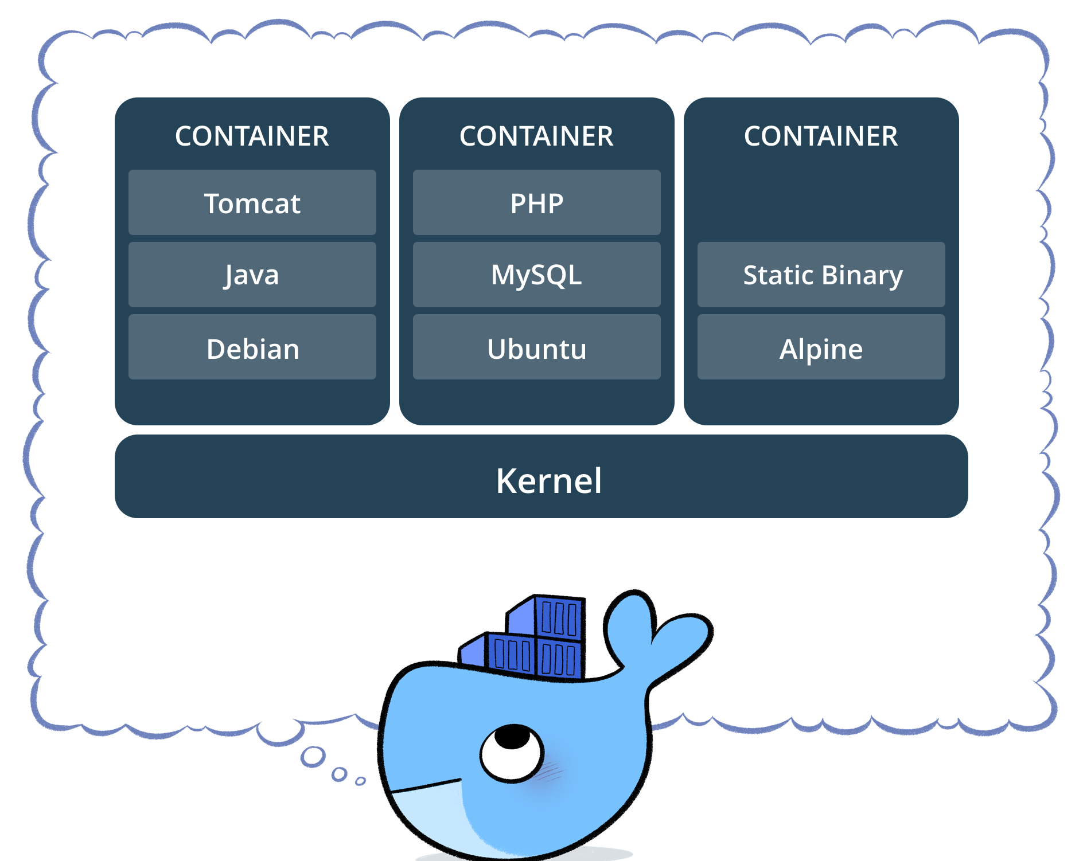
Container stack

Slide 6
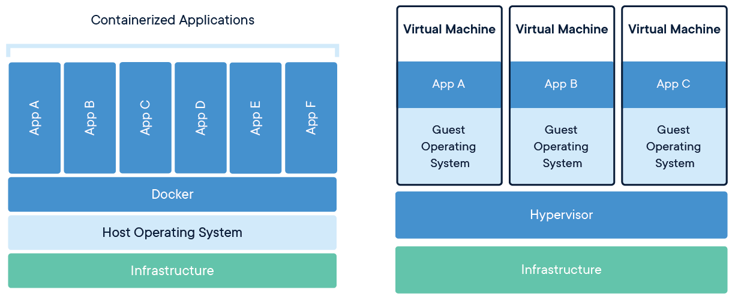

Slide 7
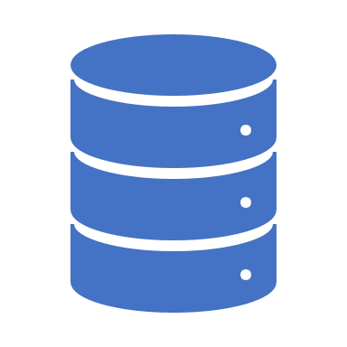
container
Isolated environment to execute applications
Run’s on top of host’s kernel
Created using images
Can execute multiple containers on the same host

Slide 8
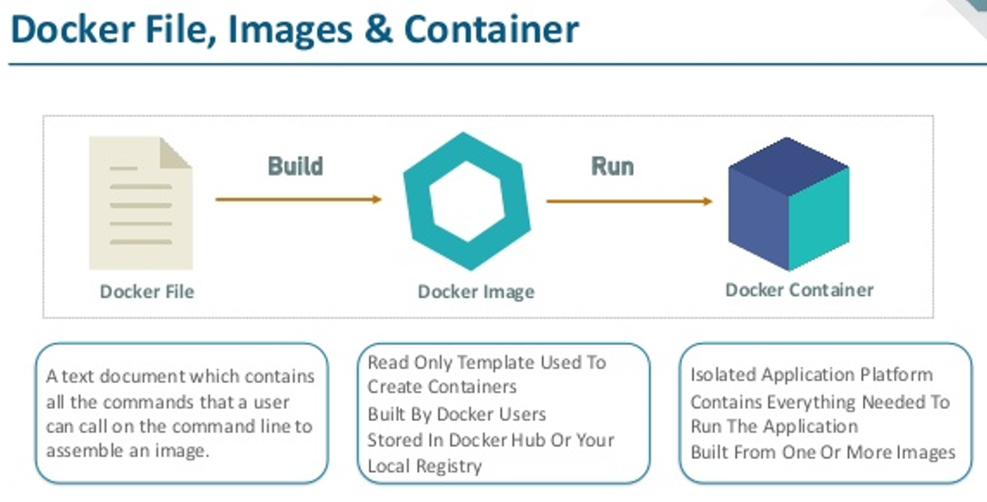

Slide 9
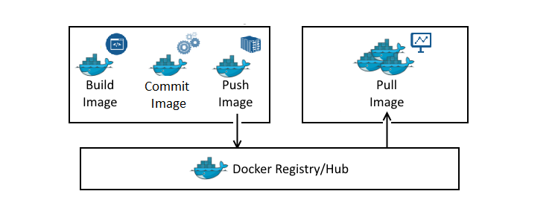

Slide 10
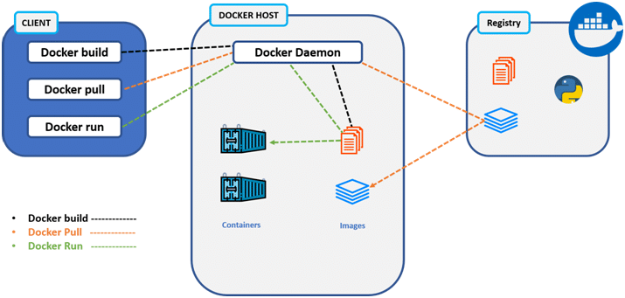
Creating Containers

Slide 11
Docker Refresher
Images
Packaging of applications
Contains filesystem
Registries
Repository to store Docker images
Facilitates sharing of resources
Public vs private
Containers
Isolated from host
Is a process running on host running docker
Resource-constrained

Slide 12
Management & development of containers
Creating new images
Using dockerfile
Using commit
Running a container image
Listing all containers and images
Inspecting a container
Getting history of image
Getting into a container
Stopping, starting and removing containers

Slide 13
Pushing image into container repository
Tagging an image
Running image on another machine

Slide 14
Kubernetes
Kubernetes is a portable, extensible, open-source platform for managing containerized workloads and services
both declarative configuration and automation
he name Kubernetes originates from Greek, meaning helmsman or pilot

Slide 15
Kubernetes
Setting up of Kubernetes Cluster
We are going to use AKS
Other methods
Kubeadm
Minikube
Other cloud providers like AWS and google

Slide 16
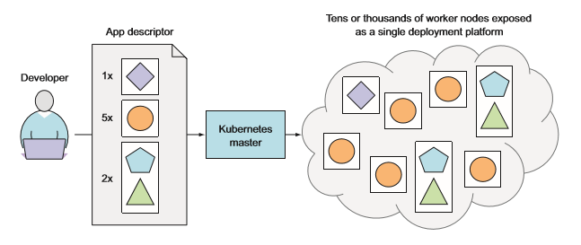
Single deployment platform

Slide 17
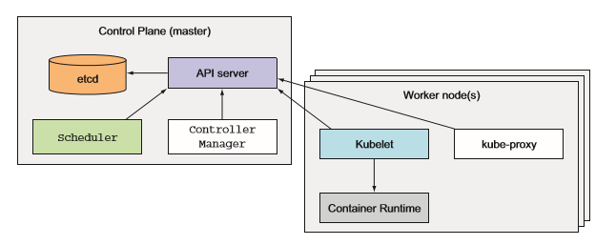
Main components
Master nodes
Worker nodes

Slide 18
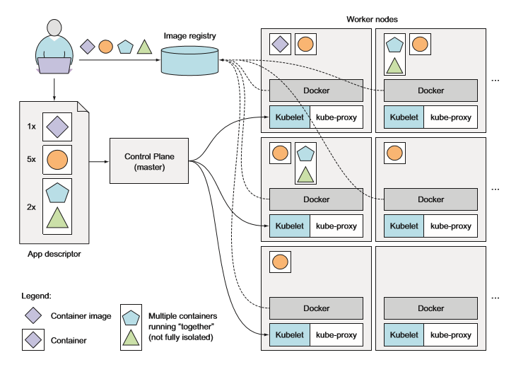

Slide 19
Advantages
Simplify application deployment
Better utilization of the hardware
Health checking and self healing
Automatic scaling
Simplify application development

Slide 20
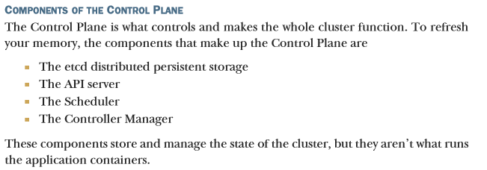
Control plane

Slide 21
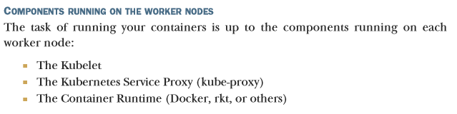
Worker nodes

Slide 22
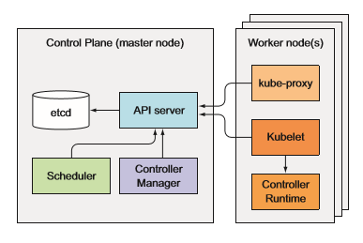
Deployment
All to be running
Communication between components
HA Mode deployment
Some components are in single mode
Node vs pod deployment

Slide 23
etcd
Data store of Kubernetes
Key value pairs
There should be odd number of etcd to achieve quoram
Keys are the paths
/registry/pods/
/registry/pods/default
/registry/pods/default/container1
/registry/pods/default/container2
/registry/pods/default/container3
{kind: POD….}

Slide 24
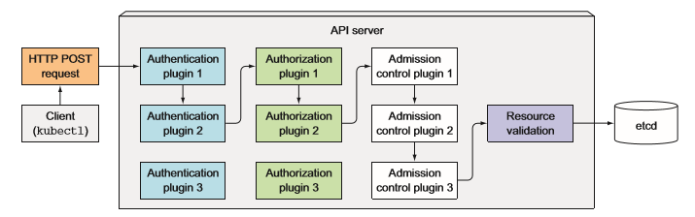
Api server
CRUD interface
Validation
REST API
Kubectl talks to it
Notifies clients of resource changes

Slide 25
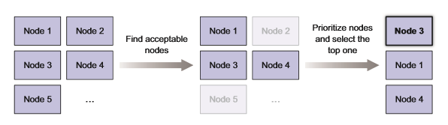
Scheduler
Assigns nodes to pods
Follows a process

