Slide 1
Bank Loan EDA case study Prepared By: Rijumani Deka Saad Teli

Slide 2
Problem statement
The loan providing companies find it hard to give loans to the people due to their insufficient or non-existent credit history. Because of that, some consumers use it as their advantage by becoming a defaulter.
This case study aims to identify patterns which indicate if a client has difficulty paying their installments which may be used for taking actions such as denying the loan, reducing the amount of loan, lending (to risky applicants) at a higher interest rate, etc. This will ensure that the consumers capable of repaying the loan are not rejected. Identification of such applicants using EDA is the aim of this case study.

Slide 3
Analysis Done
Steps
Data Understanding & preparation
Data cleaning & Manipulation
Data Analysis-
univariate
Bivariate
Presentation & recommendations

Slide 4
Data Understanding and preparation
Data Understanding and Preparation
Step1:Data sourcing
a: Imported the CSV files and then read the data
B: Data Inspection: we checked the shape of the data, as well as checked data, checked the data type of the given data, and Inspected the data frame for dimensions, null values, and summary of different numeric columns.
C: Inspecting Null Values in rows which are greater than 50%,
-Checked columns with missing values & dropped columns with missing values greater than 50%
-impute values for columns with missing values of aprox. 13% and then uniques values are less and these columns give day, week, month, year etc we can replace null values with 0
-Dropped unwanted columns
-changed ID to Object & checked datatypes of columns
-converted negative values to positive
-divided income into credit groups
-variables indicate number of days, hrs, months, etc. we can conclude that these are columns with categorical values.And regarding the null values, as it can be seen from the data above, since these are categorical columns, and there mode value is 0 for all these variables. so, it is safe to impute the null values with 0.

Slide 5
Data cleaning & Manipulation
we have the final data frame after dropping unwanted columns, we now check for data types of each columns and change their datatype based on the values they contain

Slide 6
Checking for data quality issues
The dataset initially contained 111 columns.
After removing columns with a majority of missing (NaN) values, we were left with 57 columns.
Next, columns where more than 90% of the values were zero were removed, reducing the number of columns to 46.
We further eliminated columns with only a single unique value, leaving us with 43 columns.
Finally, we reviewed the remaining columns for relevance and kept only those useful for analysis, resulting in a final dataset of 20 columns.

Slide 7
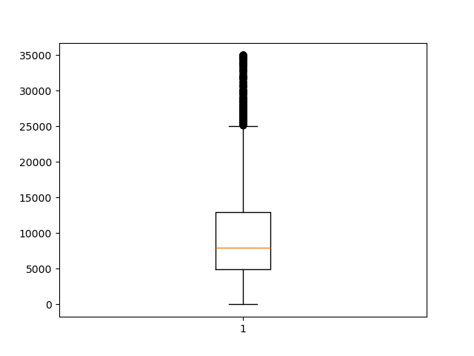
funded_amnt_inv_Boxplot

Slide 8
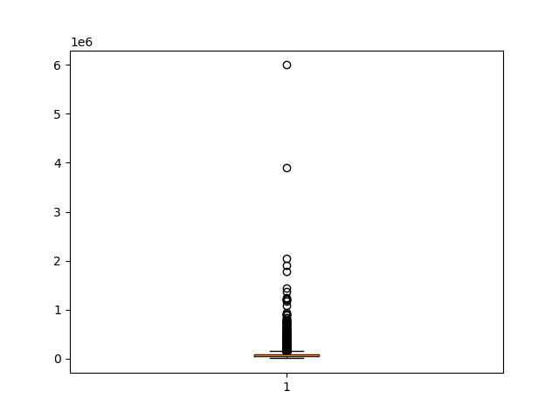
Annual income having outliers

Slide 9
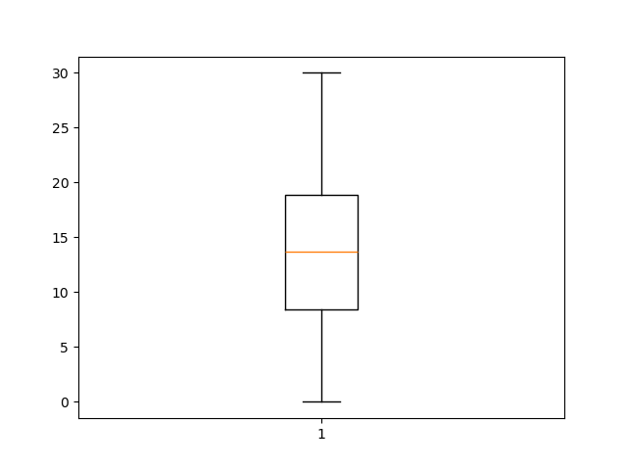
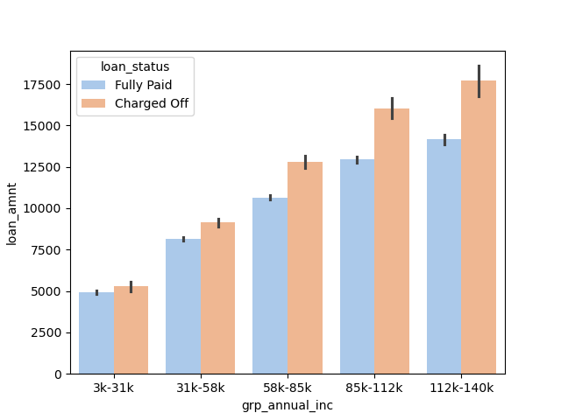
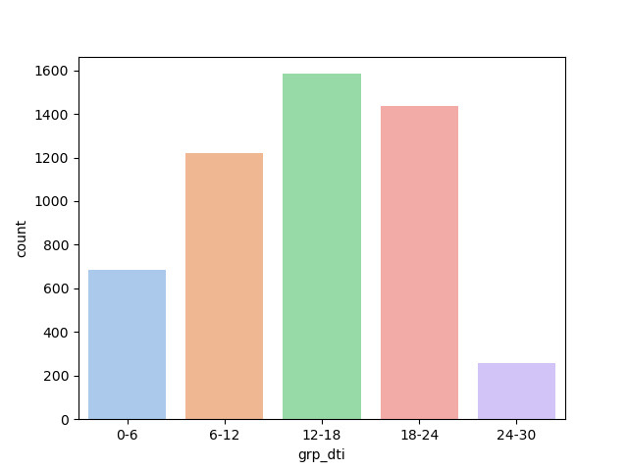
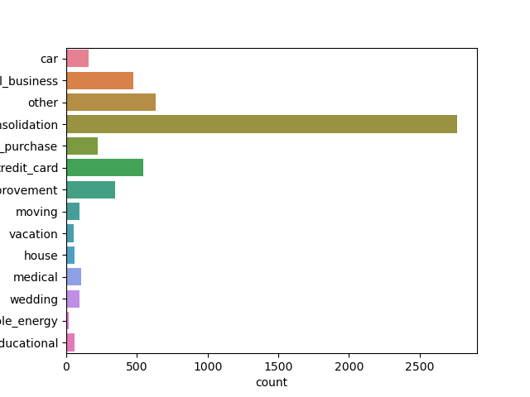

Slide 11
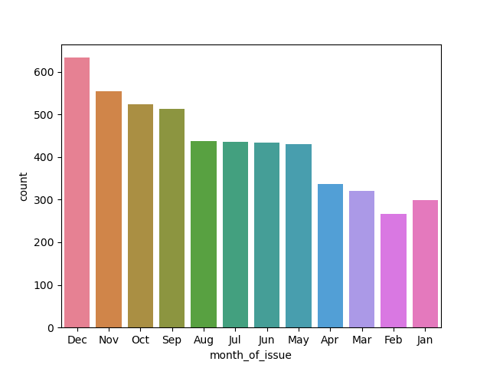

Slide 12
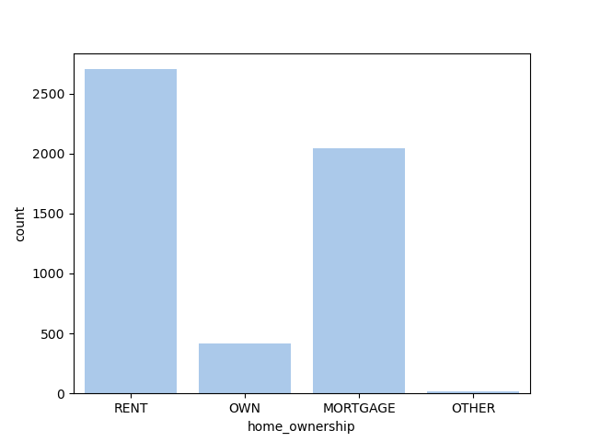

Slide 13
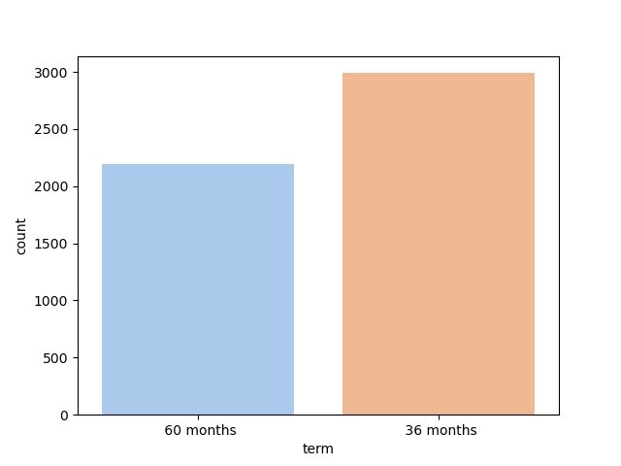

Slide 14
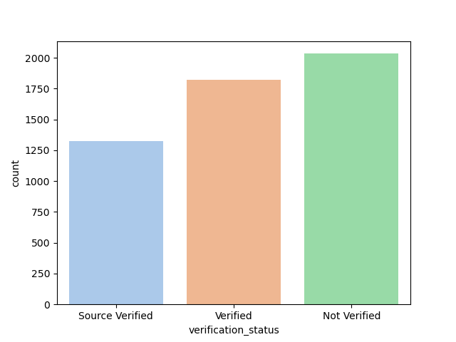

Slide 15
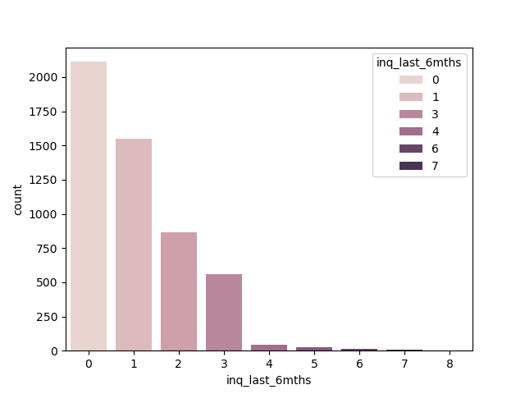

Slide 16
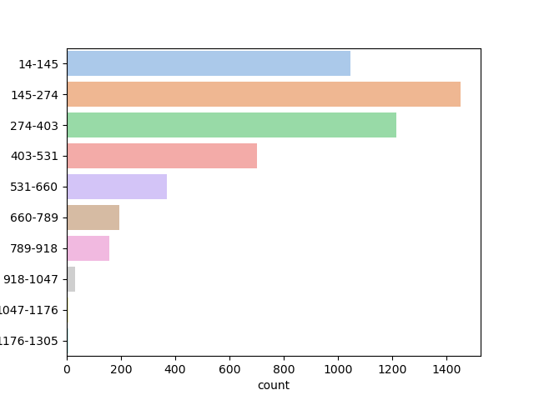

Slide 17
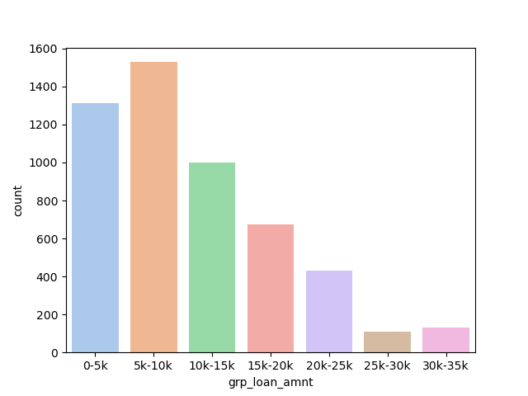

Slide 18
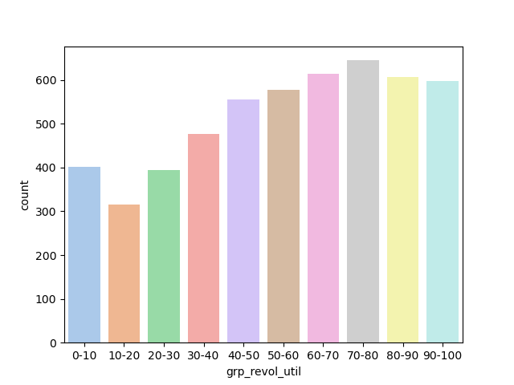

Slide 19
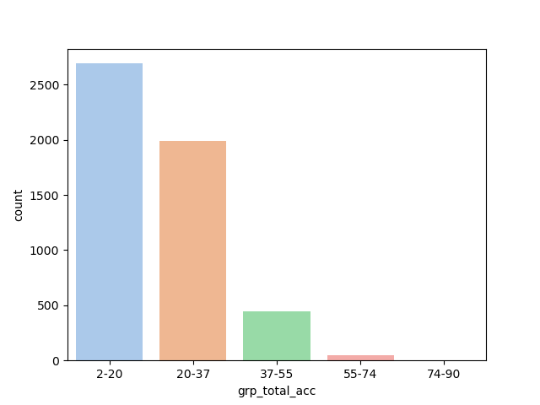

Slide 20
Recommendations & conclutions
1
2
1

Slide 21
Thanks!

