Slide 1
Jira
Hindi Learning Portal

Slide 2
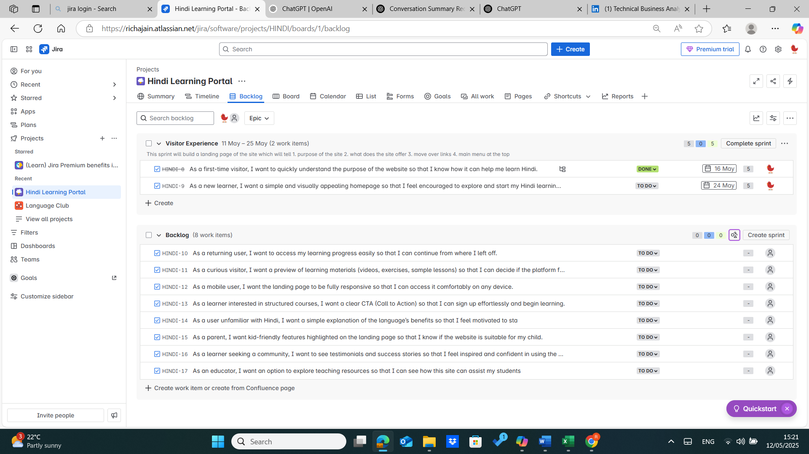
Scrum Backlog

Slide 3
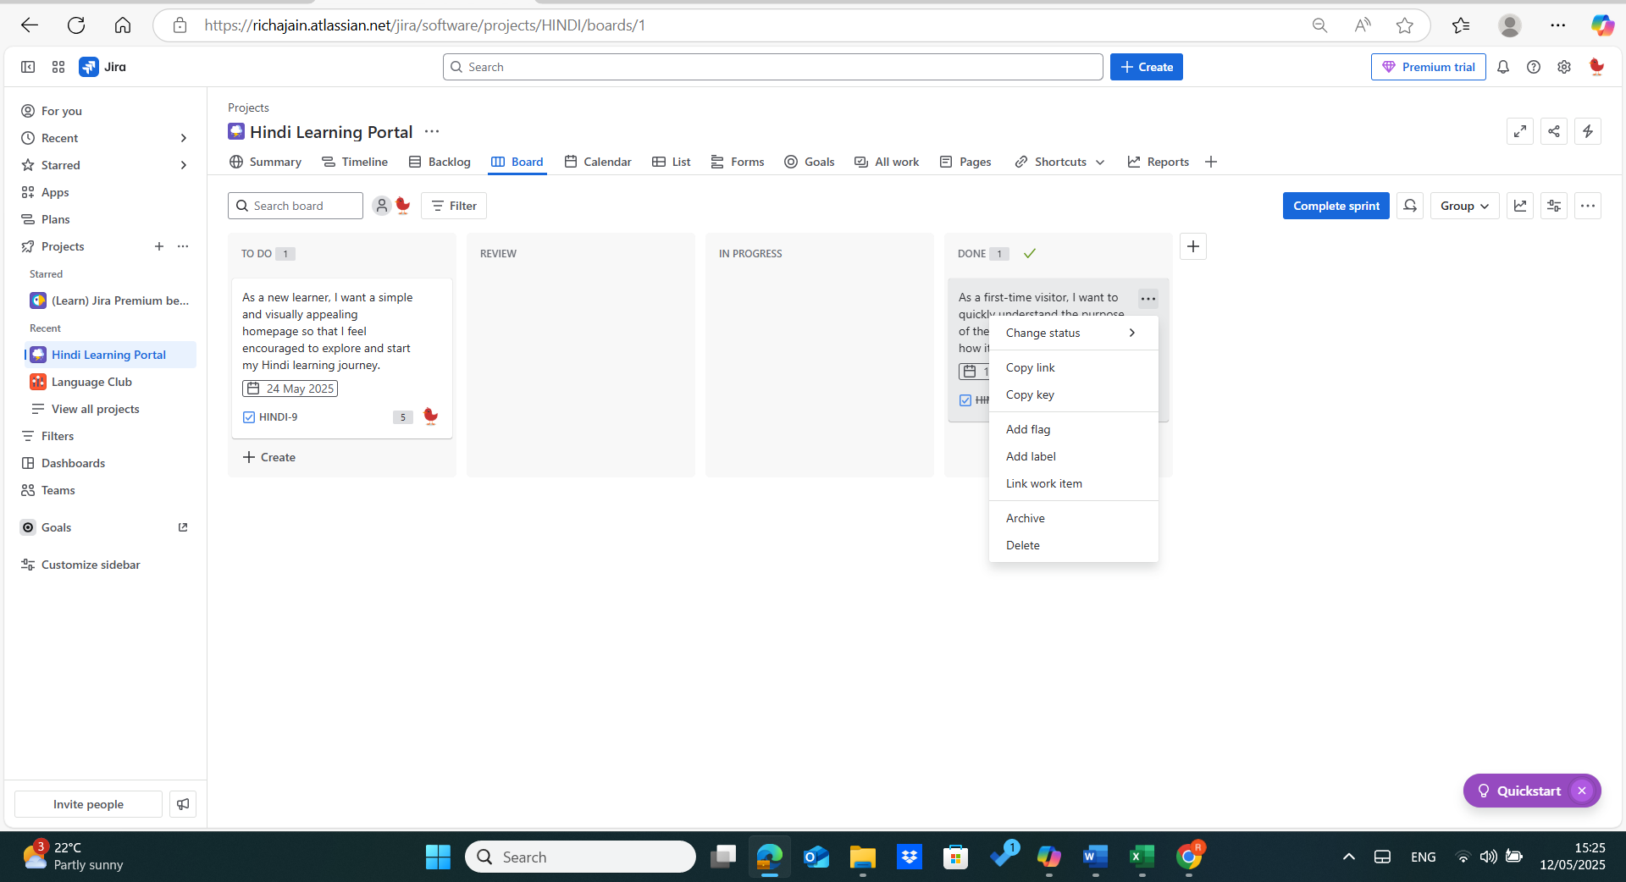
Scrum Board

Slide 4
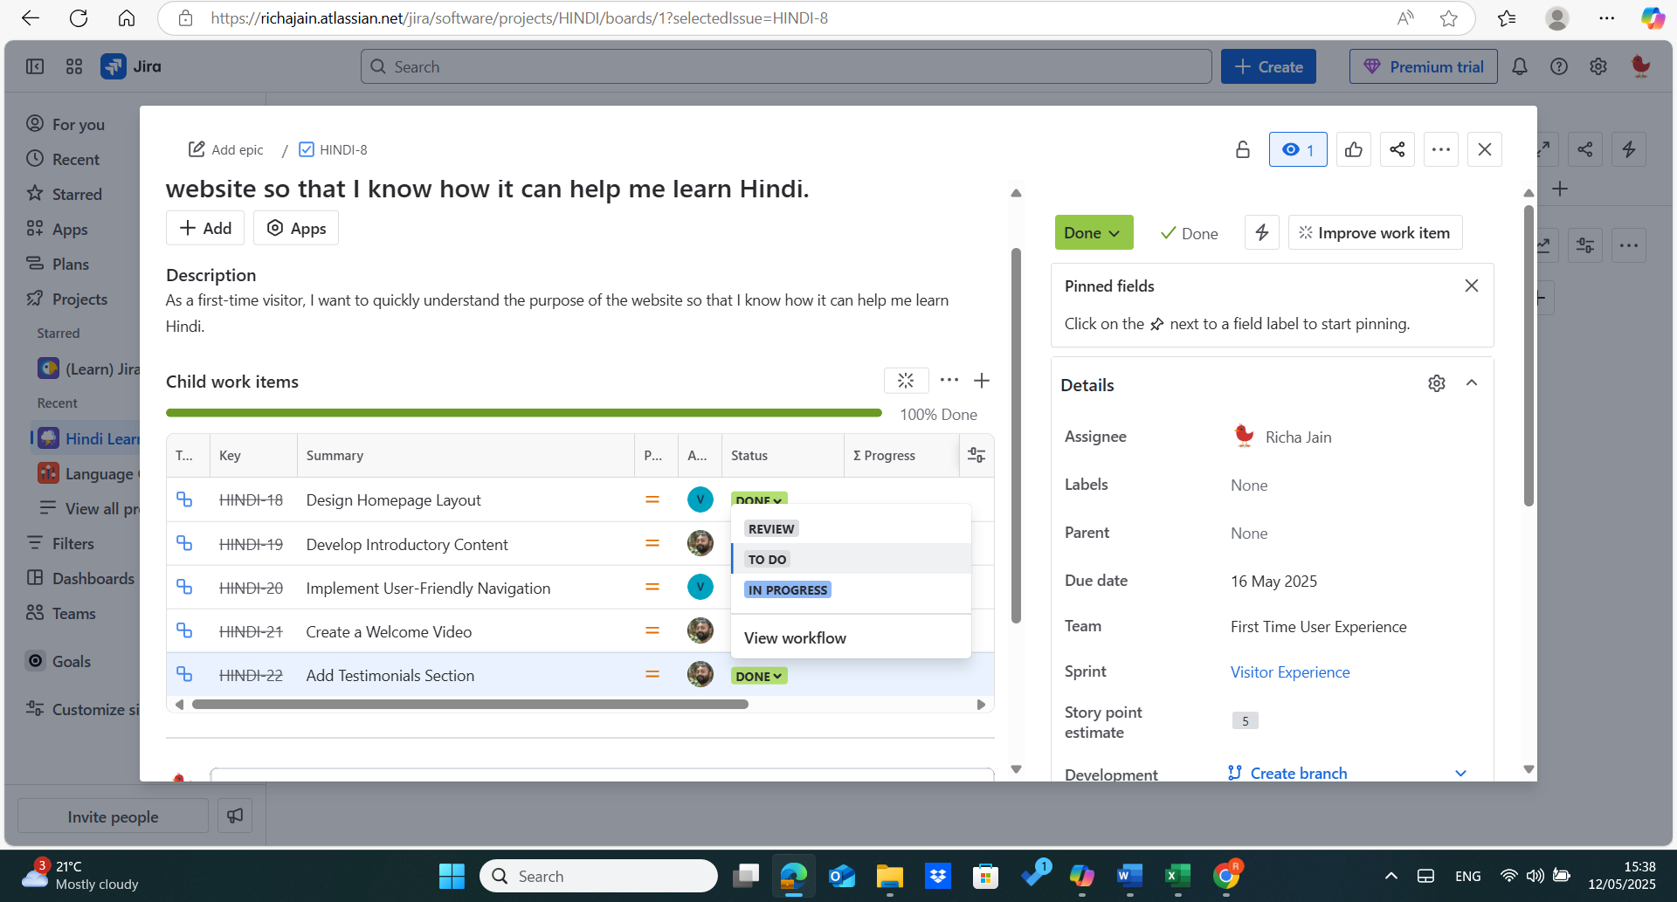
Child Work Items

Slide 5
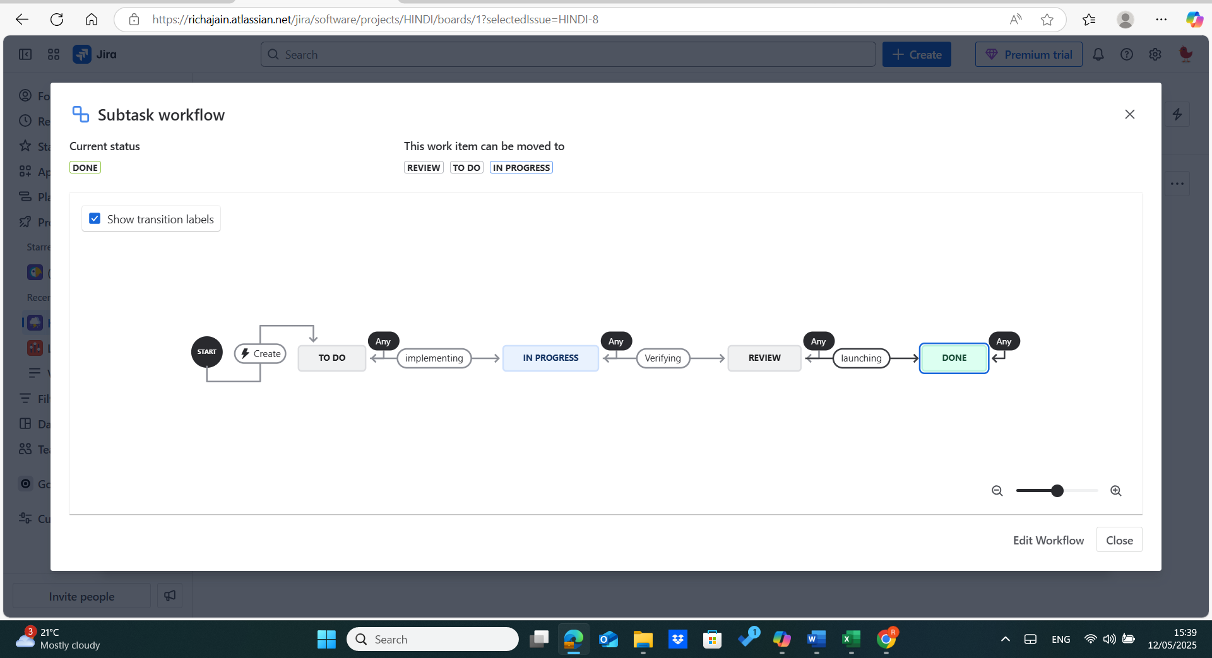
Subtask Workflow

Slide 6
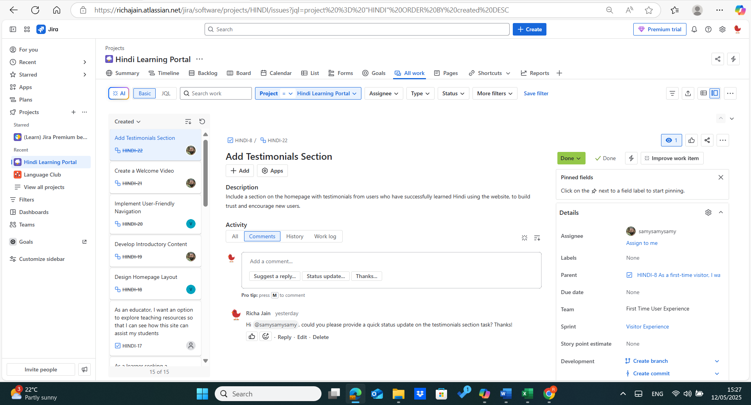
All Work

Slide 7
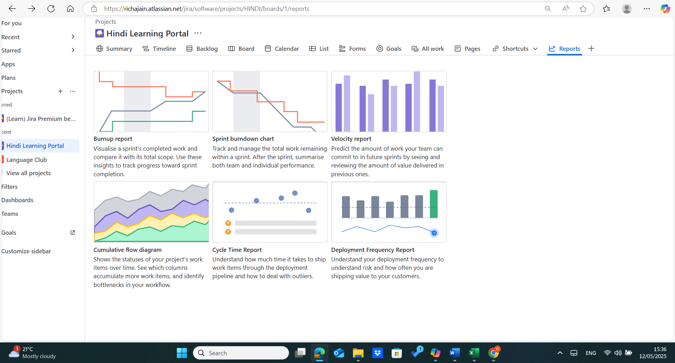
Reports

Slide 8
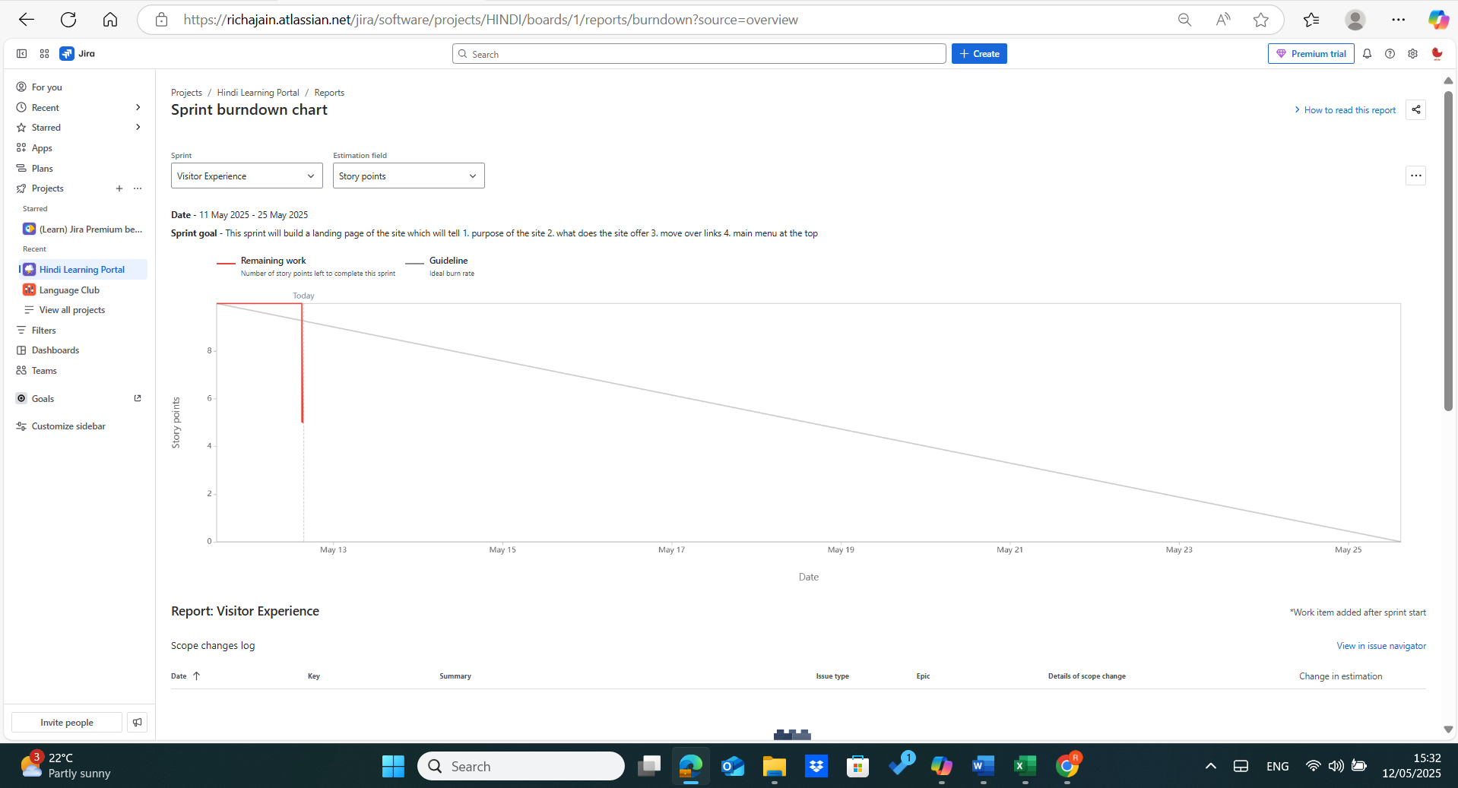
Burndown Chart

Slide 9
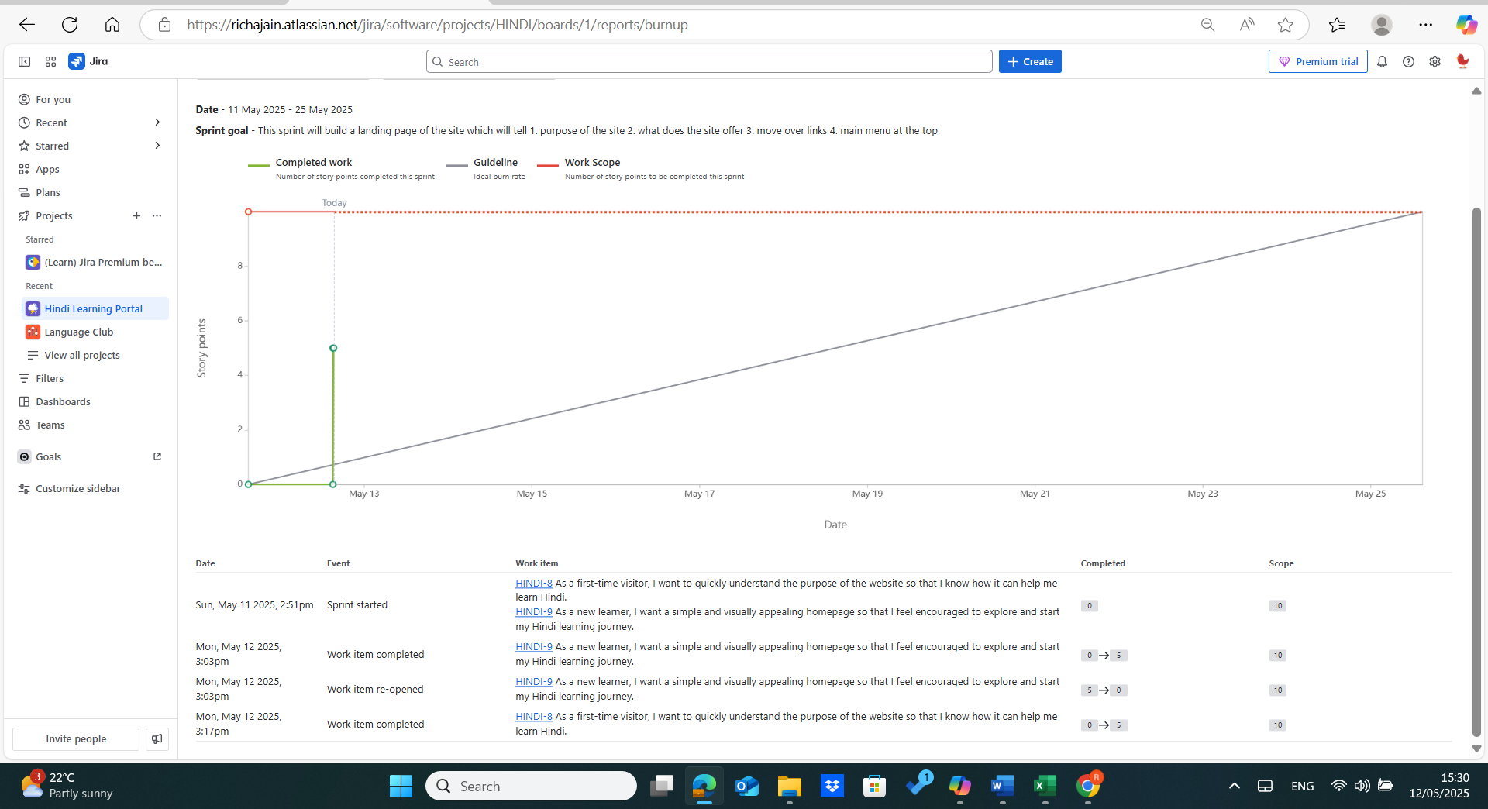
Burnup Report

Slide 10
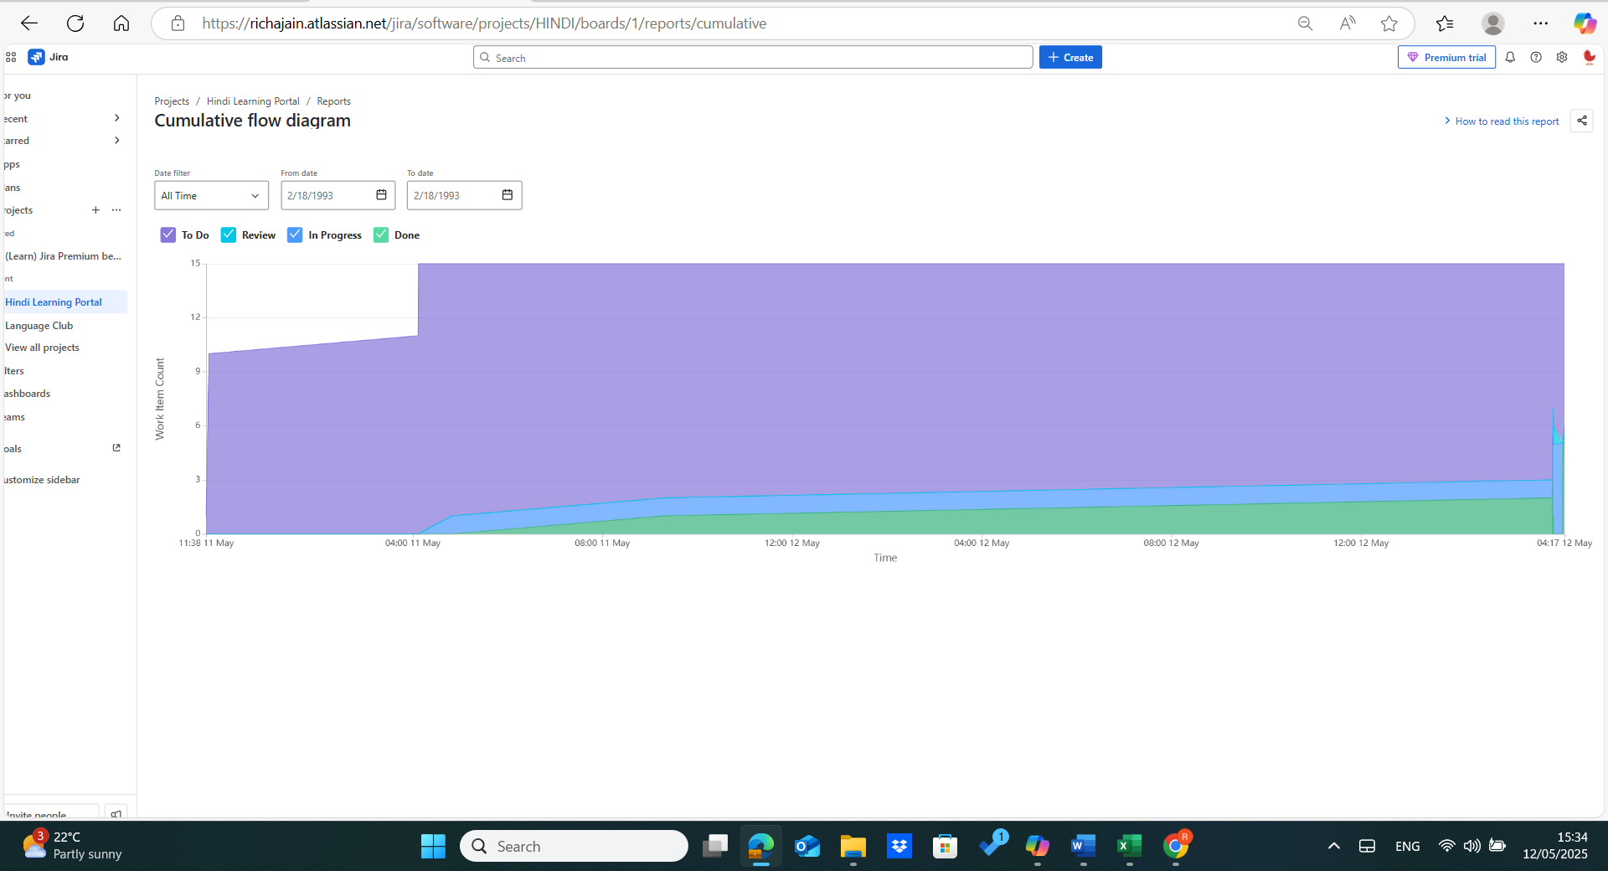
Cumulative Flow Diagram

