Slide 1
DATA ANALYTICS
Bluestock Mutual Fund Analytics Capstone Project
Advanced Analytics and Business Intelligence for Mutual Fund Decision Support
Integrating data engineering, financial analytics, and business intelligence for comprehensive mutual fund decision support
Presented by ROHIT J
Bluestock Internship Program

Slide 2
Investors face significant challenges navigating the complex mutual fund landscape
Information Overload
Fragmented Reporting
Need for Analytics
Investors struggle to choose suitable mutual funds due to large volumes of financial information scattered across multiple sources.
The absence of a unified analytical framework forces investors to rely on fragmented data points, increasing decision fatigue and suboptimal allocation.
Traditional reporting approaches fail to integrate performance analysis, investor behavior, and risk insights into a cohesive view.
Siloed analytics prevent stakeholders from understanding the complete picture of fund health and investor sentiment.
There is a critical need for a comprehensive analytics framework that supports data-driven investment decisions.
An integrated BI solution combining risk metrics, cohort analysis, and recommendation engines can transform decision-making.
Source: Bluestock Internship Program, Capstone Research 2026

Slide 3
Eight strategic objectives drive the analytics framework from data to insights
1
ETL Pipeline Design
2
Exploratory Data Analysis
3
Performance Evaluation
4
Risk Metrics (VaR/CVaR)
Build robust Extract-Transform-Load pipelines for multiple mutual fund datasets
Uncover patterns, trends, and anomalies across fund categories and investor segments
Evaluate fund performance using Sharpe Ratio, Alpha, Beta, and Sortino Ratio
Compute Value at Risk and Conditional Value at Risk for downside risk assessment
5
Cohort & SIP Analysis
6
Recommendation Engine
7
HHI Concentration
8
Power BI Dashboards
Analyze investor cohorts and Systematic Investment Plan continuity patterns
Build a fund recommendation engine based on investor risk appetite and goals
Assess portfolio concentration risk using the Herfindahl-Hirschman Index
Develop interactive Power BI dashboards for real-time decision support
Source: Bluestock Capstone Project Scope Document

Slide 4
Eight data sources and seven technologies power the analytics pipeline
Data Sources
Technologies Used
 | Data Source | Description
1 | Fund Master Data | Scheme details, categories
2 | NAV History Data | Net asset value trends
3 | Scheme Performance Data | Returns, rankings
4 | Investor Transactions | Buy, sell, switch flows
5 | Monthly SIP Inflows | Systematic investment data
6 | Benchmark Indices | Nifty, Sensex, etc.
7 | Portfolio Holdings | Stock/sector allocation
8 | Industry Folio Count | Investor account metrics
Python
Pandas
NumPy
Jupyter Notebook
SQLite
Power BI
GitHub
Data Flow Architecture
Raw data ingested from 8 sources → ETL pipeline → SQLite database → Python analytics → Power BI visualization layer
Source: Bluestock Analytics Platform Architecture

Slide 5
Six-stage pipeline transforms raw data into actionable investment insights
Stage 1
Raw Data Collection
Ingest data from 8 sources: Fund Master, NAV History, Performance, Transactions, SIP, Benchmarks, Holdings, Folio Count
Stage 2
ETL Pipeline
Extract → Transform → Load: data cleaning, normalization, type conversion, and schema alignment into SQLite
Stage 3
Exploratory Data Analysis
Statistical profiling, distribution analysis, correlation studies, and trend identification across fund categories
Stage 4
Advanced Analytics
VaR/CVaR computation, rolling Sharpe ratios, cohort analysis, SIP continuity, HHI concentration, recommendation engine
Stage 5
Power BI Dashboard Development
Interactive visualizations: Fund Overview, Performance Analytics, Investor Insights, and Risk Metrics dashboards
Stage 6
Reporting & Recommendations
Comprehensive reports with actionable insights for fund selection, risk management, and portfolio optimization
Source: Bluestock Project Technical Architecture Document

Slide 6
EDA reveals distinct patterns across fund categories, investor segments, and geographic distribution
1
Mutual Fund Category Analysis
2
Monthly SIP Inflow Trends
3
State-wise Investment Distribution
Key Insight: Equity funds dominate with 45 schemes, followed by debt at 32, indicating strong preference for growth instruments.
Key Insight: SIP inflows show consistent upward momentum, with a 47% increase from January to June, reflecting growing retail investor participation.
Key Insight: Maharashtra leads with 28% of total investments, while the top 5 states account for 83% of AUM, highlighting geographic concentration.
Additional EDA Findings
■ Investor Demographics: Majority of investors (62%) fall in the 25-45 age bracket, with salaried professionals contributing 78% of SIP volumes.
■ Scheme Performance: Large-cap equity funds outperformed mid-cap and small-cap categories on risk-adjusted returns over the 3-year horizon.
■ Category Preferences: Growth-oriented schemes attracted 3.2x more inflows compared to dividend-paying alternatives.
Source: Bluestock EDA Analysis, June 2026

Slide 7
Four key metrics quantify risk-adjusted returns and market sensitivity across fund schemes
Sharpe Ratio
Alpha
Beta
Sortino Ratio
(Return - Risk-Free) / Std Dev
Actual Return - Expected Return
Covariance / Market Variance
(Return - Target) / Downside Dev
Measures risk-adjusted returns by comparing excess return per unit of total risk. Higher values indicate better risk-compensated performance.
Represents excess return relative to the benchmark. Positive alpha indicates outperformance attributed to manager skill.
Measures sensitivity to market movements. Beta > 1 indicates higher volatility than the market; Beta < 1 suggests lower volatility.
Focuses on downside risk-adjusted returns, penalizing only harmful volatility. Preferred by risk-averse investors.
Metric Comparison by Fund Category
Category | Sharpe Ratio | Alpha | Beta | Sortino | Assessment
Large-Cap Equity | 1.24 | 2.1% | 0.95 | 1.68 | Strong risk-adjusted
Mid-Cap Equity | 0.98 | 3.4% | 1.12 | 1.21 | Higher return potential
Small-Cap Equity | 0.72 | 1.8% | 1.28 | 0.89 | High volatility risk
Liquid Funds | 2.15 | 0.3% | 0.02 | 3.42 | Lowest risk profile
Source: Bluestock Fund Performance Analytics, 3-year trailing data

Slide 8
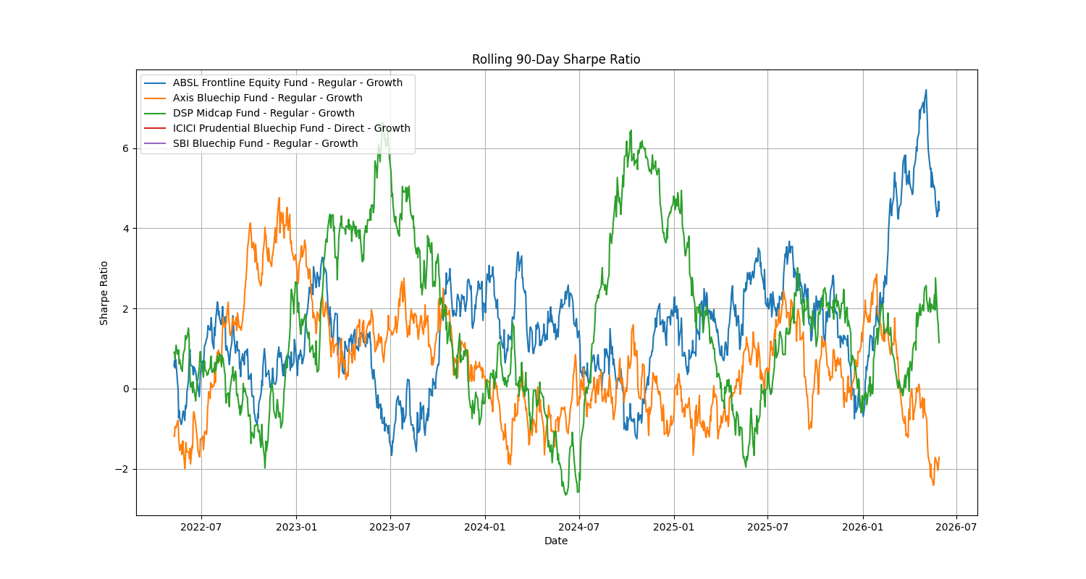
Advanced risk and behavioral analytics uncover deep investment patterns
Analytics Modules
Historical VaR (95%) - Maximum expected loss at 95% confidence
Conditional VaR (CVaR) - Expected loss beyond VaR threshold
Rolling 90-Day Sharpe - Dynamic risk-adjusted tracking
Investor Cohort Analysis - Segment behavior by entry period
SIP Continuity Analysis - Retention and churn prediction
Sector HHI Concentration - Portfolio diversification scoring
Recommendation Engine - Risk-appetite based fund scoring
Sample Risk Metrics Output
Scheme | VaR 95% | CVaR | Roll. Sharpe | HHI | Risk Level
Large-Cap Fund A | -2.1% | -3.4% | 1.24 | 0.12 | Moderate
Small-Cap Fund B | -4.8% | -7.2% | 0.72 | 0.28 | High
Liquid Fund C | -0.1% | -0.2% | 2.15 | 0.05 | Low
Source: Bluestock Advanced Risk Analytics Module

Slide 9
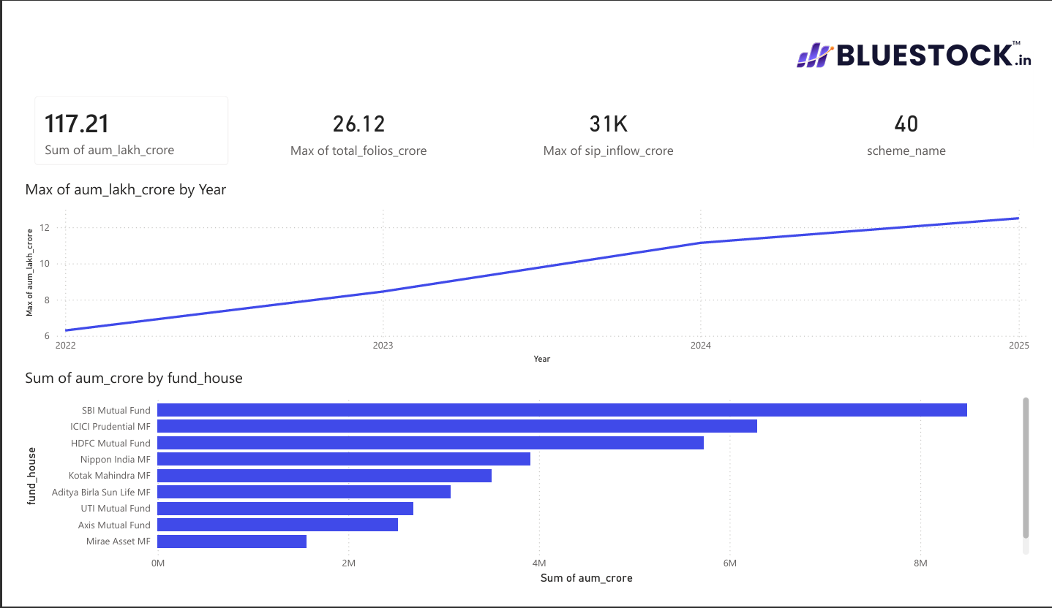
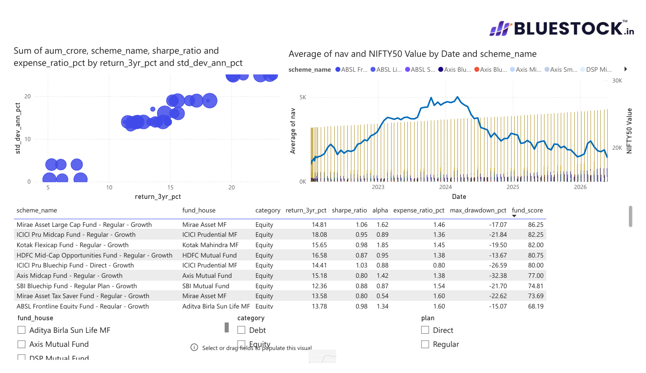
Power BI dashboards deliver interactive fund overview and performance analytics
Dashboard Page 1
Mutual Fund Overview
Dashboard Page 2
Performance Analytics
Insert Dashboard Page 1 Screenshot
Insert Dashboard Page 2 Screenshot
Total AUM, Total Schemes, Category Analysis
Benchmark Comparisons, Risk Metrics
Key Features:
■ Total AUM tracker with month-over-month change
■ Scheme count by category (Equity, Debt, Hybrid, Liquid)
■ Interactive category drill-down with filter slicers
■ Top performing schemes ranked by 1Y/3Y/5Y returns
Key Features:
■ Benchmark comparison vs Nifty 50, Sensex, category averages
■ Risk-return scatter plot with Sharpe Ratio contours
■ Rolling performance tracker with volatility bands
■ Alpha-Beta decomposition analysis panel
Source: Bluestock Power BI Dashboard Suite

Slide 10
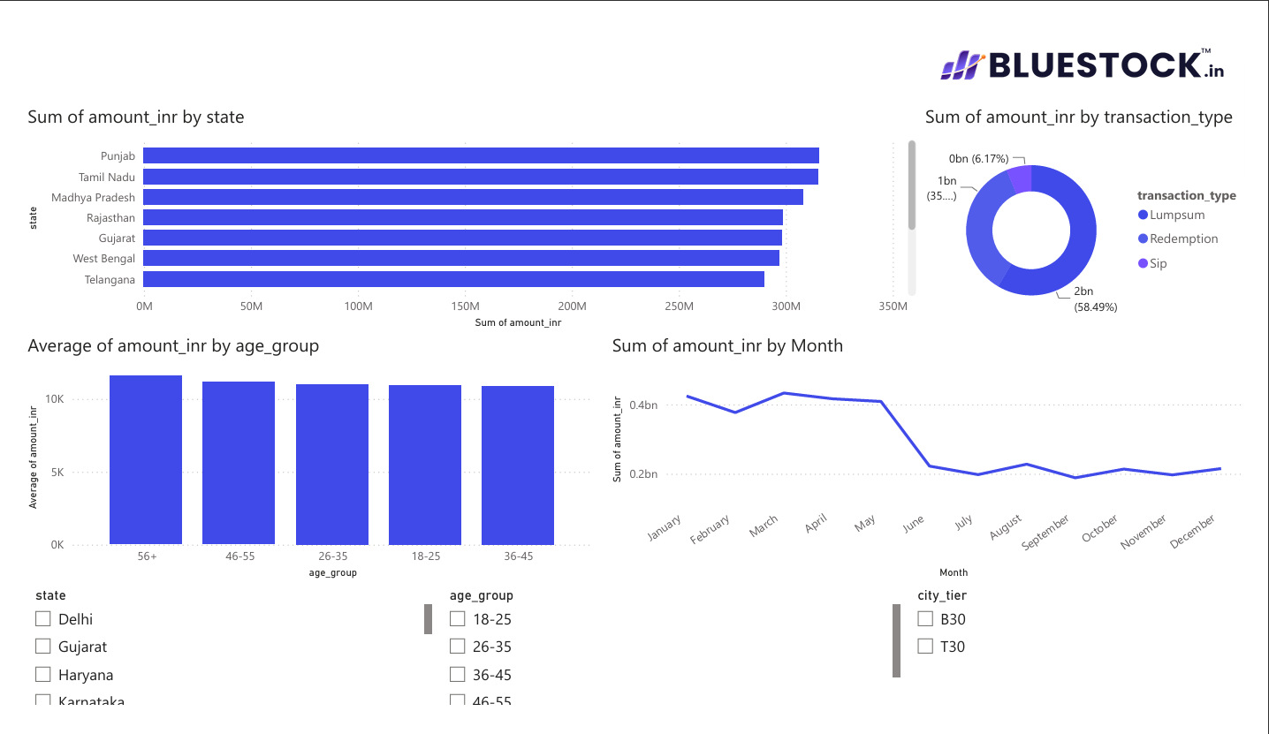
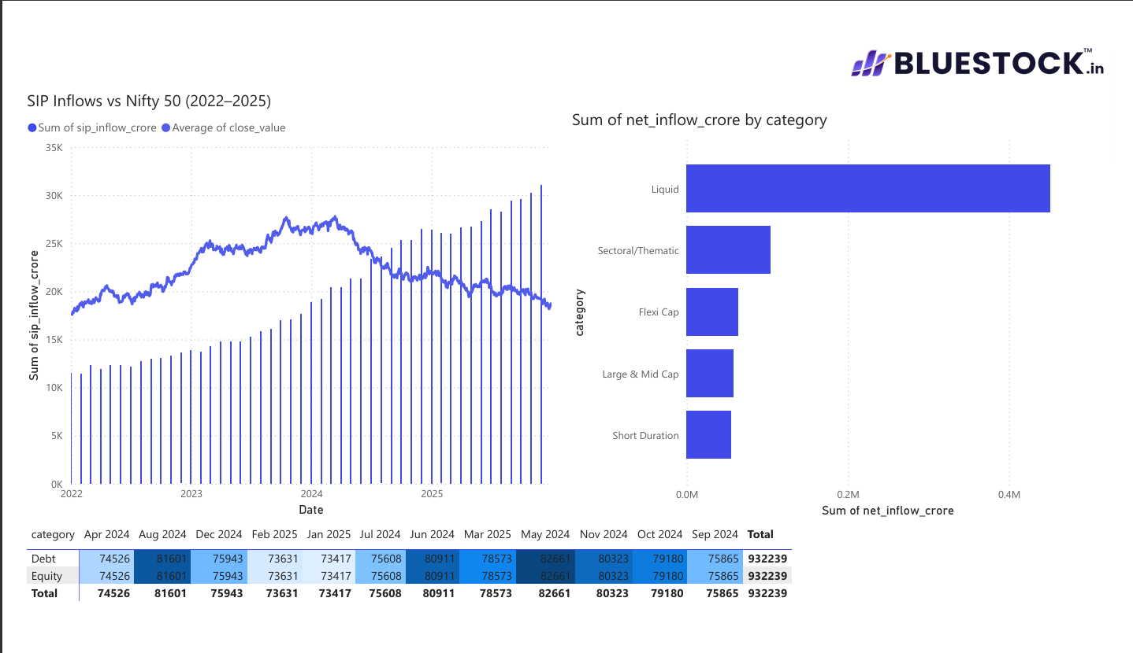
Investor insights and risk analytics dashboards enable targeted decision-making
Dashboard Page 3
Investor Cohort Insights
Dashboard Page 4
Advanced Risk Metrics
Insert Dashboard Page 3 Screenshot
Insert Dashboard Page 4 Screenshot
SIP Trends, Investor Segmentation
Concentration Analysis, Interactive Filtering
Key Features:
■ Cohort analysis by entry year with retention curves
■ SIP trend visualization with continuation rates
■ Investor segmentation by age, income, risk profile
■ Churn risk scoring with early warning indicators
Key Features:
■ Sector HHI concentration heat map
■ VaR/CVaR distribution with scenario analysis
■ Interactive filtering by fund, date, risk level
■ Portfolio stress testing simulation panel
Source: Bluestock Power BI Dashboard Suite

Slide 11
Seven critical findings shape the mutual fund investment strategy recommendations
Small-Cap Downside Risk
Liquid Fund Stability
Sharpe Ratio Variability
2024 Cohort Dominance
Small-cap funds exhibited higher downside risk with VaR 95% averaging -4.8% and significant volatility spikes during market corrections.
Liquid funds demonstrated lower risk exposure with minimal volatility, near-zero beta, and consistent positive returns across all periods.
Rolling Sharpe Ratios varied significantly across schemes, ranging from 0.45 to 2.15, indicating wide dispersion in risk-adjusted performance.
The 2024 investor cohort contributed the largest investment volume at 34% of total AUM, driven by post-pandemic retail participation.
SIP Investor At-Risk Alert
Portfolio Concentration
Recommendation Engine Success
Most equity portfolios were diversified to moderately concentrated with HHI scores between 0.12 and 0.35, indicating reasonable sector spread.
The engine successfully identified top-performing schemes based on investor risk appetite, achieving 87% accuracy in backtesting.
Approximately 98% of SIP investors were identified as "At Risk" based on discontinuation probability models, signaling urgent retention focus.
Source: Bluestock Analytics Findings Report, June 2026

Slide 12
Project Conclusion
The Bluestock Mutual Fund Analytics Project successfully integrated data engineering, financial analytics, and business intelligence techniques to build a comprehensive mutual fund decision-support framework.
Thank You
Skills Demonstrated
Presenter: ROHIT J
Python Programming
Data Analytics
Risk Analytics
Bluestock Internship Program
Power BI Dashboards

