Slide 1

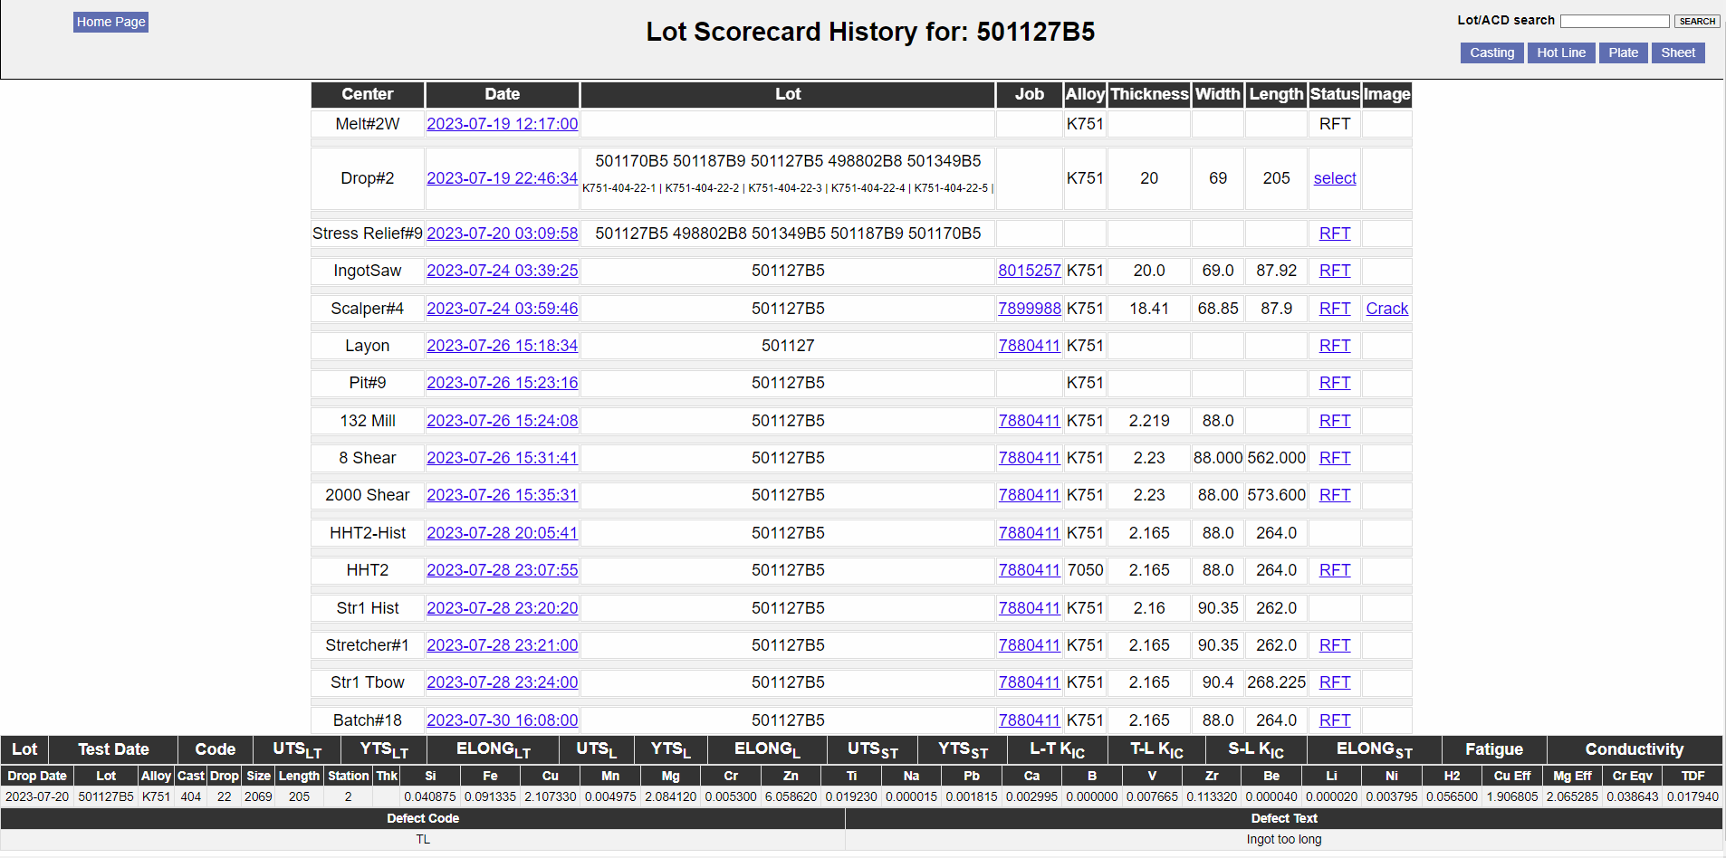
Dynamic Lot History Search
RJ Belanger

Slide 2
Outline
➣ Background
➣ Objectives
➣ Project Framework
➣ Demo
➣ Questions

Slide 3
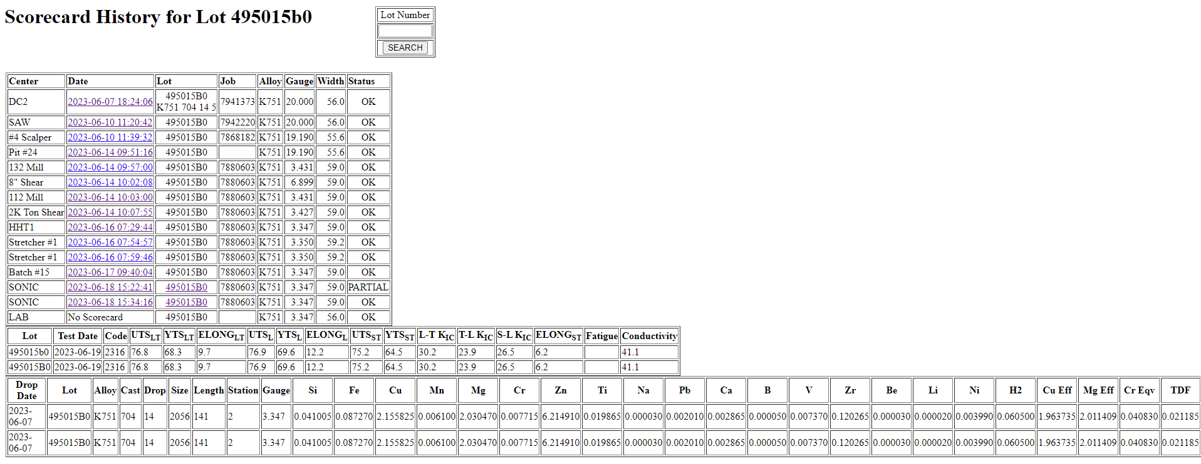
Background

Slide 4
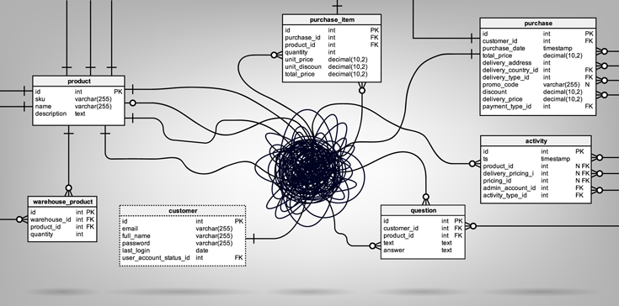
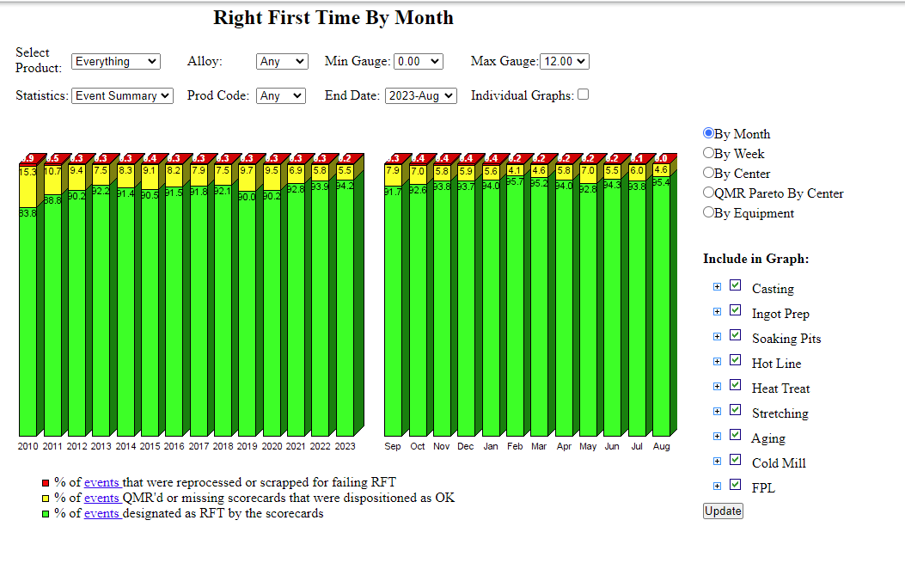
Background

Slide 5
Objectives
➣ Dynamic Search with little to no maintenance adding or removing processes
➣ Search will run off of more verbose tables that are now formatted to be usable
➣ Able to retrieve information from ALL processes and display it in a reasonable time
➣ Increase the function/usability of the search
➣ Able to enter a 6 or 8 digit lot number leveraging formatted database to give any/all useful data relating to that lot

Slide 6
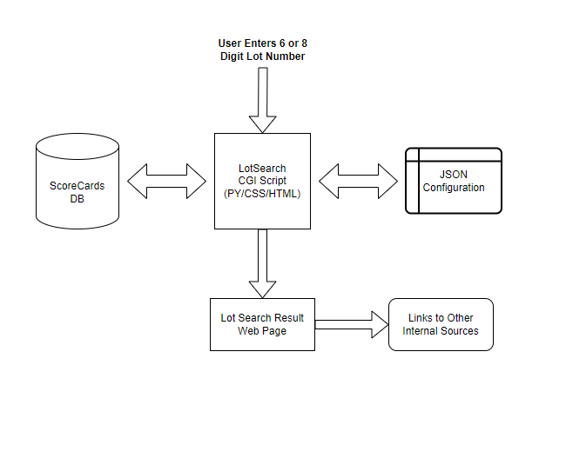
Project Framework
➣ CGI Script
➣ CSS
➣ HTML
➣ JSON CONFIG

Slide 7
Demo

Slide 8

Questions

