Slide 1

Team 8
NFT Robo predictor

Slide 2



Project
NFT Robo Predictor
Project Objectives
Program that analyses sales trends in the NFT (Non-Fungible Token) market
Use of machine learning to predict future NFT sale prices based on their traits
Auto-generation of new valuable NFTs
Team 8 Members
Charles Twitchell
Robert Giannini
George Kraft

Slide 3
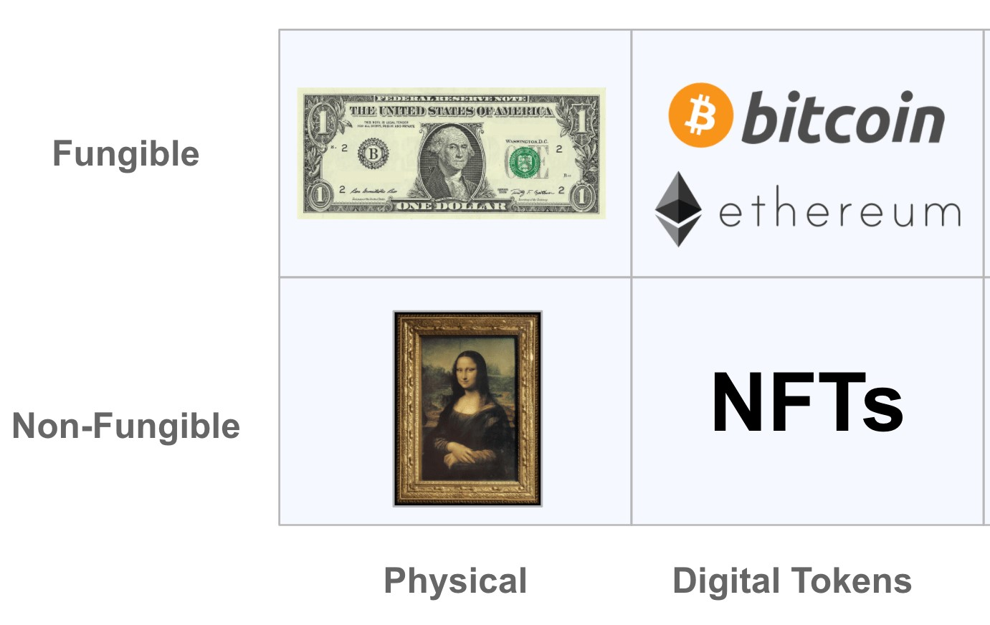
What is a NFT?
A non-fungible token (NFT) is a unique unit of data or one-of-a-kind piece of code, stored and protected on a blockchain (e.g. Ethereum) and is not mutually interchangeable, i.e. non-fungible
One bitcoin is indistinguishable from any other bitcoin and can be readily exchanged, i.e. fungible

Slide 4
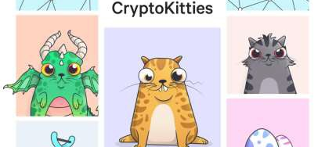
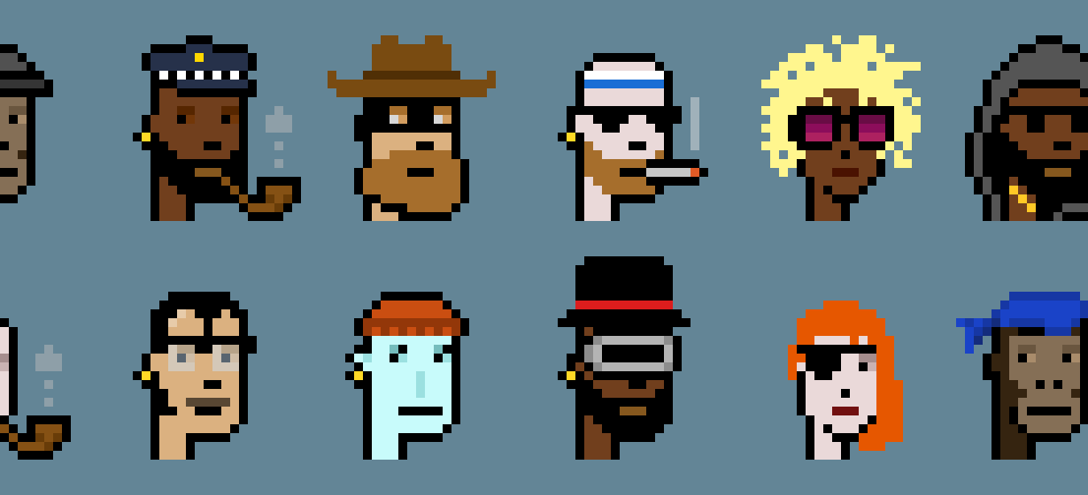
What does an NFT represent?
An NFT can represent anything that exists as a digital asset or as a physical item
NFT representing ownership of a digital asset resides in a digital wallet
Very few restrictions as to what kind of content can be "tokenized" and turned into an NFT

Slide 5
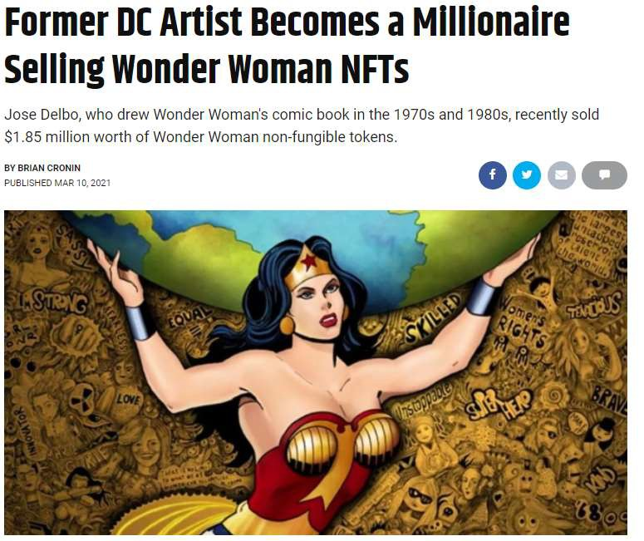
NFTs can be of significant value

Slide 6


What do you get from an NFT?
NFTs provide:
A way to authenticate ownership
Permanency
Blockchain recorded originality
Distinction between NFT and copies of underlying digital asset:
It is possible to have more than one NFT representing different copies of an identical piece of digital art or image but the code or token for each copy is unique

Slide 7
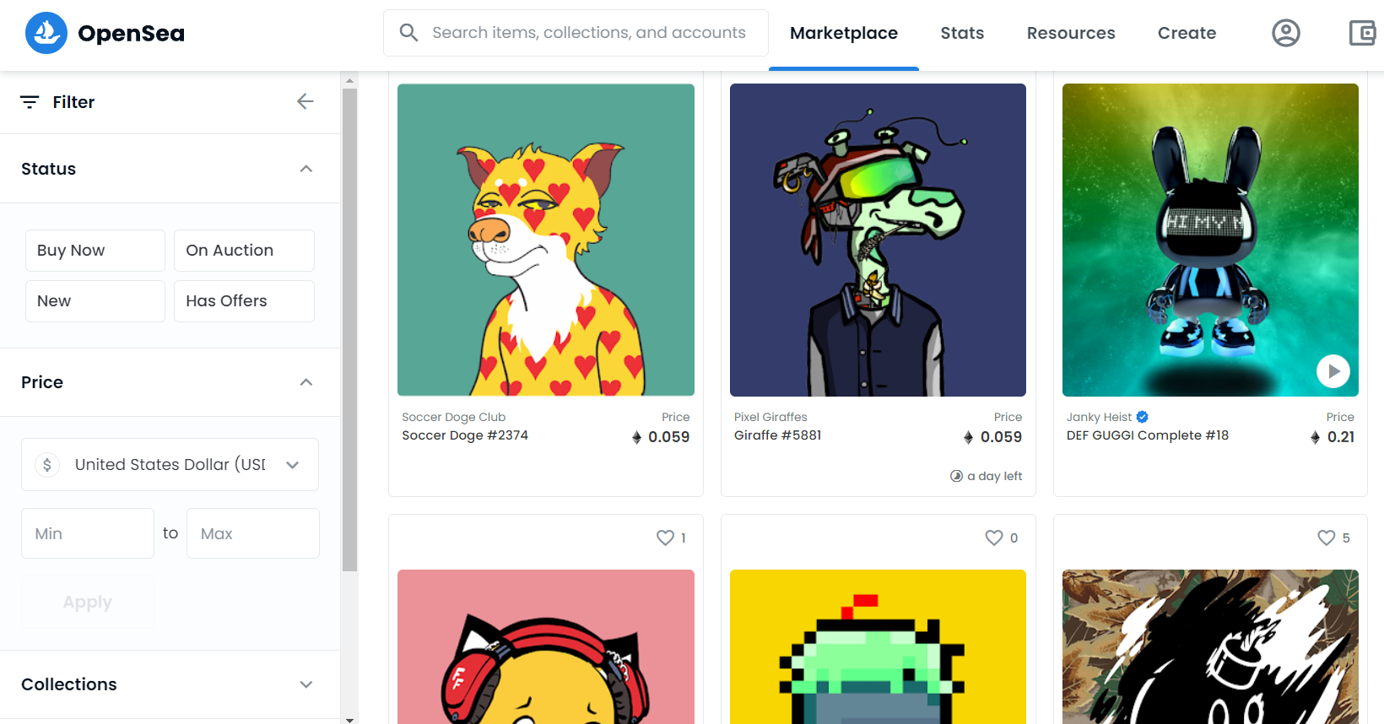
Opensea NFT Marketplace
The world’s first and largest digital marketplace for crypto collectibles and non-fungible tokens (NFTs) to buy, sell, and discover exclusive digital assets

Slide 8
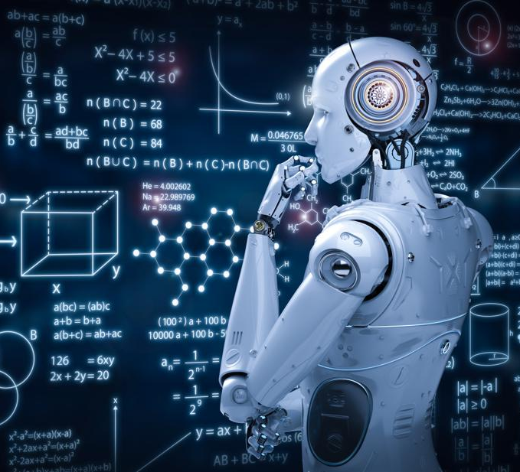
NFT Robo predictor
Use OpenSea API to pull NFT data describing each NFT by traits, attributes, sale price history, and more.
Prepare a Pandas Dataframe with key metrics.
Variables Split into Training and Testing Datasets.
Use of Machine Learning to predict Sale Price, y variable, based on Trait Count and Number of Sales, X variables.
Generate new NFTs with X variables that result in high sale price y variables.

Slide 9

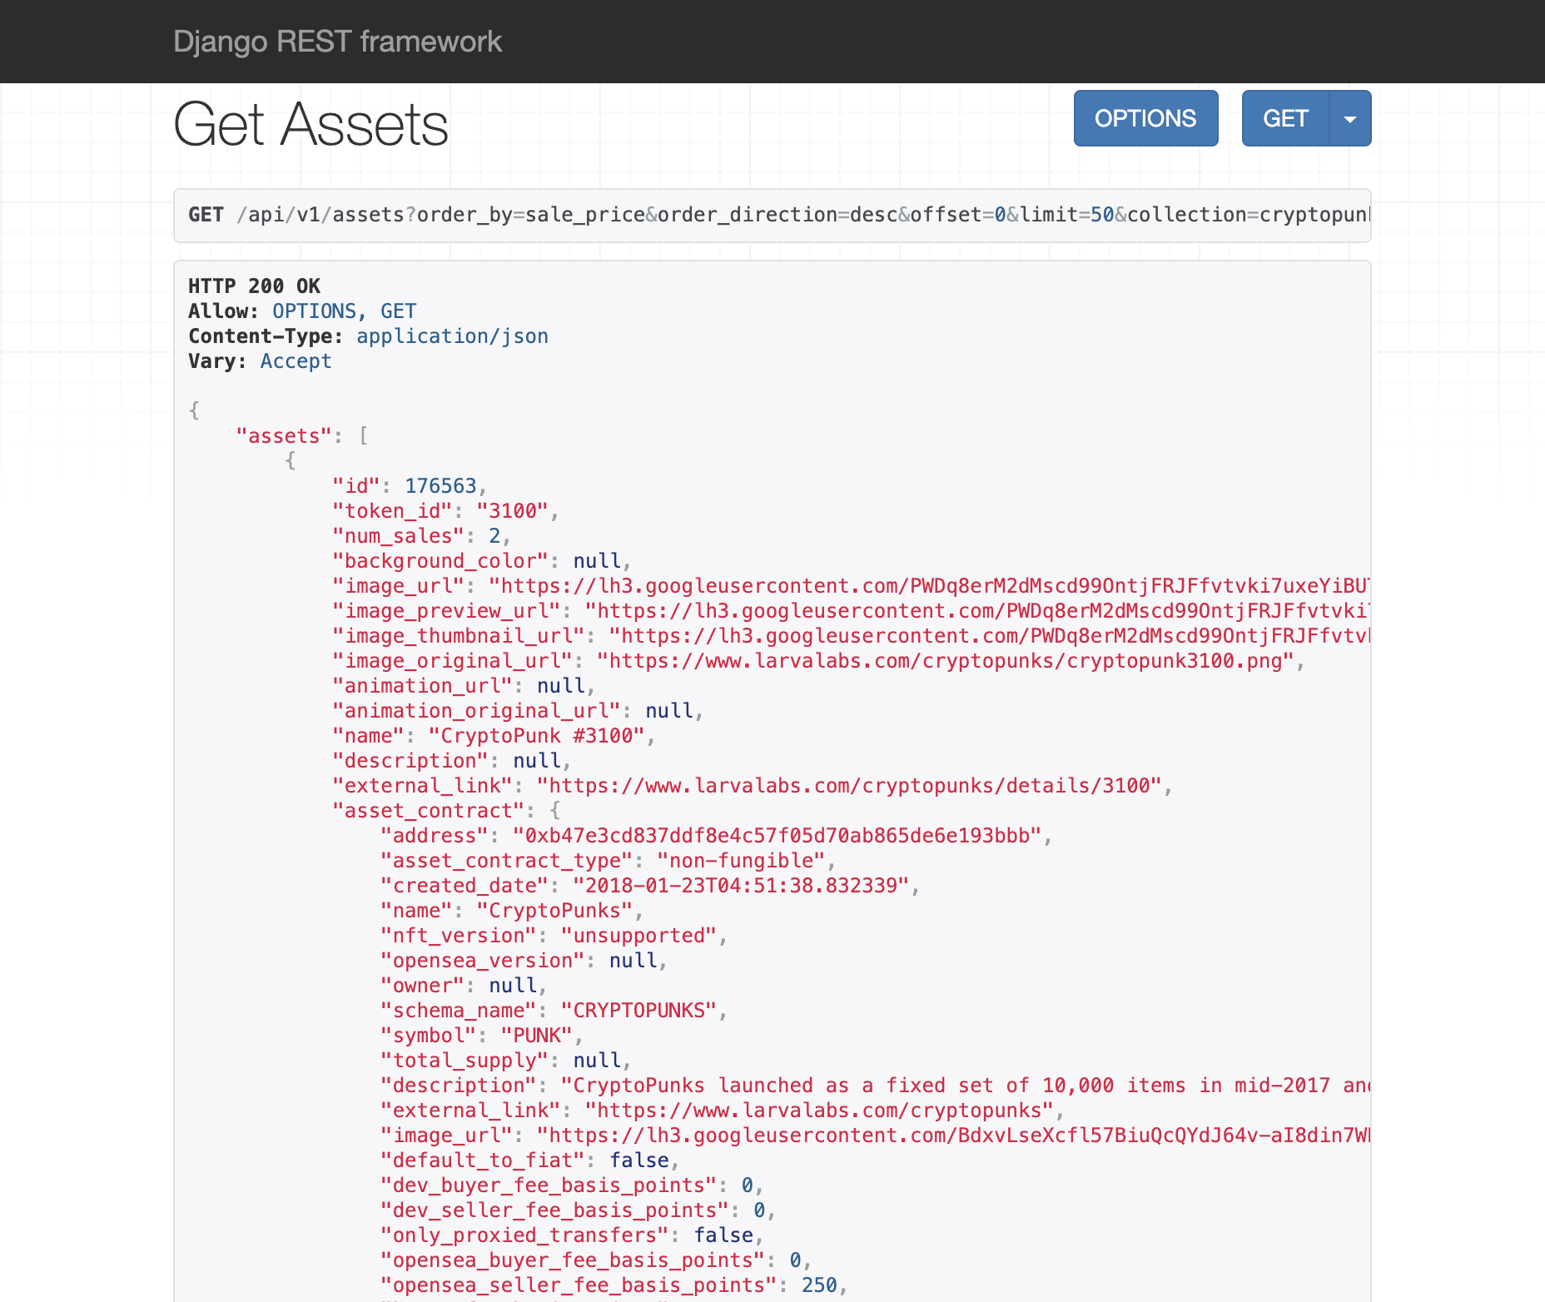
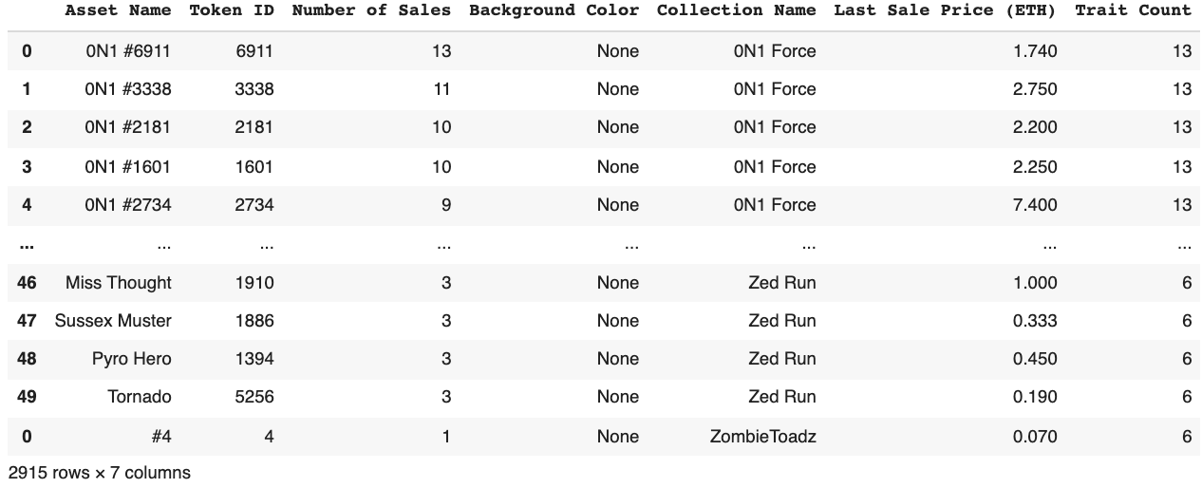
NFT DATAFRAME
Pulled data from OPENSEA api, Cleaned data, and concatenated the main dataframe.
Some Key metrics include:
asset name
token id
number of sales (all time)
Background color
Collection name
last sale price (Ethereum)
and trait count (0-19).

Slide 10
Machining the Data
Broken into two subcategories
Initial Machine learning Findings
“Number of Sale” – how many times an NFT has been sold
“Last Sale Price (ETH) – the most recent price achieved by the NFT in Ethereum
Each sale metric is split in half at the median – those that achieve above median, those that sell below.
Trait length and type is significant
Price can be affected by number of previous sales
Background color can impact sales
Being tied to a certain collections can drive NFT price

Slide 11
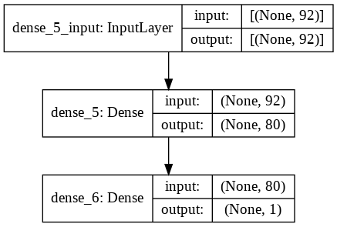
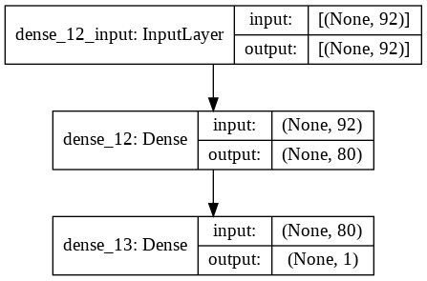
Layering Makes a Difference
For each subgroup, the two most accurate models made use of 100 epochs.
Group 1 (Number of Sales) achieved 90% accuracy and a prediction test of 92%
Group 2 (Last Sale Price in ETH) achieved an 85% accuracy and a prediction test of 60%
More successful at predicting Number of Sales

Slide 12

Next Steps
Generate NFTs with X variables that likely result in high sale prices
Enable image processing to identify high-value NFTs
Natural Language Processing to identify high-value NFTs based on word choice
Store high-value NFTs in digital wallets
Trade NFTs in marketplaces like OpenSea if desired

