Slide 1

Team 8
NFT Robo predictor

Slide 2



Project
NFT Robo Predictor
Project Objectives
Program that analyses sales trends in the NFT (Non-Fungible Token) market
Use of machine learning to predict future NFT sale prices based on their traits
Auto-generation of new valuable NFTs
Team 8 Members
Charles Twitchell
Robert Giannini
George Kraft

Slide 3
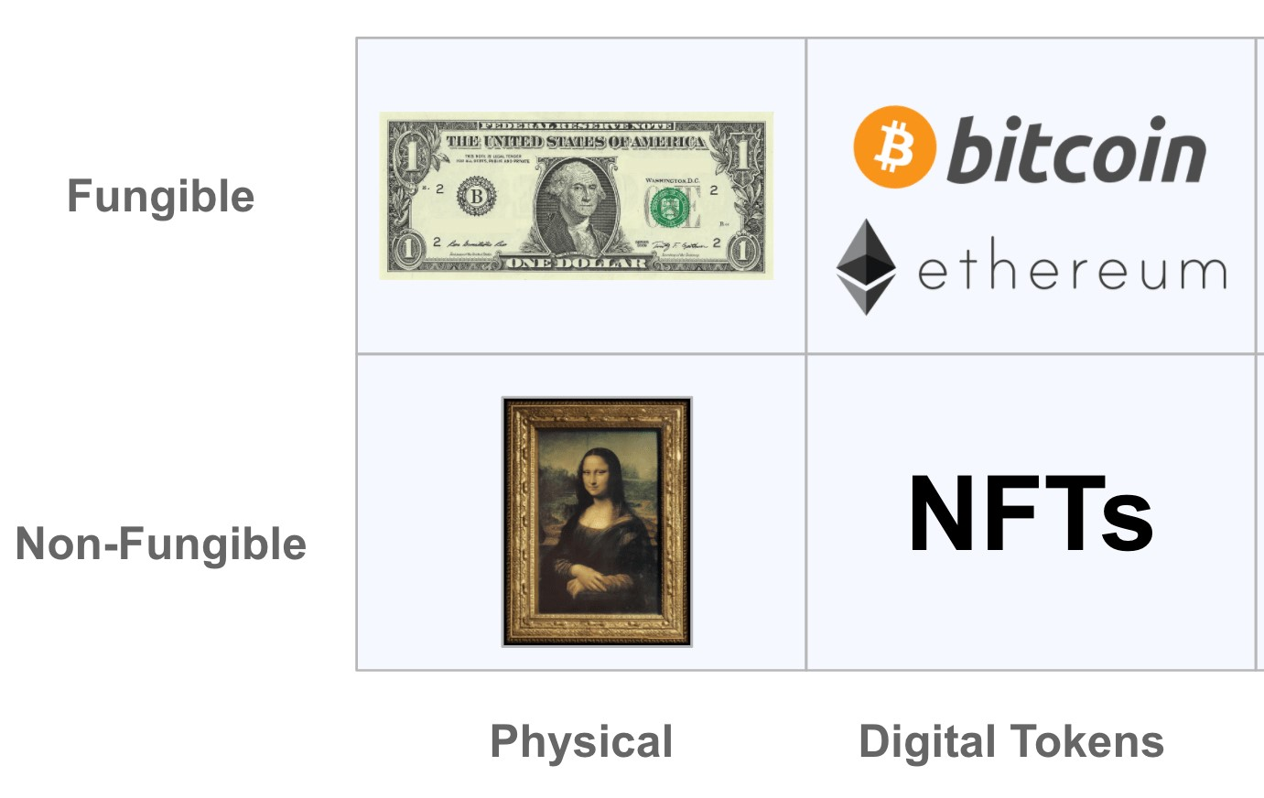
What is a NFT?
A non-fungible token (NFT) is a unique unit of data or one-of-a-kind piece of code, stored and protected on a blockchain (e.g. Ethereum) and is not mutually interchangeable, i.e. non-fungible
One bitcoin is indistinguishable from any other bitcoin and can be readily exchanged, i.e. fungible

Slide 4
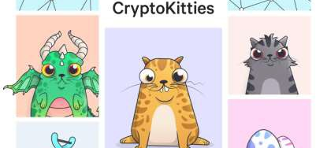
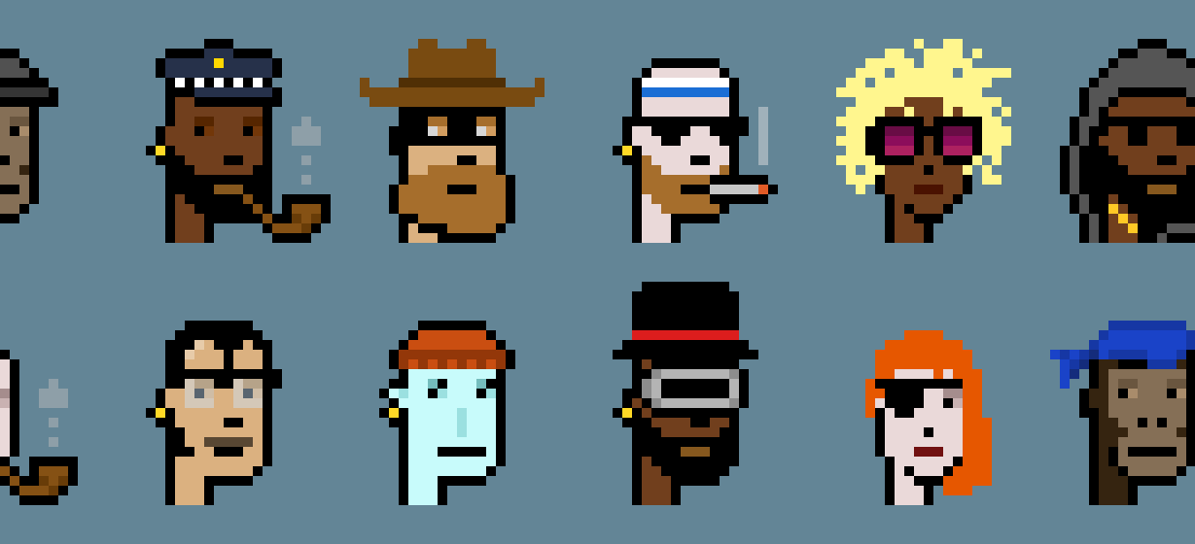
What does an NFT represent?
An NFT can represent anything that exists as a digital asset or as a physical item
NFT representing ownership of a digital asset resides in a digital wallet
Very few restrictions as to what kind of content can be "tokenized" and turned into an NFT

Slide 5
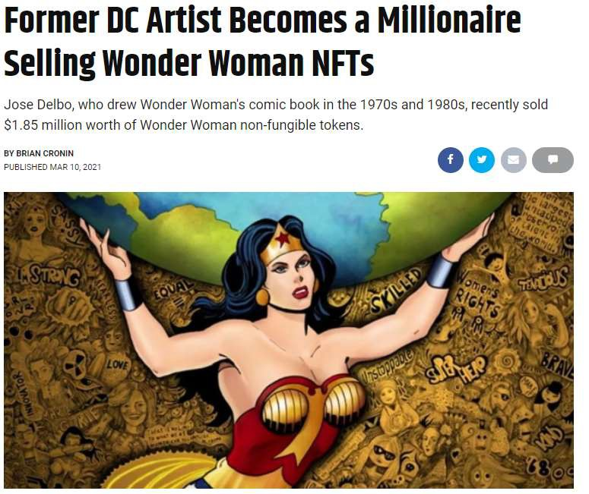
NFTs can be of significant value

Slide 6


What do you get from an NFT?
NFTs provide:
A way to authenticate ownership
Permanency
Blockchain recorded originality
Distinction between NFT and copies of underlying digital asset:
It is possible to have more than one NFT representing different copies of an identical piece of digital art or image but the code or token for each copy is unique

Slide 7
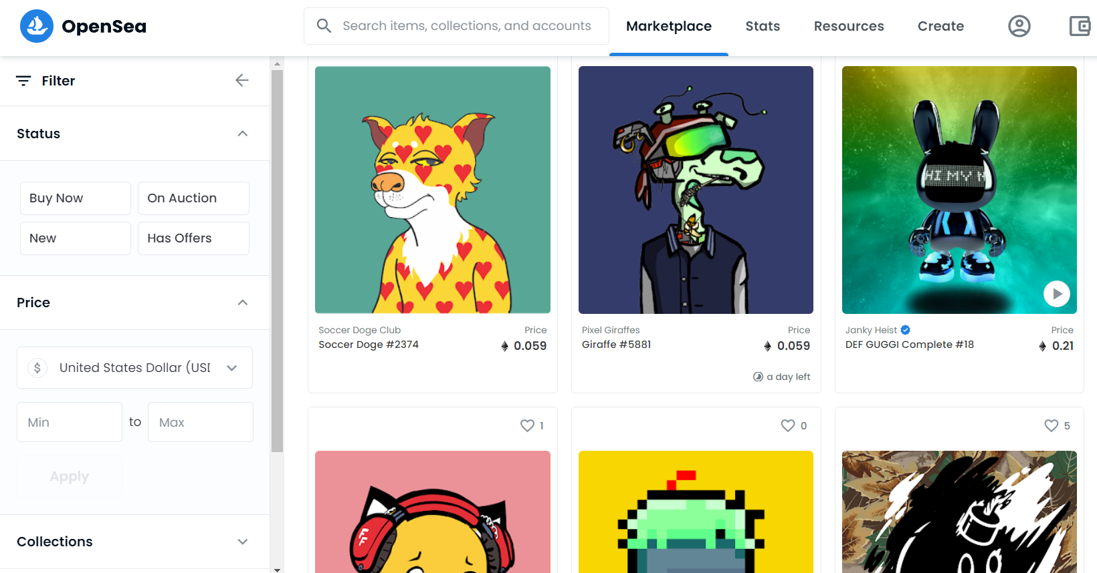
Opensea NFT Marketplace
The world’s first and largest digital marketplace for crypto collectibles and non-fungible tokens (NFTs) to buy, sell, and discover exclusive digital assets

Slide 8
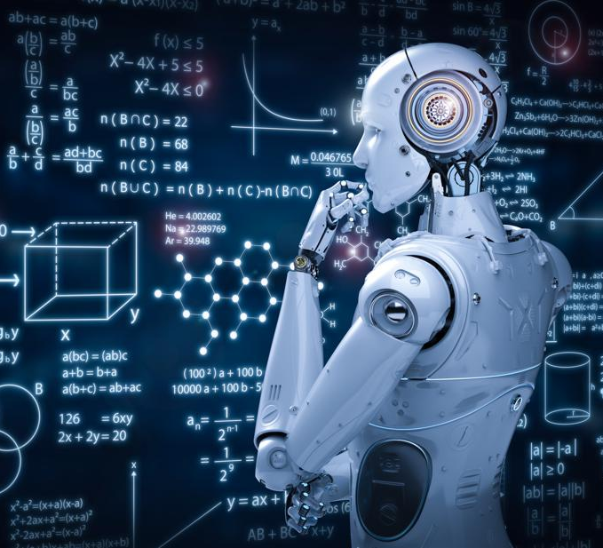
NFT Robo predictor
Use OpenSea API to pull NFT data describing each NFT by traits, attributes, sale price history, and more.
Prepare a Pandas Dataframe with key metrics.
Variables Split into Training and Testing Datasets.
Use of Machine Learning to predict Sale Price, y variable, based on Trait Count and Number of Sales, X variables.
Generate new NFTs with X variables that result in high sale price y variables.

Slide 9

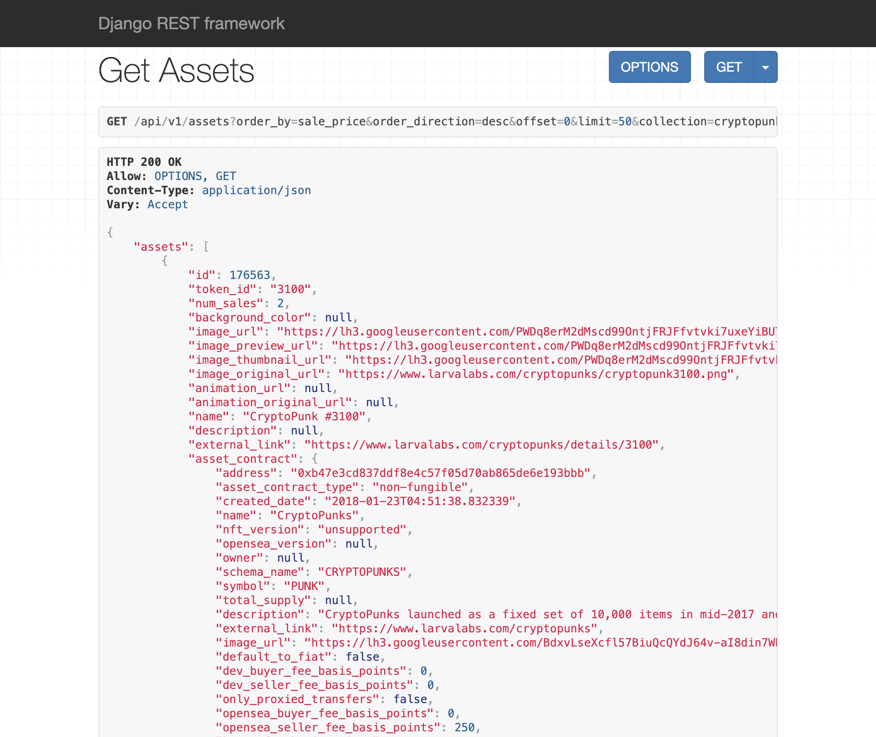
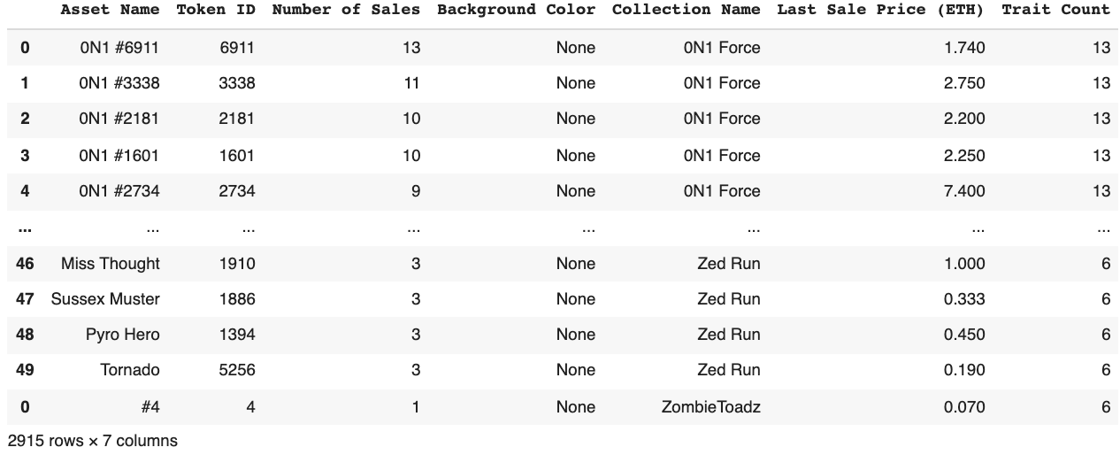
NFT DATAFRAME
Pulled data from OPENSEA api, Cleaned data, and concatenated the main dataframe.
Some Key metrics include:
asset name
token id
number of sales (all time)
Background color
Collection name
last sale price (Ethereum)
and trait count (0-19).

Slide 10
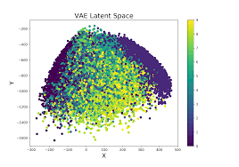
Initial Machine learning Findings
Trait length and type is significant
Price can be affected by number of previous sales
Background color can impact sales
Being tied to a certain collections can drive NFT price

Slide 11

Next Steps
Generate NFTs with X variables that likely result in high sale prices
Enable image processing to identify high-value NFTs
Natural Language Processing to identify high-value NFTs based on word choice
Store high-value NFTs in digital wallets
Trade NFTs in marketplaces like OpenSea if desired

