Slide 1
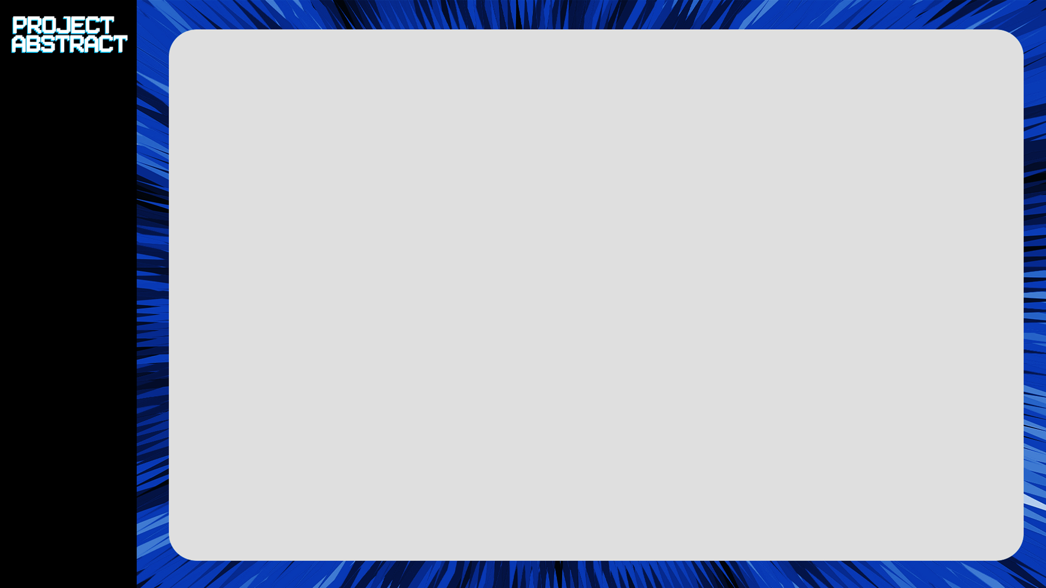
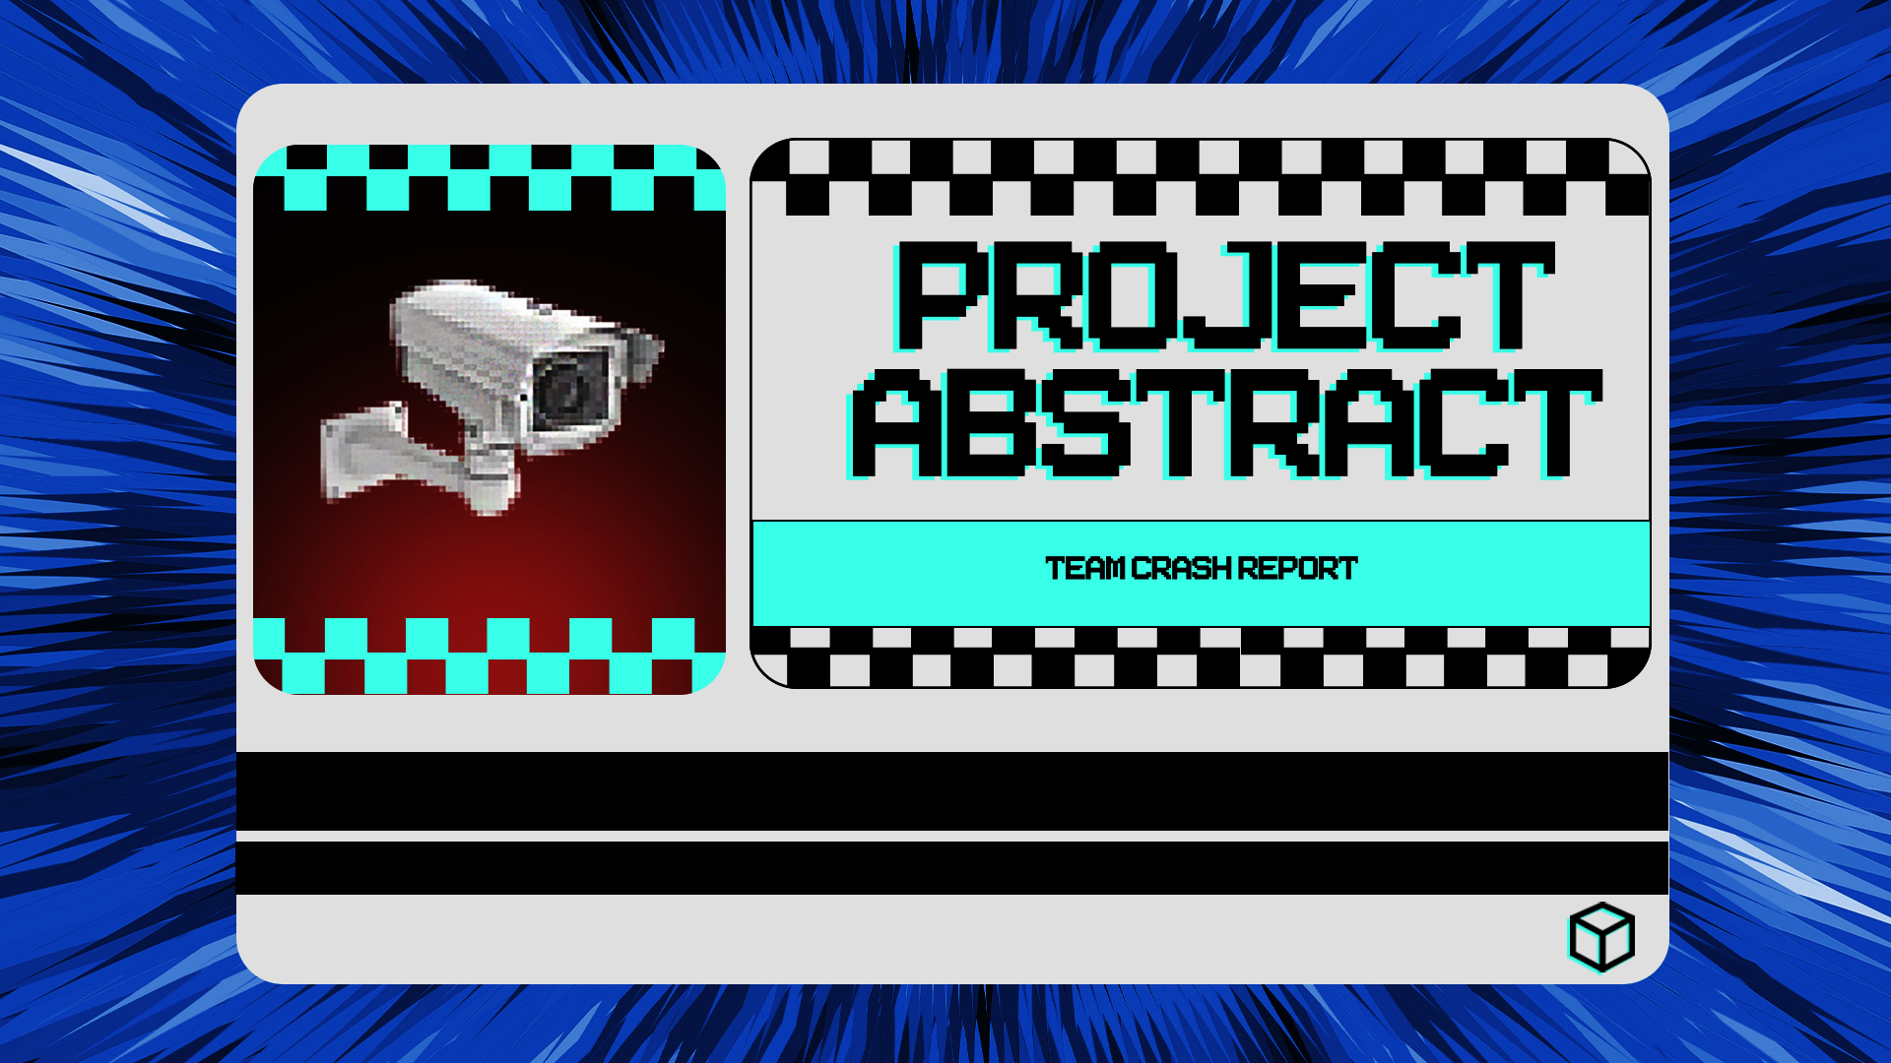

Slide 2


Project Rundown
Lucas Redmond
Programmer, BSc Video Game Development Year 2
Project Abstract is a stealth, physics-based puzzle game that requires its players to traverse the dystopian sci-fi world that presents itself. Moving blocks, avoiding turrets and overseers and fighting against the clock, you will have to survive before the chip in your brain controlling you, finally deteriorates.
Ryan Kerry
Programmer, BSc Video Game Development Year 2

Slide 3

Project Burndown
Progress has been a lot better this week, we’ve made up on lost hours from the first week and have enacted our peer-coding idea as the university systems are now equipped with the tools we need.
Our updated workflow and revised work-plan has helped contribute to this and we are feeling the benefits of the order to how we’re working.

Slide 4
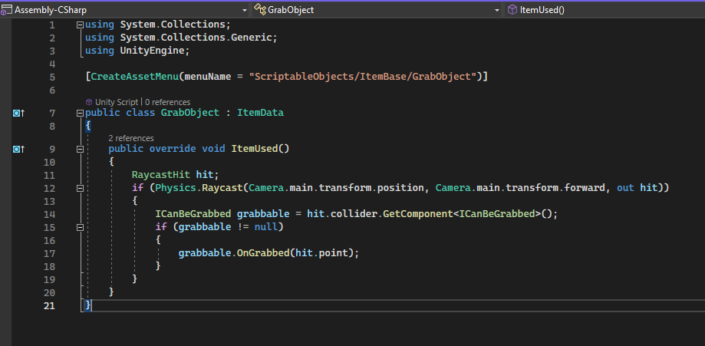
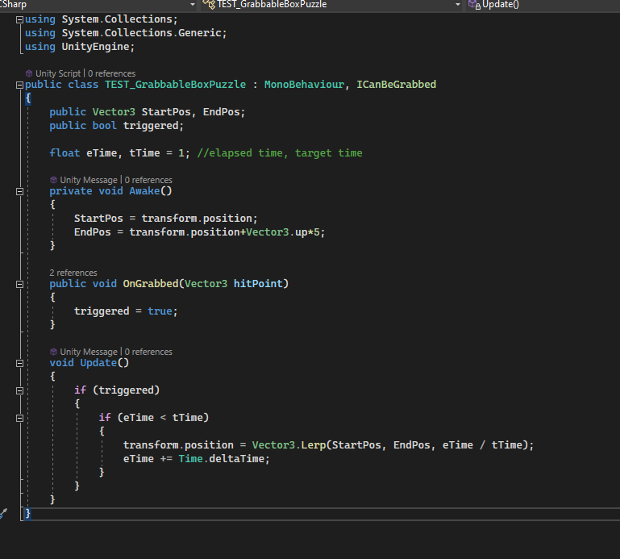
Puzzles!!!!!
We have puzzles! We have created the puzzle classes/interface and begun the movement system for the blocks.
Switch to unity real quick ;)
We also have made the executive decision to scale back to 4-5 puzzle types, to prevent an over-scope.

Slide 5
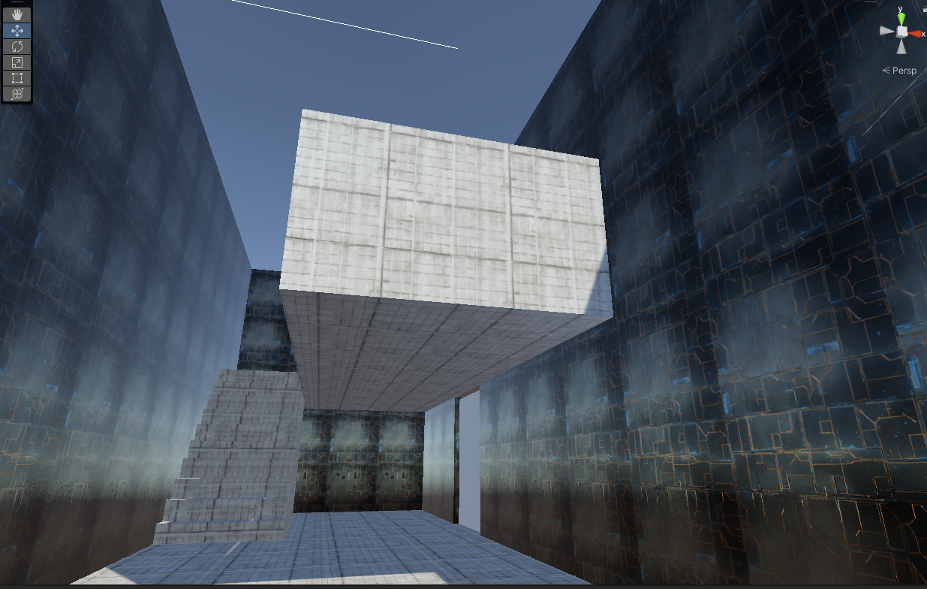
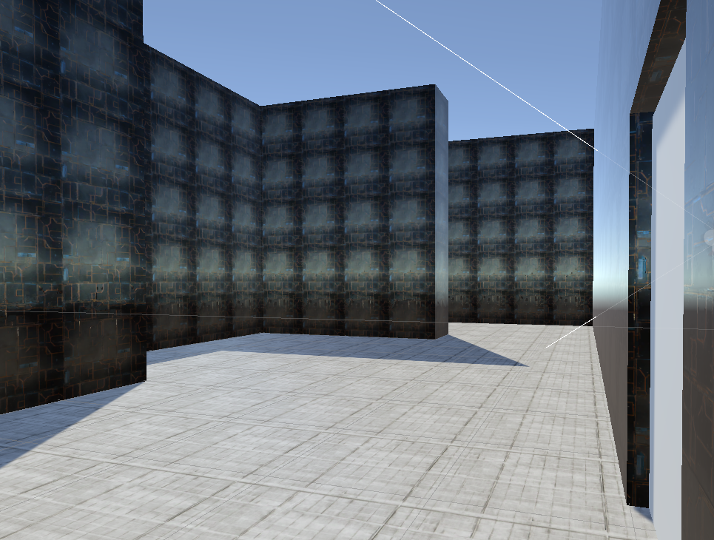
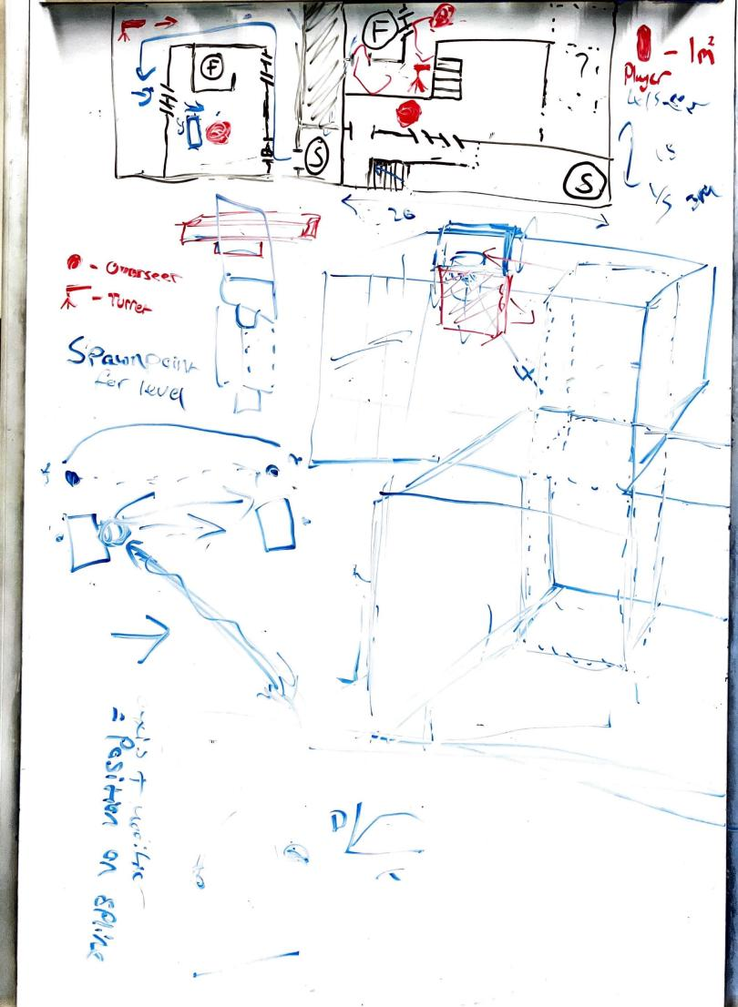
Pro-Builder
Level Design continues, we are utilising Pro-Builder to put together the level whiteouts, we have some temporary tile textures that follow the theme. This concept is based on previous white-boxes we have done were not to scale or accurate, this one was planned out and drawn up in scale with the player character to ensure perspective is consistent.
1m

Slide 6
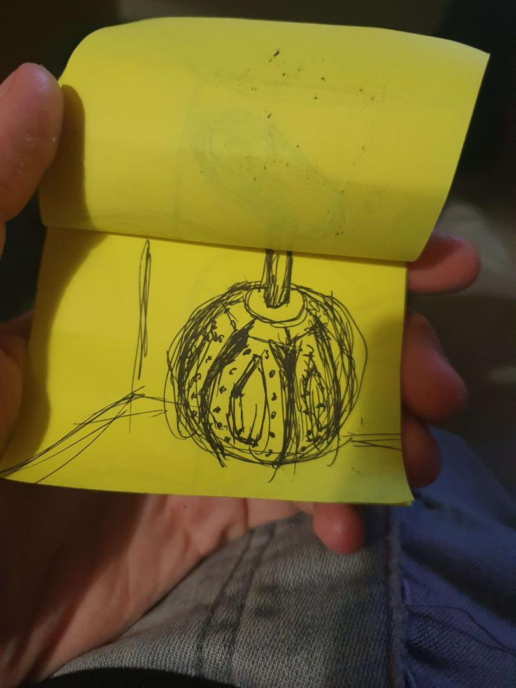
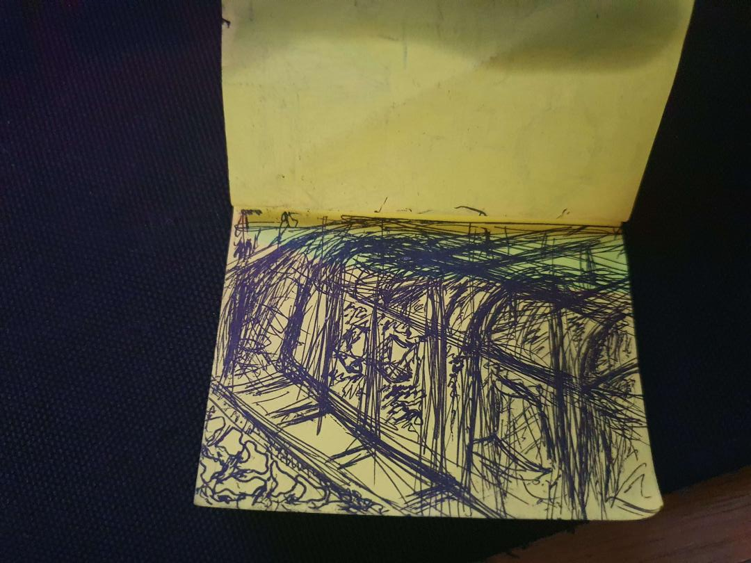
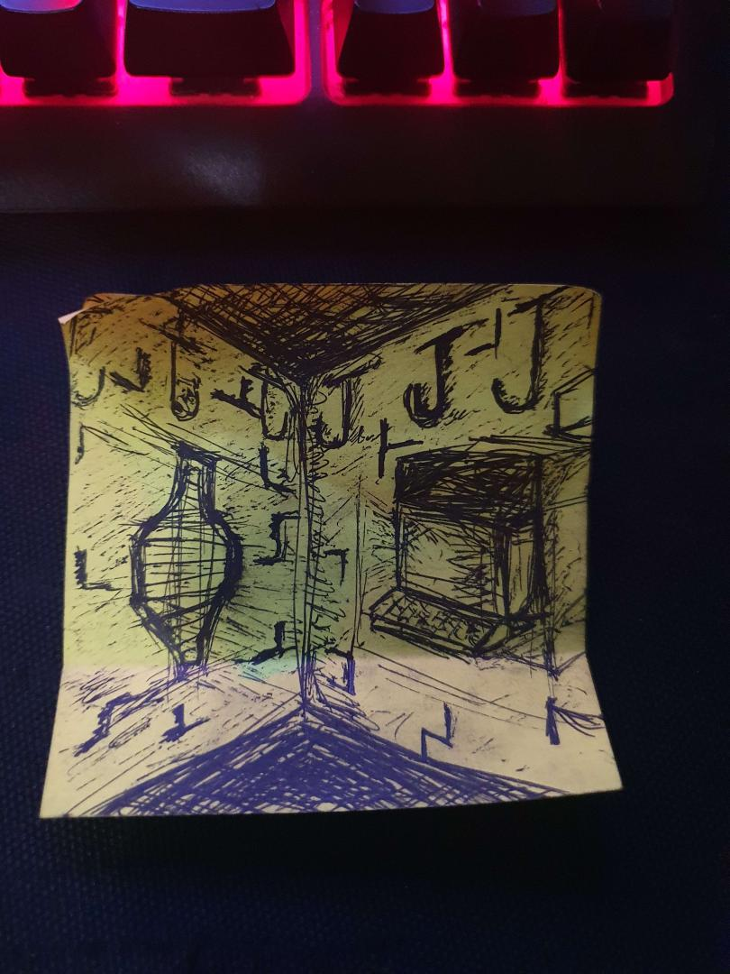
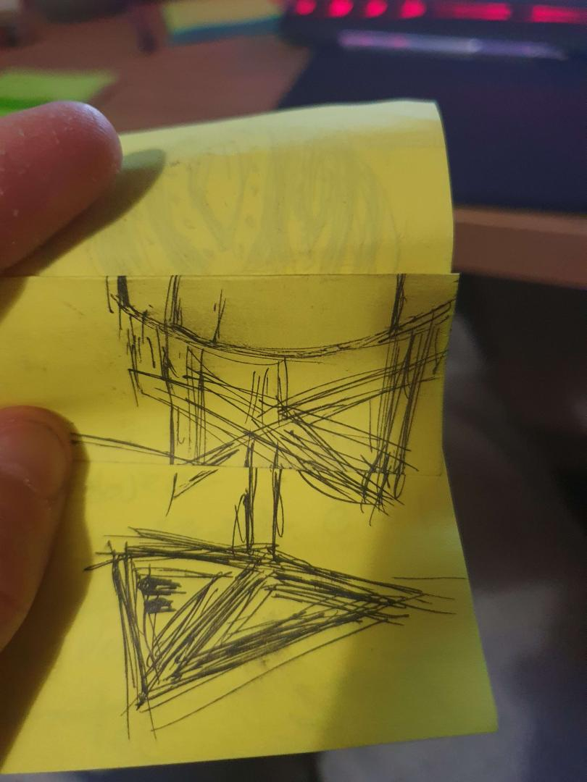

Slide 7
Thank you, have any questions?

