Slide 1
Why Buses Bunch
The Relationship Between Passenger Demand and Bus Bunching on CapMetro Rapid Route 801, July–December 2021
ELE IDSA Project 1 · GEC2B · Group 10 · Instructor: Ezron John D. Cabrera
Badal, Khalil, Lopez, Elijah David, Marquez, Rence Joseph

Slide 2
INTRODUCTION
Background
• Data: CapMetro (Austin, Texas) automatic passenger counter (APC) records, Texas Open Data Portal, free and public
• Route 801 (CapMetro Rapid): scheduled every 10 minutes on weekdays 7:00–18:00
• Bus bunching: buses lose their even spacing and arrive in pairs, then a long gap
• A late bus finds more riders, dwells longer and falls further behind, while the bus behind catches up
ELE IDSA Project 1 · GEC2B · Group 10
2

Slide 3
INTRODUCTION
Motivation and hypotheses
• Bunching makes riders wait longer and crowds some buses while others run nearly empty
• The dataset is large (229,421 stop records), real and stop-level, so bunching can be measured directly
• H1: Buses with a longer gap behind the bus ahead (headway) carry more passengers.
• H2: The more people board and alight, the longer the bus stays at the stop (dwell time).
• H3: Headways become more irregular further along the route (bunching builds up).
ELE IDSA Project 1 · GEC2B · Group 10
3

Slide 4
METHODOLOGY
Data source
• CapMetro (Austin, Texas) APC Raw July–December 2021, Texas Open Data Portal (im6q-3pc9), free to download
• APC = automatic passenger counters: door sensors count boardings and alightings; GPS and clock record each stop
• One row = one bus at one stop; raw file: 9,197,694 rows × 47 columns, all routes
• Study subset: Route 801 southbound, Jul 1 – Dec 30, 2021: 229,421 records, 29 stops, 143 buses
• Tools: Python (pandas, Matplotlib, SciPy, statsmodels)
ELE IDSA Project 1 · GEC2B · Group 10
4

Slide 5
METHODOLOGY
Parameters used to segregate the data
Parameter | Values used | Purpose
Route / direction | 801, southbound | Study route
Period | Jul 1 – Dec 30, 2021 | Full coverage
Day type | Weekday / weekend | Demand patterns
Analysis window | Weekdays 7:00–17:59 | Buses scheduled every 10 min
Hour of day | 0–23 | Demand by time
Stop order | 1 (first) to 29 (last) | Position on the route
Headway group | 0–5, 5–10, 10–15, 15–20, 20+ min | Close vs far-apart buses
ELE IDSA Project 1 · GEC2B · Group 10
5

Slide 6
METHODOLOGY
Data cleaning
Records kept only if they pass all six filtering rules:
Step | Rule | Records left
Raw | All routes | 9,197,694
1 | Route 801 | 547,616
2 | Bus serving its assigned route | 524,728
3–4 | No error flags | 480,452
5 | Valid stop ID | 455,654
6 | Southbound only | 229,421
ELE IDSA Project 1 · GEC2B · Group 10
6

Slide 7
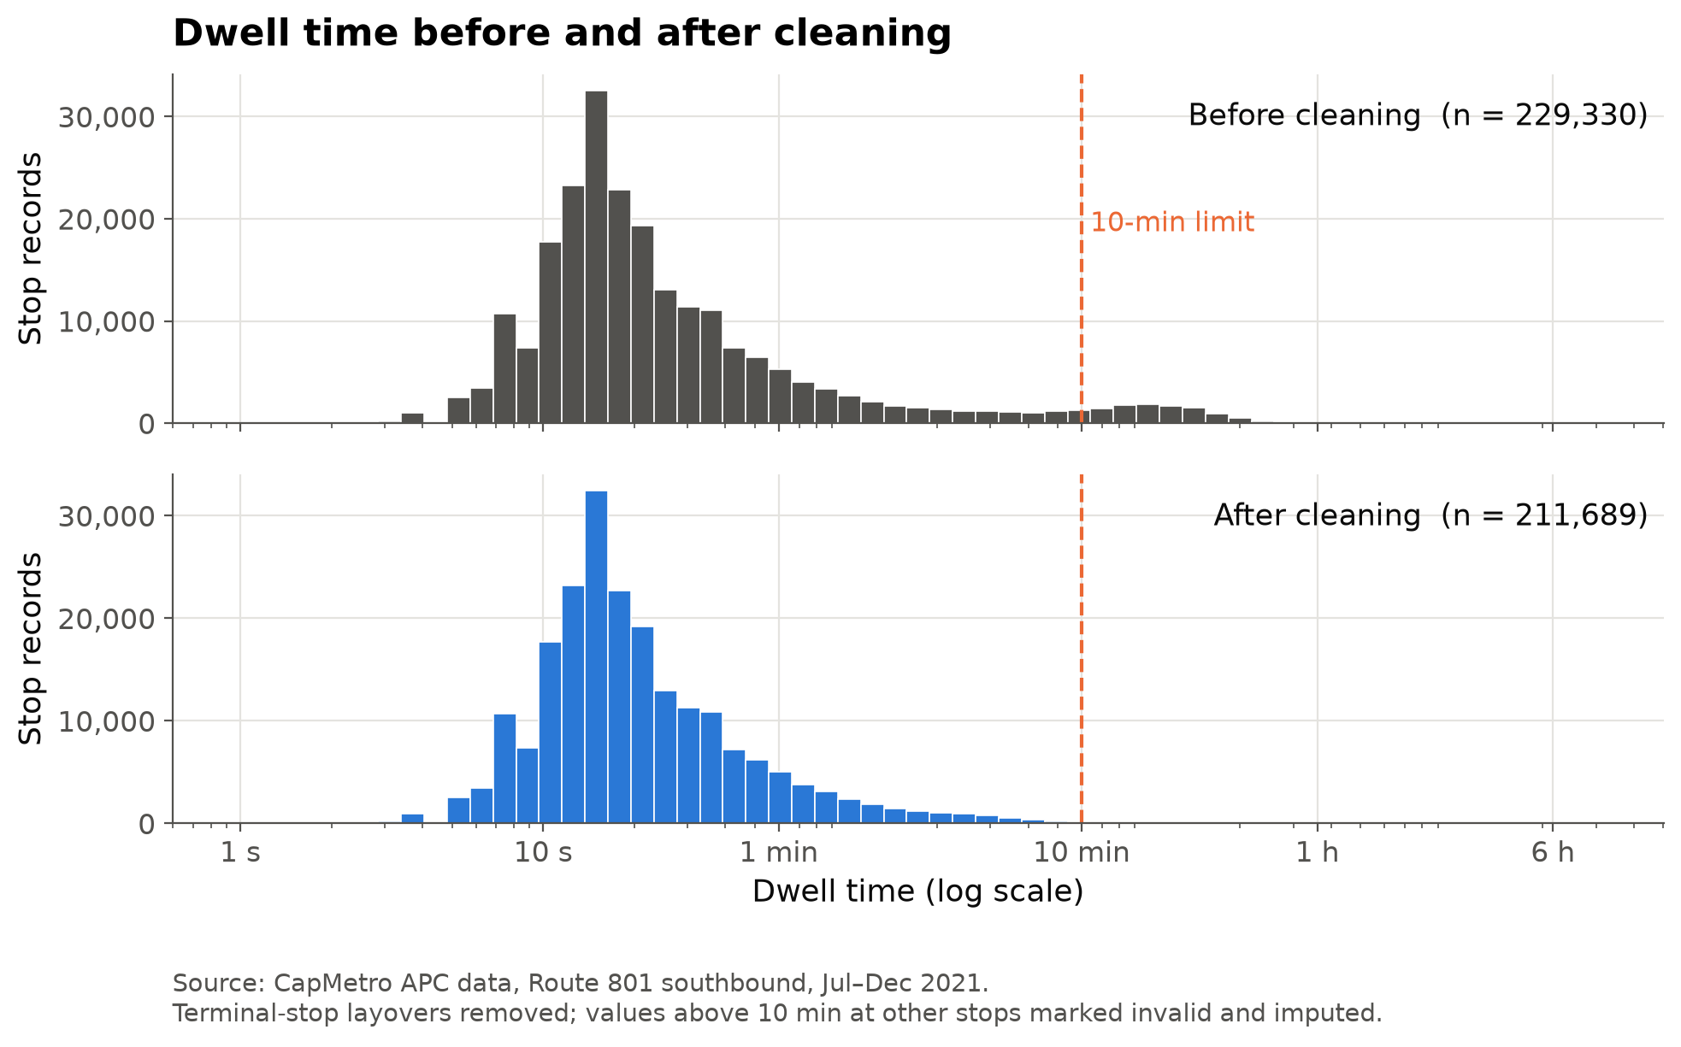
METHODOLOGY
Dwell time before and after cleaning
• End stops (1, 29): layovers, not service; 17,659 records left out of dwell and headway analysis
• Invalid values: >40 boardings at one stop, or dwell >10 min, marked missing
• Imputation: median of the same stop and hour (414 values, <0.2%)
• Headways kept only between buses scheduled 10 min apart, so unrecorded trips don't create fake gaps (51,437 valid)
Figure 1. Dwell time before and after cleaning
ELE IDSA Project 1 · GEC2B · Group 10
7

Slide 8
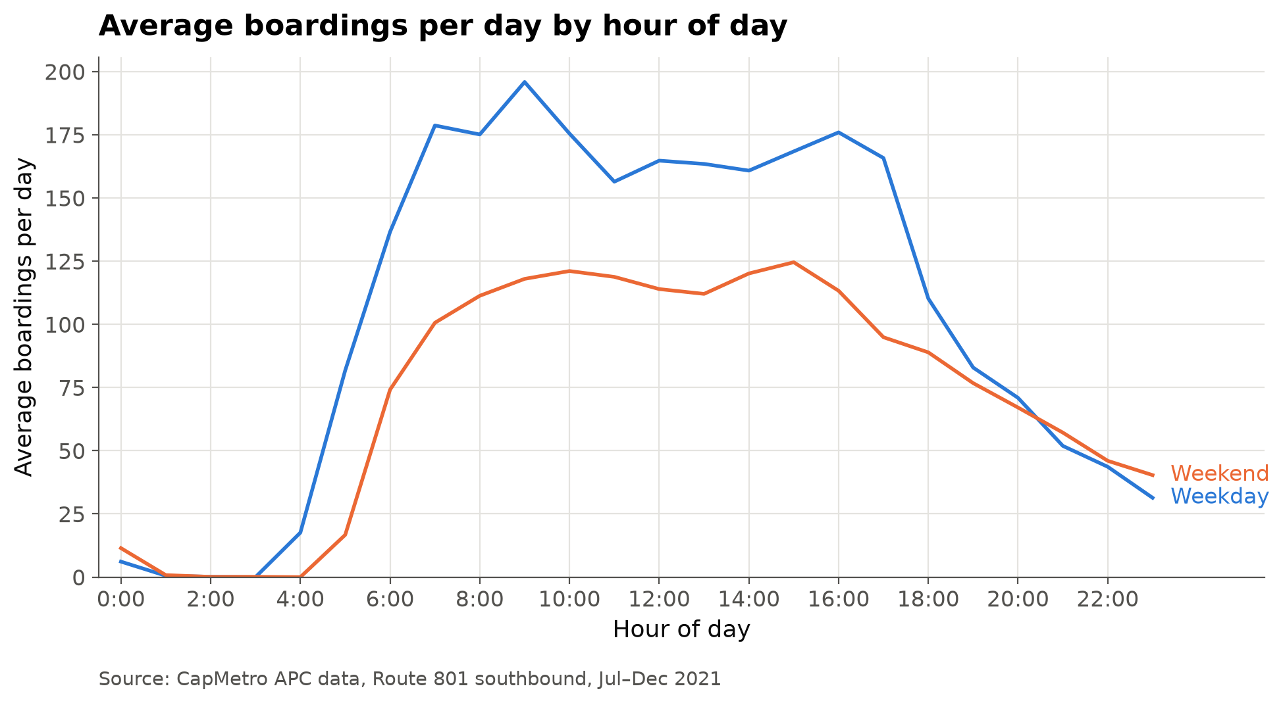
RESULTS AND DISCUSSION
Boardings by hour of day, weekdays vs weekends
• Weekday peaks: 9:00 (195.9) and 16:00 (175.9), matching the commute
• Weekend peak: 15:00 (124.6), 36% lower
• 2,514 boardings per weekday vs 1,728 per weekend day (+45%)
Figure 2. Boardings by hour of day, weekdays vs weekends
ELE IDSA Project 1 · GEC2B · Group 10
8

Slide 9
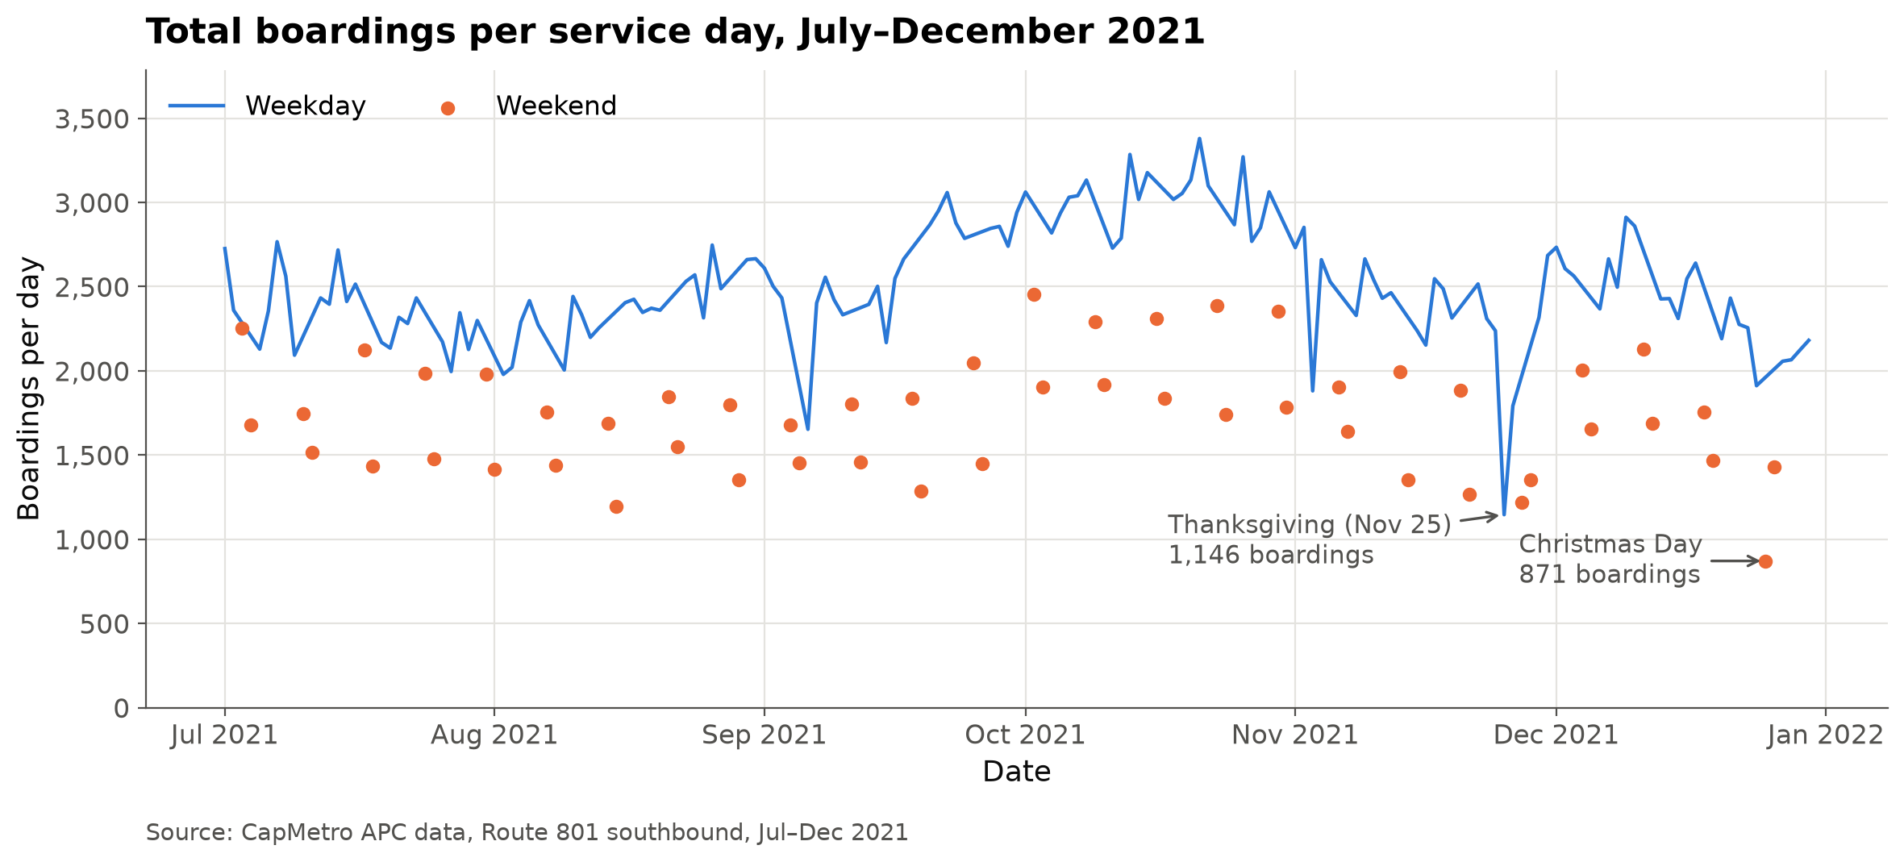
RESULTS AND DISCUSSION
Total boardings per day, July–December 2021
• Busiest month: October (3,025 per weekday)
• Thanksgiving: 1,146 boardings, less than half a normal weekday
• Christmas Day: 871, the lowest day overall
Figure 3. Total boardings per day, July–December 2021
ELE IDSA Project 1 · GEC2B · Group 10
9

Slide 10
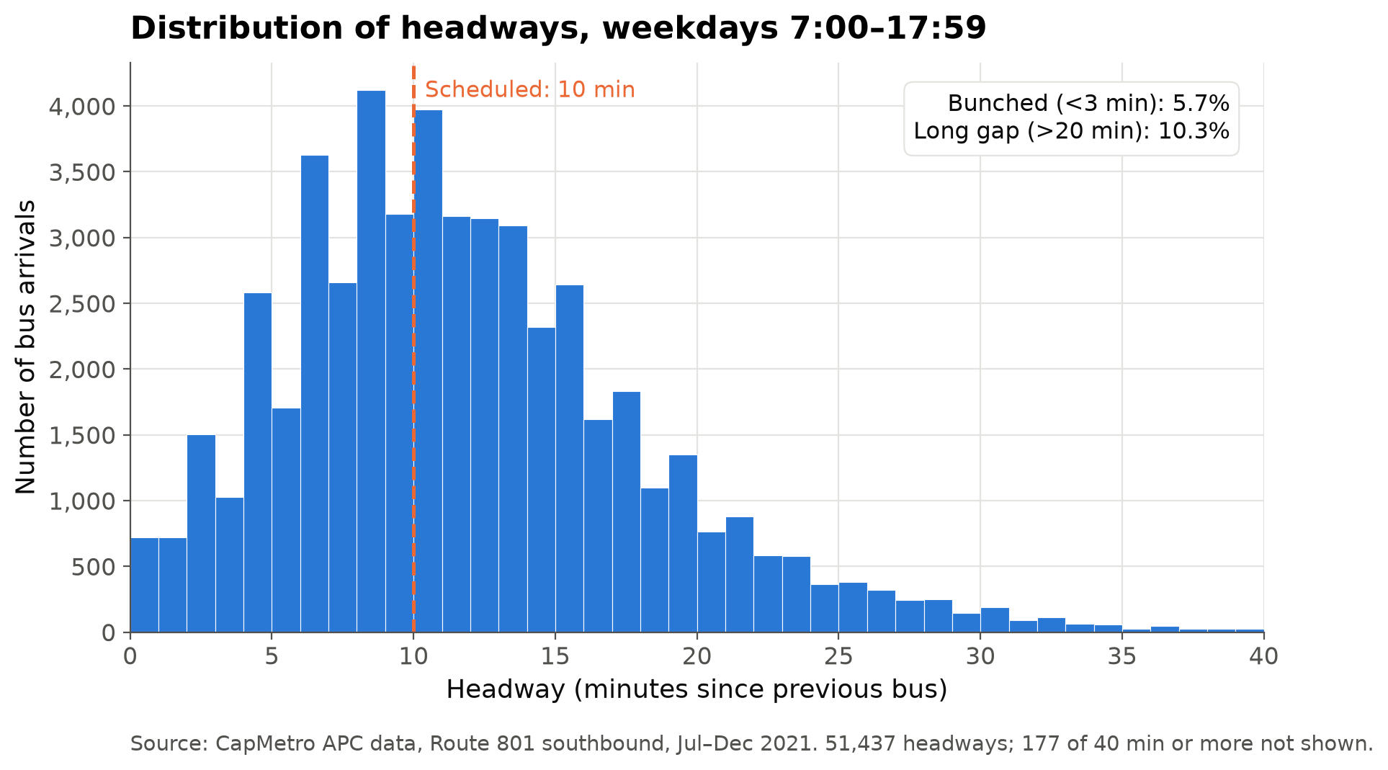
RESULTS AND DISCUSSION
Distribution of headways, weekdays 7:00–17:59
• Median headway 11.0 min (scheduled 10)
• 5.7% bunched (<3 min), 10.3% long gaps (>20 min)
• About 1 in 6 arrivals is bunched or a long gap
Figure 4. Distribution of headways, weekdays 7:00–17:59
ELE IDSA Project 1 · GEC2B · Group 10
10

Slide 11
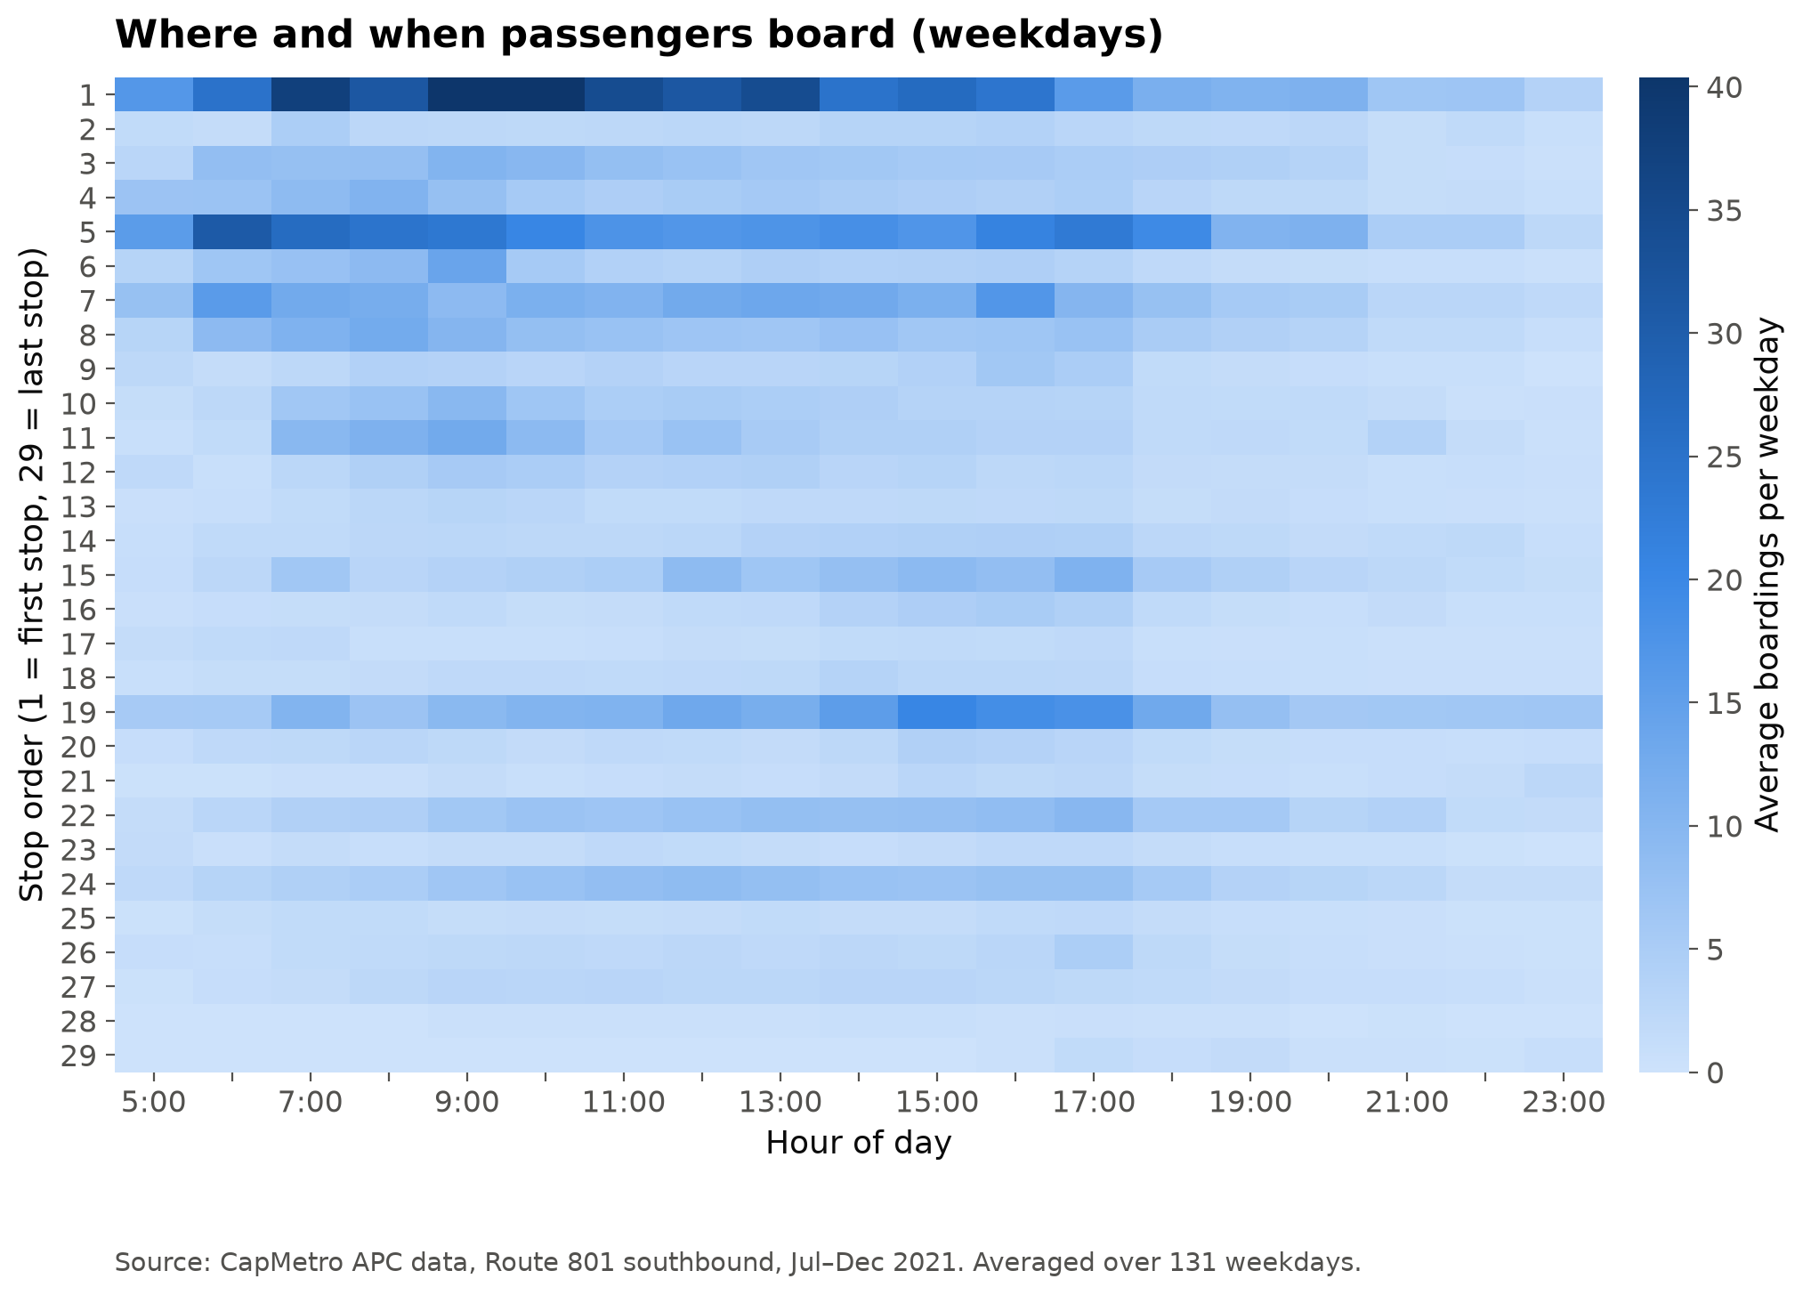
RESULTS AND DISCUSSION
Average weekday boardings by stop and hour
• Stop 1 is busiest: about 442 boardings per weekday, peaking 7:00–10:00
• Stop 5 peaks in the morning; stop 19 in the afternoon (15:00–17:00)
• Most stops after stop 20 have few boardings
• Demand is very uneven across stops and hours
Figure 5. Average weekday boardings by stop and hour
ELE IDSA Project 1 · GEC2B · Group 10
11

Slide 12
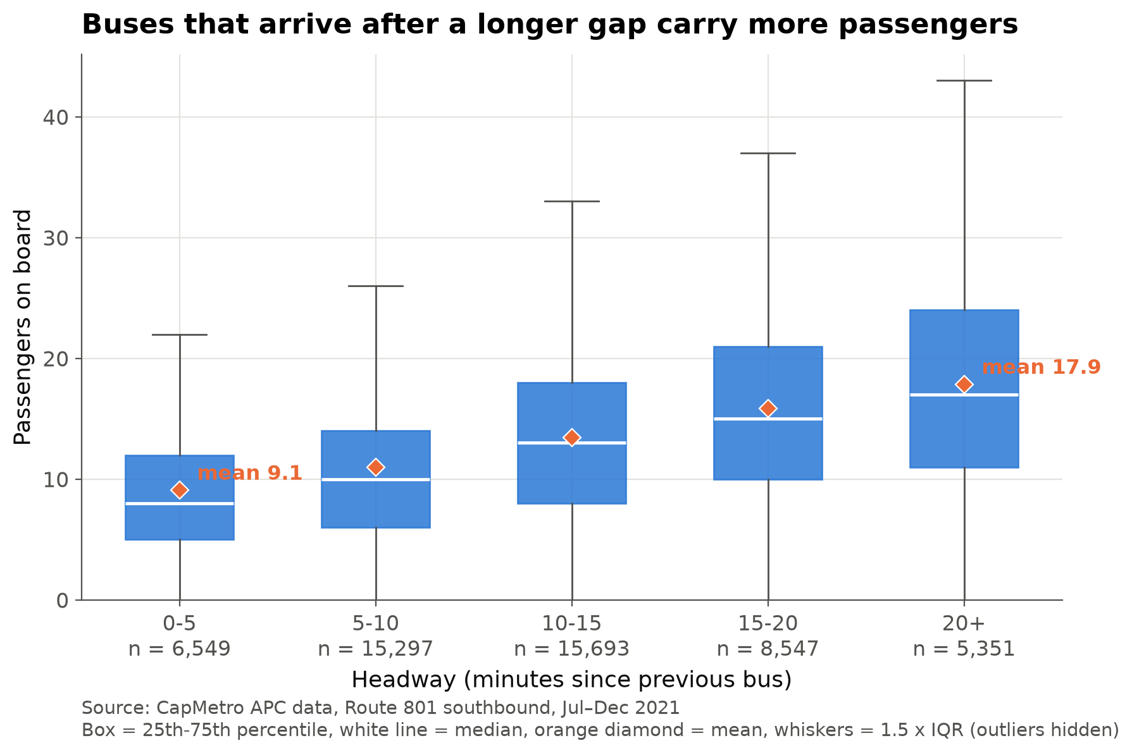
RESULTS AND DISCUSSION
H1: Passengers on board by headway group
All tests: weekdays 7:00–17:59, 126,070 stop events, 131 service days, alpha = 0.05.
• Mean load doubles as the gap grows: 9.1 passengers (0–5 min) → 11.0 → 13.4 → 15.8 → 17.9 (20+ min)
• Medians move the same way (8 → 17), so a few crowded buses are not driving it
• Spearman: rho = 0.349, p < 0.001 (n = 51,437)
• Kruskal-Wallis: H = 5,883.4, df = 4, p < 0.001 → reject H₀
Figure 6. H1: Passengers on board by headway group
ELE IDSA Project 1 · GEC2B · Group 10
12

Slide 13
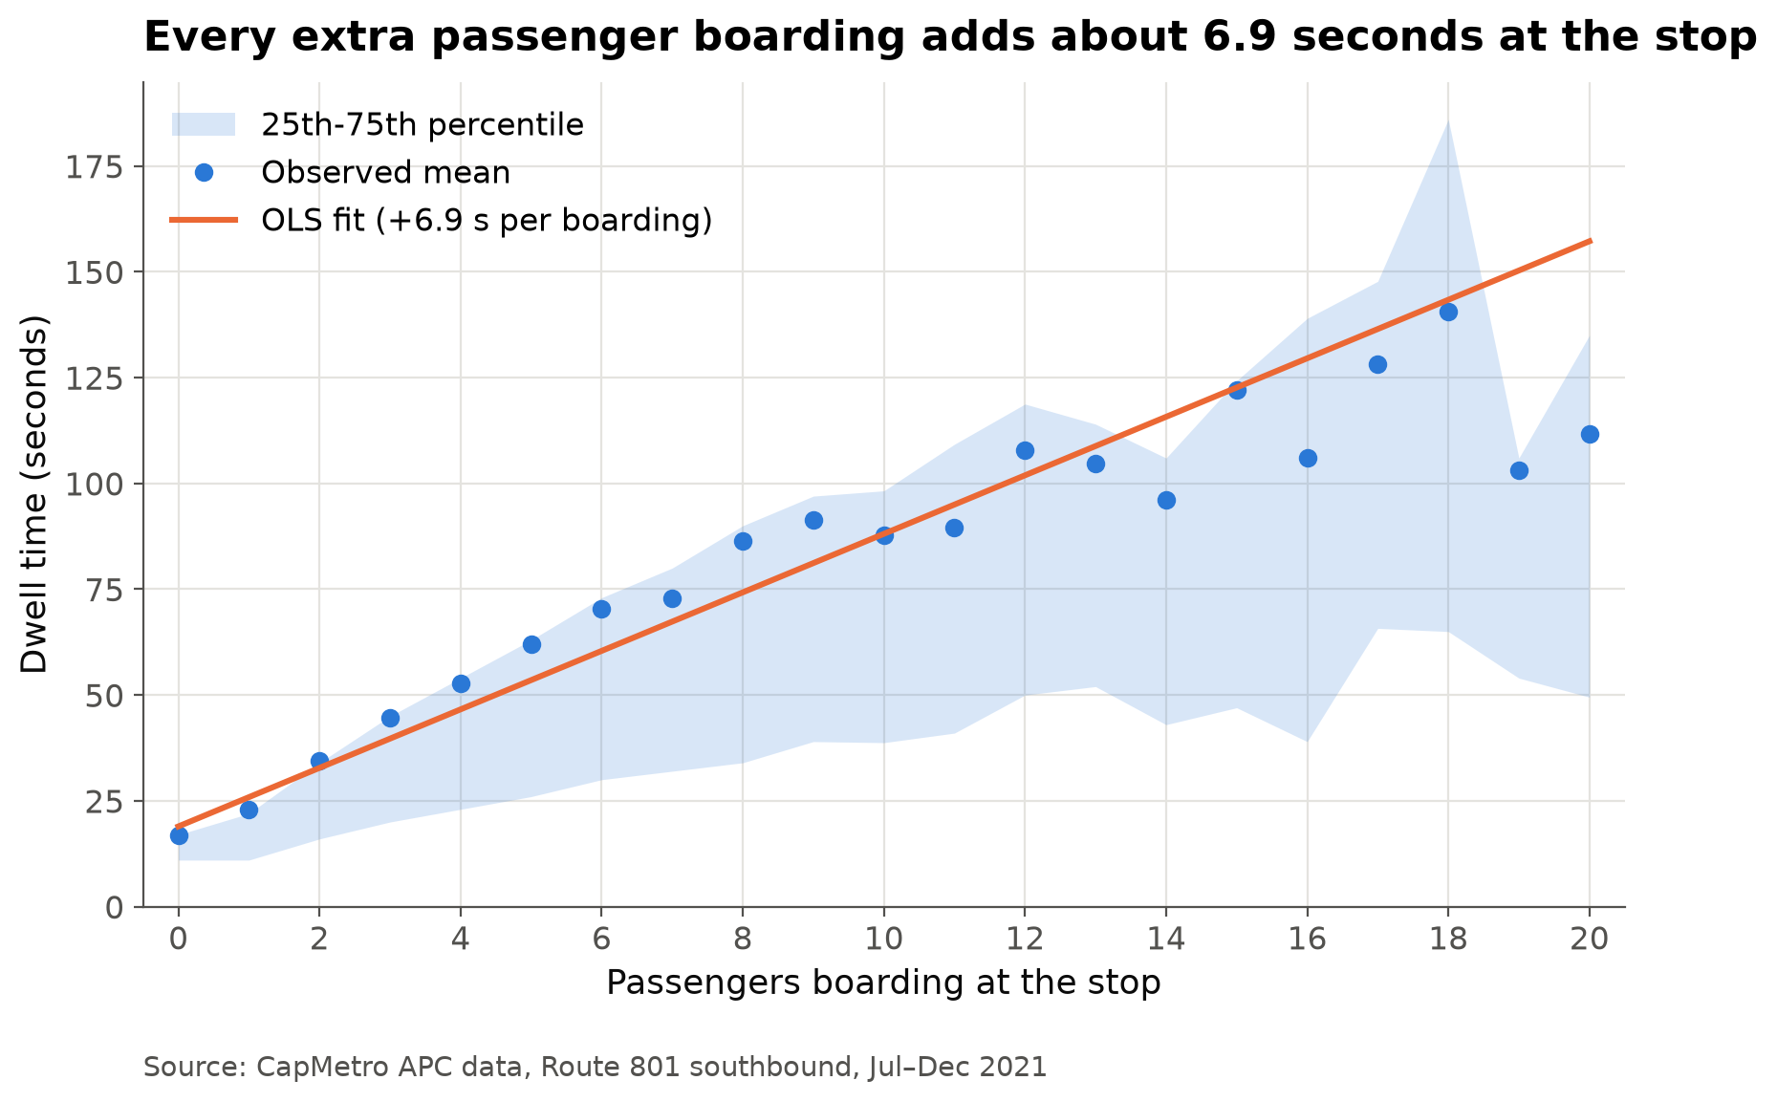
RESULTS AND DISCUSSION
H2: Dwell time vs passengers boarding
• OLS (n = 116,697): dwell = 12.79 + 6.91 × ons + 3.65 × offs seconds
• Each boarding adds ~6.9 s, each alighting ~3.7 s — boarding costs 1.9× more
• Mean dwell climbs from 16.9 s at no boardings to 111.8 s at 20 boardings
• Both p < 0.001 → reject H₀; R² = 0.180 (traffic and ramps explain the rest)
Figure 7. H2: Dwell time vs passengers boarding
ELE IDSA Project 1 · GEC2B · Group 10
13

Slide 14
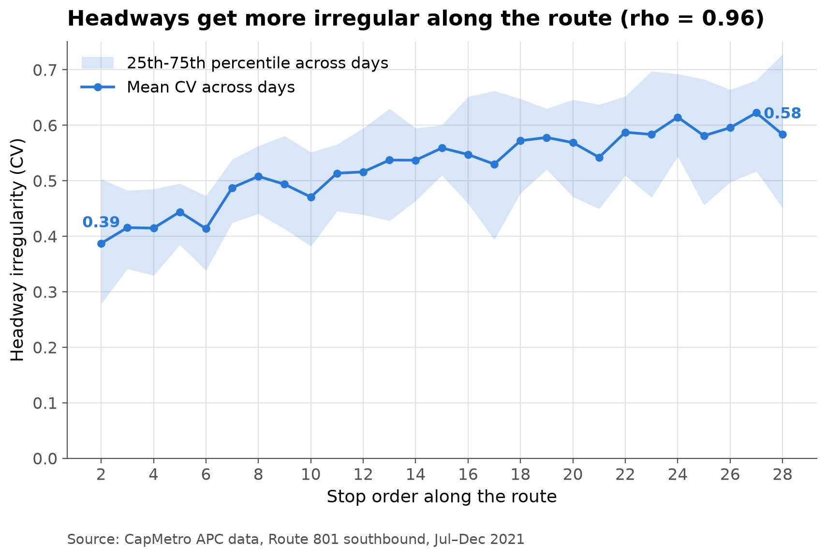
RESULTS AND DISCUSSION
H3: Headway irregularity along the route
• Irregularity = CV (std ÷ mean of headways) per day and stop; 3,382 day × stop cells
• Mean CV rises from 0.39 at stop 2 to 0.58 at stop 28 (+51%), peak 0.62 at stop 27
• Spearman: rho = 0.955, p < 0.001 (n = 27 stops) → reject H₀
• The 25th–75th band widens too: bad days get worse further down the line
Figure 8. H3: Headway irregularity along the route
ELE IDSA Project 1 · GEC2B · Group 10
14

Slide 15
RESULTS AND DISCUSSION
Discussion: one self-reinforcing cycle
• H2 → H1: more passengers → longer stops (+6.9 s each) → the bus falls behind
• H1 → H2: a bigger gap → more passengers waiting (9.1 → 17.9) → longer stops again
• → H3: each turn amplifies the last, so spacing gets more uneven downstream (CV 0.39 → 0.58)
• Meanwhile the bus behind finds empty stops and catches up — that is bunching
ELE IDSA Project 1 · GEC2B · Group 10
15

Slide 16
RESULTS AND DISCUSSION
Limitations
• Association, not proof of cause
• One route, one direction: 801 southbound, weekdays 7:00–17:59, Jul–Dec 2021
• APC counting errors: sensors miscount at crowded doors
• Missing trips: only headways between buses scheduled 10 min apart were kept (51,437)
ELE IDSA Project 1 · GEC2B · Group 10
16

Slide 17
CONCLUSION
What we studied
• Data: CapMetro APC records, Route 801 Rapid southbound, Jul 1 – Dec 30 2021 — 229,421 stop events, 29 stops, from 9.2 million raw rows
• Window: weekdays 7:00–17:59, when buses run every 10 min (126,070 events, 131 days)
• Cleaning: six filtering rules, end-stop layovers removed, impossible values imputed (<0.2%), 51,437 verified headways
• Demand is concentrated: stop 1 ~442 boardings per weekday, stop 5 ~329 (morning), stop 19 ~204 (afternoon)
• Commuter pattern: 2,514 boardings per weekday vs 1,728 per weekend day; peaks at 9:00 and 16:00; 5.7% of arrivals bunched, 10.3% long gaps
ELE IDSA Project 1 · GEC2B · Group 10
17

Slide 18
CONCLUSION
What we found
• H1 — demand follows the gap: mean load 9.1 → 17.9 passengers as headway grows (rho = 0.349, p < 0.001)
• H2 — passengers cost time: +6.9 s per boarding, +3.7 s per alighting (n = 116,697, p < 0.001)
• H3 — bunching builds up: headway irregularity CV 0.39 → 0.58 along the route (rho = 0.955, p < 0.001)
• All three hypotheses are supported at alpha = 0.05
ELE IDSA Project 1 · GEC2B · Group 10
18

Slide 19
CONCLUSION
Conclusion and recommendation
• The three results close one loop: more passengers → longer stops → bigger gap → still more passengers
• Route 801 does not hold its 10-minute spacing, and the unevenness is worst at the end of the route
• The evidence is a strong association, not proof of cause
• Recommendation: break the loop early — holding control at a mid-route timing point, and faster boarding at stops 1, 5 and 19 (all-door boarding or off-board fare payment)
ELE IDSA Project 1 · GEC2B · Group 10
19

