Slide 1

Insurance Data

Slide 2

Problem:
Which clients are more likely to lapse or default on their payments?
How do we determine who lapses?
This involves identifying the clients who are most likely to default on their payments

Slide 3
Importance of the study

Slide 4
Why reduce the lapse rate
Why should we reduce the lapse rate?
It is important to reduce the number of clients who default on their contracts as this affects their bottom-line and reduces the profits of the business
Being able to identify the characteristics of individuals who will default on their premiums allows the business to act in time to prevent the possible lapse or to prevent them from signing up individuals with the trigger personalities
Default from premiums also puts the insurer under pressure as the pooling nature of insurance means that those who do not claim pay for those who have claimed and if the business has a lot of individuals defaulting on their payments then this reduces the resource base available for the payment of premiums

Slide 5
How the data was collected
The lay of the land and what our data means
Data is collected from the clients who are registered with the business
Data for a total of 17 983 clients was collected and information on their payment patterns and their residency was collected.
The data was a summary of these clients demographic and transactional data
The count of payments missed in bands of 3-6 months , 6-12 months and greater than 12 months were collected as well
The data is collected from the database of clients and updated when needed
The data spans a duration of two years and contains a sample of chosen clients

Slide 6
What does our data look like?

Slide 7
Data Exploration
The data exploration can be found in the html file attached in the report.
The other parts of the exploration are continued in the slides below.

Slide 8
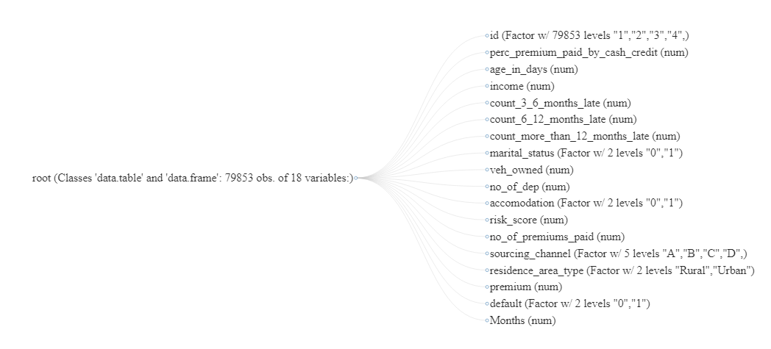

Quick Insights

Slide 9
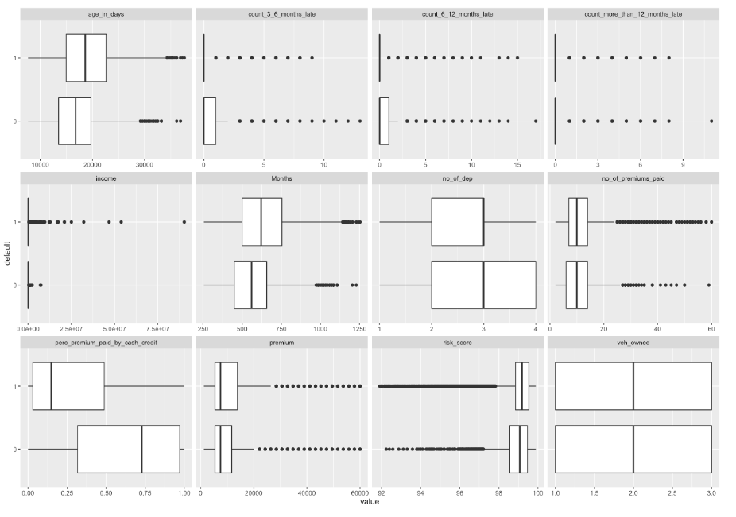
Quick Insights
The age of the individual, number of premiums paid and the percentage of premium paid by cash vary by whether someone has defaulted or not

Slide 10
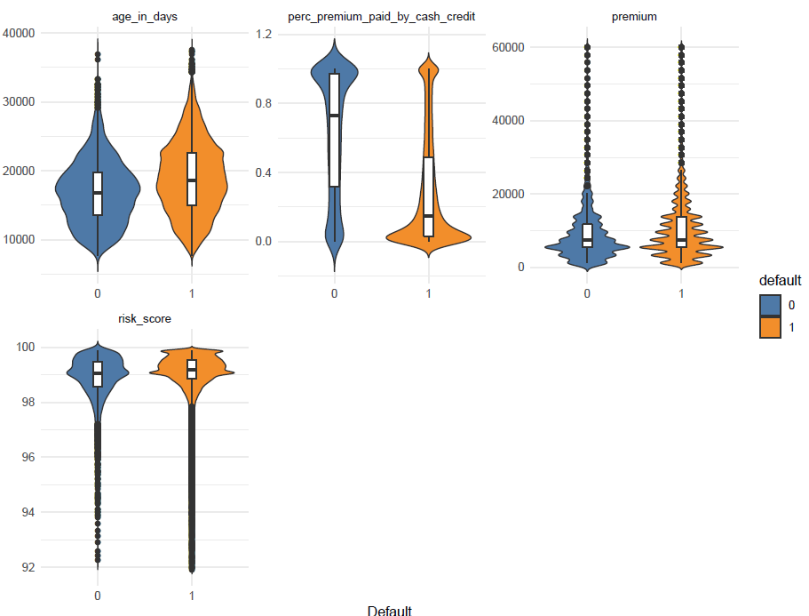
Quick Insights
Older clients are less likely to default than younger clients.
Individuals who pay a higher percentage of their premium paid by cash or credit are more likely to lapse or default on their payment compared to individuals who pay less with their cash or credit.

Slide 11
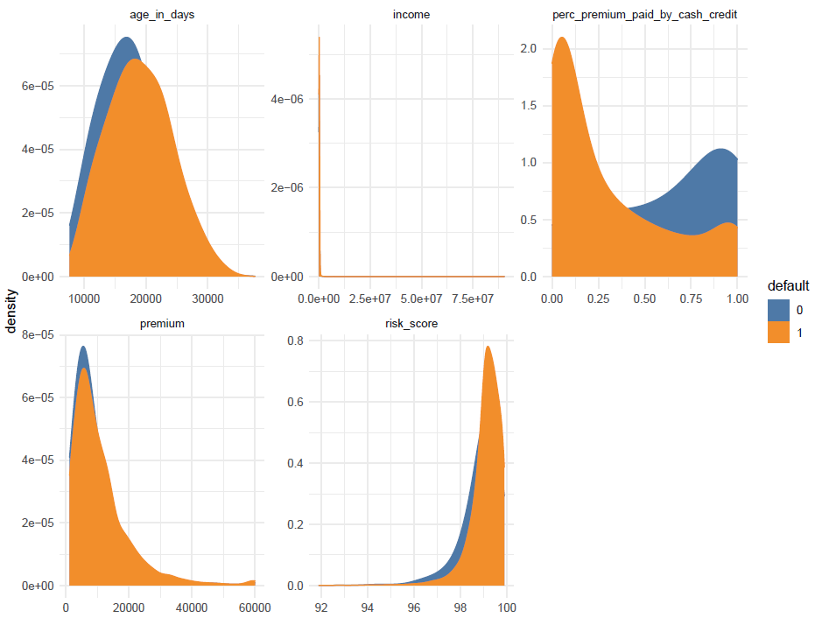
Quick Insights
Individuals with a higher age (older) are more likely to lapse
Individuals who pay a higher proportion of their premiums by cash or credit are more likely to lapse
There is no marked difference in terms of the risk score and the premium between those who have defaulted and have not

Slide 12
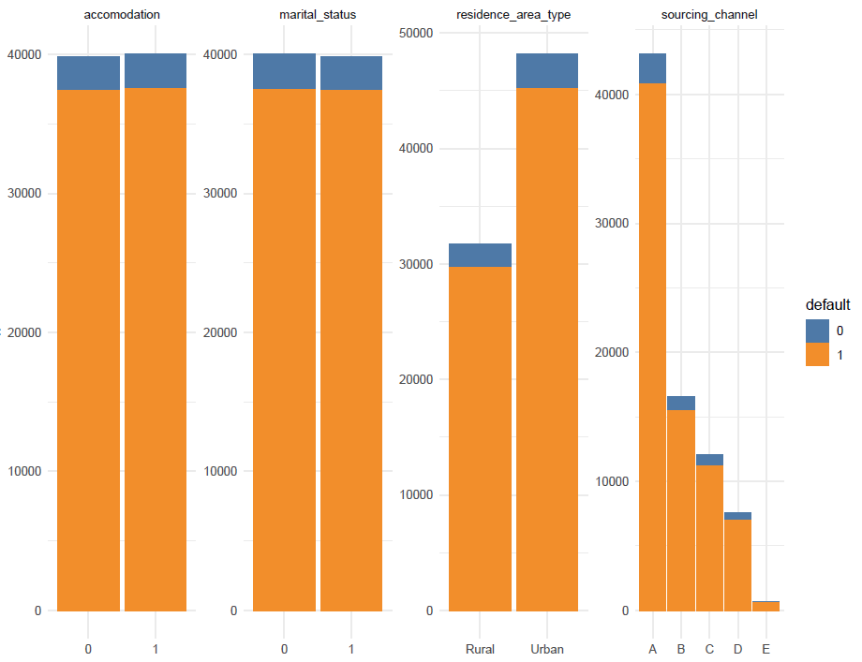
Quick Insights
Individuals with a higher age (older) are more likely to lapse
Individuals who pay a higher proportion of their premiums by cash or credit are more likely to lapse
Most of the business comes from the Urban Area
Sourcing Channel A is the most prominent channel but the channels do not affect the default

Slide 13
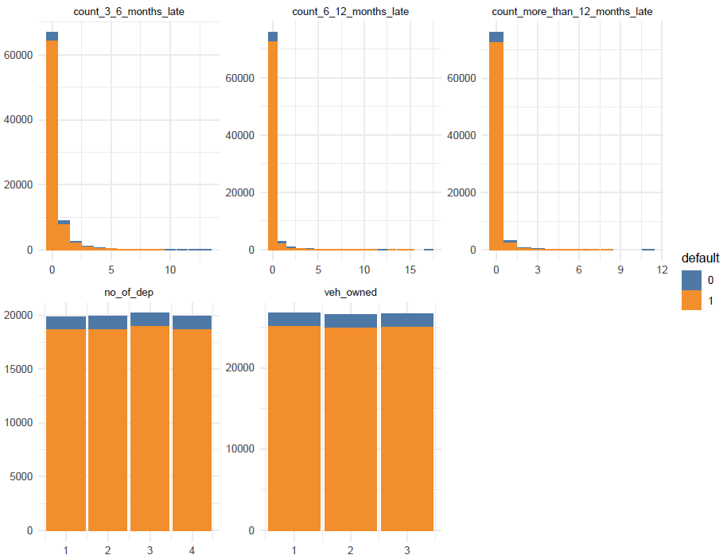
Quick Insights
These factors do not differentiate between individuals who have lapsed and not lapsed

Slide 14
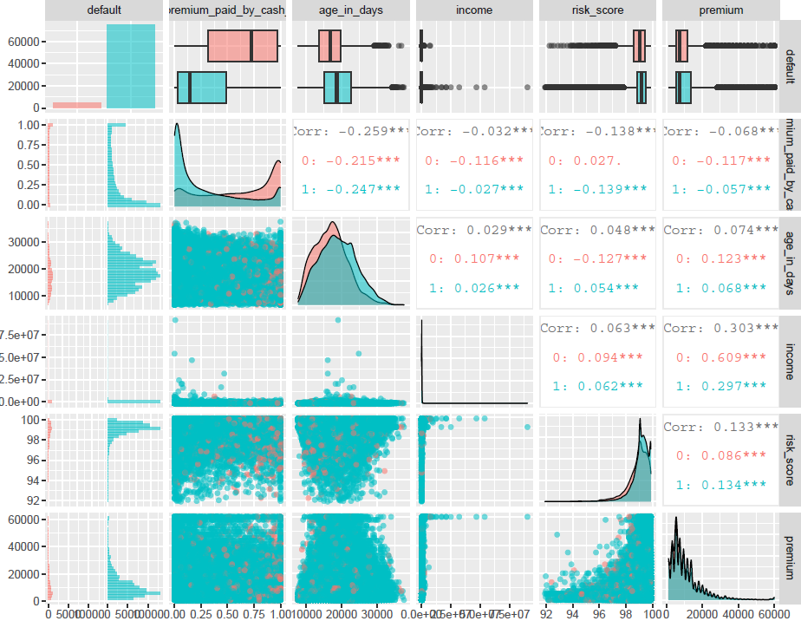
Quick Insights
There is a larger proportion of individuals who have not defaulted compared to those who have
Default payments are 6.26% of the total clients whilst the non-defaulters make up 93.74% of the population

Slide 15
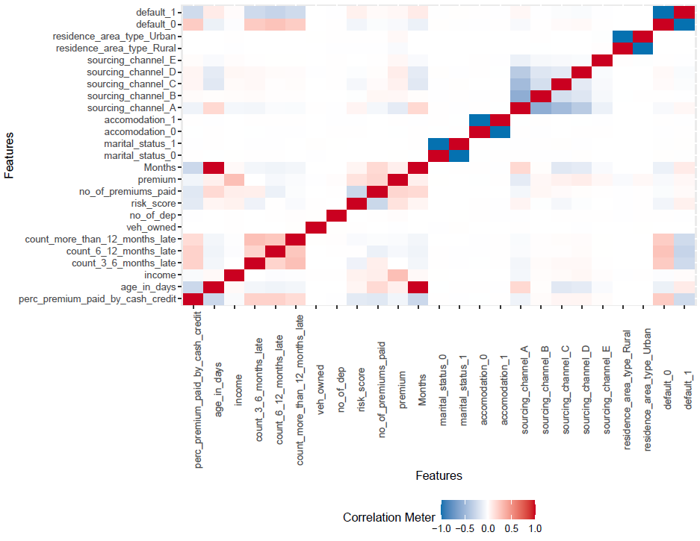
Quick Insights
None of the variables are strongly correlated with each other

Slide 16
Conclusion

Slide 17
Conclusion
Individuals with a higher age (older) are more likely to lapse
Individuals who pay a higher proportion of their premiums by cash or credit are more likely to lapse

