Slide 1
Capstone Submission 3

Slide 2
Building the model

Slide 3
Picking the right model
We build four models
GLM
(+) Efficient to train (+) highly scalable (-) requires independent predictor features
LOGISITC
(+) Easy to train (+) Efficient to train (-) Black box (-) Takes longer to train
NEURAL NETWORK
(+) Robust (-) Black box (-) Takes longer to train
GBM
(+) Robust (-) Black box (-) Takes longer to train

Slide 4


Comparing model performance of top 3 models
Quick Insights
Baseline models were built for the selected models and only the most accurate model was further developed
The GBM model performed the best compared to all the other models
Further enhancements to the modelling process include removing outliers and SMOTE variable oversampling
The GBM model performs the best compared to all the other models and has a lower likelihood of misclassifying a person as a defaulter
The AUC and AUCPR are quite high due to the class imbalance and the best model is judged on how well it does when it comes to predicting the clients who default (that’s what we are mostly concerned with)
GLM
Neural Network
GBM Model
Reference
Reference
Reference
 | Error%
Default | 99%
No_Default | 0…%
Totals | 6%
 | Error%
Default | 36%
No_Default | 13%
Totals | 25%
 | Error%
Default | 29%
No_Default | 16%
Totals | 22%
Prediction
Prediction
Prediction
AUC: 0.83
AUCPR: 0.98
AUC: 0.83
AUCPR: 0.98
AUC: 0.84
AUCPR: 0.98

Slide 5
Comparing the models

Slide 6

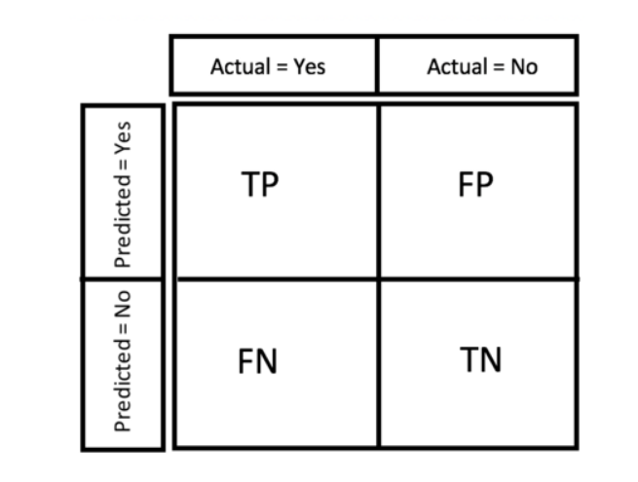
Analyzing the results
Confusion Matrix
Metric Considerations
The point of the model is to make the best prediction of the individuals who default. This means that we want to minimize the number of people we wrongly predict to default(false positives) and reduce the false negatives as well (i.e. people we predict to not have cars)
Because of the highly imbalance nature of the data and the fact that there are more people who do not default, we need to choose the model that has the lowest false positive rate.

Slide 7
Top 3 performing models

Slide 8
Comparing results
Quick Insights
GBM Model
The best model misclassifies 29% of people who default as if they do not.
A risk rating based on the model output has been produced and as such there will be 3 tiers of clients (High risk, Medium Risk and Low risk)
The clients with high risk are those most likely to default.
Action should be taken once specific conditions are met
 | Default | No Default | Error | Error%
Default | 707 | 297 | 297/1004 | 29%
No Default | 2715 | 12251 | 2715/14966 | 18%
Total | 11 | 116 | 3012/15970 | 19%
Prediction

Slide 9
Conclusion

Slide 10
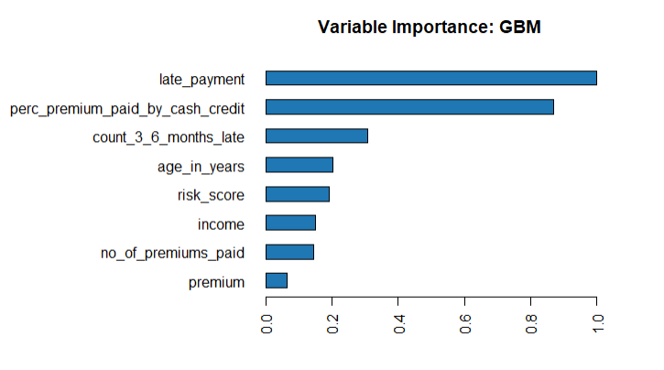
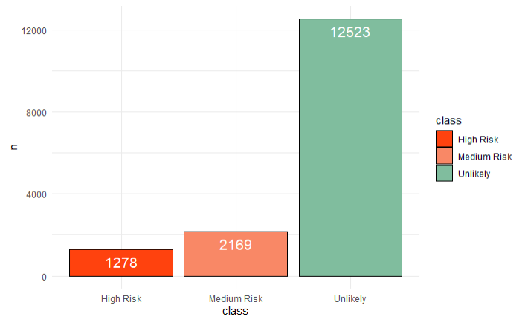
Conclusion
The most important variable in determining default is whether a person missed a premium or not
Clients have been tiered into three groups based on their probability of default
The risk bands are high, medium and low
If an individual has missed a payment and their risk level is high or medium the business should intervene
If the person has a higher percentage of their premium paid by credit or cash (higher than 50%) then the business should keep an eye on the clients
Important Variables
Quick Insights
To lower losses due to defaulting, the business should:
Avoid individuals who pay most of their premiums by cash credit
Further clustering of the clients according to their demographics will be pursued
Numbers are based on the test set

