Slide 1
CRIMSON GOAT EVENT WEBSITE FOR venues and users
Douglas Sigmon
Christina Pitch
Aaron Cottrel
Ryan Miskoviak

Slide 2
USER roles
Vendor
User
Create, Update, or Delete Events when logged into a vendor profile.
Add favorite events to your profile.
Events display relevant information for a user to keep track of in case a vendor applies updates.
search events while logged in, or just as a site visitor
Administrator
Visitor
Deactivate Users
Delete Venues
Delete Events
Search Events

Slide 3
Main responsibilities (Douglas Sigmon)
Event Entity and mappings
EventDao/EventDAOImpl
Event Controller
Any Event JSP’s(create event, delete event, etc)
Database Administrator

Slide 4
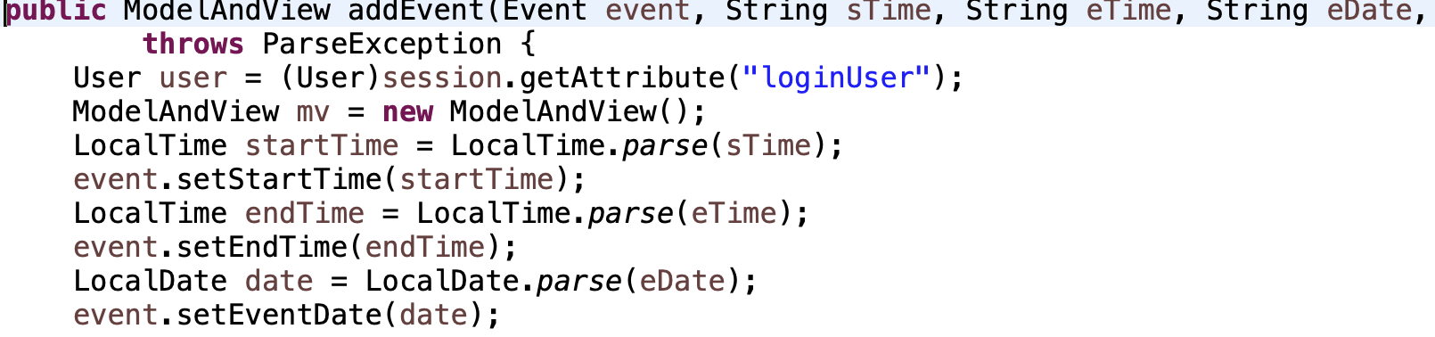
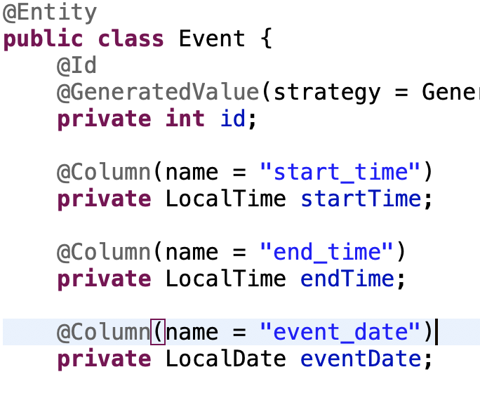
Lessons Learned And key take away’s
Team work makes the dream work
When parsing a value make sure to not name them the same name in the JSP/controllerMethod as they are named in the entity you created

Slide 5
Main responsibilities (christina pitch)

Slide 6
Main responsibilities (aaron cottrel)

Slide 7
Main responsibilities (ryan Miskoviak)

Slide 8
Quick run of the website

Slide 9
Things to do / Functionality to add

