Slide 1
Business Intelligence
View
(decoupling only one-on-one with underlying table)
View – Virtual Mart
(decoupling with business logic)
The decoupling views are effectively the Dimensional Model (or other Mart types) as exposed to BI
dbo schema
Table
(physical storage for performance reason)
Fully virtual Data Marts are recommended, as most BI solutions are either MOLAP or in-memory.
ben schema
View - Logic
(join and business logic)
When objects with the same name appear in both schema, SQL Server defaults to dbo, so it makes sense to have the exposed views available in the dbo schema.
Presentation Layer
Integration Layer

Slide 2
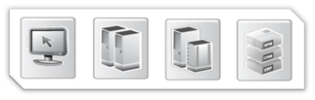
Integration Layer
Staging Layer
Regular feeds.
Re-initialisation processing, and/or regular feeds.
Core requirements:
Log record source information
Log process information
Set load date/time stamp
Force row order
<Table or file>
Archiving
<Table or file>
Staging Area
Persistent Staging Area
Transient: truncate & load
Load (delta of) source data
Streamline data types
Derive event date/time
Persistent: archive of all received data
Load using SCD2 insert-only mechanism
Delta loading
Delta loading

Slide 3
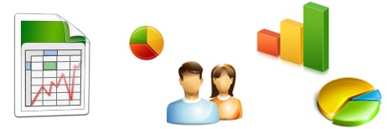
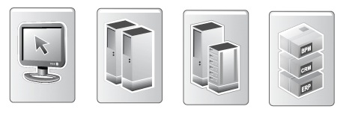
Staging Layer
Business Intelligence
Exception Handling
Presentation Layer
Integration Meta Data
Integration Layer / Data Vault
Staging Layer
Source Systems

Slide 4
Integration Metadata
Information Delivery
Exception Handling
Presentation Layer
Integration Metadata
Integration Layer / Data Vault
Staging Layer
Source Systems

Slide 5
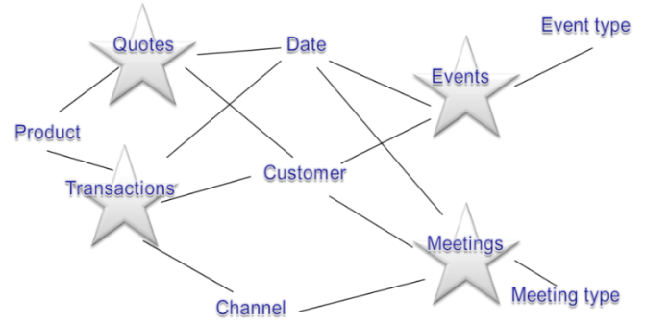
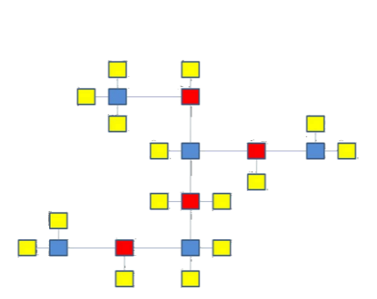
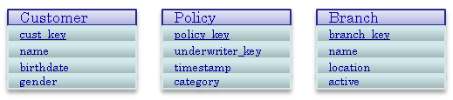
Reference Architecture
Business Intelligence
Exception Handling
Presentation Layer
Integration Meta Data
Integration Layer / Data Vault
Data Warehouse
Examples of each Layer
Staging Layer
Source Systems

Slide 6
Reference Architecture
Exception Handling
Integration Meta Data
Presentation Area
Prepare data / information for consumption
Apply subject area specific business logic (Raw / Information Marts)
Define structure and hierarchy
Aggregation and transformation
Helper Area (optional)
Semi-aggregates
Helper tables
Performance improvements
Presentation Layer
Integration Area
Key distribution
History management
Data Integration to core DWH model
Raw data, but organised
Interpretation Area (optional)
Application of enterprise-wide (generic) business logic
Integration Layer
Staging Area
Prepare data / information for consumption
Apply subject area specific business logic (Raw / Information Marts)
Define structure and hierarchy
Aggregation and transformation
History Area (optional)
Archive source data / transactions
Insert only (effective-dated)
Staging Layer

Slide 7
Presentation Layer
Integration Layer
Recycling
Integration Area
(Mandatory)
Interpretation Area
(Optional)
Log record source information
Define error bitmaps
Generation and assignment of persistent surrogate keys (SK)
Store history
Load to hybrid model
Raw data
Apply enterprise wide business logic
Cleaned data
Staging Layer

Slide 8



Presentation Layer
Recycling
Reporting Structure Area
(Mandatory)
Helper Area
(Optional)
Apply Data Mart / Subject Area specific business logic
Define structures and hierarchies
Calculate facts and metrics
Load to any model, usually a start or snowflake
Aggregations
Semi – aggregates for usage by multiple Data Marts.
Performance
Note: data can be loaded from both the Integration and Interpretation Area.
Integration Layer

Slide 9
In this hypothetical example the Customer Code is the business key, and is therefore mapped to the Hub Customer Integration Layer table.
The Address information also needs to be mapped to Hub Customer, but the business key is not present in the Address table.
In this case, a view that joins both tables together will make it easier for upstream integration
View Address
ID
Address Type
Customer Code
Address
Post_Code
CIty
Customer table
ID
Customer Code
Name
Address table
ID
Address Type
Address
Post_Code
CIty
Historical Staging Area
The joined table must be joined from the Historical Staging Area, against the most recent record for the key or a point-in-time equivalent. This is because duplication in data must be prevented, and time-variant attribute may be included in the join.
It is not possible to join tables in the Staging Area as the data delta and loading frequency may differ leading to empty joins. Even if a full data delta is present the resulting dependency in loading makes this a bad option.
Adopting views in the Staging Layer means that the outlying table (the Historical Staging Area) needs to be updated before it is joined to the driving Staging Area table. This will make sure all data is present prior to the join, meaning no data will be left out.
Staging Area

Slide 10
Oracle is queried via the Attunity Oracle connector
SSIS directly accesses SQL Server
Current state source selection
Most recent state History selection
Source table
(MIDAS – Oracle)
History Area table
(C-Customer – SQL Server)
SSIS
Hash keys for the full record are created by Oracle
SSIS compares both datasets using a Merge Join operation and interprets the join results (Insert, Update or Delete)
Data delta is inserted in the Staging Area
Staging Area table
(C-Customer – SQL Server)

