Slide 1
“City Slave Girls” of Chicago
The Fundamental and Forgotten Exposé of Nell Nelson

Slide 2
Thesis:
The purpose of this capstone is to restore Nell Nelson as an influential female journalist and pioneer of investigative reporting in the late nineteenth century.
The illumination of Nelson’s “City Slave Girls” series as a fundamental exposé of the cruel and unsanitary working conditions of industrialization highlight Nelson’s ability to overcome the gender restraints she faced as a middle-class woman exposing the most prominent men and successful corporations of Chicago.

Slide 3
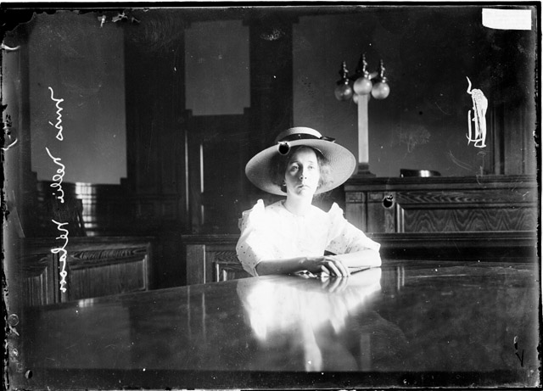
Nell Nelson
Helen Cusack Carvalho
middle-class woman of the late 1800s
undercover investigative reporter
employed by Chicago Daily Times and then New York’s, The World
no complete biography
“City Slave Girls” Exposé
front-page series of The Chicago Daily Times
daily coverage (twenty-one part series)
first report published on July 30th, 1888
full-page ad preceded series
in-depth reports of conditions, wages, and working girls (complete exposure)
published response letters to the editor and interviews with public officials
A Photonegative of “Miss Nellie Nelson” taken by an unnamed Chicago Daily News photographer in 1910. This image is courtesy of the online database of the Chicago History Museum.
Microform duplicate of the front page from The Chicago Daily Times on July 29th, 1888.
Notes:
Image 1: Preferred Source Citation: DN-0008610, Chicago Daily News negatives collection, Chicago History Museum.
Full Page Advertisement published on July 29th, 1888
Image 2: Source Citation: Eric W. Liguori. “Nell Nelson and The Chicago Times ‘City Slave Girls’ Series: Beginning a National Crusade for Labor Reform in the late 1800s.” Journal of Management History, 18, no. 1 (2012):62. doi: 10.1108/17511341211188655

Slide 4

Historiography
*Women in Journalism and Investigative Reporting of the Late Nineteenth Century*
*Industrialization, Labor Reform, and Working Women*
Alice Fahs
Out on Assignment: Newspaper Women and the Making of Modern Public Space
Jean Marie Lutes
Front Page Girls: Women Journalists in America Culture and Fiction, 1880-1930
Maurine H. Beasley and Sheila J. Gibbons
Taking Their Place: A Documentary History of Women and Journalism
David Paul Nord
Communities of Journalism: A History of American Newspapers and Their Readers
Eric W. Liguori
“Nell Nelson and The Chicago Times ‘City Slave Girls’ Series: Beginning a National Crusade for Labor Reform in the late 1800s.”
Lara Vapnek
Breadwinners: Working Women and Economic Independence, 1865-1920
Ruth Milkman
Women, Work & Protest: A Century of U.S. Women’s Labor History
Meredith Tax
The Rising of the Women

Slide 5
Evidence:
Nell Nelson. “City Slave Girls.” Chicago Daily Times (Chicago, IL), July 30-August19, 1888 and August 26-27, 1888. Accessed via the NYU digital library.
Nell Nelson [pseud.]. The White Slave Girls of Chicago. (Chicago, IL: Berkley Publishing Co., 1888). Also available on microfilm at History of Women: No. 3519. (New Haven, CT: Research Publications Inc., 1976).
John T. McEnnis. The White Slaves of Free America. (Chicago, IL: R.S. Peale & Company, 1888). Also available online courtesy of Harvard University’s digital library.

Slide 6
Methodology:
NYU Digital Library
“City Slave Girls” newspaper articles as they appeared in the Chicago Daily Times
Included all twenty-one articles as well as published letters received by the editor in response to the series
Commentary of unnamed, digital library guide author provided basics regarding the publication and Nell Nelson
The White Slave Girls of Chicago
Included majority of the series (excluded published series’ responses)
Written out in plain text
Truncated company titles and abbreviated names
Articles and subtitles were abridged
The White Slaves of Free America
Included abridged portions of Nelson’s series
Written out in plain text
McEnnis incorporated the “City Slave Girls” series in his broadened exposé of the labor conditions across America’s largest nineteenth-century cities.
Excluded company names/addresses and abbreviated names

Slide 7
Conclusions:
There is a lack of substantial information regarding Nell Nelson and the impact of her “City Slave Girls” series.
The restoration of Nell Nelson’s “City Slave Girls” series would prove valuable to the following three fields of history:
women’s history
labor history (regarding industrialization and labor reform)
the history of undercover journalism / investigative reporting
Snapshots of Headlines courtesy of the NYU Digital Library.
.
Notes:
Images 1-4: Source Citation: Nell Nelson. “City Slave Girls.” Chicago Daily Times (Chicago, IL), 1888: July 30, August 5, August 27, and September 3.

