Slide 1
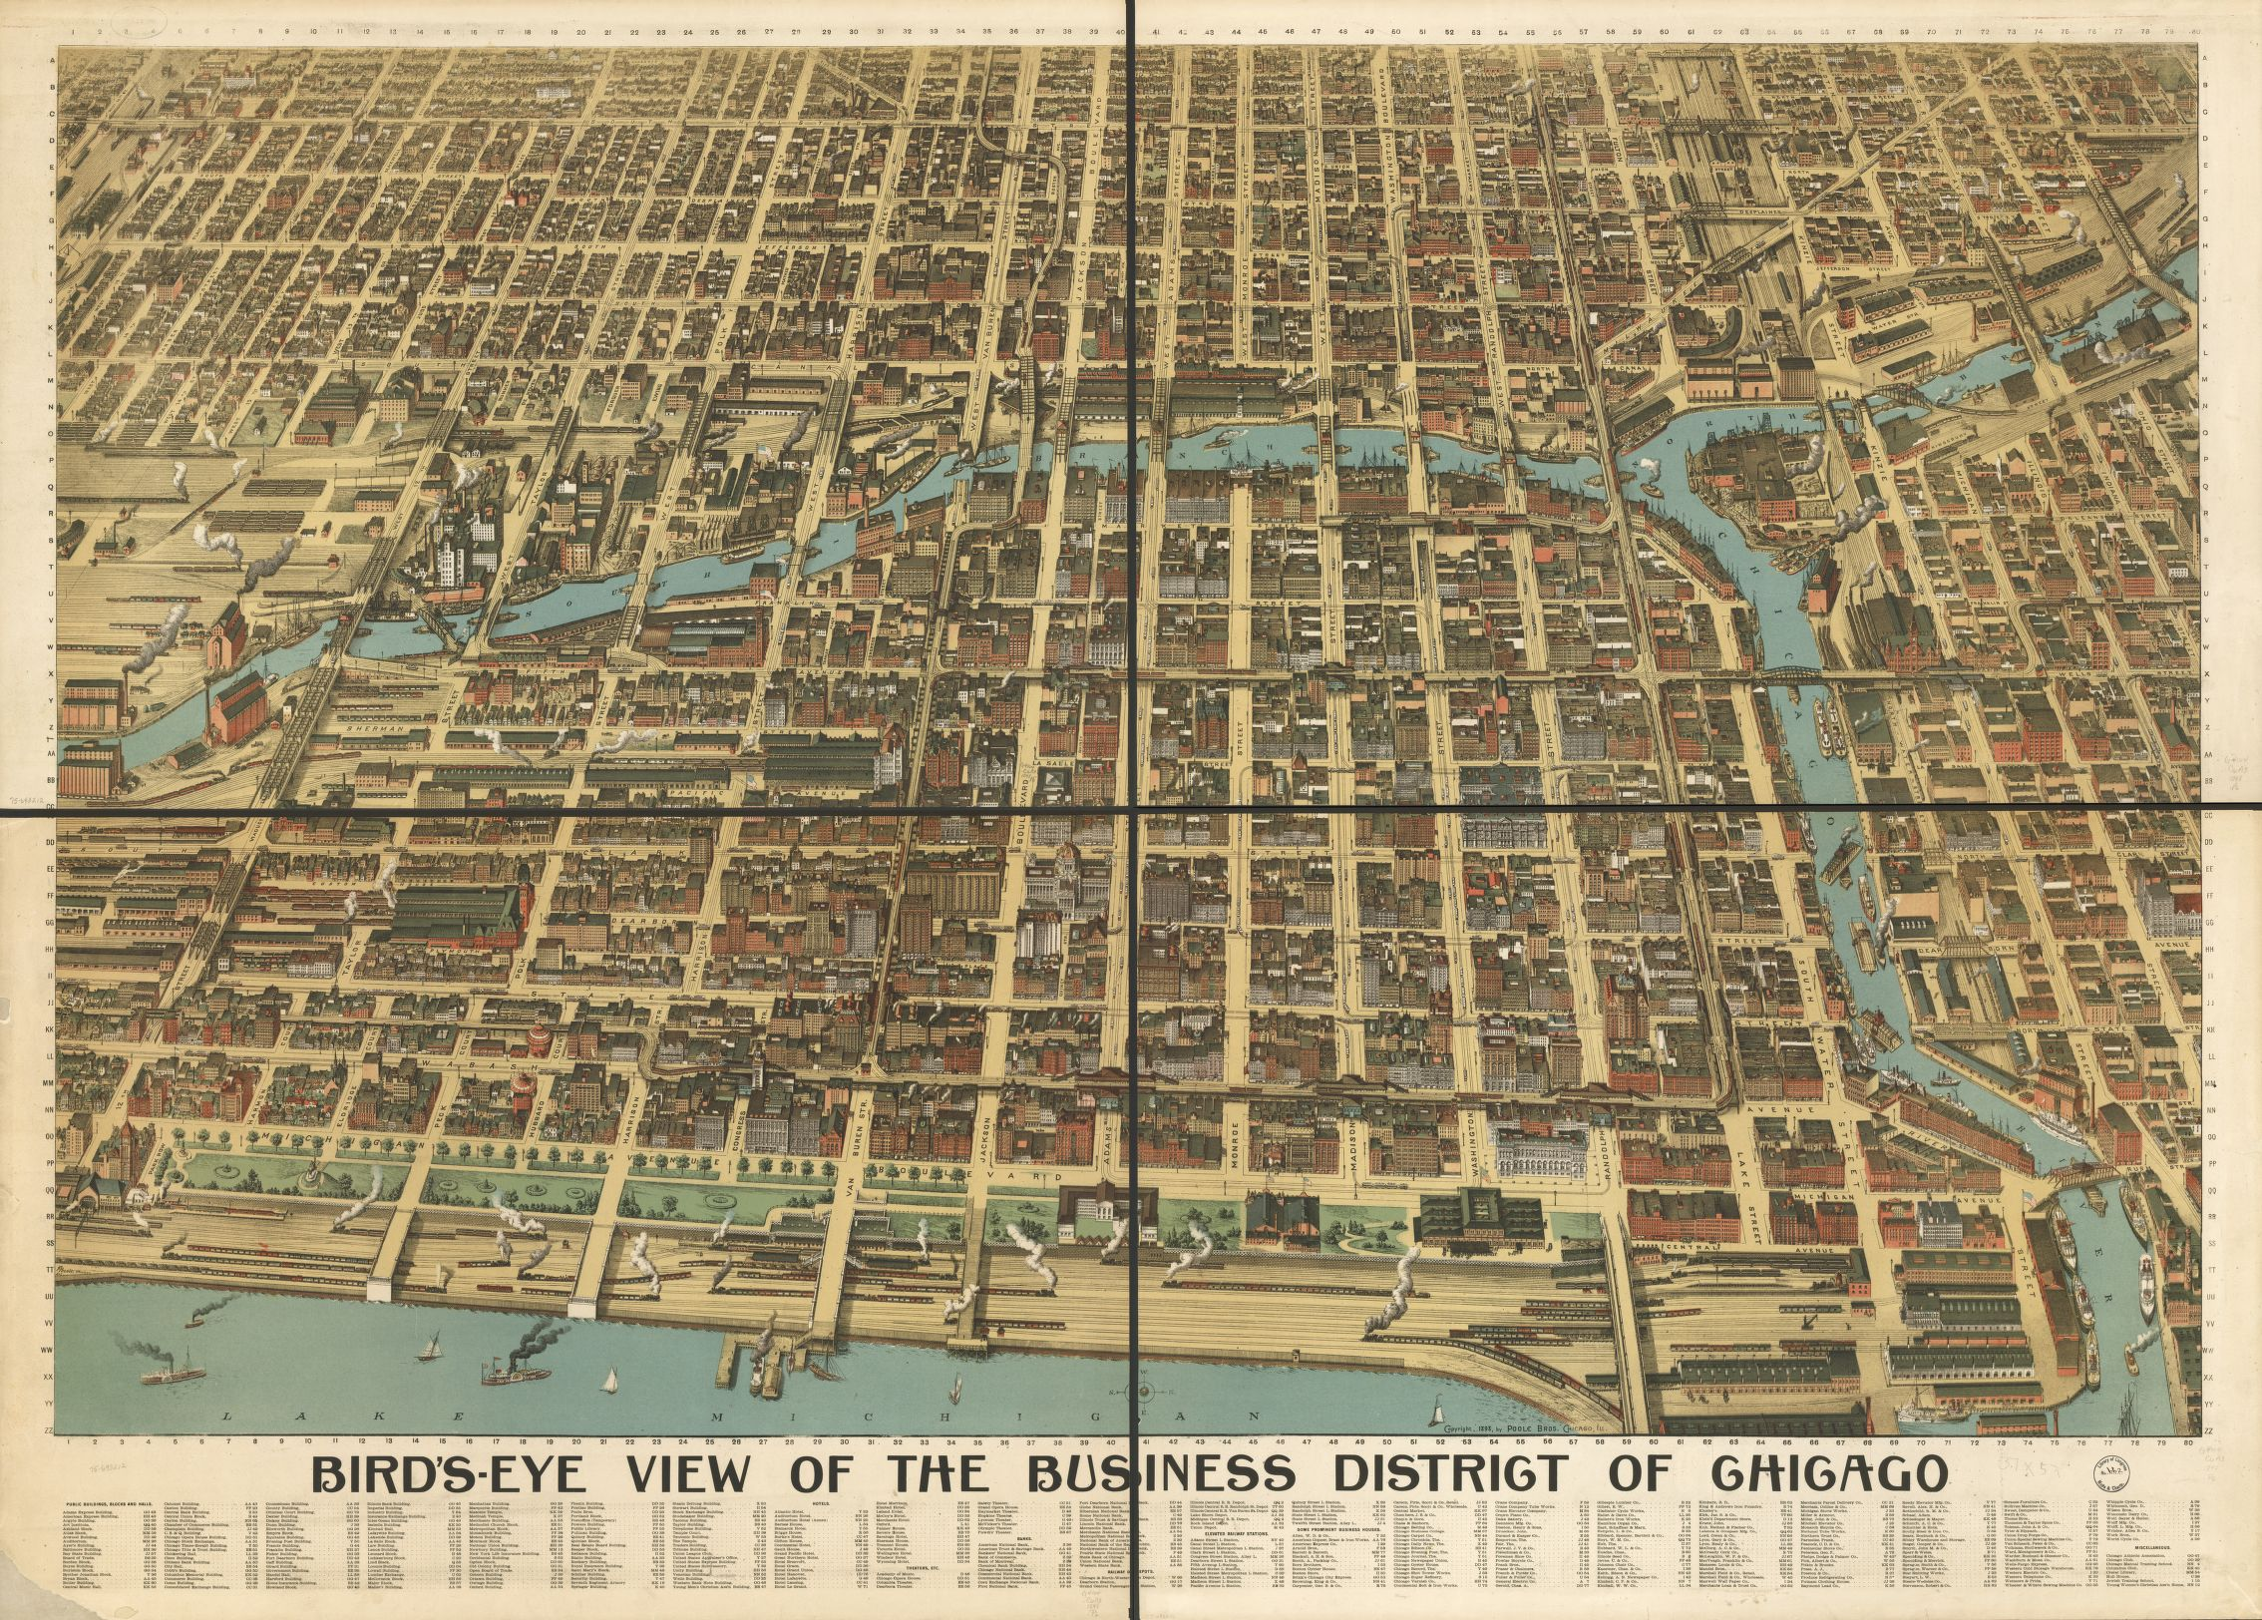
Chicago 1886-1
Chicago 1886-2
Chicago 1893
Chicago 1898

Slide 2
Extensive Updates to Site Index
<org xml:id="Beifeld"> <orgName>Joseph Beifeld &amp; Company</orgName> <desc>Jackets and Cloaks</desc> <location> <placeName>105 West Taylor street</placeName> <geo>41.8684174,-87.6286052</geo><!-- 2016-07-26: nll: Taylor Street is a little different in modern times than it is in 1888. --> <placeName>163 West Taylor</placeName> <geo>41.8690303,-87.633062</geo> </location> <bibl corresp="#CT012"/> <note>The multiple street addresses are for each place in the article that is commissioned to do the needlework of said company. The addresses are listed here in the order they appear in the article. The second address was listed in the article just as the number 163; however, it was in succession with an address on West Taylor so it was assumed to be same street.</note> </org> <org xml:id="Benson"> <orgName>Benson's Shop</orgName> <desc>vest-maker</desc> <location> <placeName>Hobbie and Chatham streets</placeName> <geo>41.9013873,-87.6437283</geo>

