Slide 1
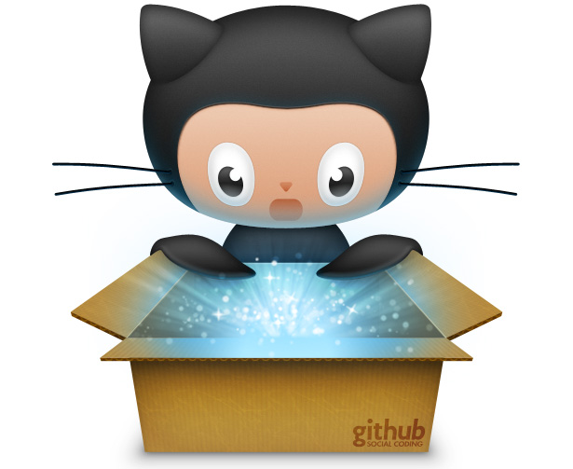
Git CTRL! COMMAND LINE, GIT, & GITHUB
Rebecca Parker
Twitter: @bcpkr396
Email: rparker3@luc.edu
https://github.com/RJP43
Notes:
Rebecca Parker co-authored with Dr. Elisa Beshero-Bondar a recently published chapter in New Directions for Computing Education: Embedding Computing Across Disciplines, titled A GitHub ‘Garage’ for a Digital Humanities Course - http://bit.ly/GitHubGarage.

Slide 2
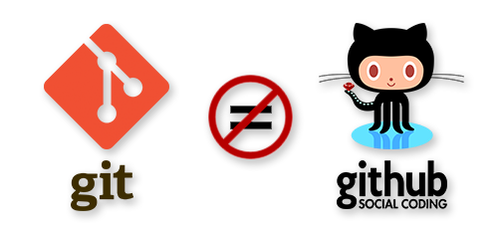
@bcpkr396

Slide 3
What is Git?
Software Downloaded Locally
Distributed Version Control System
What is GitHub?
Remote Storage of Git Repos
Social Network Access / Collaboration
@bcpkr396
Notes:
This means that instead of doing a "checkout" of the current tip of the source code, you do a "clone" of the entire repository.
This means that even if you're using a centralized workflow, every user essentially has a full backup of the main server. Each of these copies could be pushed up to replace the main server in the event of a crash or corruption. In effect, there is no single point of failure with Git (less there is only a single copy of the repository).
Allows for many options of workflows.

Slide 4
https://git-scm.com/
@bcpkr396
Notes:
I think the best source for documentation is the source itself so here is the link for all of the documentation you will need to get Git installed and begin working with Git and GitHub. Note: There is a plethora of resources about Git and GitHub available via YouTube, stack exchange, etc. since it is so well known among developers worldwide.

Slide 5
Controlling Git?
GUI Client
VS
Command Line
@bcpkr396
Notes:
I set these two in contrast with one another because of my personal experience and the experience of our Pitt Greensburg course with Git and GitHub. Let me explain… the GUI client is a tool that incorporates a “user-friendly” interface outside of shell or command line accessibility. My initial personal experience with Git was using one of the many GUIs available, in particular GitHub Desktop. What I found was even though the GUI allowed for an easy step-by-step, plug and play understanding of Git, the GUI failed to offer a way of conceptually understanding the user’s interaction with Git not just of adding and modifying files, committing repository changes, and syncing remote changes but especially when incorporating other Git Workflows that include branching and forking . The kinds of workflows that help to ensure the quality and security of any single repository. What the GUI lacks the command line or shell interface more than compensates. And what we found out in implementing an increased use of Git and GitHub in our DH course was that the command line allows users to come to an equal understanding of the basic and complex concepts that are a critical to the use of Git.
Some people might prefer to still download the GUI use it for configuration and setup and access points, but then perform the daily tasks of Git use through command line.

Slide 6
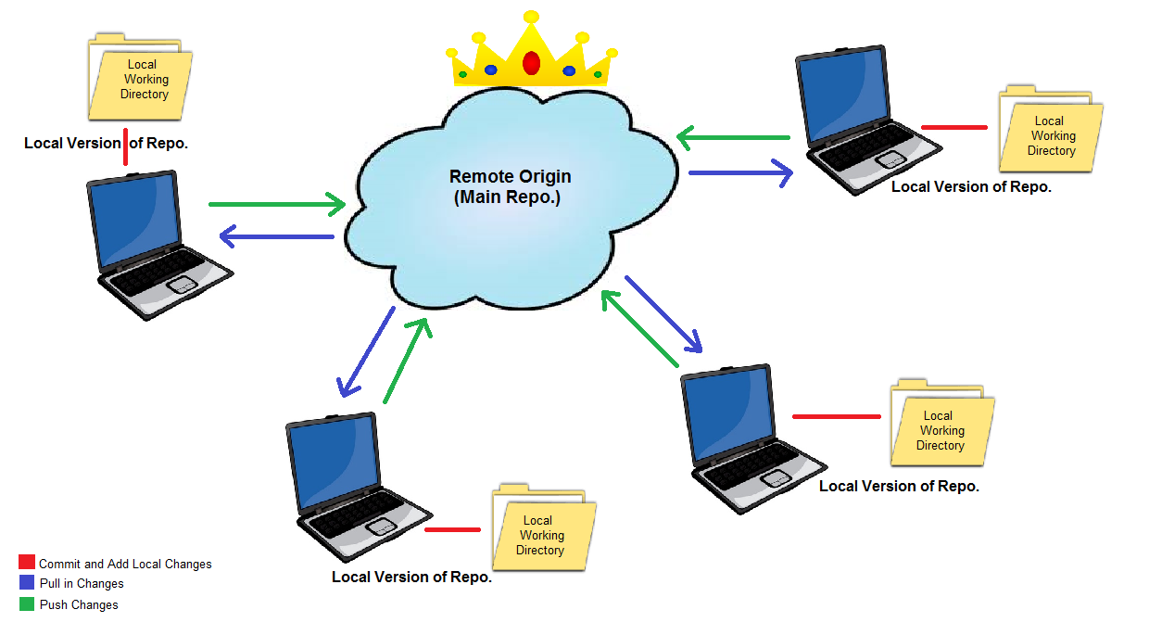
@bcpkr396
Notes:
Note the that the queen cloud is a central meeting space for the repo that can be cloned and added too, but also that each local version of the repo has a workspace and ability to contribute to what is available remotely. This representation was a part of tutorials I created to explain the concepts of Git and GitHub to our Digital Humanities undergrads at UPG.

Slide 7
FUNDAMENTALS OF FUNCTIONALITY
Collaboration
Contribution
Accountability
@bcpkr396
Notes:
Collaboration – respectful interactions in a mutually accessible workspace with clear expectations and goals
Contribution – logical and organized system of sharing and development (emphasis on organization --- file management)
Accountability – EVERY PARTY INVOLVED completing tasks and maintaining expectations with an available log of participation to collaborators as well as the public (which for students could mean future employers and/or educators.

Slide 8
Sample Workflow Models
Git Garage: DHClass-Hub
(https://github.com/ebeshero/DHClass-Hub)
Project Repo: CitySlaveGirls
(https://github.com/RJP43/CitySlaveGirls)
Project Repo: PlainTextPodCast
(https://github.com/RJP43/PlainTextPodcast)
Workshop Sandbox Repo: GitCtrl
(https://github.com/RJP43/GitCtrl)
@bcpkr396
Notes:
Let’s explore!

Slide 9
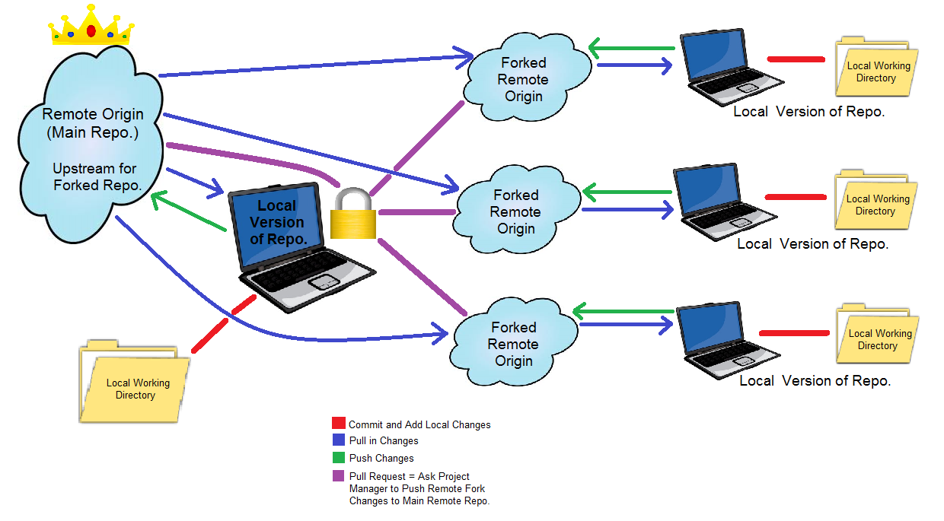
@bcpkr396

Slide 10
Resources
GitHub’s Markdown Tutorial:
(https://guides.github.com/features/mastering-markdown/)
GitHub Features Documentation:
(https://github.com/features)
Becca’s Git Command Line Tutorial : (http://dh.newtfire.org/explainGitShell.html)
Abdur Khan’s Command Line Blog/Tutorial:
(http://bit.ly/2oBWtes)
@bcpkr396
Notes:
Let’s explore!

Slide 11
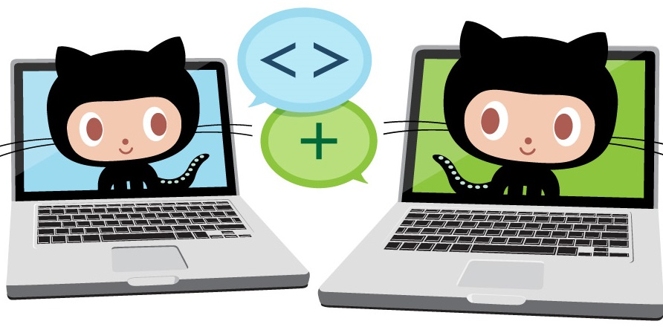
THANK YOU!
Rebecca Parker
Twitter: @bcpkr396
Email: rparker3@luc.edu
https://github.com/RJP43

