Slide 1
CITE BEFORE YOU WRITE: A JAVA CITATION GENERATOR
Abdur Khan, Rebecca Parker, Sam Schultz
Our custom project program is backed up on GitHub.
Notes:
NOTE:
To change the image on this slide, select the picture and delete it. Then click the Pictures icon in the placeholder to insert your own image.

Slide 2
PROGRAM STRUCTURE
MyCitations
Citation
HTML and counts of citations
Constructors and methods for citations
CitationGenerator
Main

Slide 3
PROGRAM STRUCTURE
In Main, user chooses medium (book or website).
In Main, user is asked to provide information necessary for the related medium’s constructor in the citation class (the information requested is based off of their initial source medium selection).
Citation class methods get called in Main.
Citations are organized into a string array in MyCitations class.
In MyCitations class, the citations get exported to a HTML file.
Main prints citation statistics (number of citations and number of each source medium cited) and provides name of HTML file to be found on user’s computer.
Main uses a do while loop so that a user can decide to run the program multiple times in order to populate the HTML file with more citations.

Slide 4
DEVIATIONS FROM PROPOSAL
Three citation styles (MLA, CHICAGO, APA): Only MLA citation style
Source medium options - book > whole or section > physical or online, journal > whole or single article > physical or online, website: Limited source mediums to physical book and website
A class for each citation style/medium: Citation creation completed in a single class
Citation output in Main: Citations output to HTML file

Slide 5
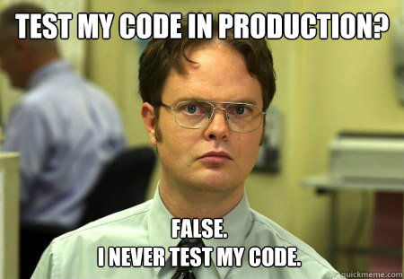
LET’S TEST!
Final Round
One book - success, but citation printed twice because we forgot to remove old code
One book, one website - success, but we were using the character code for curly quotes and those were not displaying correctly
Several books and several websites some without publishers as well as some without publish dates - success

Slide 6
KEY PROBLEM AREAS
Don’t display the citations in alphabetical order like a bibliography
Don’t have all of the detailed tests included for incorrect inputs, such as values, incorrect dates, etc. We focused on logical implementation/flow in order to get a functioning, workable program, without spending too much time on nit-picky catches and exceptions; as advised by Professor Honig.
Relatively limited scope as compared to the original (quite ambitious) plan.
Don’t have an option to remove unwanted citations or modify existing ones.

Slide 7
WHAT WE HAVE LEARNED
Communication is key to group projects especially coding projects because all parts of a program are connected and reliant on each other. Pseudo-code and regular team meetings to discuss workflow expectations and alterations was key in completing this project.
In the most basic sense, working on this project has distilled the many components of creating a basic java program that we have learned throughout this class. The key concepts of encapsulation, logical method usage, as well as class and object creation are all better understood by each of us now that we have worked on this joint program.

