Slide 1
Unveiling Netflix Content Trends
This presentation delves into key observations from the Netflix dataset, highlighting patterns and trends in its content library.

Slide 2
Content Type Distribution
Movies Dominate
TV Shows Hold Their Ground
The Netflix dataset reveals a significant leaning towards movies. This suggests that Netflix prioritizes a diverse selection of films for its subscribers.
Despite the predominance of movies, TV shows are well-represented. Netflix clearly recognizes the growing popularity of serialized storytelling.

Slide 3
Popular Genres
1
Drama Takes the Lead
Drama stands out as the most frequent genre. This aligns with the general popularity of dramatic narratives across various platforms.
2
Comedy Holds its Own
Comedy follows closely behind, highlighting the importance of lighthearted entertainment.
3
Documentaries Gain Momentum
Documentaries are well-represented, suggesting a strong demand for informative and engaging nonfiction content.

Slide 4
Global Production
Country
Content Share
United States
40%
India
15%
United Kingdom
8%
Canada
5%
Japan
4%

Slide 5
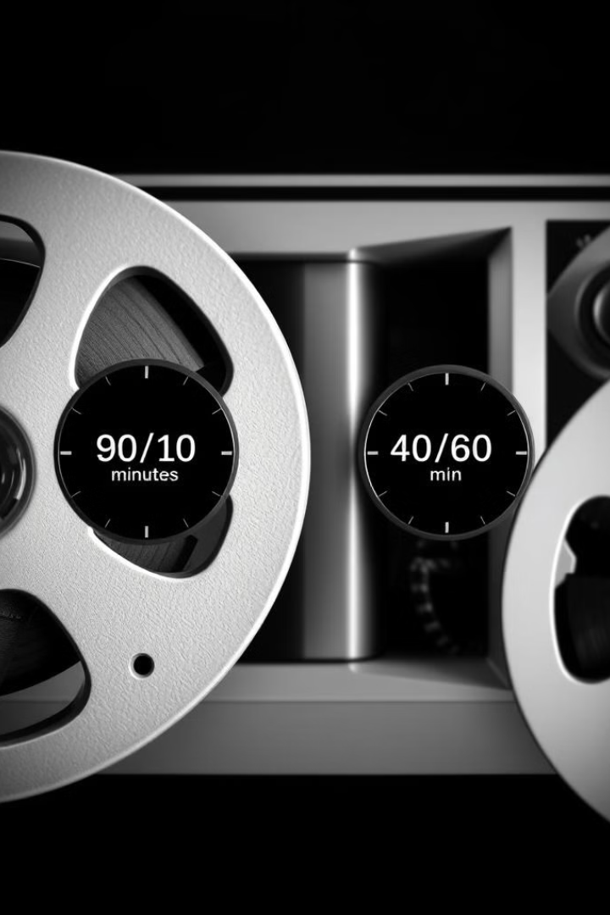
Content Duration
1
Movies
Movies on Netflix typically range between 90 to 120 minutes, offering a substantial cinematic experience.
2
TV Shows
TV shows on Netflix have an average episode length of 40-60 minutes, making them ideal for binge-watching sessions.

Slide 6
Content Rating Distribution
Mature Audiences
Family-Friendly Content
Limited NC-17 Content
The TV-MA rating dominates the dataset, indicating a significant focus on content aimed at mature viewers.
The NC-17 rating is rarely used, suggesting a limited presence of extremely mature content.
PG-13 and TV-PG content also hold a considerable share, catering to family audiences.

Slide 7



Missing Values
Data Gaps
Impact on Analysis
Addressing the Issue
The dataset exhibits missing values in certain fields, particularly for director and cast information. This highlights the potential for incomplete data.
Missing values can affect model accuracy, as algorithms rely on complete datasets to draw meaningful insights.
Effective data imputation or handling of missing values is crucial for achieving reliable results in data analysis.

Slide 8



Genre Mixing
Cross-Genre Appeal
Many titles on Netflix belong to multiple genres, showcasing a hybrid approach to content categorization.
Enhanced Discoverability
Genre mixing expands the reach of content, making it more discoverable to a wider audience.
Algorithmic Challenges
Classifying content with multiple genres can pose challenges for recommendation algorithms.

Slide 9
MongoDB
Project Flow Chart
Data Ingestion
EDA
Feature Engineering
Model Training on Local
Streamlit web
Deploy on Render

Slide 10
Loading the Dataset
The first step involves loading the Netflix dataset. We use the Pandas library to read the CSV file and drop irrelevant columns such as 'show_id' and ‘release_date ‘ and “date_added”.
Dataset Preparation
Data Exploration
Feature Selection
The raw dataset contains various columns, including movie titles, release years, ratings, and genres. Only necessary columns are retained for further analysis.
We explore the dataset to identify missing values, outliers, and potential issues that require preprocessing. This allows us to ensure data quality and consistency.
Based on the dataset's characteristics and our goal of building a recommendation engine, we select features that will be used for training the model. This could include features like listed_in, rating, and director.

Slide 11
Encoding Categorical Features
Categorical features such as genres and directors need to be transformed into numerical representations for machine learning models. LabelEncoder and onehot-encoder is used for this task.
1
Label Encoding
2
Data Transformation
3
Feature Scaling
We employ LabelEncoder to convert categorical features into numerical values, allowing the model to understand and process them effectively.
Encoding categorical features allows us to use them as input to the recommendation engine. Numerical representations are necessary for most machine learning algorithms.
Encoding features with different ranges can sometimes lead to biases in model training. Therefore, scaling features is important to ensure fair comparison.

Slide 12
Handling Genres and Directors
Genre and director information needs to be processed efficiently for the movie recommendation engine. One-hot encoding is a suitable method for this.
Genres
Directors
Integration
Genres are exploded into separate entries and then one-hot encoded. This allows the model to understand the individual genres associated with each movie.
Similar to genres, directors are one-hot encoded. Each director is represented as a separate feature, allowing the model to learn director-specific preferences.
The encoded genre and director features are then integrated into the main dataframe, ready to be used for model training.

Slide 13




Extracting Duration
The 'duration' column in the dataset contains textual information like "1 hr 37 min". We need to extract numerical values for the duration.
Text Processing
Conversion
Feature Inclusion
The 'duration' column is first parsed to extract the hours and minutes components separately.
The hours and minutes components are then converted into a single numeric value representing the total duration in minutes.
The extracted duration values are finally added to the main dataframe, providing an important feature for the recommendation engine.

Slide 14
Handling Missing Values
It's crucial to address missing values in the dataset. They can affect the performance of the recommendation engine.
Method
Description
Dropping Rows
Removing rows with missing values. This can be effective when the percentage of missing values is low.
Imputation
Filling missing values with the mean, median, or mode of the respective feature. It's a suitable method for numeric features.
Forward Fill
Replacing missing values with the last known value. This is beneficial for time-series data where there's a trend.

Slide 15




Feature Engineering
Feature engineering plays a crucial role in enhancing the accuracy of the movie recommendation engine.
Interaction Features
Feature Scaling
Creating new features by combining existing ones can reveal hidden patterns and improve the model's predictive power. For example, interaction terms can be generated from genre and release year.
Scaling features with different ranges to a common scale can help avoid bias in model training. It ensures features with larger ranges don't dominate the training process.
Dimensionality Reduction
Feature Selection
Reducing the dimensionality of the feature space can improve the efficiency of the model and prevent overfitting. Techniques like Principal Component Analysis (PCA) are commonly used.
Identifying and selecting the most relevant features can enhance the model's accuracy. Techniques like feature importance scores and recursive feature elimination are often used.

Slide 16
Thanks for Watching

