Slide 1


Slide 2
Hunger in
India
Hunger
In
NEPAL
Vs

Slide 3
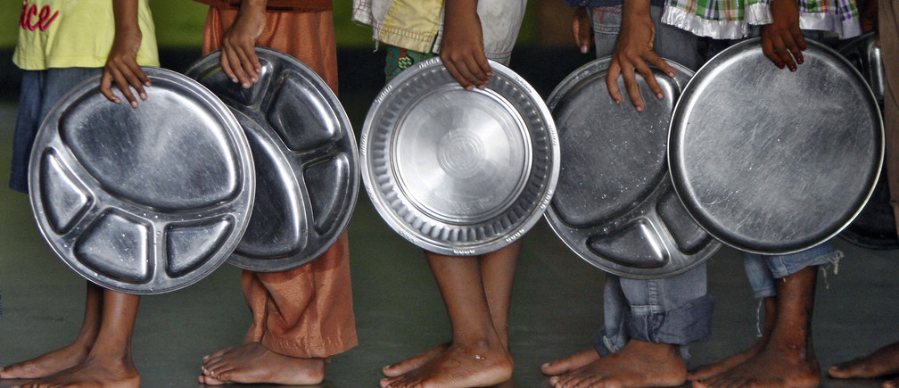
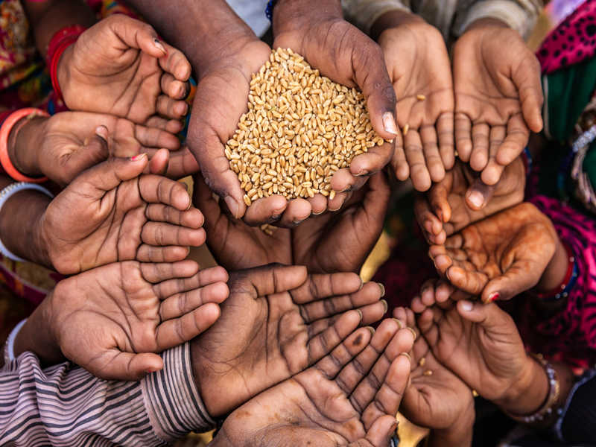
What is hunger?
Hunger is a feeling of discomfort and weakness caused by lack of food, coupled with desire to eat. It can manifest itself in different ways – undernourishment, malnutrition and wasting.
Malnutrition is when people have an inadequate intake of protein, energy and micronutrients. Starved of the right nutrition, they can die from common infections such as measles or diarrhea.
Undernourishment occurs when people do not take in enough calories to meet minimum physiological needs.
Wasting, usually the result of starvation or disease, is an indicator of acute malnutrition with substantial weight loss.

Slide 4
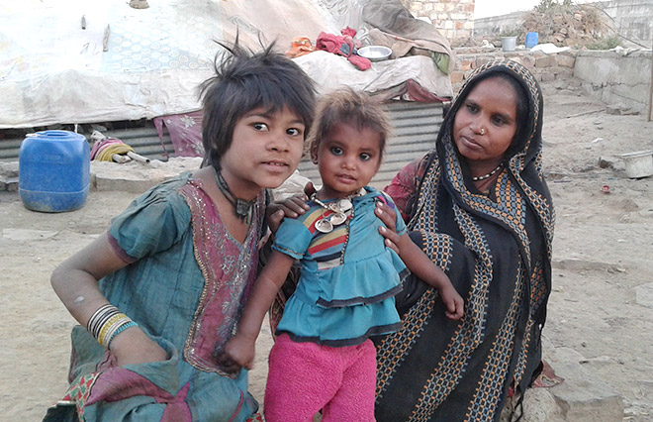
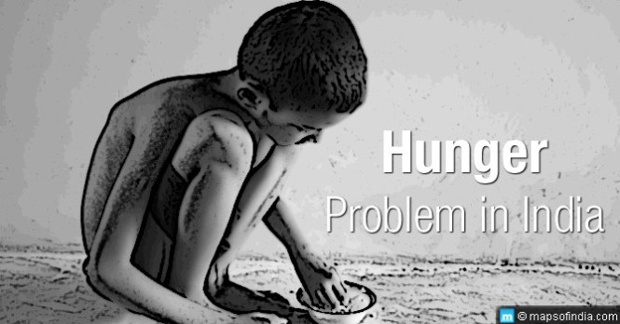
Causes of hunger in India-
POVERTY- It seriously affects the availability of adequate amounts of nutritious food.
LACK OF ACCESS TO FOOD- Most major crisis do not occur because of a lack of food, but because people are too poor to obtain enough food.
LACK OF SAFE DRINKING WATER- Lack of potable water, poor sanitation, and dangerous hygiene practices increase vulnerability to infectious and water-borne diseases.
DISEASE -A combination of disease and malnutrition weakens the metabolism which leads to vulnerability to illness.
CONFLICTS- Conflicts have a direct impact on food security, drastically compromising access to food.

Slide 5
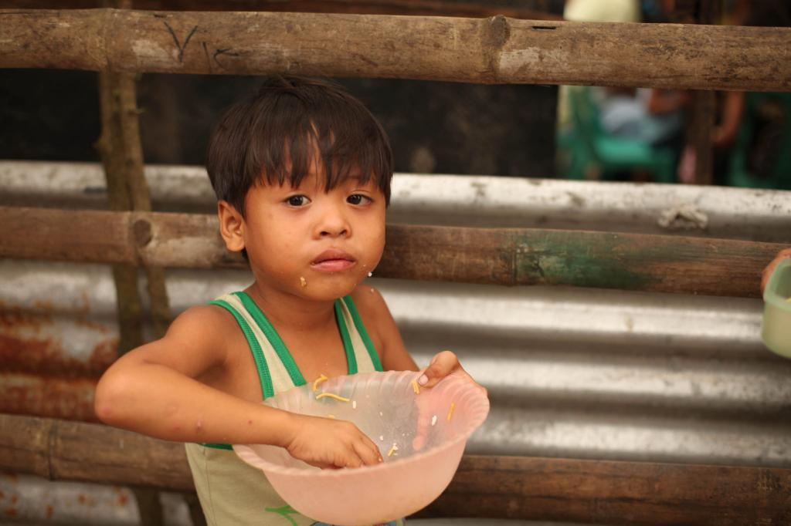
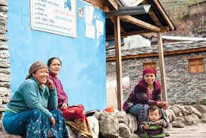
Causes of hunger in Nepal-
One in four people in Nepal lives below the national poverty line that is just 50 cents per day. People that live under the poverty line do not have enough money to meet their basic needs like food, clothing and shelter.
Those who live in mountainous, more rural areas are the most likely to suffer from poverty and hunger that affects the country.
Agriculture provides work to 68 percent of Nepal’s population and accounts for 34 percent of the country’s GDP, yet food is in low supply for Nepali citizens.
Nepalese children who are stunted suffer from a variety of severe mental and health issues, especially in the first 1,000 days of their lives. These issues can reflect on their adult life, specifically on poor cognition, nutritional issues and even low wages.

Slide 6
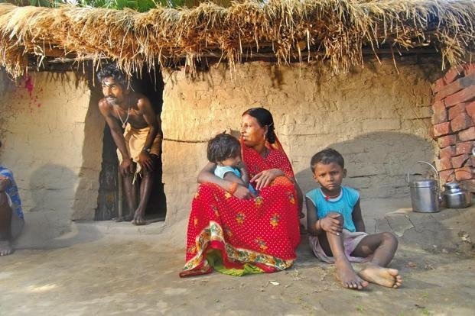
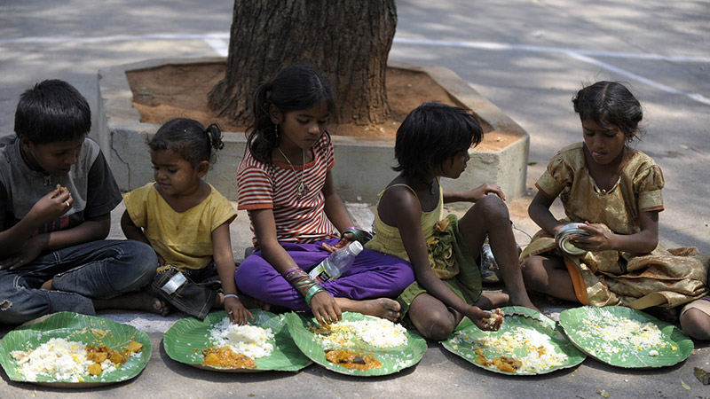
Extent of hunger in India
Hunger in India- India, with a population of over 1.3 billion, has seen tremendous growth in the past two decades. Gross Domestic Product has increased 4.5 times and per capita consumption has increased 3 times. Similarly, food grain production has increased almost 2 times. However, it is unable to provide access to food to a large number of people, especially women and children.
State of Hunger in India- 194.4 million people are undernourished in India. By this measure 14.5% of the population is undernourished in India. Also, 51.4% of women in reproductive age between 15 to 49 years are anaemic. Further according to the report 37.9% of the children aged under five in India are stunted (too short for their age), while 20.8% suffer from wasting, meaning their weight is too low for their height. Malnourished children have a higher risk of death from common childhood illnesses. The Global Hunger Index 2018 ranks India at 103 out of 119 countries.
Food Loss & Food Waste- It is estimated that nearly one third of the food produced in the world for human consumption every year gets lost or wasted. 40 percent of the fruits and vegetables, and 30 percent of cereals that are produced are lost due to inefficient supply chain management and do not reach the consumer markets. While significant levels of food losses occur upstream, at harvest and during post-harvest handling, a lot of food is lost or wasted during the distribution and consumption stages. Food is also wasted in domestic and business shelves.

Slide 7
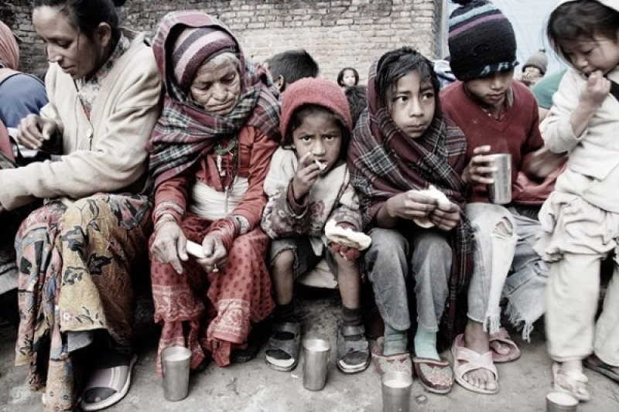
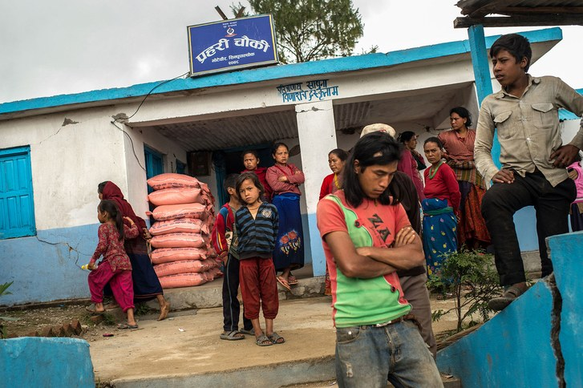
Extent of Hunger in Nepal
The occurrence of floods in 2017 caused 80% of the southern agricultural belt to submerge in water causing a loss of about $57 million of agricultural crops and also claimed hundreds of lives. It show the under-preparedness of the country to fight against climate change
The growth in population of Nepal was not simultaneous with improvement in crop production. The cereal crop growth is scanty in the country causing intensive agriculture nearly impossible reducing the GDP by about 10%.
Climate variability and change affects food security and nutrition through a combination of reduced food production, higher food prices, and lower food utilization and more intense & frequent climate-related disasters, which negatively affect livelihoods and access to critical health and social facilities.
Poor diet diversity is a serious problem across much of Nepal where malnutrition plays a role in 60 percent of child deaths. About 518,000 children under five years of age are suffering from acute under-nutrition, or wasting, and have a heightened risk of morbidity and mortality.nx

Slide 8
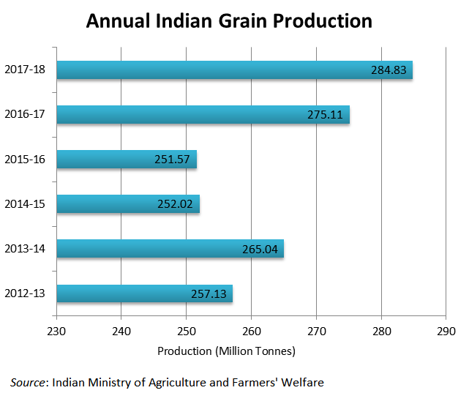
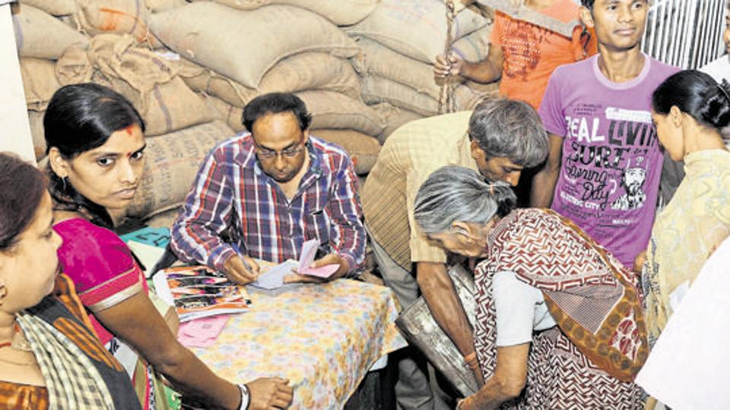
Measures against Hunger in India
There are a series of organizations and nonprofits who have focused their efforts on India’s most solvable issue. For instance, Action Against Hunger has been instrumental in saving lives in India in the past decade by taking a hands-on, direct approach.
It includes the Midday Meal Scheme, Integrated Child Development Services scheme and the Public Distribution System. In 2017-18, over Rs 1500 billion (7.6% of the government's total expenditure) have been allocated to provide food subsidies under the Targeted Public Distribution System (TPDS).
In order to provide the Right to food to every citizen of the country, the Parliament of India, enacted a legislation in 2013 known as the National Food Security Act, 2013. This Act seeks to provide subsidized food grains to approximately two thirds of India's 1.33 billion population.
India’s ambitious Zero Hunger Programme through interventions in farm sector was launched on 16 October 2017 focusing on agriculture, nutrition and health in a symbiotic manner. The Programme was initiated by Indian Council of Agricultural Research (ICAR) to curb hunger in the nation

Slide 9
Measures Against Hunger in Nepal

