Slide 1
Python for Engineering Applications
Ryan Kinnear
University of Regina
With support from NSERC - USRA
& Dr. Laforge

Slide 2
What This Is About
A presentation about solving hard problems with computers
Focused more on Python as a tool, rather than for building end products
Anyone studying Engineering, Science, Business or Math could benefit
Notes:
-Boring if I just explain syntax
-Broad strokes
-It may help if you jot some stuff down

Slide 3
What am I Going to Talk About?
A modern perspective on problem solving
How using Python got me an excellent job offer and impressed my boss
Show you some stuff that may be useful in class
I hope to introduce you to and get you thinking about a huge swath of problems and application areas
Lots of interesting ideas / examples from a broad range of fields
Not diving too much into specifics
Notes:
Modern problem solving
Computers have changed the world, even just since we were born.
A lot of what we learn in class is somewhat outdated, simply because it isn't computer focused

Slide 4
Python
High level “batteries included'' scripting language
  Very easy to learn and use (in direct contrast to C++)
  Effective for an extremely broad set of tasks
  Supports broad set of programming paradigms
Yes, it is actually named after the comedy group
  References to Spam are highly encouraged
Notes:
Batteries included
Monty python comedy

Slide 5
Why Am I Doing This?
I want to share things I've learned
I hope this information can be useful to others
I think it is good for my own professional development
I like to hear myself talk
Notes:
-The willingness to study math is a huge factor in the number of jobs available to you.
-Vast number of white collar jobs are unaccessible if you aren't willing to do math
-A similar trend is happening with computers.

Slide 6
Why Should You Care?
Increasing demand for computer proficient engineers
You won't see much of this in class
Start to feel like you can actually do stuff
Useful in every technical discipline
Suprisingly easy to impress people that don't know better (e.g. your boss)
Notes:
-The willingness to study math is a huge factor in the number of jobs available to you.
-Vast number of white collar jobs are unaccessible if you aren't willing to do math
-A similar trend is happening with computers.

Slide 7
Why Should You Care?
Python is NOTHING like C++
  Get cool stuff working quickly
  Useful datastructures built in
  Syntax is much simpler
  No pointers!
  Error messages are far more helpful
  Famous for it's simplicity (in direct contrast to C++)

Slide 8
Why Should You Care?
The most useful thing I have ever learned
  Boss at SaskPower amazed at what I could do
  Offered full time position at SaskPower
  Used extensively throughout my capstone project
  Helped a lot throughout my classes
Exposure to broad application areas
You can add a ton of buzzwords to your resume
Notes:
-maximum pay
-

Slide 9
“In Practice''
Example: Model or estimate the spread of disease
Example: Statistical quality control of a complex manufacturing or chemical process
Example: Predict future load on SaskTel's network
Example: Analyze the stock market
Example: Model traffic flow/congestion
Example: Visualize a city's demographics
Example: Interact automatically with a webservice
Notes:
-The willingness to study math is a huge factor in the number of jobs available to you.
-Vast number of white collar jobs are unaccessible if you aren't willing to do math
-A similar trend is happening with computers.

Slide 10
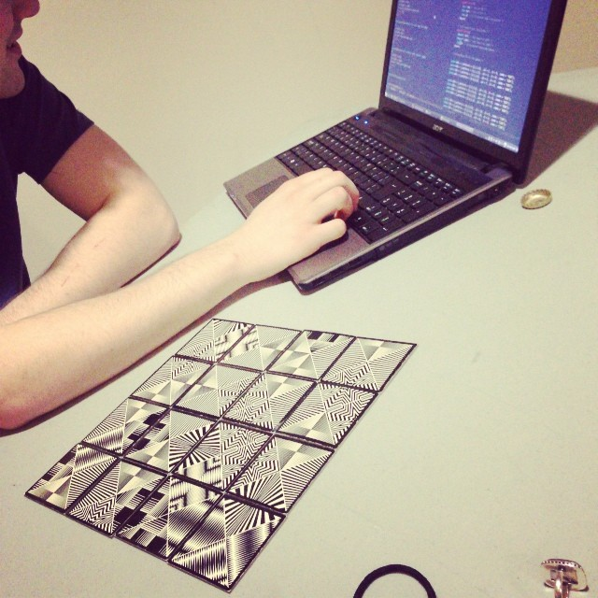
Fun Stuff
Notes:
-The willingness to study math is a huge factor in the number of jobs available to you.
-Vast number of white collar jobs are unaccessible if you aren't willing to do math
-A similar trend is happening with computers.

Slide 11
What is a Programming Language
Formal language for controlling a computer
Used to express algorithms in a computer-readable format
Examples: C, FORTRAN, Python, Ruby, Haskell, LISP, etc...

Slide 12
Final Product, Design Tool, Scripting
Code as a Final Product (I'm not focusing on this)
  Web browser, operating system, facebook, word processor...
  Control system for chemical production, network router
Programming as a Design Tool
  Design an electronic filter, model a car's suspension
  Fit data to a model, work symbolically with complicated equations
Use as a Scripting Tool
  Automate mundane spreadsheet tasks, interface automatically with a web service
  Find / replace over thousands of files
Notes:
-Operating system is just code running on the computer.
-Any program (browser word processor) is code
-But also things like network routers/switches are mostly software
-And control systems for power plants, chemical processes, etc... All of this is done with software. You can't build complex control systems without code
-

Slide 13
Scripting
Python is an effective scripting language
Useful for writing small applications to help you with simple, repetitive, or error prone tasks
Many applications (e.g. MS Office, AutoCAD) have scripting interfaces – learning Python is a good start to understanding them in general
Notes:
-Operating system is just code running on the computer.
-Any program (browser word processor) is code
-But also things like network routers/switches are mostly software
-And control systems for power plants, chemical processes, etc... All of this is done with software. You can't build complex control systems without code
-

Slide 14
Examples From Term at SaskPower
Take an excel sheet with (many) legal land locations (e.g. SE-12-20-33-W1) and convert them to GPS coordinates with http://prairielocator.com/ to import into Google Earth.
Used AutoCAD's scripting interface to search thousands of drawings for a reference to a specific site, move the file into a folder, and print. Resulted in 200+ printed drawings.
Using MS office scripting interface, did a find/replace over 300+ word files for an erroneous email address.
Notes:
-Operating system is just code running on the computer.
-Any program (browser word processor) is code
-But also things like network routers/switches are mostly software
-And control systems for power plants, chemical processes, etc... All of this is done with software. You can't build complex control systems without code
-

Slide 15
Examples From Term at SaskPower
Scripting Geographic Information Systems (GIS)
At SaskPower, I had to pull every single transmission line out of a slow GIS database by hand, convert it to GPS coordinates, and load it into GoogleEarth
This was a painful, error prone task
ArcGIS for example, supports Python scripting
See: Python Scripting for ArcGIS, Paul A. Zandbergen
Notes:
-Operating system is just code running on the computer.
-Any program (browser word processor) is code
-But also things like network routers/switches are mostly software
-And control systems for power plants, chemical processes, etc... All of this is done with software. You can't build complex control systems without code
-

Slide 16
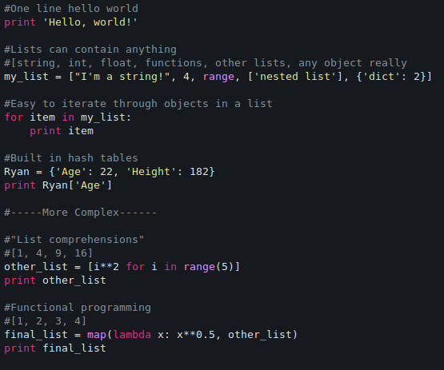
What Makes Python Easy?
Notes:
-Operating system is just code running on the computer.
-Any program (browser word processor) is code
-But also things like network routers/switches are mostly software
-And control systems for power plants, chemical processes, etc... All of this is done with software. You can't build complex control systems without code
-

Slide 17
Alternatives to Python (and why Python is better)
Ruby
  Similar to Python in many ways.
  Smaller ecosystem for number crunching and scientific tasks
  Claim to fame is RoR
MATLAB
  Non-existant ecosystem for non-scientific tasks
  Python is as good for many scientific tasks, both use the same backend
  Expensive and proprietary
Notes:
-Operating system is just code running on the computer.
-Any program (browser word processor) is code
-But also things like network routers/switches are mostly software
-And control systems for power plants, chemical processes, etc... All of this is done with software. You can't build complex control systems without code
-

Slide 18
Alternatives to Python (and why Python is better)
Excel
  Very limited capability
  Slooooowwwww
  Expensive
Others (e.g. Javascript, C#, Java, C++) suffer from some combination of
  Complicated
  Immature
  Limited scope / ecosystem
Notes:
-Operating system is just code running on the computer.
-Any program (browser word processor) is code
-But also things like network routers/switches are mostly software
-And control systems for power plants, chemical processes, etc... All of this is done with software. You can't build complex control systems without code
-

Slide 19
Python Interpreter
Lines of code are read, decoded, and executed by an interpreter line by line
Possible to experiment and play with ideas interactively
  Improves development time, debugging is far easier
Genearlly slower than compiled code
  Bindings can alleviate this problem in many cases
  Programmer time is far more valuable than computer time
Notes:
-Operating system is just code running on the computer.
-Any program (browser word processor) is code
-But also things like network routers/switches are mostly software
-And control systems for power plants, chemical processes, etc... All of this is done with software. You can't build complex control systems without code
-

Slide 20
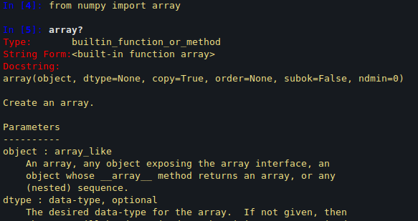
IPython Interpreter
Ipython is a “souped up'' Python interpreter
Deeper introspection
Built in documentation e.g.
Notes:
-Operating system is just code running on the computer.
-Any program (browser word processor) is code
-But also things like network routers/switches are mostly software
-And control systems for power plants, chemical processes, etc... All of this is done with software. You can't build complex control systems without code
-

Slide 21
Number Crunching
Curve fitting, differential equations, optimization, numerical integration, modeling etc...
Python libraries Numpy and Scipy interface with...
  BLAS: Free-software FORTRAN code carefully tuned for basic linear algebra operations
  LAPACK: Similar to BLAS, but higher level operations (e.g. SVD, QR)
  The same backend (and hence very similar performance) to MATLAB
Don't use “for'' loops for numerics! Use built in matrix / vector operations
Notes:
-Operating system is just code running on the computer.
-Any program (browser word processor) is code
-But also things like network routers/switches are mostly software
-And control systems for power plants, chemical processes, etc... All of this is done with software. You can't build complex control systems without code
-

Slide 22
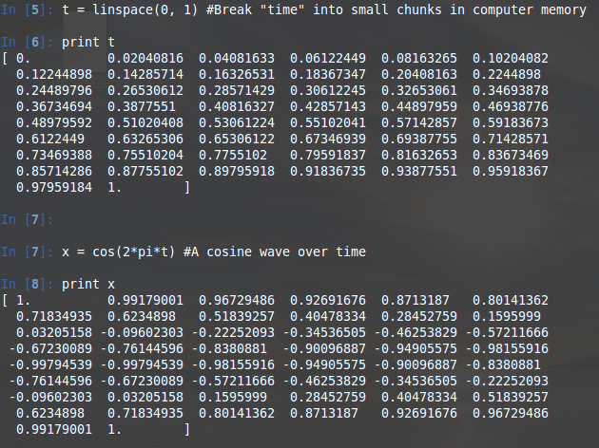
Number Crunching
The magic lies in storing numbers in efficient numpy arrays
Notes:
-Operating system is just code running on the computer.
-Any program (browser word processor) is code
-But also things like network routers/switches are mostly software
-And control systems for power plants, chemical processes, etc... All of this is done with software. You can't build complex control systems without code
-

Slide 23
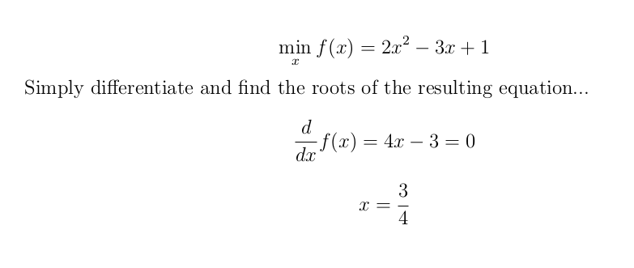
Optimization
In math class you deal with trivial optimization problems
  This is because you have to solve them by hand e.g.

Slide 24
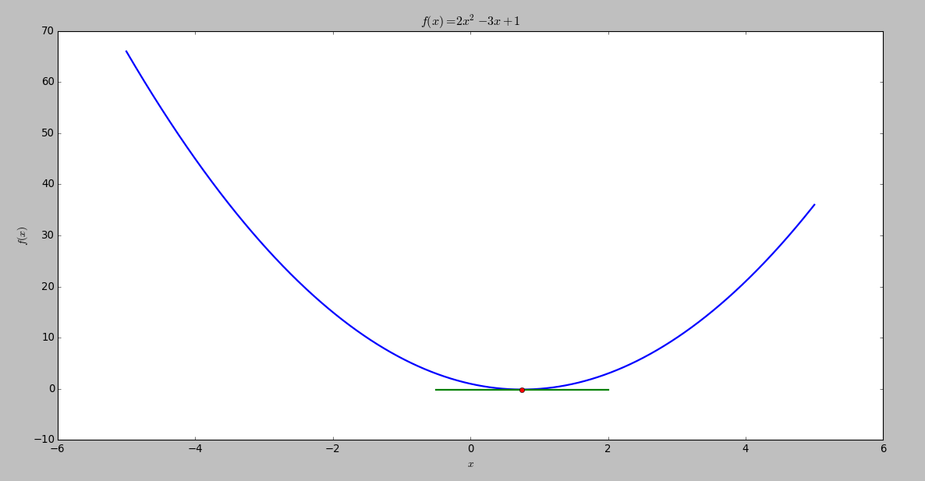
Optimization
Here is a plot of the previous problem and the optimum point

Slide 25
Real Optimization Problems
Predict load on a power network and use this prediction to schedule generators and transmission lines
Find an investment portfolio with the maximum expected return and minimum variance
Efficiently schedule jobs onto computer nodes
Efficiently schedule work crews on a large job site
Fitting a ton of data to some model (machine learning)
Design high frequency electronic filters (Part of my NSERC project)

Slide 26
Example: Predicting Titanic survival
Competition problem from www.kaggle.com
  Some problems here worth $100,000, some people solve them with Python. E.g. Detecting diabetic retinopathy
  Possible source of a really cool 4th year project!
Given a dataset of titanic passengers including their age, gender, ticket price, name, and whether or not they survived.
Create a model from this data to predict who would have survived out of a new dataset.

Slide 27
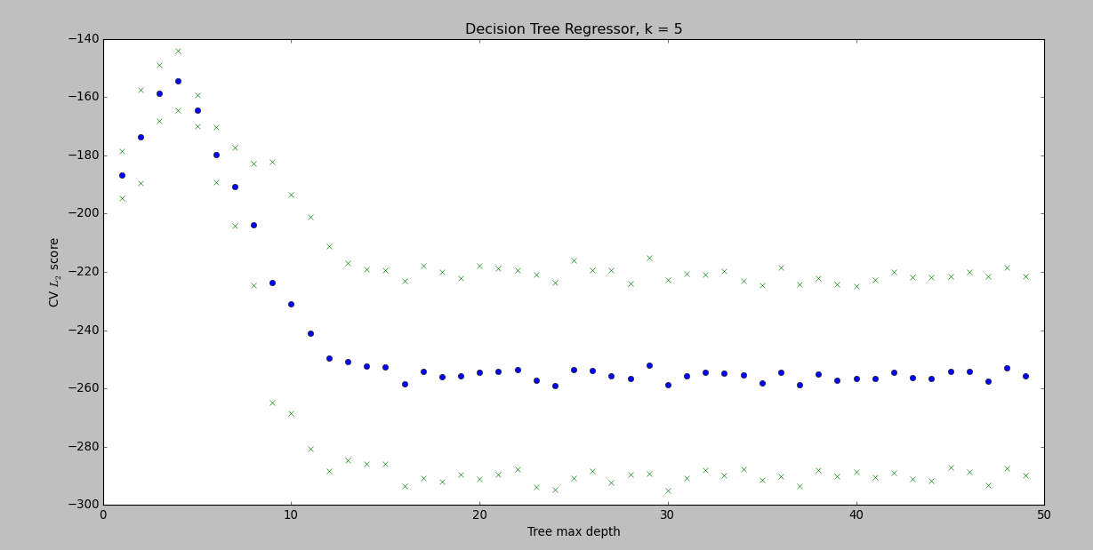
Predicting Titanic survival

Slide 28
Plotting
MatplotLib provides great ways to visualize data and plot functions
  It is again similar to MATLAB in many ways
Example: Plot the decision boundary for a binary classifier.
Example: Plot some particular solution for a differential equation
Notes:
-Operating system is just code running on the computer.
-Any program (browser word processor) is code
-But also things like network routers/switches are mostly software
-And control systems for power plants, chemical processes, etc... All of this is done with software. You can't build complex control systems without code
-

Slide 29
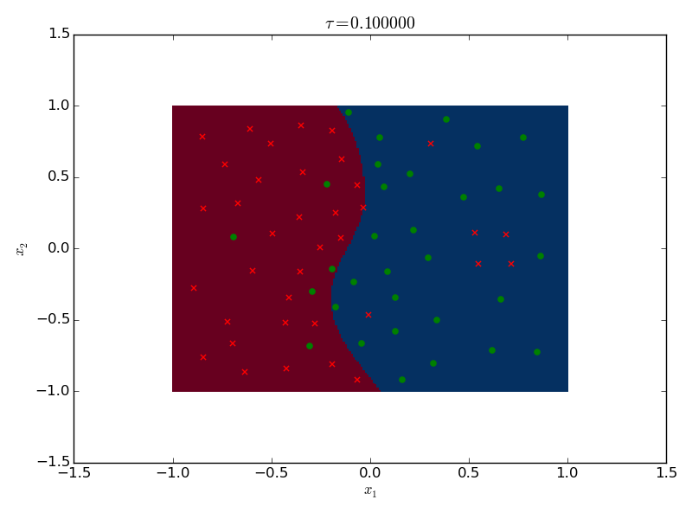
Example: Binary Classifier

Slide 30
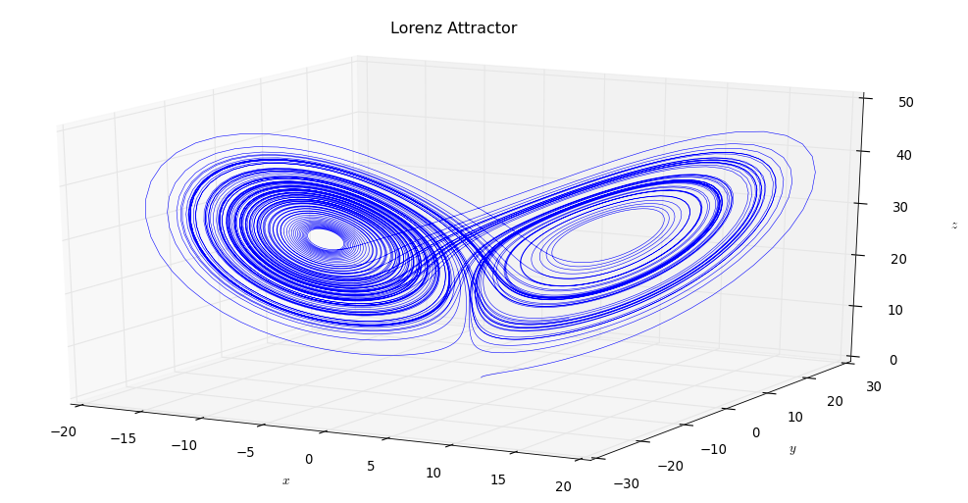
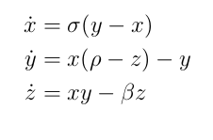
Example: Lorenz Attractor

Slide 31
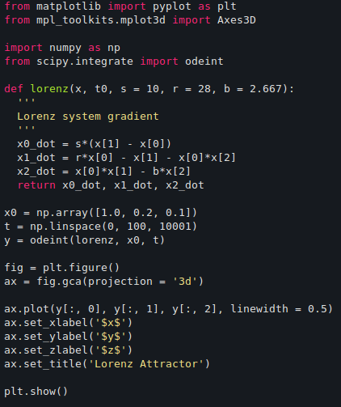
Example: Lorenz Attractor code

Slide 32
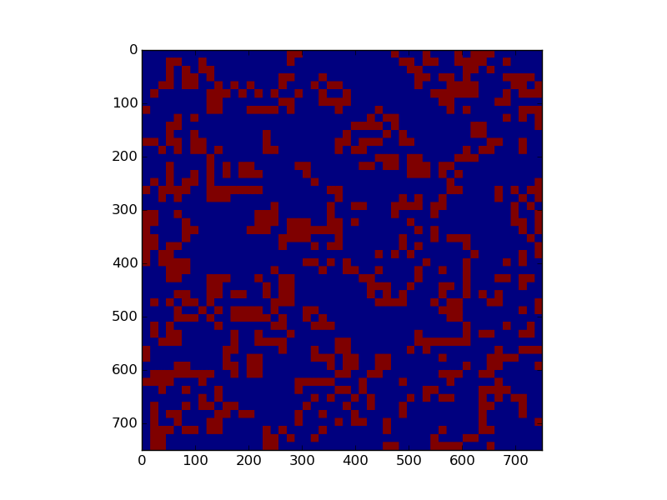
Example: Game of Life

Slide 33
Example: Multi Armed Bandits
You are in a casino in a room with a bunch of one armed bandits (slot machines)
Each one has a different probability of paying out
Your goal is to make money as quickly as possible
You need to explore the machines to find the better ones, but also exploit the ones you know are good
Very hard, and very practical problem
Notes:
-Operating system is just code running on the computer.
-Any program (browser word processor) is code
-But also things like network routers/switches are mostly software
-And control systems for power plants, chemical processes, etc... All of this is done with software. You can't build complex control systems without code
-

Slide 34
Multi Armed Bandit Applications
Clinical trials: Find the best treatment while letting few people perish
Advertising: Find the most effective ad, while still using ones that work
Networks: Find the best network route or channel while still getting your data through
Finding a mate: Find the best boyfriend/girlfriend while ...
Notes:
-Operating system is just code running on the computer.
-Any program (browser word processor) is code
-But also things like network routers/switches are mostly software
-And control systems for power plants, chemical processes, etc... All of this is done with software. You can't build complex control systems without code
-

Slide 35
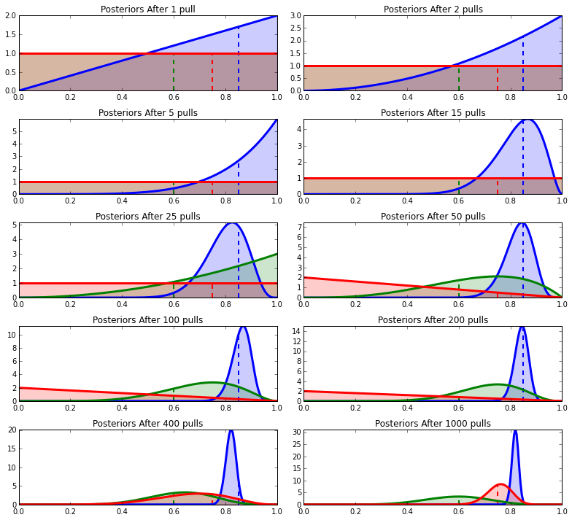
Solution in Python “Bayesian Bandits''
From the freely available book – 'Bayesian Methods for Hackers' by Cameron Davidson-Pilon
Notes:
Posterior equals the likelihood times the prior divided by the evidence
P(theta | X) = P(X | theta)P(theta)/P(X)
P(X) = int_theta P(X | theta)P(theta)
Bayesian methods for hackers
Stats 160, but it makes sense

Slide 36
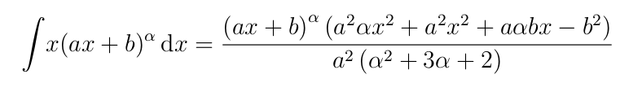
Symbolic Math
SymPy – a computer algebra system for Python (similar to Maple)
Very complex equations can be dealt with in closed form
Trigonometry, calculus, special functions, differential equations, combinatorics... all in closed form
e.g. This integral was evaluated via Sympy and printed to LaTeX

Slide 37
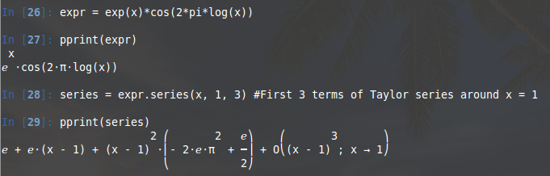
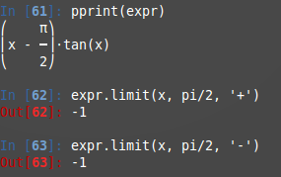
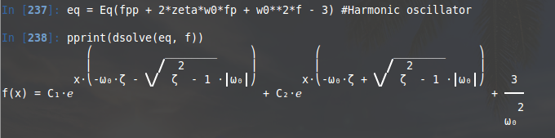
Examples
Taylor Series
Limits
Differential Equations

Slide 38
Other Stuff
Pandas: Library for efficiently working with labeled and time series data (e.g. financial data, data on individuals, sales over time ...)
Sklearn: Library implementing large number of high quality mahine learning algorithms (regression/classificiation, clustering, visualization, etc...)
Skimage: Library for image processing
Scipy.signal: Various signal processing methods (e.g. filter design, LTI systems). I used this extensively for my fourth year project

Slide 39
Other Stuff
Django: Popular web framework similar to Ruby on Rails
Theano: GPU computing, C code generation
PyQt: Develop GUIs
Cython: Write C extensions and bindings
BeautifulSoup: HTML parsing
Scrapy: Web crawling
PyMC: Markov Chain Monte Carlo (MCMC) methods

Slide 40
Possible Thoughts on Your Mind
“This stuff is not useful, I never see problems where I would need to make use of any of this stuff ''
  I would suggest that this is because the people who assign you problems assume you aren't aware of any of these tools
“Using this is probably much harder than you make it seem...''
  You are right, it can be challenging. But, who will pay you to do stuff that is easy?

Slide 41
Possible Thoughts on Your Mind
“Am I ever going to use this?''
  Maybe, maybe not. But, it's another skill to set you apart from others in a competitive job market.
“I don't have time to learn this stuff...''
  Yes you do.
“I hated my programming classes, programming *#@$^& sucks!''
  Python is 100x easier than C++, and you can get exciting results 100x faster

Slide 42
Possible Thoughts on Your Mind
“This is so cool omg!''
  Yes.

Slide 43
How to Get Started
Anaconda Python distribution (Windows, OSX, Linux)
You will be well served to use a Unix-like environment
  Mac OS
  Linux Virtual Machine inside Windows
  Dual boot Linux - Ubuntu and Linux Mint are very user-friendly
  Not strictly necessary, everything still works on Windows
Unix was designed for programmers by programmers, it should make your life easier in the long run (my opinion...)

Slide 44
Summary
Python is a phenomenal tool with a huge ecosystem of useful libraries
Excellent starting place to learn about scientific computing and scripting languages
There are specialized tools that are better than Python for specialized tasks – but learning Python gives you a tool that is still perfectly capable for most tasks
Very easy, and very powerful – especially as a student
Skills will carry over to other languages / environments

Slide 45
How to Get Started
Huge amount of resources on the web
docs.python.org/2/tutorial/introduction.html (Informal intro to Python)
Anaconda scientific python distribution
Google search “SciPy''
Check out www.kaggle.com
Solve some problems on www.projecteuler.net
Email me: Ryan@Kinnear.ca (seriously)
QUESTIONS?

