Slide 1

CROSSROADS
Roscoe J. Matthews-Tveit
22 July 2020

Slide 2
AGENDA
ABOUT ME
CONCEPT
USER INTERFACE
QUESTIONS

Slide 3


ABOUT me
Us Marine from 2012 to 2021
Attending SNHU for computer science
Introduced to MSSA in 2016
Joined to gain fundamentals, network, and for the chance to interview with Microsoft

Slide 4
CONCEPT
Crossroads will be a community for local muscians.
Bios, pictures, schedules, and links to music libraries and merchandise.
Users can register an account and post reviews, concert pictures, and post recommendations.
Users will be able to search for their favorite local artists, and browse by genre, locality, or alphabetical order.

Slide 5
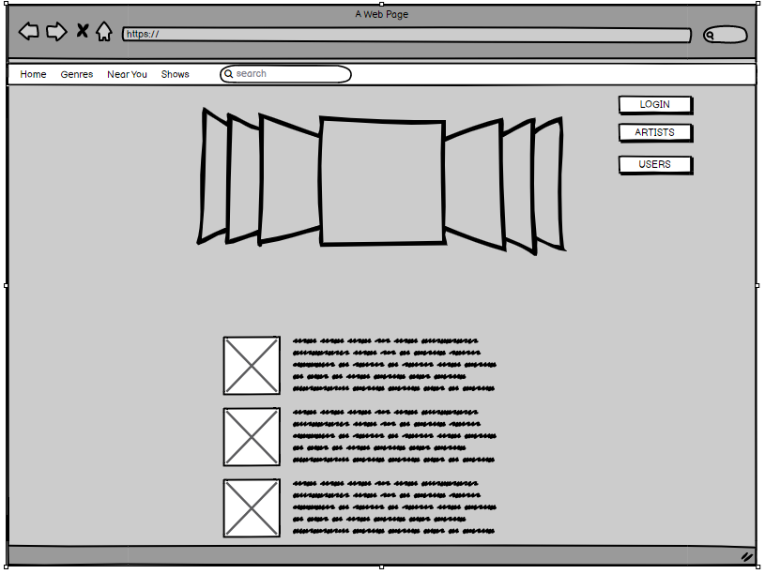
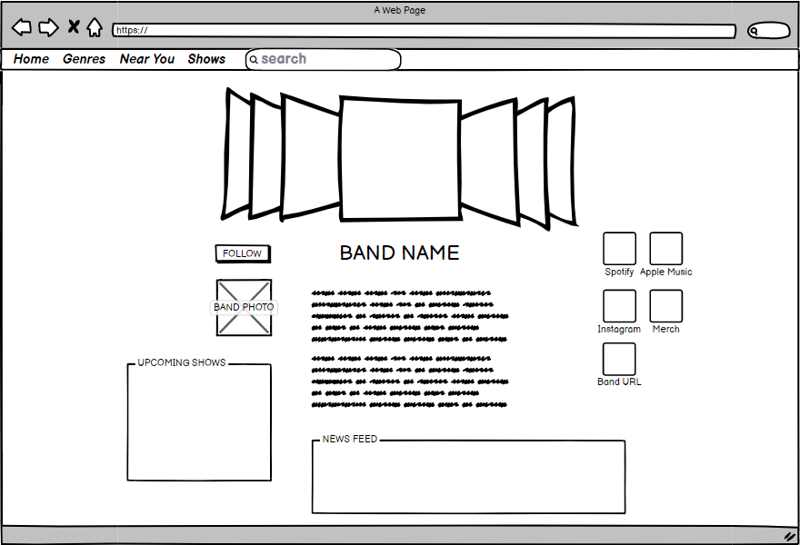
USER INTERFACE

Slide 6

Questions

