Slide 1

Green Pace
Security Policy Presentation
Developer: Robert Wheeler
[Complete this template by replacing the bracketed text with the relevant information.]

Slide 2

OVERVIEW: DEFENSE IN DEPTH
Purpose of the Green Pace Security Policy
Establish consistent security practices for all developers.
Reduce vulnerabilities in software and system architecture.
Standardize secure coding, testing, and remediation procedures.
Support defense in depth through multiple layers of protection.
Defense-in-Depth Layers
Secure coding standards
Code reviews and compiler warnings
Static analysis and unit testing
Encryption and access controls
Monitoring, auditing, and incident response

Slide 3
THREATS MATRIX
STD-004-SQL | SQL injection | High | High | Medium | 1
STD-005-MEM | Memory and bounds errors | High | High | Medium–High | 2
STD-008-PTR | Invalid or null pointers | High | Medium–High | Medium | 3
STD-009-DYN | Dynamic memory management | High | Medium | Medium–High | 4
STD-003-STR | Unsafe string handling | High | Medium | Medium | 5
STD-010-RNG | Weak security randomness | High | Medium | Low–Medium | 6
STD-007-EXC | Exception-handling errors | Medium–High | Medium | Low–Medium | 7
STD-002-VAL | Invalid data values | High | Medium | Medium | 8
STD-001-TYP | Unsafe data types | Medium | Medium | Low | 9
STD-006-AST | Misused assertions | Medium | Low–Medium | Low | 10

Slide 4
10 PRINCIPLES
Validate Input and Data — STD-002-VAL: Data Values; STD-004-SQL: SQL Injection
Heed Compiler Warnings — STD-006-AST: Assertions; STD-007-EXC: Exception Handling
Design with Security in Mind — STD-001-TYP: Data Types; STD-005-MEM: Memory Protection
Keep It Simple — STD-003-STR: String Handling; STD-009-DYN: Dynamic Memory Management
Principle of Least Privilege — STD-005-MEM: Memory Protection; STD-008-PTR: Pointer Safety
Secure Defaults — STD-001-TYP: Data Types; STD-010-RNG: Secure Random Number Generation
Sanitize Data Sent to Other Systems — STD-002-VAL: Data Values; STD-004-SQL: SQL Injection
Defense in Depth — STD-004-SQL: SQL Injection; STD-005-MEM: Memory Protection; STD-010-RNG: Secure Random Number Generation
Establish Effective Quality Assurance — STD-006-AST: Assertions; STD-007-EXC: Exception Handling; STD-008-PTR: Pointer Safety
Adopt a Secure Coding Standard — All ten standards: STD-001-TYP through STD-010-RNG

Slide 5
CODING STANDARDS
STD-001-TYP — Data Types
STD-002-VAL — Data Values
STD-003-STR — String Handling
STD-004-SQL — SQL Injection Prevention
STD-005-MEM — Memory Protection
STD-006-AST — Assertions
STD-007-EXC — Exception Handling
STD-008-PTR — Pointer Safety
STD-009-DYN — Dynamic Memory Management
STD-010-RNG — Secure Random Number Generation

Slide 6
ENCRYPTION POLICIES
Encryption in Flight
Use TLS to protect data transmitted over networks.
Reject expired, invalid, or untrusted certificates.
Do not transmit sensitive information through unencrypted connections.
Encryption at Rest
Encrypt sensitive databases, files, backups, and storage.
Restrict access to encryption keys.
Rotate and protect keys according to policy.
Encryption in Use
Limit access to sensitive data while applications process it.
Minimize plaintext exposure in memory.
Use secure execution environments or confidential computing when appropriate.

Slide 7
TRIPLE-A POLICIES
Authentication — Who are you?
Require strong passwords and multifactor authentication where appropriate.
Verify user and service identities.
Disable or remove inactive accounts.
Authorization — What can you access?
Apply least-privilege permissions.
Use role-based access controls.
Deny access by default unless explicitly approved.
Accounting — What did you do?
Record security-relevant events.
Protect logs against unauthorized modification.
Monitor activity and investigate suspicious behavior.

Slide 8
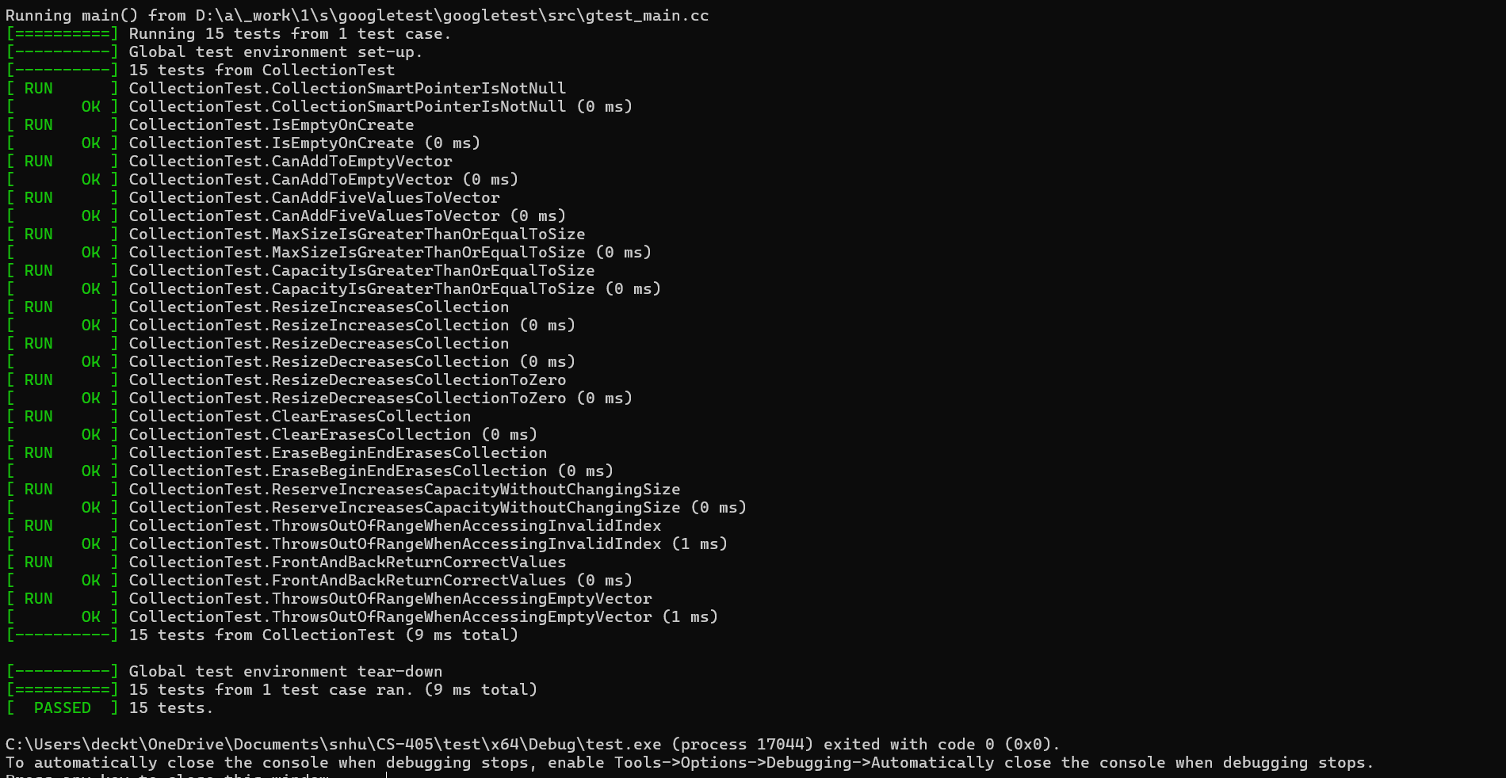
Unit Testing
Test Type: Positive Test
Test Name: CanAddToEmptyVector
Test Objective: Verify that values can be added to an empty std::vector.
Expected Result: The vector stores the added values and its size increases as expected.
Actual Result: PASS — the implemented Google Test assertions passed.
Evidence: Insert the screenshot of the successful Google Test run.

Slide 9

AUTOMATION SUMMARY
How Security Automation Works
Static Analysis: Cppcheck scans source code for potential vulnerabilities.
Compiler Warnings: Visual Studio identifies potential coding errors during compilation.
Automated Unit Testing: Google Test verifies expected behavior using positive and negative tests.
Continuous Testing: Security checks are repeated after code changes to identify new problems.
Manual Review: Developers investigate findings and address issues automated tools may miss.
Goal: Identify and fix vulnerabilities early, consistently, and efficiently.

Slide 10
TOOLS
DevSecOps Pipeline
Develop: Follow secure coding standards in Visual Studio.
Build: Compile and review compiler warnings.
Analyze: Run Cppcheck and review static-analysis findings.
Test: Execute unit tests and controlled security tests.
Release: Review results and resolve critical findings.
Operate: Monitor logs, investigate incidents, and update dependencies.
External Tools
Visual Studio compiler and Error List
Cppcheck static analyzer
C++ unit-testing framework
Version control and automated build pipeline

Slide 11
RISKS AND BENEFITS
Act Now
Fix high-priority vulnerabilities before release.
Reduce the likelihood of data exposure and service disruption.
Establish repeatable security testing.
Wait
Existing vulnerabilities may remain exploitable.
Remediation may become more expensive.
A security incident could damage customer trust.
Strategy Gaps and Risks
Static analysis can produce false positives and miss runtime problems.
Unit tests only cover the scenarios that are tested.
Encryption and access controls require correct configuration and key management.
Tools need maintenance, review, and integration.

Slide 12
RECOMMENDATIONS
Security Policy Gaps
Define measurable remediation deadlines based on severity.
Specify approved encryption protocols and key-management procedures.
Document account reviews and access-removal procedures.
Require security checks in the build and release pipeline.
Establish procedures for reviewing false positives and accepting residual risk.
Define ongoing monitoring, incident response, and policy review responsibilities.

Slide 13
CONCLUSIONS
Standards to Prevent Future Problems
Follow the ten secure coding standards.
Apply CERT C++ secure coding guidance.
Use OWASP SQL injection prevention practices.
Align secure development processes with the NIST Secure Software Development Framework.
Require code review, static analysis, unit testing, and ongoing monitoring.

Slide 14
REFERENCES
Cppcheck. (n.d.). Cppcheck manual. https://cppcheck.sourceforge.io/manual.html
National Institute of Standards and Technology. (2022). Secure software development framework (SSDF) version 1.1: Recommendations for mitigating the risk of software vulnerabilities (SP 800-218). https://doi.org/10.6028/NIST.SP.800-218
OWASP Foundation. (n.d.). SQL injection prevention cheat sheet. https://cheatsheetseries.owasp.org/cheatsheets/SQL_Injection_Prevention_Cheat_Sheet.html
U.S. Government Accountability Office. (2018). Data protection: Actions taken by Equifax and federal agencies in response to the 2017 breach (GAO-18-559). https://www.gao.gov/products/gao-18-559
SEI CERT. (n.d.). SEI CERT C++ coding standard. Carnegie Mellon University Software Engineering Institute. https://wiki.sei.cmu.edu/confluence/display/cplusplus/SEI+CERT+C%2B%2B+Coding+Standard

