Slide 1
An introduction to git
Ryan Bignell

Slide 2
Quote
Dot points
What is git
“Git is a distributed version-control system for tracking changes in source code during software development. It is designed for coordinating work among programmers, but it can be used to track changes in any set of files. Its goals include speed, data integrity, and support for distributed, non-linear workflows”
Version control system
External backup solution
Collaborative design environment
This presentation will be based on Albert’s guide and also https://patrickzahnd.ch/blog.html#gittransport

Slide 3
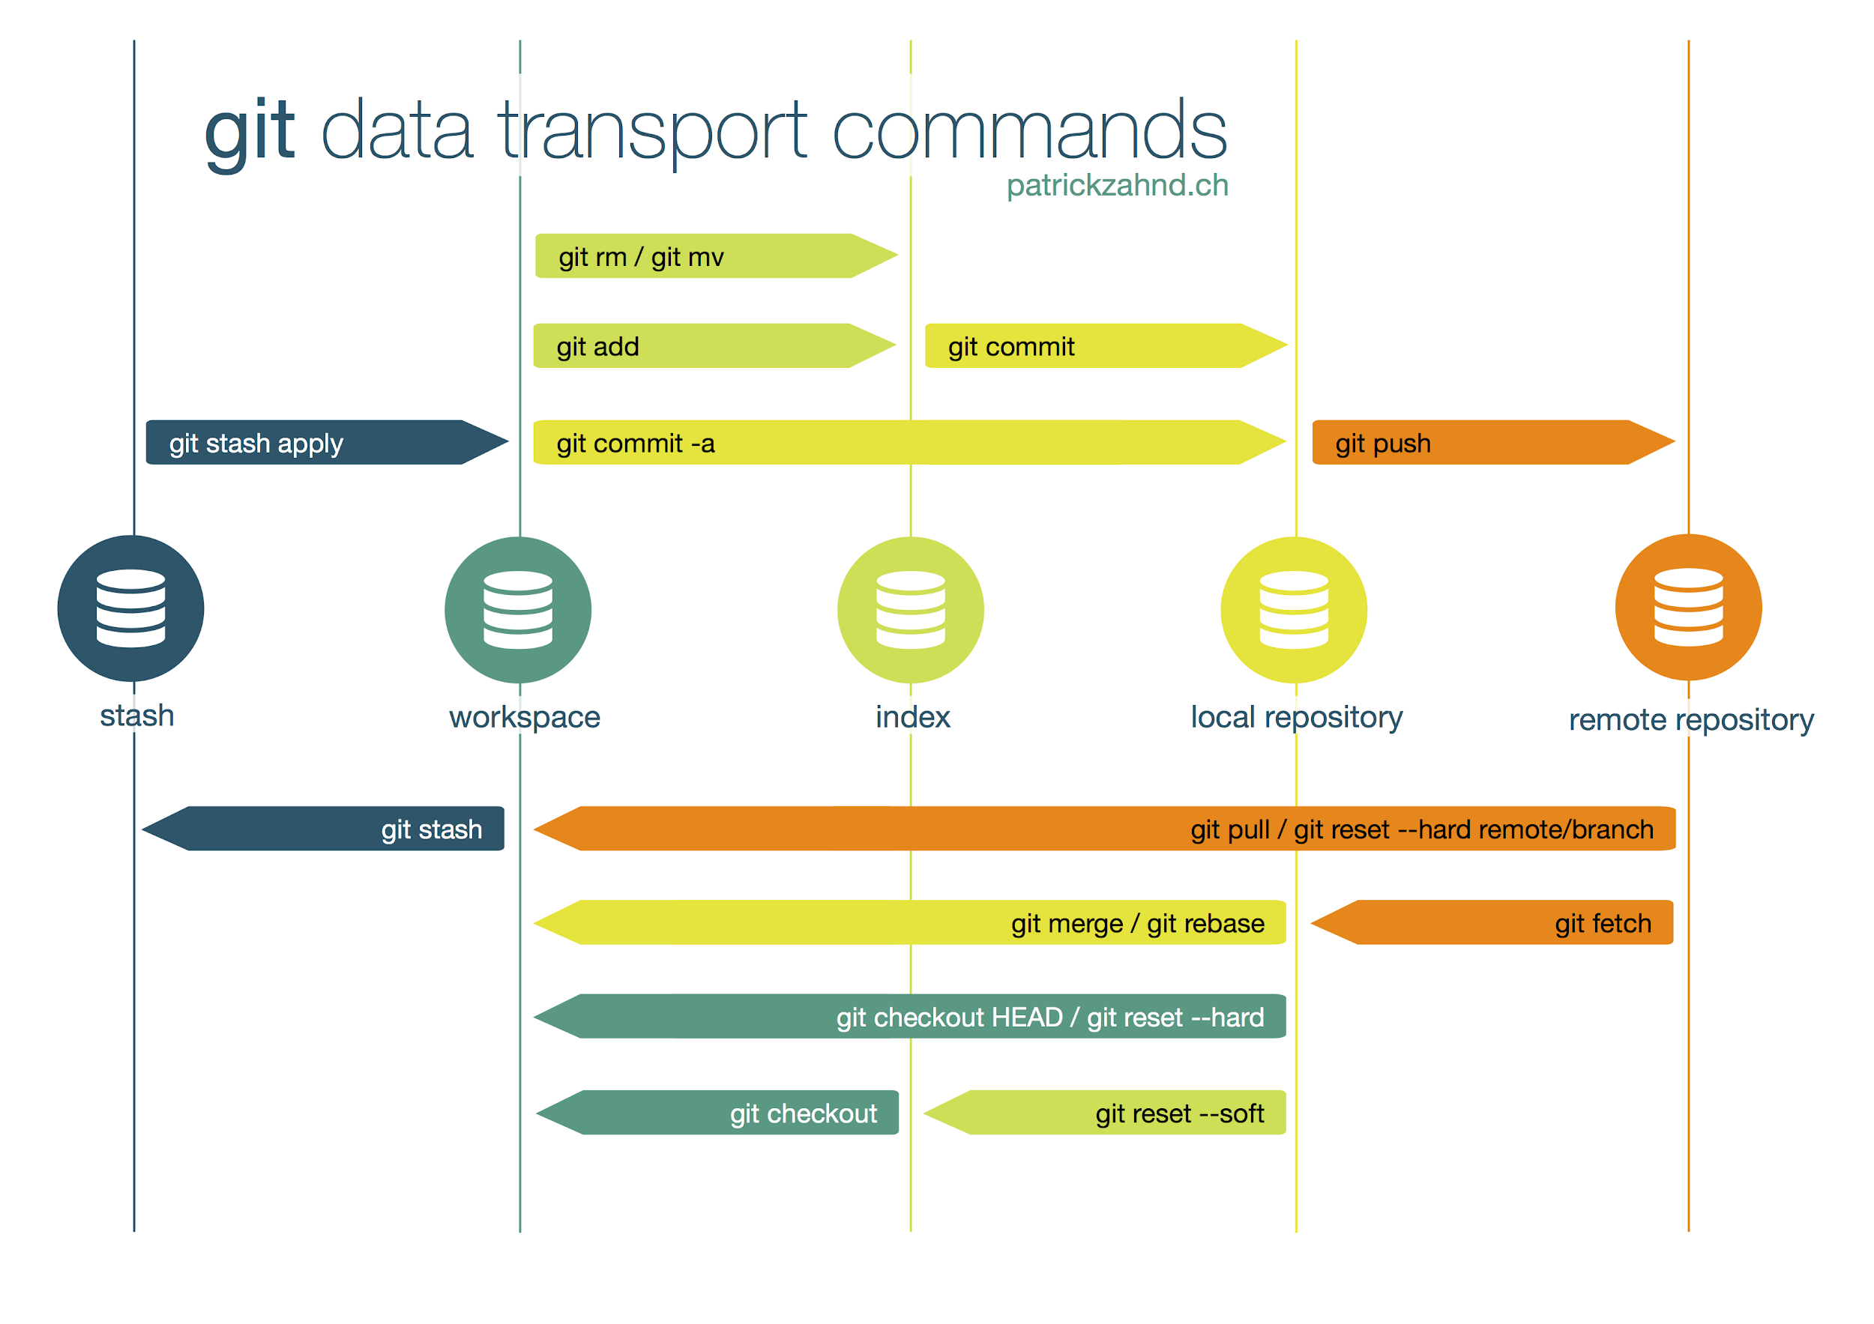

Slide 4
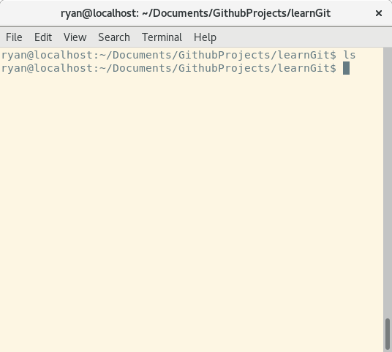
Commands
Getting Started
Start a new repository in an empty folder using
git init
See the status of the git repository using
git status

Slide 5
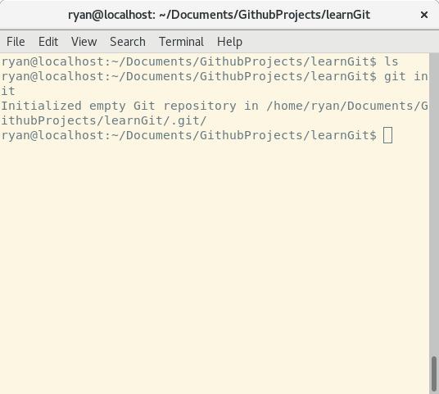
Commands
Getting Started
Start a new repository in an empty folder using
git init
See the status of the git repository using
git status

Slide 6
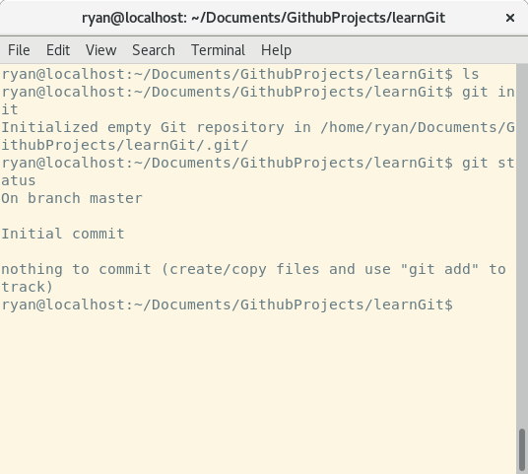
Commands
Getting Started
Start a new repository in an empty folder using
git init
See the status of the git repository using
git status

Slide 7
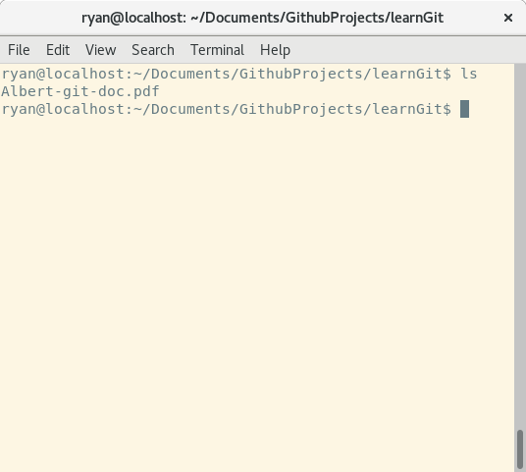

Commands
Getting Started
Copied a file into our folder
Albert-git-doc.pdf
This item is in the workspace

Slide 8
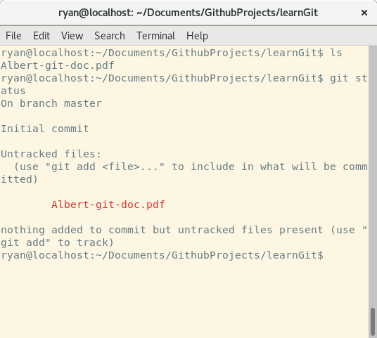
Commands
Getting Started
Copied a file into our folder
Albert-git-doc.pdf
This item is in the workspace

Slide 9
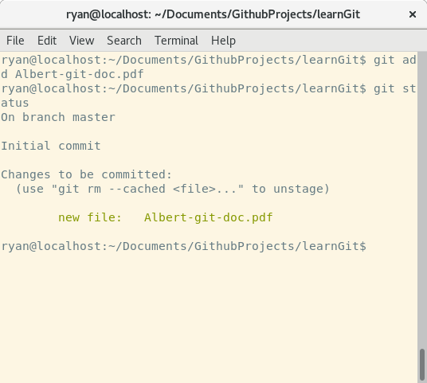

Commands
Getting Started
Add the file to the index using
git add Albert-git-doc.pdf
A snapshot of this file is now in the index

Slide 10
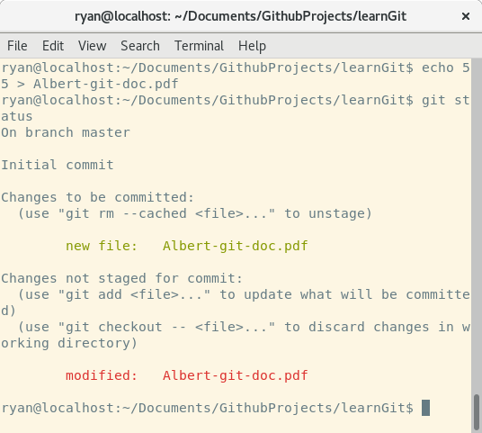
Commands
Getting Started
What if I change Albert-git-doc.pdf ?
echo 55 > Albert-git-doc.pdf
git status
Change in workspace but the snapshot in index is unchanged

Slide 11
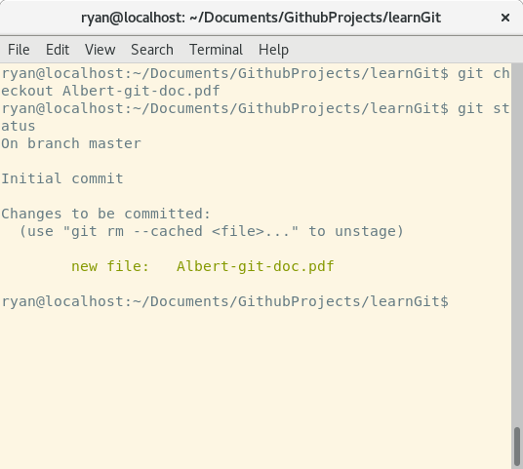
Commands
Getting Started
Ok echo 55 is pretty dumb, let’s get rid of that change and go back to the version in the we snapshotted
git checkout Albert-git-doc.pdf
git status

Slide 12
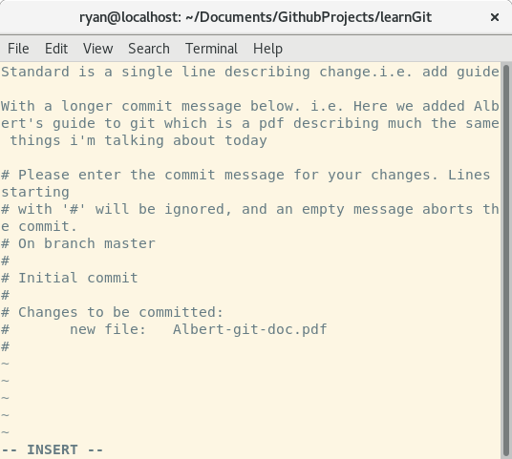
Commands
Getting Started
Let’s commit this change. I.e. We’re finished what we were doing with Albert-git-doc.pdf
git commit

Slide 13
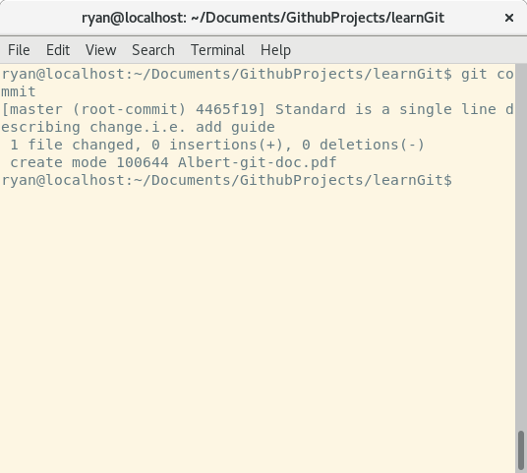

Commands
Getting Started
Let’s commit this change. I.e. We’re finished what we were doing with Albert-git-doc.pdf
git commit
File is now stored in the local repository.

Slide 14
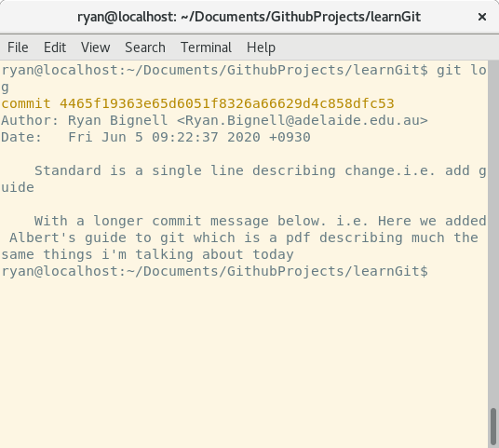
Commands
Getting Started - Recap
What have we done so far?
Created a repository
Added a file to the repository so that git knows about it.
Committed the state of that file to the repository.
git log

Slide 15
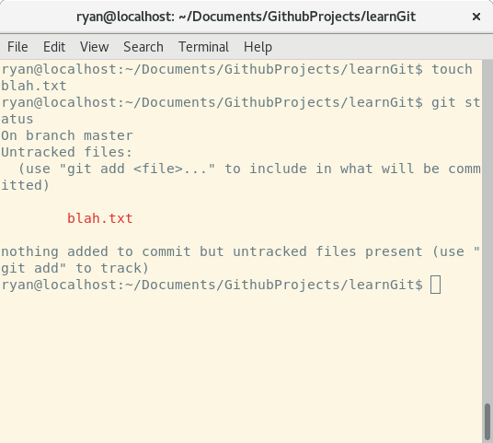
Commands
Aside: Tracking
When you add a file to git using `git add` you tell git you care about this file and want modifications to this file to be tracked
touch blah.txt
git status
blah.txt is untracked as we haven’t added it. It’s still in our workspace though

Slide 16
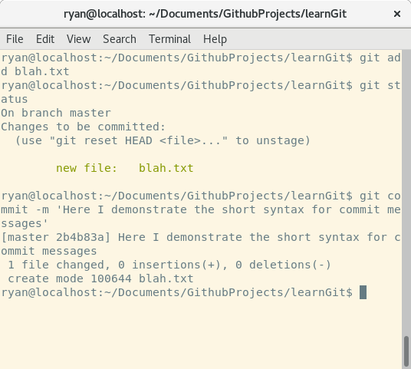
Commands
Continued
Let’s add blah.txt
git add blah.txt; git status; git commit -m ‘Here I demonstrate the short syntax for commit messages’
We’ve now added blah.txt to our repository

Slide 17
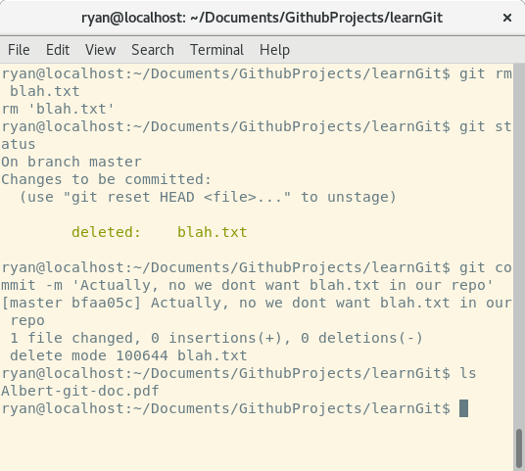
Commands
Removing files
Let’s remove blah.txt from repository
git rm blah.txt
Removes the file - both from repository tracking and file system.
git status; git commit -m ‘Actually, no we dont want blah.txt in our repo’; ls

Slide 18
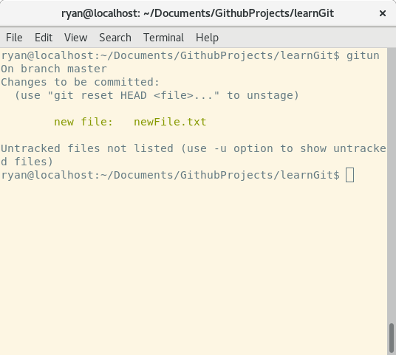
Commands
Unstaging changes
Let’s add (stage) a new file to be committed.
Touch newFile.txt; git add newFile.txt; git status

Slide 19
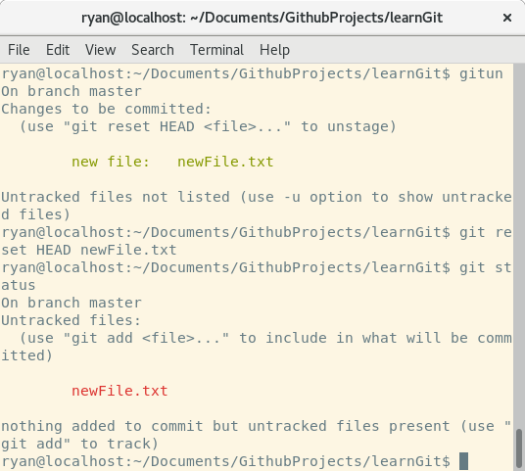
Commands
Unstaging changes
We haven’t finished editing yet though. It is not ready to be committed.
So unstage so we can do another snapshot to index later
git reset HEAD newFile.txt

Slide 20
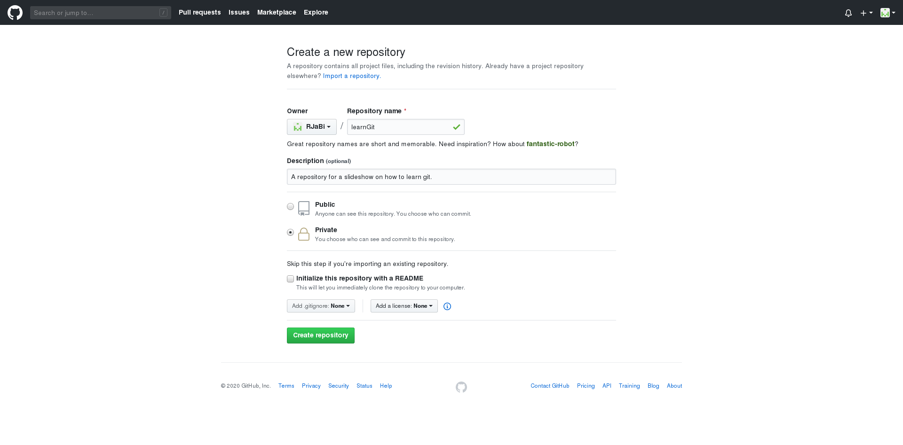

Aside: Remote Repository

Slide 21
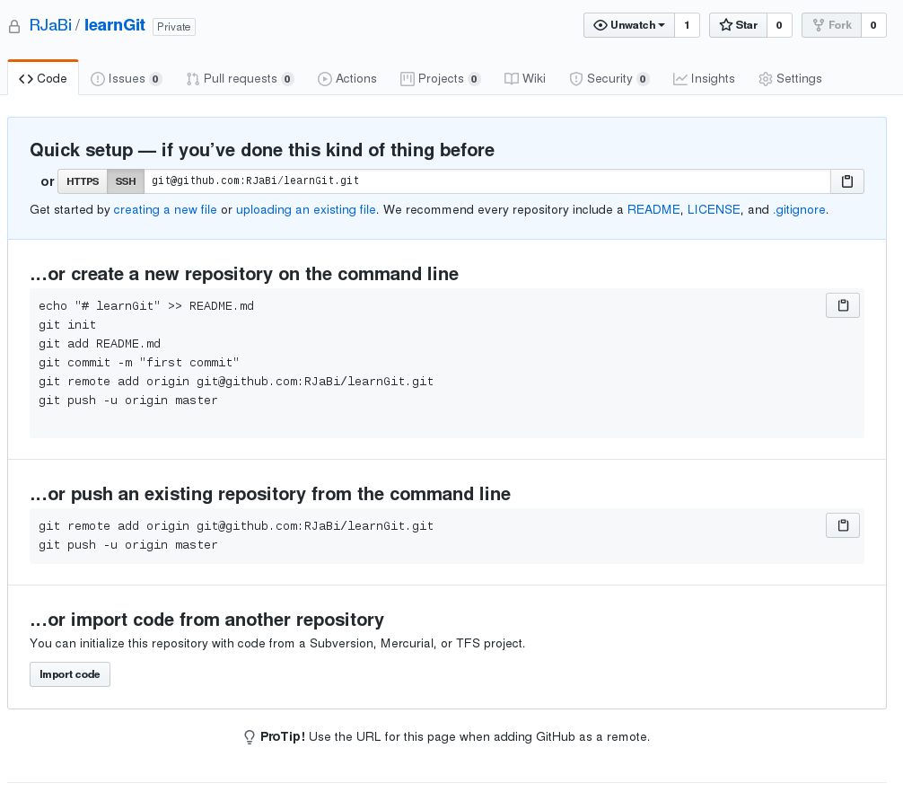
Github
Aside: Remote Repository
Github is one of many online git repository systems. I use it purely because I have an account there.
Alternatives include
bitbucket
Gitlab
Self hosted and enterprise solutions are also available.

Slide 22
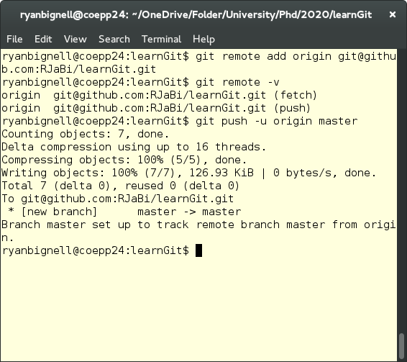
Commands
Aside: Remote Repository
I use the ssh interface, https also available
git remote add origin git@github.com:RJaBi/learnGit.git
Check remote worked using
git remote -v
Push to remote repository using
git push -u origin master
Origin is address of remote repo, master is the branch we’re pushing

Slide 23
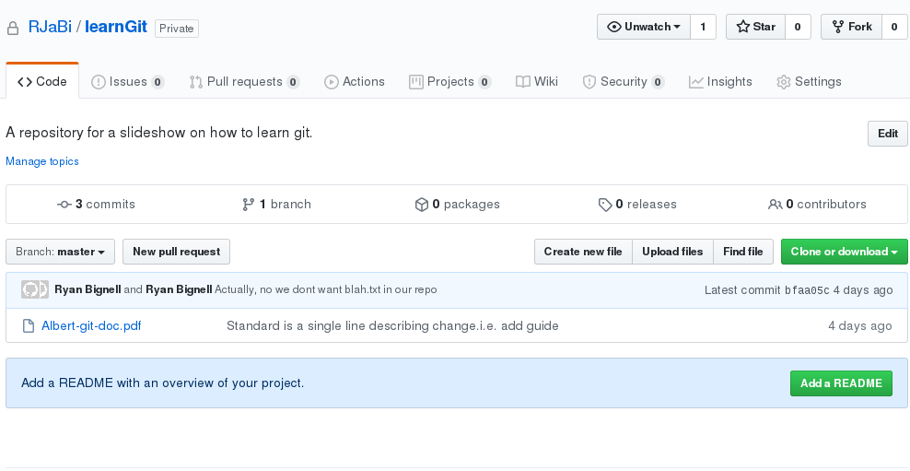
Aside: Remote Repository

Slide 24
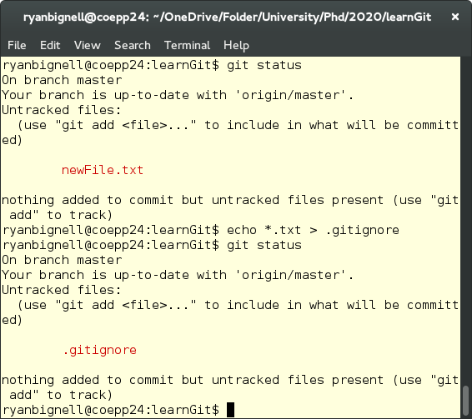
Commands
Gitignore Files
Add a file to tell it we don’t care about .txt files
git status; echo *.txt > .gitingore; git status
Can see that have a new file .gitignore and that git status is no longer telling us about .txt files.
Intended for use with i.e. *.pyc, *aux files (working files)
This Github Repo has examples for different languages.

Slide 25
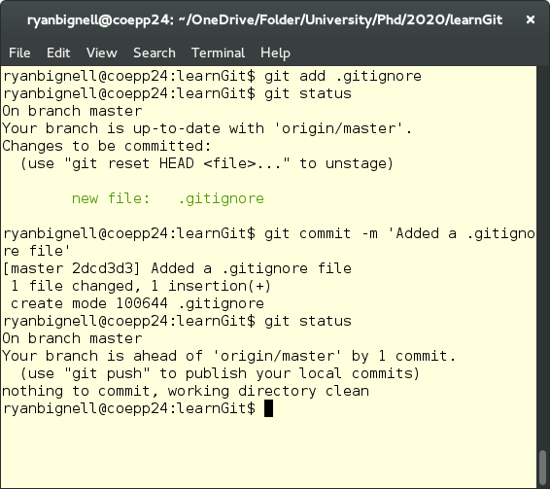
Commands
Gitignore Files
Let’s just add this file to our repo
git add .gitignore; git status; git commit -m ‘Added a .gitignore file’
git status
Now see that our local repository has more commits than the remote.

Slide 26
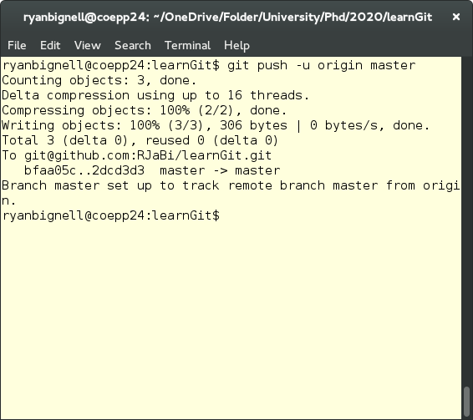
Commands
Gitignore Files
So push the changes to remote repository
git push -u origin master

Slide 27

Quotes
Brief outline to Branches
“The diagram right visualizes a repository with two isolated lines of development, one for a little feature, and one for a longer-running feature. By developing them in branches, it’s not only possible to work on both of them in parallel, but it also keeps the main master branch free from questionable code.”
“Git branches are effectively a pointer to a snapshot of your changes.”
Good guides are available from Atlassian and Noble Desktop.
(I actually used Atlassian git guides a lot when first learning git. They’re very good).

Slide 28
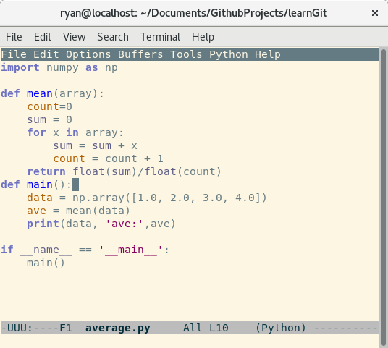
Words
Average branching example
Use the example of calculating average as an example. Write the opposite python script. The mean value here is 2.5.

Slide 29
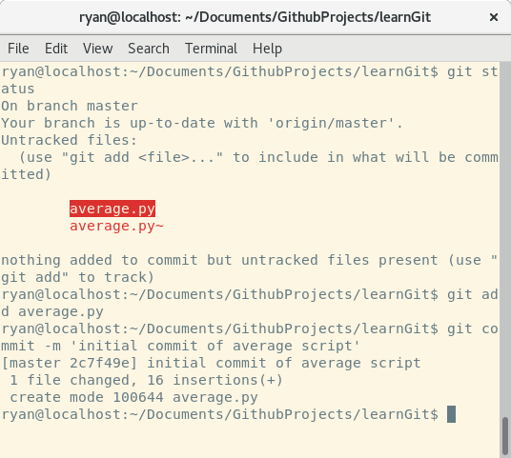
master
Average branching example
Use the example of calculating average as an example. Write the opposite python script. The mean value here is 2.5.
Let’s commit it as usual.
git status; git add average.py; git commit -m ‘initial commit of average script’

Slide 30
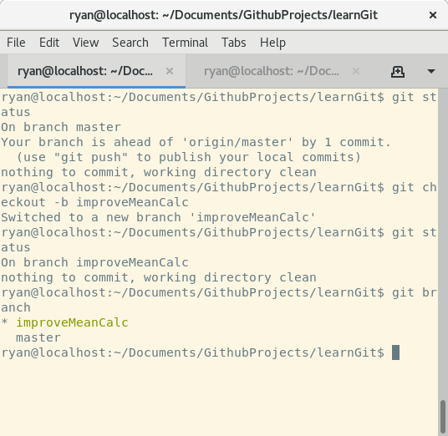
improveMeanCalc
Average branching example
Now switch to a new branch. We’re going to make the calculation of the mean better.
git status; git checkout - b improveMeanCalc
improveMeanCalc is the name of the branch
git status; git branch
git branch shows the branches in our local repository. Clearly improveMeanCalc is the active branch in the workspace/index

Slide 31
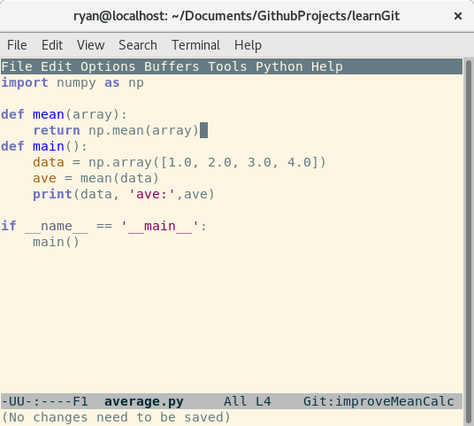
improveMeanCalc
Average branching example
So i’ve just replaced the loop to calculate the mean with numpy’s vectorised form.

Slide 32
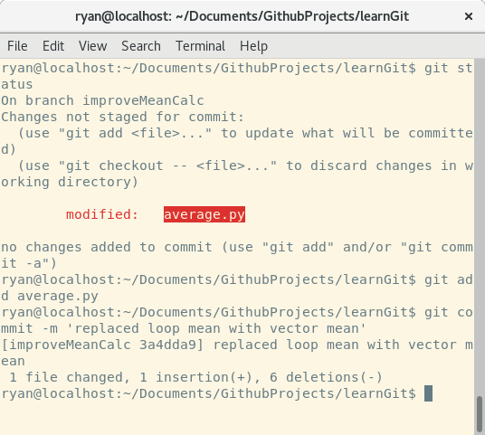
improveMeanCalc
Average branching example
So i’ve just replaced the loop to calculate the mean with numpy’s vectorised form. Then commit to repo
Git status; git add average.py; git commit -m ‘replaced loop mean with vector mean’

Slide 33
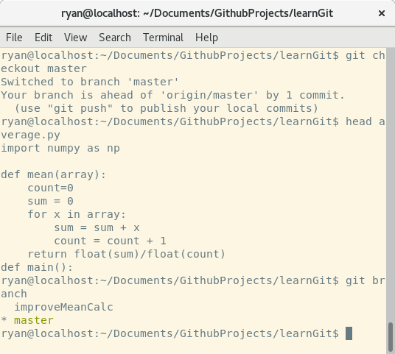
improveMeanCalc -> master
Average branching example
Let’s double check that master hasn’t been changed.
git checkout master; head average.py
It hasn’t changed! Still the loop calc.
We used git checkout earlier to ‘reset’ a changed file to the version in the index. Here we use it to switch what branch we’re on
git branch

Slide 34
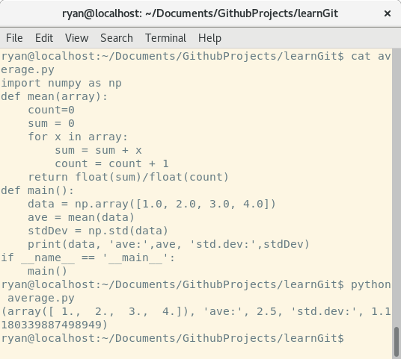
master
Average branching example
While we’re here. Let’s add some new functionality to average.py - the std. Dev. Here i’ve just made that change, printed the python file to the terminal and run it once.

Slide 35
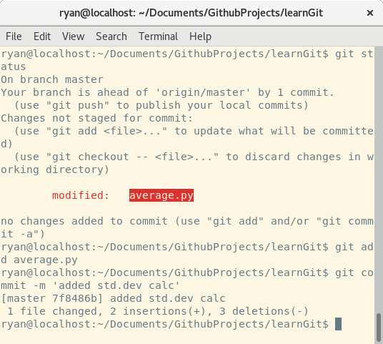
master
Average branching example
Let’s commit changes
git status; git add average.py; git commit -m ‘added std.dev calc’

Slide 36
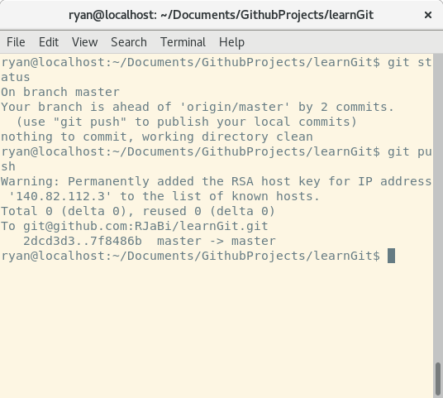
master
Average branching example
Let’s commit changes
git status; git add average.py; git commit -m ‘added std.dev calc’
Also push changes on master branch to remote repo

Slide 37
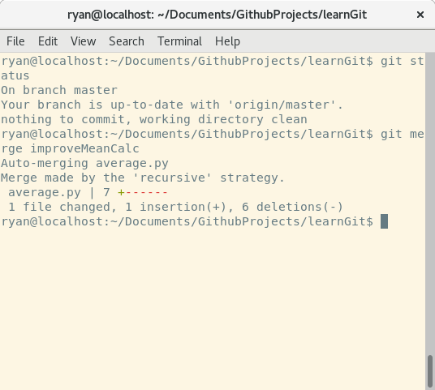
master
Average branching example
Let’s grab the changes from the improveMeanCalc branch now.
git status; git merge improveMeanCalc
This bring changes from improveMeanCalc into master

Slide 38
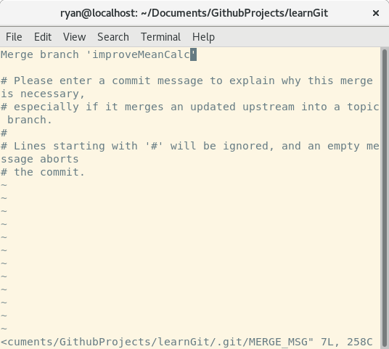
master
Average branching example
Let’s grab the changes from the improveMeanCalc branch now.
git status; git merge improveMeanCalc
This bring changes from improveMeanCalc into master

Slide 39
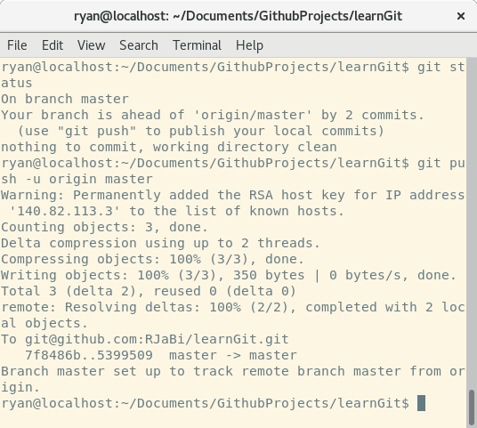
master
Average branching example
Push to remote repo
git status; git push -u origin master
Can see that now 2 commits ahead of remote repo. This is as the merge process is in itself a commit.

Slide 40
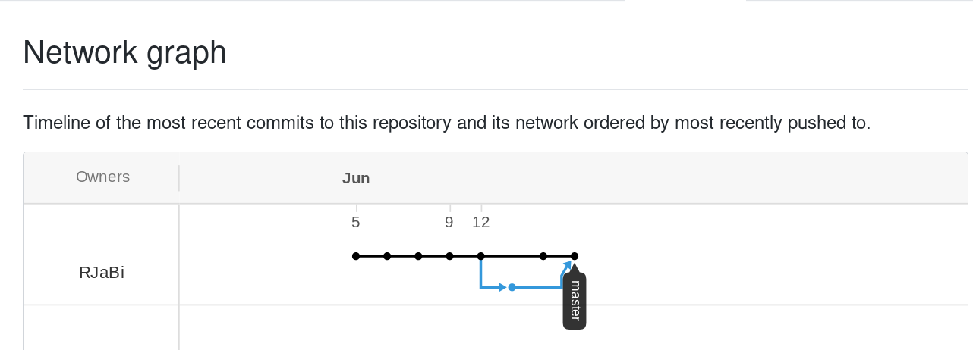
Github Network
A convenient way to visualise your branch structure is on Github.
Here we can see where we branched off for the improveMeanCalc commit (in blue)

Slide 41
Conclusions?
Resources
Final Slide
Hopefully this slideshow is useful as a guide to some basic git usage.
I haven’t covered features such as
The stash
Pull requests
git log
git diff
Albert’s repo of git tricks: https://github.cs.adelaide.edu.au/a1687112/git-gear
`git status -uno` is my standard git status command. It doesn’t show untracked files
Atlassian and Noble Desktop.
https://patrickzahnd.ch/blog.html#gittransport
This repository and slideshow: https://github.com/RJaBi/learnGit

