Slide 1
An introduction to lyncs (io)
Ben Page & Ryan Bignell
https://github.com/RJaBi/learnLyncs

Slide 2
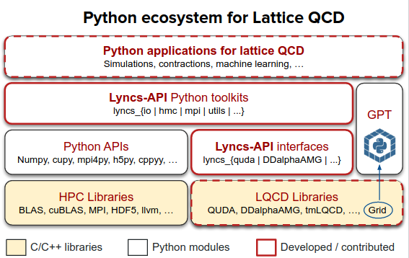
A Python API for Lattice QCD applications
Dot points
What is Lyncs-API?
“Lyncs is a Python API for Lattice QCD, currently under development. Lyncs aims to bring several popular libraries for Lattice QCD under a common framework.”
Version control system
External backup solution
Collaborative design environment
This presentation will be based on Albert’s guide and also https://patrickzahnd.ch/blog.html#gittransport

Slide 3
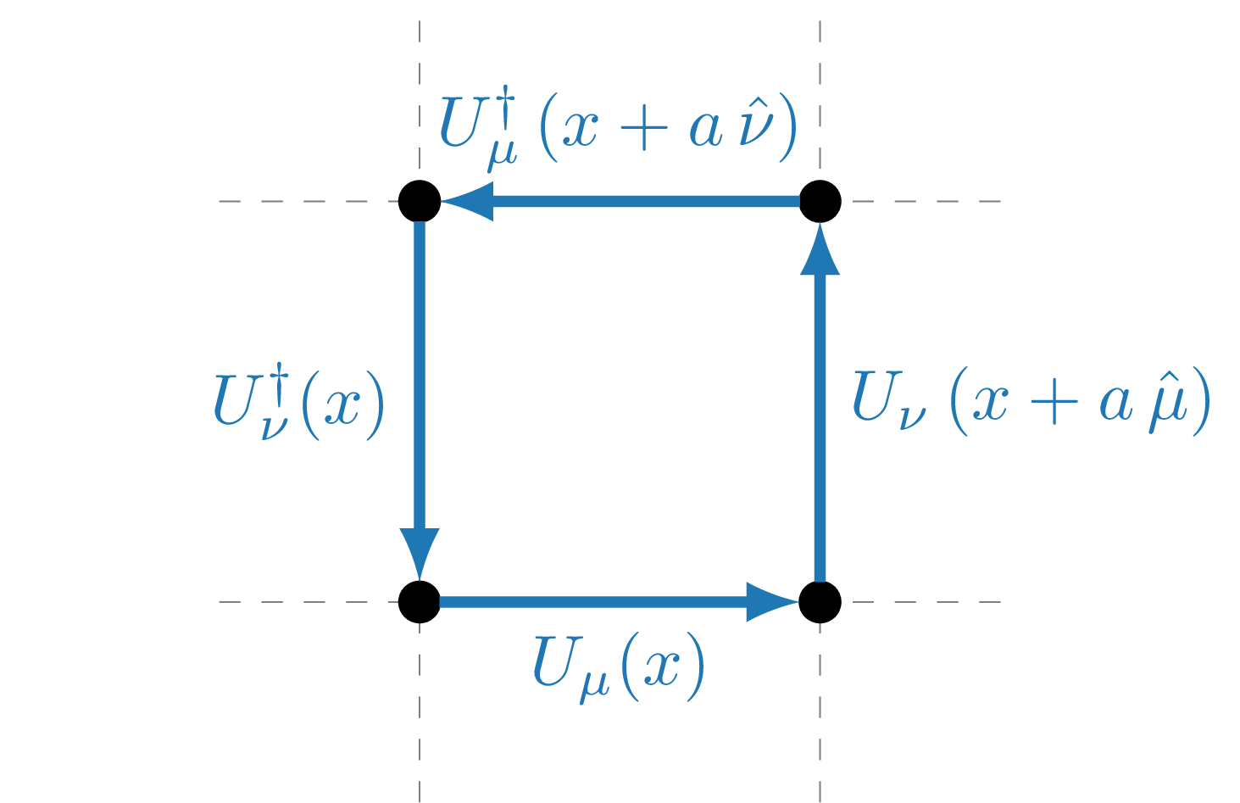
READ GAUGEFIELD
GOAL
We would like to read our gaugefield into a rank 7 array
NT, NX, NY, NZ, MU, NC, NC
Space-time dimensions, direction, colour, colour
This will make understanding and interoperability easier
Example calculation will be the plaquette
Used in gluonic portion of QCD action

Slide 4
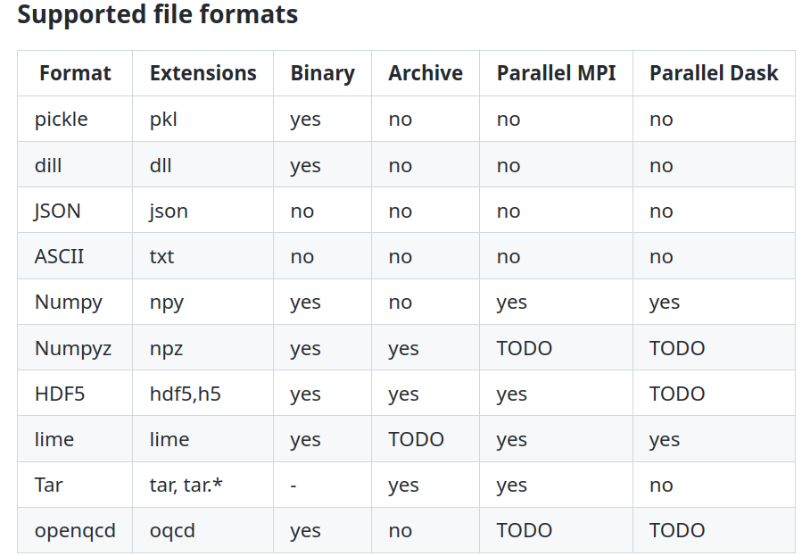
lyncs_io
IO functions (load and save) that supports various formats and also parallel IO via MPI and Dask.
Available via pip (see Installation)
$ pip install lyncs_io

Slide 5
pip / conda
Environment.yml
INSTALLATION
Lyncs can be installed via the pip or conda package installers using: $ pip install lyncs
or
$ conda install lyncs
Individual lyncs packages may be installed by explicitly specifying the subpackage:
$ conda install lyncs_io
We supply conda environment files for linux, max and windows (untested)
These set up the packages needed
After installing conda, simply run
$ conda env create -f environment.yml
With the appropriate environment file
Activate environment with
$ conda activate lyncs

Slide 6
Installation
Executing learnLyncs.ipynb
JUPYTER
Jupyter may be installed in a similar manner to Lyncs via pip:
$ pip install jupyterlab
conda requires the forge channel to be set first:
$ conda config --add channels conda-forge
$ conda config --set channel_priority strict
$ conda install jupyterlab
The demonstration notebook may be found at github.com/RJaBi/learnLyncs
Follow the installation section to configure the notebook environment
Start jupyter via
(linux) $ jupyter notebook
(mac) $ jupyter-notebook

Slide 7
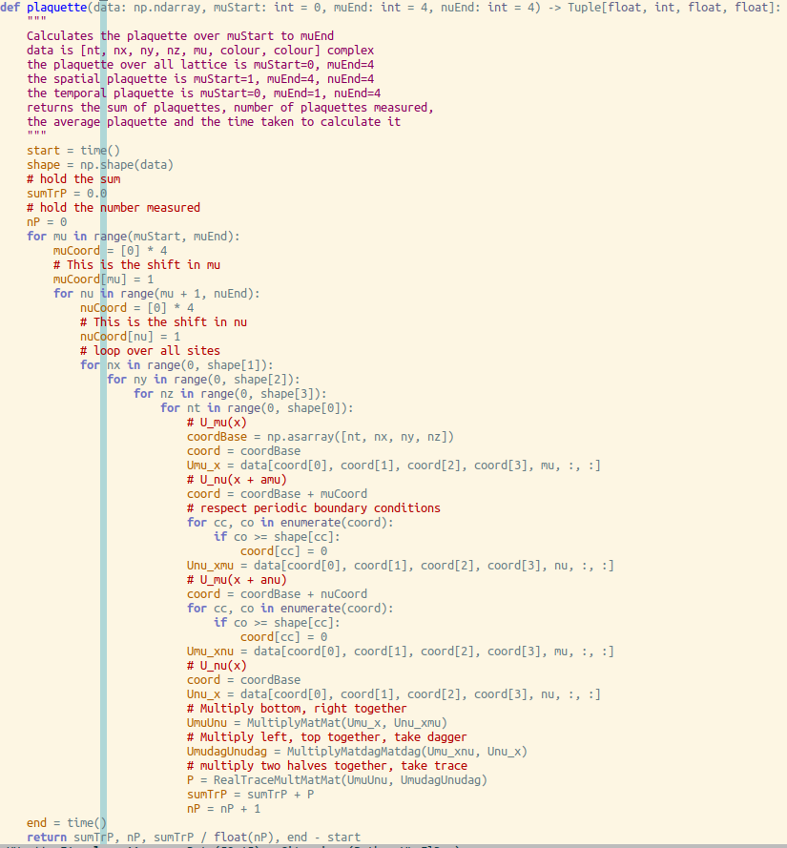
Algorithm
Plaquette Calculation
Loop over each direction combination
Loop over each lattice site
Calculate plaquette on each site/direction combination
Respecting periodic boundary conditions
Return sum, average and time taken
Here data has shape
NT, NX, NY, NZ, MU, NC, NC
PLAQUETTE CODE PICTURE

Slide 8
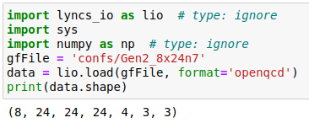
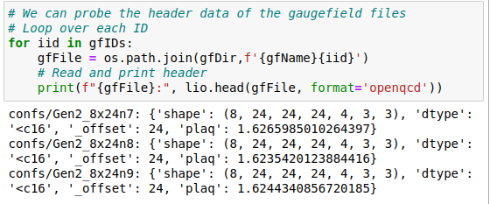
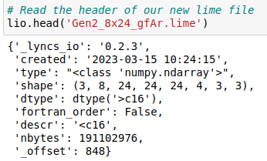
Reading gaugefield data
Reading header data
USING LYNCS

Slide 9
C
FORTRAN
OUTPUT TO C/FORTRAN
Lyncs offers Numpy as a data container
Numpy has the same (row-major) memory ordering as C
data = lyncs_io.load(<infile>)
data.to_file(<outfile>)
See ‘readC.c’ for reading back into C
Fortran uses column-major memory ordering
Need to recast data before saving
data = lyncs_io.load(<infile>)
data.reshape(data.shape, order=`F`)
data.to_file(<outfile>)
See ‘readFortran.f90’ for reading back into Fortran

Slide 10
https://github.com/RJaBi/learnLyncs/blob/main/learnLyncs.ipynb
This is a link to the demonstration notebook

