Slide 1
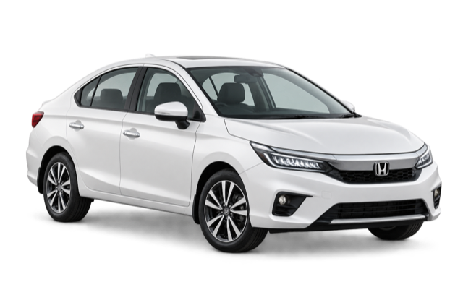
BUILD WHAT MOVES INDIA · 2026
Parivahan
Sarathi
The understandable layer for India’s transport services
One person · One transport workspace · One clear next action
Independent hackathon prototype · Synthetic data
PARIVAHAN SARATHI
01
Notes:
Open with the citizen problem, not the feature list. Position Sarathi as a guidance and orchestration layer—not an official replacement.
[Sources]
- docs/PRD.md
- docs/RESEARCH.md

Slide 2
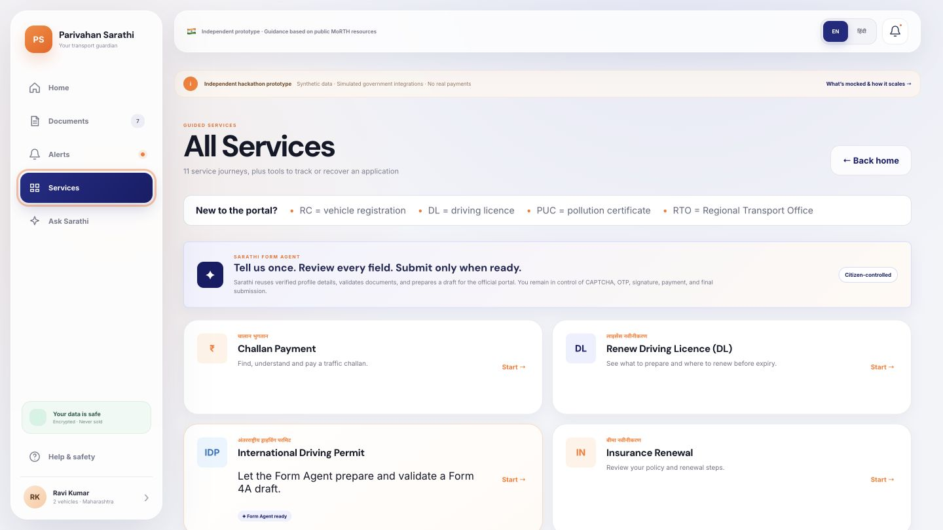
WHY I PICKED THIS PROBLEM
A service can be online—and still feel impossible to complete.
When I explored transport journeys, the transactions existed. The missing layer was understanding.
Which service owns my task?
What should I prepare before I start?
Did the payment or application really complete?
Online does not always mean understandable.
PARIVAHAN SARATHI
02
Notes:
Explain the origin honestly: the public services exist, but a novice citizen still has to map intent to portals, forms, prerequisites, and confirmation.
[Sources]
- https://parivahan.gov.in/contactus
- https://parivahan.gov.in/parivahan/en/content/download-forms
- docs/RESEARCH.md

Slide 3
THE COMPLETION GAP
The burden is not finding a portal. It is completing the journey.
Vahan
Sarathi
eChallan
State RTO
→
→
→
vehicle records
licence services
notices & payment
local rules & visits
CITIZEN REALITY
One deadline crosses documents, forms, language, eligibility, payment and proof.
PARIVAHAN SARATHI
03
Notes:
Show fragmentation without attacking official systems. These portals are authoritative; the user burden is the cross-system preparation and interpretation required around them.
[Sources]
- https://parivahan.gov.in/contactus
- https://sarathi.parivahan.gov.in/
- docs/RESEARCH.md

Slide 4
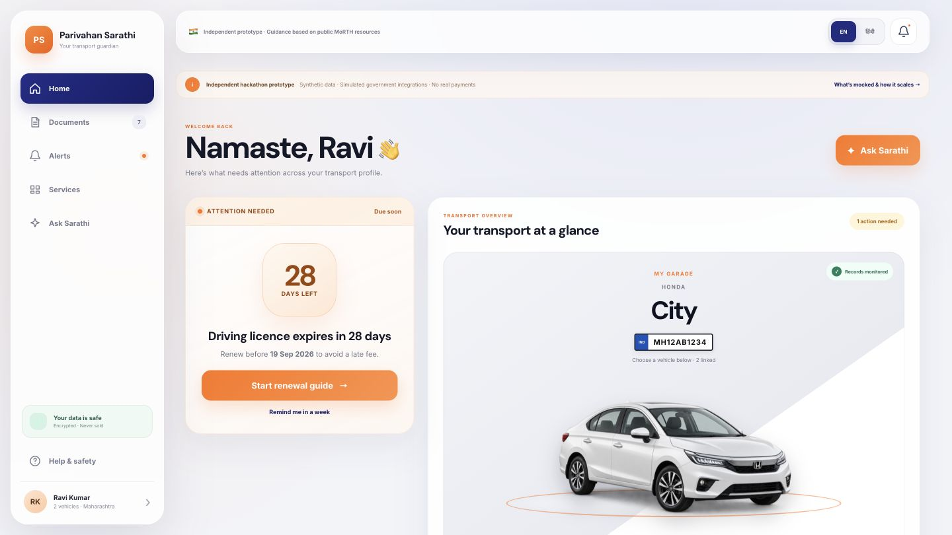
THE PRODUCT INSIGHT
Citizens need the next action—not another service directory.
Sarathi behaves like a guardian around official services.
01
Prioritise
02
Explain
03
Prepare
04
Hand off safely
PARIVAHAN SARATHI
04
Notes:
Introduce the product model: one person-centred workspace across licences, vehicles, documents, deadlines, and applications.
[Sources]
- docs/PRD.md
- docs/RESEARCH.md

Slide 5
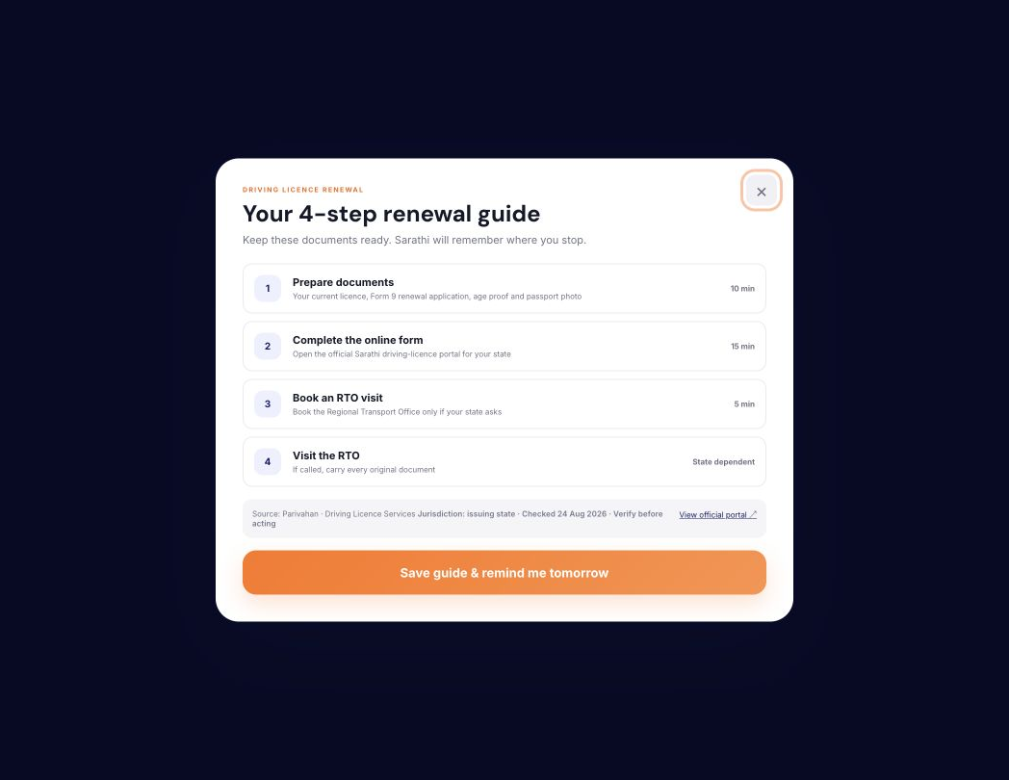
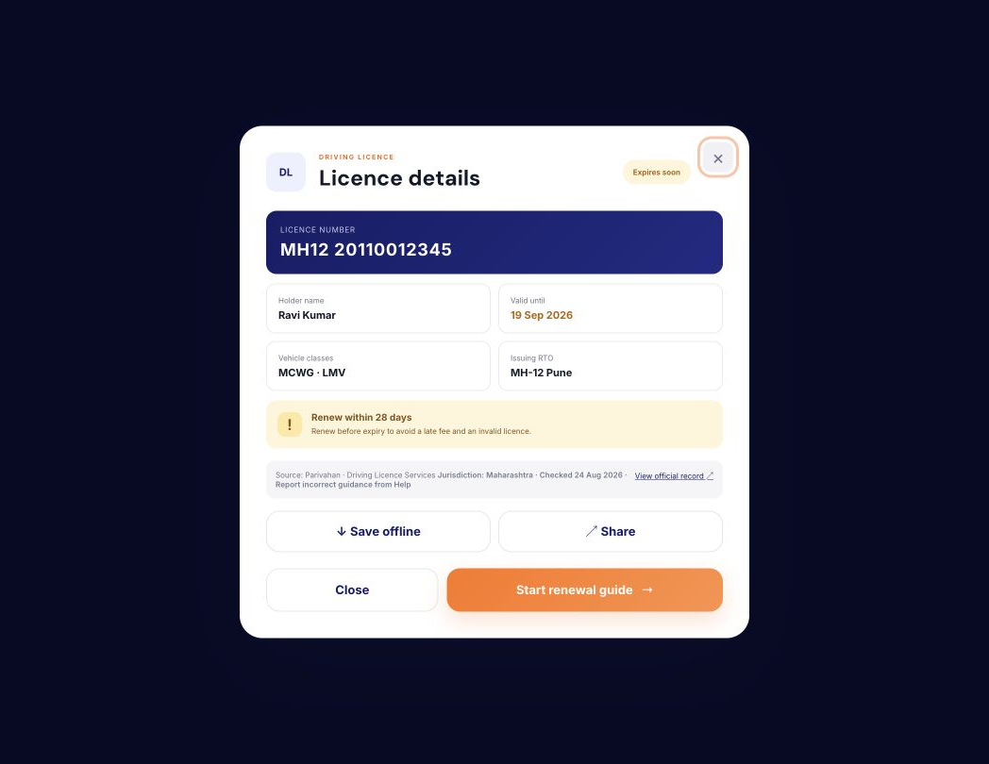
THE HERO JOURNEY
A looming deadline becomes a prepared official handoff.
→
→
28 days
4 steps
Ready
Know what matters
Understand the path
Carry the right record
PARIVAHAN SARATHI
05
Notes:
Walk through one complete citizen story: Ravi sees the deadline, understands the steps, and reaches the official service prepared. Do not imply the prototype renews the licence.
[Sources]
- docs/PRD.md
- https://mparivahan.parivahan.gov.in/mstatic/english/dl-info-renewal-dl.html

Slide 6
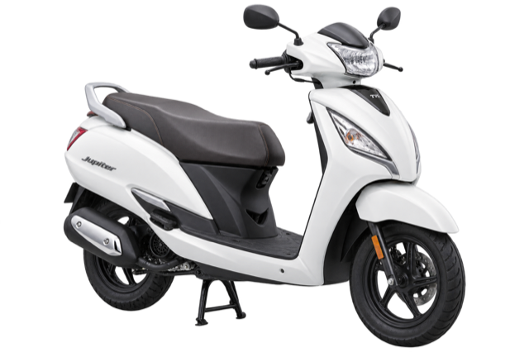
DESIGNED AROUND THE PERSON
Ravi is not a registration number.
Personal obligations stay separate from vehicle records—without losing the whole picture.
RAVI
Driving Licence
Applications
Preferences
+
Honda City
TVS Jupiter
PERSONAL
RC · Insurance · PUC
RC · Insurance · PUC
PARIVAHAN SARATHI
06
Notes:
Explain the key redesign: identity begins with a person and optional mobile profile, while vehicles are linked assets. This supports households and multiple vehicles cleanly.
[Sources]
- docs/PRD.md
- docs/adr/0014-person-centred-multi-vehicle-profile.md
- docs/adr/0015-mobile-profile-and-guest-payment.md

Slide 7
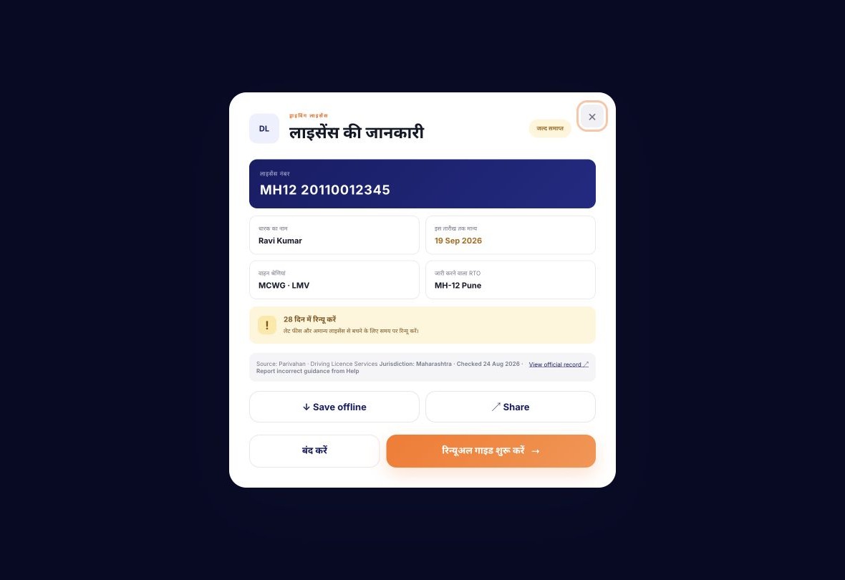
INCLUSION IS PART OF THE FLOW
Less reading. Fewer barriers. Useful even when connectivity drops.
हिंदी + English
Interface-level language switching
Guest first
Challan and guidance without forced login
Offline + Share
Citizen-controlled document access
Mobile first
Responsive navigation and touch targets
PARIVAHAN SARATHI
07
Notes:
Position inclusion as reduced cognitive load, not only translation. Mention that native-language and accessibility testing remain future validation work.
[Sources]
- docs/ACCESSIBILITY.md
- docs/PRD.md
- docs/TEST_REPORT.md

Slide 8
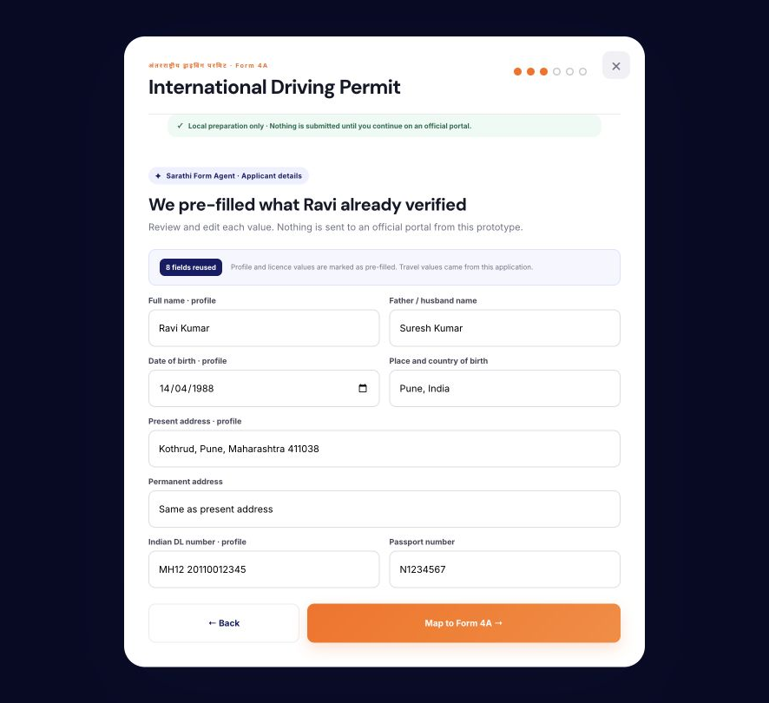
RESPONSIBLE FORM AGENT
AI prepares. The citizen authorises.
International Driving Permit preparation demonstrates the boundary.
Reuse reviewed profile fields
Find missing evidence
Prepare a local draft
NEVER
CAPTCHA · OTP · declaration · payment · submission
PARIVAHAN SARATHI
08
Notes:
This is the responsible-AI centrepiece. The agent organises and validates information but leaves authentication, legal declarations, payment, and submission with the citizen.
[Sources]
- https://parivahan.gov.in/parivahan/sites/default/files/DownloadForm/form4a.pdf
- https://mparivahan.parivahan.gov.in/mstatic/english/dl-info-international.html
- docs/AI-EVALUATION.md
- docs/ARCHITECTURE.md

Slide 9
TRUST IS A PRODUCT FEATURE
Consequential actions never depend on generated confidence.
AI may assist
Workflow must validate
Citizen or authority decides
Explain a term
Required fields
OTP and CAPTCHA
Extract into a schema
Amounts and states
Payment and declaration
Prepare a draft
Source freshness
Official completion
PARIVAHAN SARATHI
09
Notes:
Explain the authority model. A success animation is not proof; production completion requires an authoritative receipt or status reconciliation.
[Sources]
- docs/ARCHITECTURE.md
- docs/AI-EVALUATION.md
- docs/RESPONSIBLE-AI-THREAT-MODEL.md

Slide 10
HOW IT CAN SCALE SAFELY
A production system adds consent, approved integrations and reconciliation.
1
2
3
4
5
Citizen consent
→
Approved gateway
→
Rules + grounded AI
→
Official handoff
→
Reconciled status
Purpose + revocation
Least privilege + audit
Versioned official sources
Citizen confirms action
Receipt before ‘complete’
Prototype today: no backend · no live model · no government API · no real payment
PARIVAHAN SARATHI
10
Notes:
Be explicit about what exists and what does not. The hackathon correctly uses transparent mocks; production would require formal consent, approved APIs, controls, and reconciliation.
[Sources]
- https://buildwhatmovesindia.com/brief
- https://buildwhatmovesindia.com/faq
- https://www.meity.gov.in/writereaddata/files/Digital%20Personal%20Data%20Protection%20Act%202023.pdf
- docs/ARCHITECTURE.md
- docs/MOCKS-AND-LIMITATIONS.md

Slide 11
BUILT, TESTED AND DOCUMENTED
This is a working prototype—not a concept render.
11
20
20
137
service catalogue entries
architecture decisions
responsible-AI acceptance cases
unique interface IDs checked
Desktop + mobile
English + Hindi
Safe mock boundary
Regression-tested at 1440 × 900 and 390 × 844
Interface switching demonstrated end to end
No real citizen data, payment or official mutation
PARIVAHAN SARATHI
11
Notes:
Use these as build-evidence metrics, not population impact. The prototype has deterministic regression checks, documented product decisions, and an AI acceptance specification for future integration.
[Sources]
- docs/TEST_REPORT.md
- docs/AI-EVALUATION.md
- docs/adr/README.md
- tests/static-smoke.mjs

Slide 12
THE NEXT MOVE
Shortlist the layer that helps citizens finish the journey.
A focused pilot can turn the strongest assumptions into evidence.
01
02
03
Validate
Partner
Measure
Five moderated mobile tests
with novice citizens
One state · one service
approved sandbox
Time to correct action
completion · trust
paarivaahan.vercel.app · github.com/RJsankar/Paarivaahan
PARIVAHAN SARATHI
12
Notes:
Close with a concrete ask: shortlist the prototype for deeper validation and an approved integration pathway. Do not claim existing partnerships or measured impact.
[Sources]
- docs/PILOT-PLAN.md
- docs/BENCHMARK.md
- docs/RESEARCH.md

