Slide 1

Mary Rahal, Renjie Zhu Yunfei Skye, Ruiwei Zhang, Amit Naik

Slide 2

SpotCheck
Problem/Solution
Target Group
Flow Diagram
Cloud Architecture
Use Case
Cost of the Plan
Future Update
Goals and Expectations
Questions

Slide 3

What is SpotCheck?
SpotCheck is an infrared sensor based technology that interprets whether or not something is occupied
Uses real time data
Has a multipurpose use
The data is stored and analyzed using a cloud based application

Slide 4
Market Analysis
Similar product: very few(ECOFIT)
Target consumer: SU and barnes center
Target user: All SU students

Slide 5
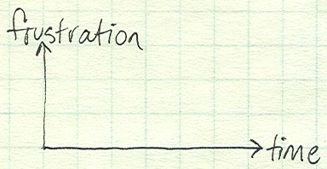
Business Problem
Areas become overcrowded
Example) Gym, not able to run on the treadmill when you want to
High demand of usage results in waiting around or not being able to use the resources at the time you planned to
Time is wasted waiting around for resources to be available

Slide 6
Business Solution
Implementation of SpotCheck will eliminate the problem of waiting around, or arriving at a busy time of the day
Plan out your day more efficiently
The sensor technology will be used to detect whether or not a resource is being used by using heat and motion as variables
For example...
Track the quantity of people using exercise machines (i.e. treadmills, bikes, ellipticals)
Built a mobile application, which displays the data on the app for the users to see
User satisfaction and feedback will be collected and report to the director of Barnes Center regularly

Slide 7
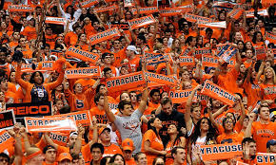
Target Group
College students
Faculty members

Slide 8
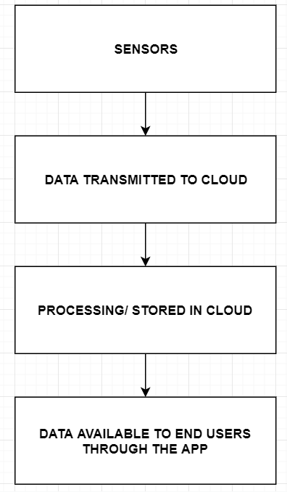
Flow Diagram

Slide 9
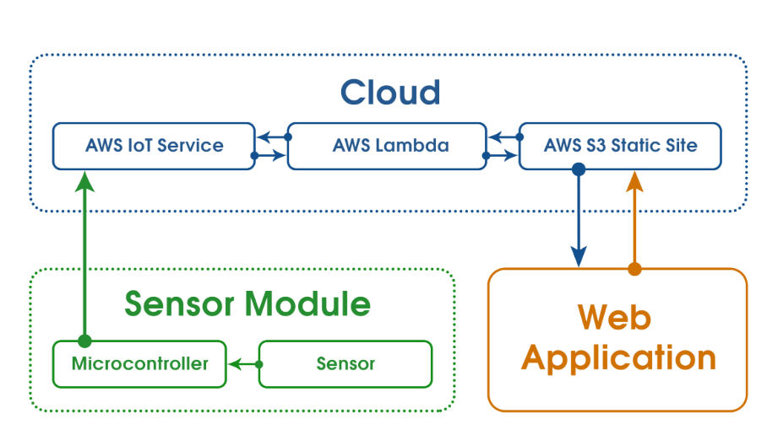
Cloud Architecture

Slide 10
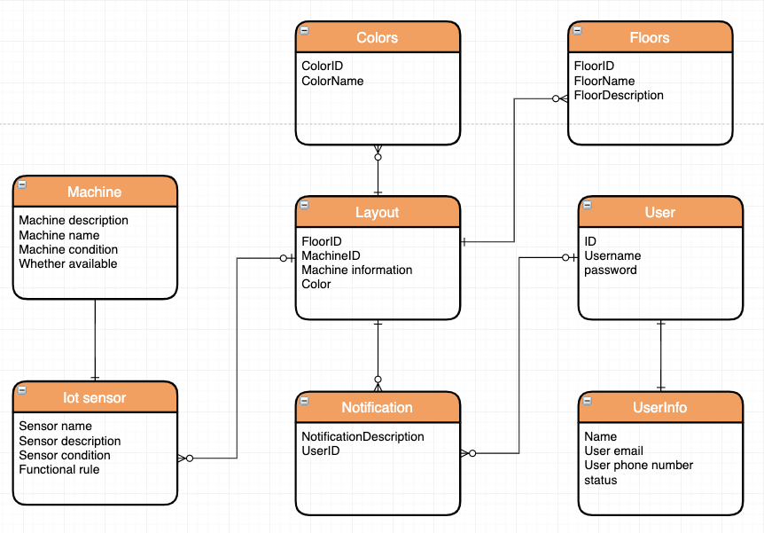
ERD-Entity Relationship Diagram

Slide 11
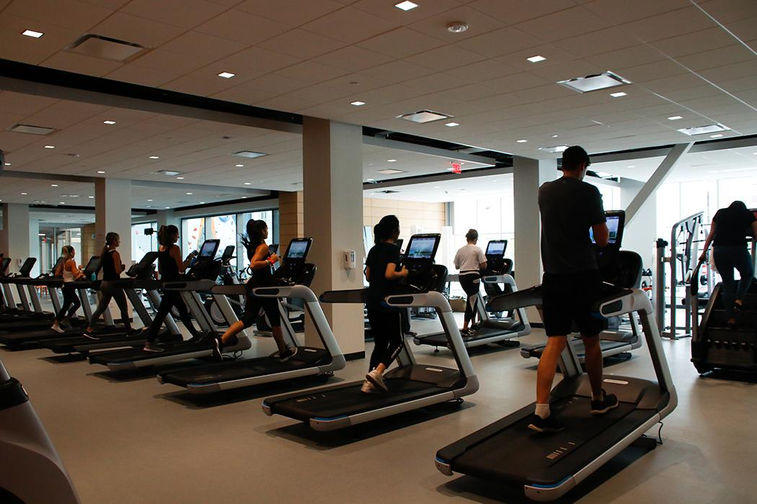
User case for now – Barnes Center
Build a GUI interface for occupancy of the calorie machines.
Show the total number of the machines
Show the number of available machines
Show the condition of each machine

Slide 12
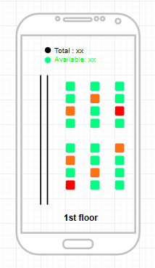
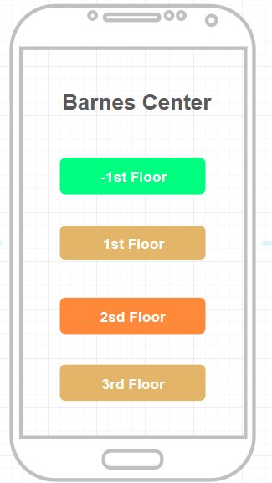
User case for now – Barnes Center
Vacant- Green
General –Light orange
Busy--Orange
Available –Green
Occupied –Orange
Broken/ maintaining --Red

Slide 13
Cost of the Plan
Hardware
Infrared sensor: $1.00 each, $40 in all
Wifi module: $2.00 each, $80 in all
Arduino nano board: $8.59 each, $343.6 in all
Shell: below $5.00 each, $200 at most
Total: $670.58
Maintenance:
Whole equipment renews: $16.59 each
Appliance repairer: $20 per hour

Slide 14
Cost of the Plan
Website
Web designer: $60/hour
Whole web fee: $300 estimated
Price of cloud service:
Aws iot core:
Connectivity pricing: $0.08 (per million minutes of connection)
Message pricing: $1.00 (per million messages)
S3 Standard:
First 50 TB / Month: $0.023 per GB
AWS Lambda:
$0.20 per 1M requests
Total: $11.28 per year

Slide 15
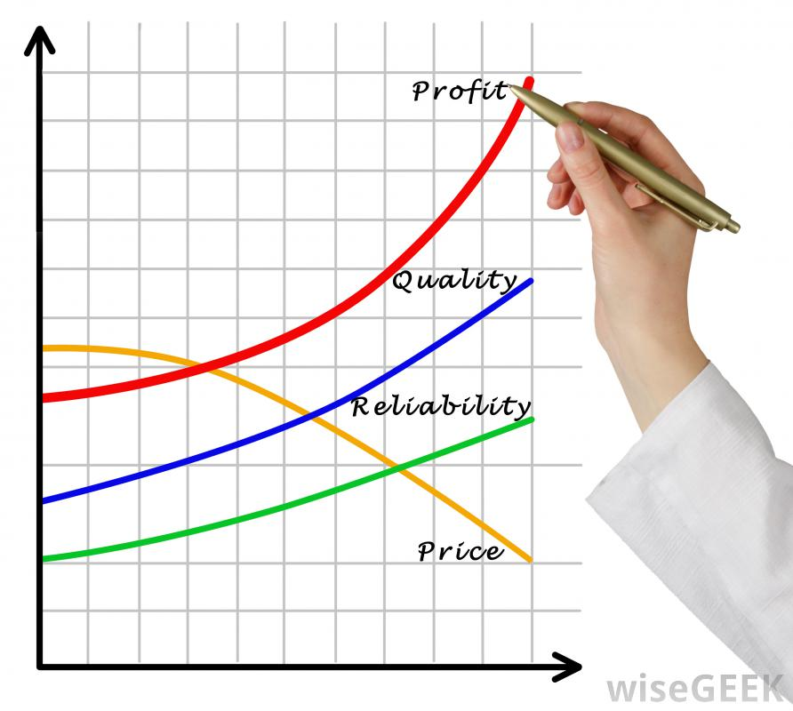
How to make profit
Short term:
Sell the service to the university and Barnes Center
Increase the functions step by step
Improve the service quality while at the small-scale
Long term:
Ensure the reliability and stability
Increase the market-share
Build a feasible profit model (advertise or something else)
Add a prime service
Notes:
As for the profit part: In short term, we just sell the service to the university and relevant centers. And try our best to improve our product.
In long term: we may try some other ways to make profit while ensuring the reliability and stability

Slide 16

Privacy and Security
SPI (Sensitive personal information):
User could choose to allow or deny our collection of their data
Using the data in a proper way
Design the system with security and privacy in mind
Notice the difference between GDR and ADR
Using ADR first (American areas)

Slide 17
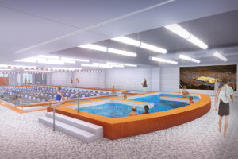
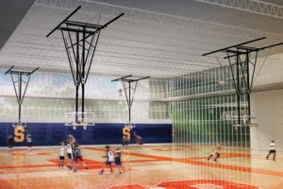
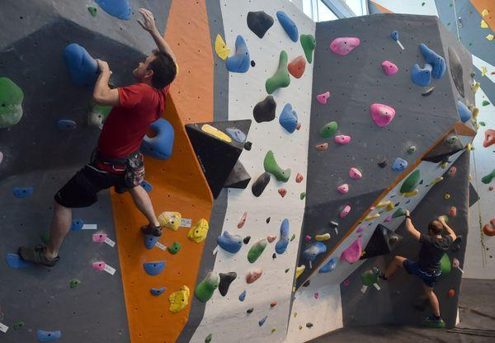
Future Update- Barnes Center at the
Arch
Update the scale of the project.
Basketball courts
Esports room
Swimming pool
Climbing wall
Other equipments

Slide 18
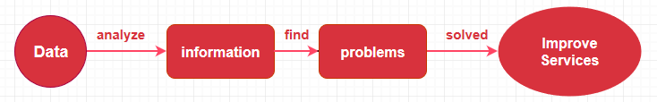
Future Update- Barnes Center at the
Arch
2. Collect every day data and analyze them to get more information so that the center could improve the quality of services efficiently.
When is the busiest time period in barnes center every day?
Which day is busy? Tuesday? Wednesday?
Which kind of equipment is the most popular? Highest utilization ?

Slide 19
Future Update- Barnes Center at the
Arch
3. Also, we could record and analyze the users’ data to improve the services
Services
Appointment system
Exercise recommendation
Exercise notification
Exercise date and exercise duration
Favorite equipment
Exercise goals
Record

Slide 20
SWOT analysis
Strengths Nice idea Cloud based Help students and faculty have better exercise experience | Weakness Lack other functions May be hard to work with the existing system in gym
Opportunities There are no same apps on market There are so many gyms in the world This idea meets the user requirement | Threats Lack initial fund Other big companies may build similar products IoT sensor maintenance is a big problem

Slide 21
Goals and Expectations
Goals:
Analyze data of the occupancy for exercise machines in the Barnes Center
Predict user activity on exercise machines based on the collected data
Make data accessible to consumers through a mobile application
Expectations:
Deploying an app service using AWS to store user data and analyze it to predict user habits
Notes:
Goal: in a word, to create such a application to make the users have better exercise experience.
Expectations: to deploy the service based on cloud service

Slide 22

THANK YOU!

Slide 23
Member Responsibilities
Mary - Business idea
Amit - Architecture
Ruiwei - Cost Control
Renjie - User case for the future, security and privacy
Skye - User case for now, demo

