Slide 1

Southeast Airlines:
Combating Customer Churn
Ryan Reed, Sidney Lanier, Abhiram Gopal, Renjie Zhu, Scott Kessel
IST 687: Introduction to Data Science
Notes:
And its partners.
Churn - simple terms - customer has left the company. Lets see how we combat this

Slide 2
Business Questions
How do we improve the Net Promoter Score?
Net Promoter Score = Promoters - Detractors
Target
Convert passives to promoters
Convert detractors to passives or promoters
Strategy
Why are customers passives? Why are they detractors?
Find the reasons why and focus on them
Notes:
NPS(Net promoter score) - management tool used to gauge the loyalty of customer relationship.
3 categories of which customer falls into - promtoers , detractors & passives.
In our dataset, we have a column called “Likelyhood ot recommend” which has customer scores. - This is our “GOAL” column.
Target is straight forward - ( as per the above ).
Strategy - Find the factors responsible - what makes the customer passive and not a promoter , worse, What makes the customer fall into the detractor zone? Where he actually gives us harmfull reviews.

Slide 3
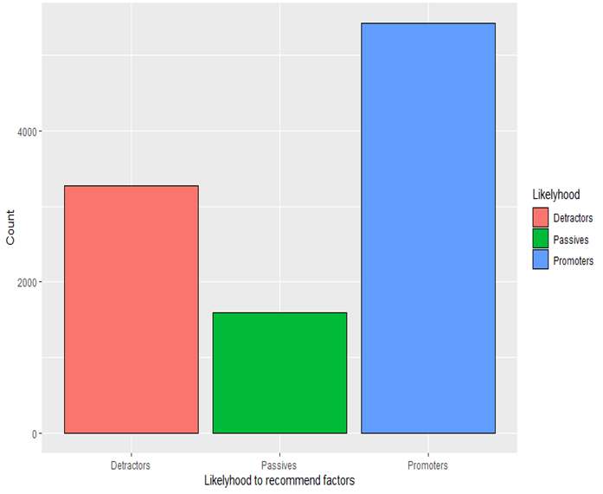
Sample Data - Airline Survey
10282 Observations and 32 attributes
About 50% of the data are Passives and Detractors
Total
14 airlines (SouthEast and its partners)
Notes:
First up - What is the sample that we have?.
2nd line : The intresting thing to note here is.<2nd line> . Which is what we are gonna work on. You can look at the graph. Thats what it says.
3rd : what we have here is a set of 14 airlines , which is how we shall be working on. So...Analyzing for individual 14 airlines ( So 14 slides of analysis and 14 slides of results...jk..)

Slide 4
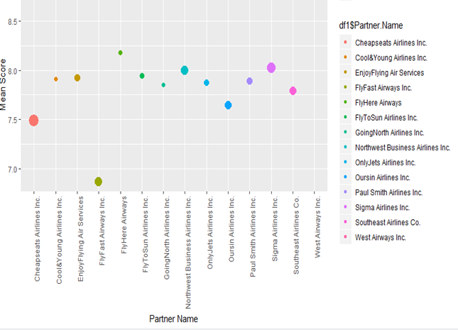
Sample Data - Airline Survey
One airline (Flyfast) needs immediate attention
9 Airlines are in the passive region
Airline selection for MAX benefit?
Notes:
Yeah.. So surely no one wants 28 slides..We need to just focus on specific airlines so that our OVERALL NPS score improves. As you can see..(Personally I cant coz i forgot my glasses) This graph gives the mean score of each airline, and those bubble sizes as its number of records. S\
After 2nd point.. So we recduced 28 slides to 20...But.. still 20 is a bit too much. Our question..Which one’s to select for maximum benefit..? To improve the overall NPS?

Slide 5
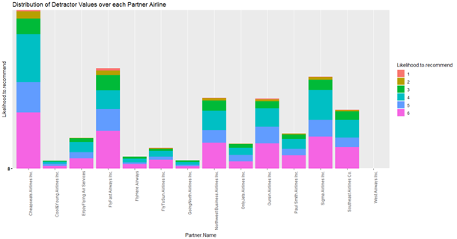
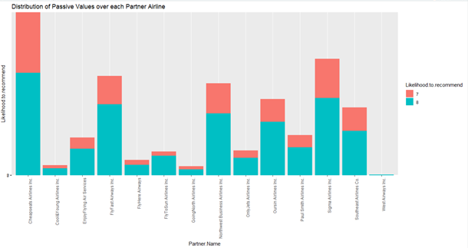
Finding Meaningful Data to Analyze
Review Goal: Increase Net Promoter Score NPS (NPS = Promoters - Detractors) -> 3755 - 3267 = 488
Current NPS from data provided = Likely.hood.to.recommend variable
Strategy: Analyze meaningful datasets (Detractor & Passive Datasets) to Increase Detractor & Passive values which in turn will increase our or NPS
Analysis: 6 Airlines contain 80% of Passive and Detractor Records
Conclusion: Perform analysis on new meaningful data to identify areas of focus to increase NPS

Slide 6
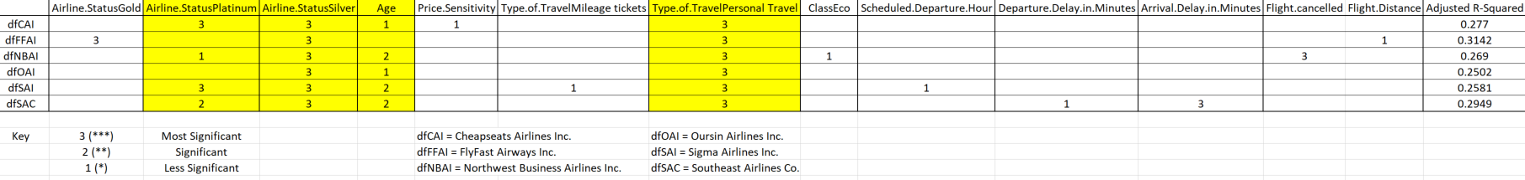
Linear Model Analysis & Results
6 linear models constructed and analyzed based on the 6 selected airlines accounting for 80% of Detractor and Passive records within airline company
Dependent Variable: Likely.Hood.To.Recommend (NPS Variable)
Analysis: Airline partners showed high significance between the dependent variable and:
Conclusion: Perform a marketing campaigns to appeal to:
Age: (less than 45)
Status Members: Platinum or Silver
Traveling on personal travel
to increase Detractor/Passive Likely.hood.to.recommend scores for overall NPS Increase

Slide 7
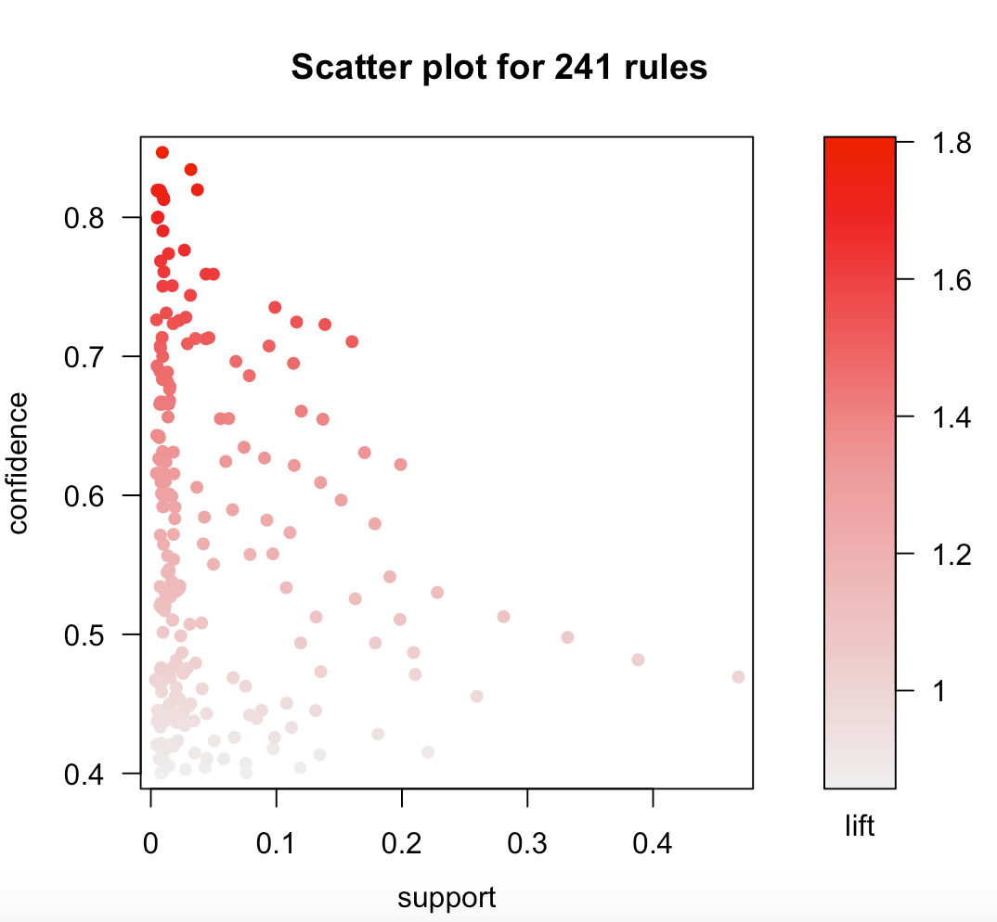
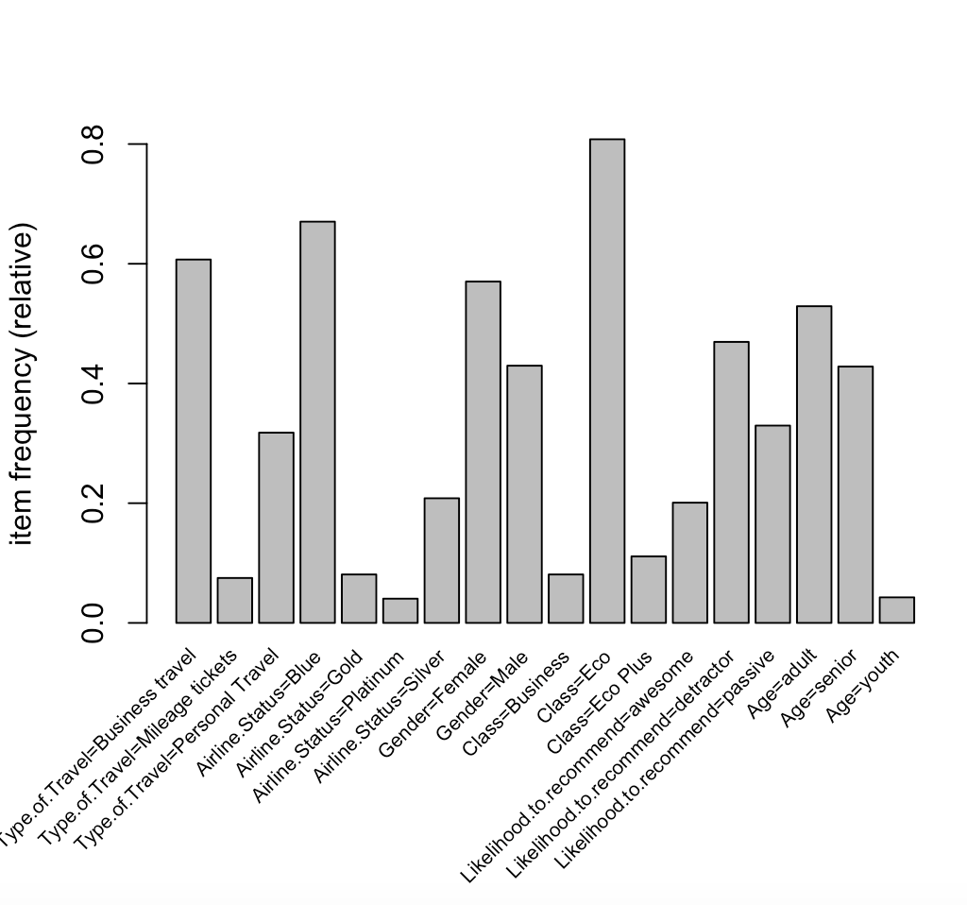
Visualizations used to determine support, confidence, and lift levels
Ran on 6 airlines with sufficient data to detect trends
Initially included:
Type.of.Travel, Flight.cancelled, Airline.Status, Gender, Class, and Likelihood.to.recommend
Focused on:
Age, class, and type of travel for more granular analysis since they had highest lift/confidence scores
Notes:
Ran on 6 individual airlines - many similar results, combined all 6 airlines into 1 matrix
Used variables that were most easily converted to factors - and the ones that complemented the numeric variables in the linear analysis
Used plot and frequency diagram to determine lift,confidence,and support and narrow down rules to about 15
Generated rules where age, class, and type of travel stood out
Ran Apriori() on individual variables for added granularity
Found that the high frequency of flight.cancelled and Gender were responsible for high confidence of occurrence with other variables

Slide 8
Association Rules
RHS:
Found variables that occured in association with likelihood.to.recommend
Detractor Traits:
that Personal Travel & Blue Status were most frequently related to a “detractor”
Passive Traits:
that Silver Status and “Adult” (19-50 yrs old) were most frequently related to “passive” scores
Customers to focus on to improve NPS:
need to focus on passengers with Blue Status and passengers with Personal travel type because they are most frequently detractors

Slide 9
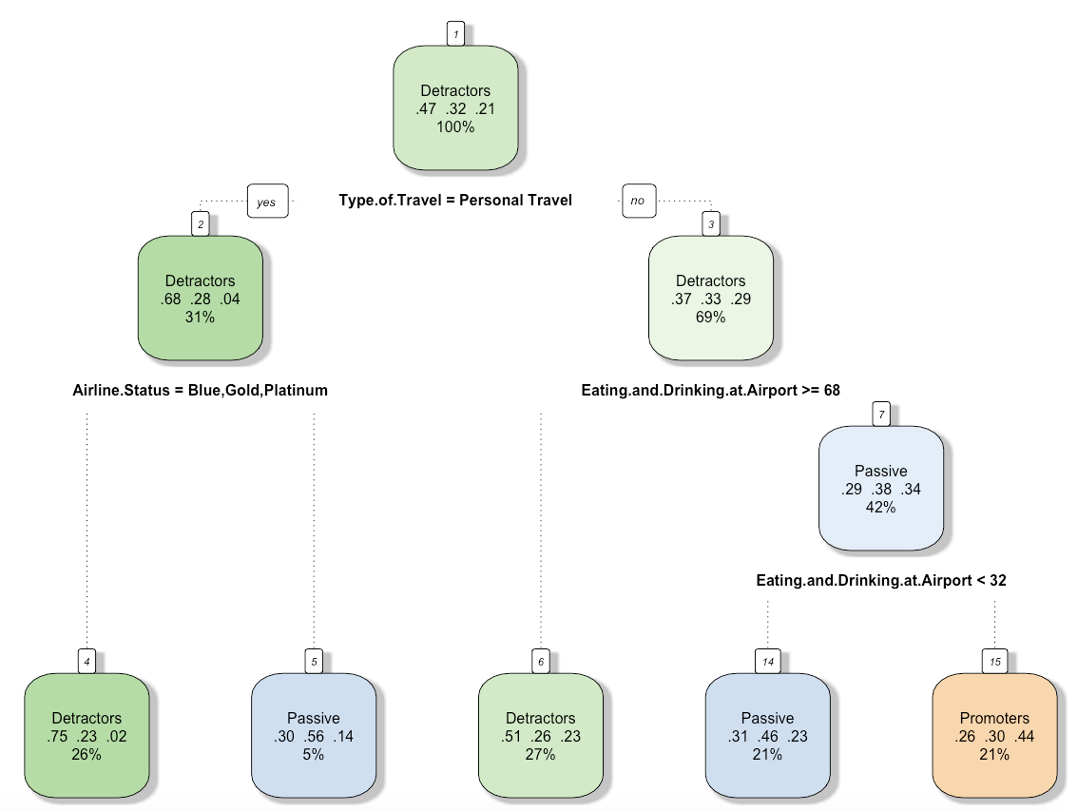
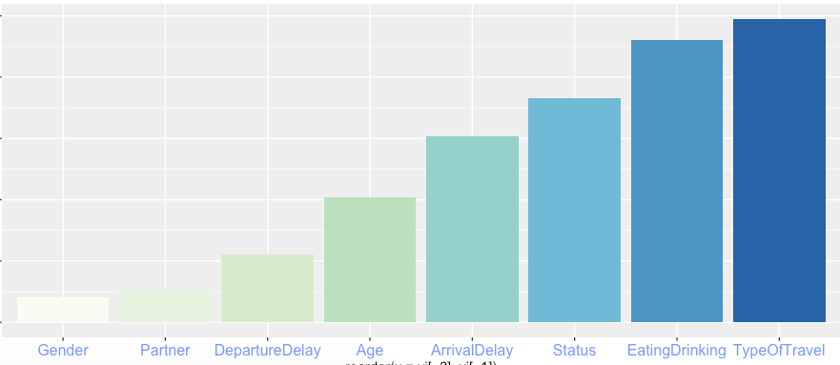
Decision Tree Analysis
Ran decision tree and random forest models on nearly all columns except destination, origin city, origin state, and freetext
Found the type of travel, Eating and Drinking at Airport, and Airline status have higher variable importance
Notes:
Firstly, I converted the likelihood column into 3 factors Detractors Passive and Promoter. And I ran decision tree and random forest models on nearly all columns except a few geographically relevant columns. And I get two plots, the left plot is the visualization of the decision tree model. The right one is the variable importance plot. It shows the type of travel, Eating and drinking , Airline status have higher importance.

Slide 10
Further Decision Tree Analysis
Do the decision tree analysis for the 6 airline chosen by the Linear model
Found that Age, Flight per year, and Delay time are also important variables
Then do more analysis on the different types of travel
For “Business Travel”, Eating and Drinking matters most, especially large amount of consumption
For “Personal Travel”, Arrival Delay matters most. If delay time beyonds 5.5 minutes, then the likelihood to recommend will mostly be below 9
For “Mileage tickets”, Silver status shows high scores of likelihood to recommend. We should focus more on other status
Then do more analysis on different age groups
For age group above 65, Delay matters most (both arrival and departure)
For age group below 65, Eating and Drinking matters most, and we should focus on those expensive foods in the airport

Slide 11
Sentiment Analysis
Overall Sentiment: 31 percent positive words, 24 percent negative words
Negative Leaning Sentiments
Cheapseats Airlines Inc.
12 percent positive words
13 percent negative words
FlyFast Airways Inc.
10 percent positive words
14 percent negative words
Positive Leaning Sentiments
Northwest Business Airlines Inc.
13 percent positive words
9 percent negative words
Oursin Airlines Inc.
22 percent positive words
11 percent negative words
Sigma Airlines Inc.
16 percent positive words
10 percent negative words
Southeast Airlines Co.
19 percent positive words
12 percent negative words

Slide 12
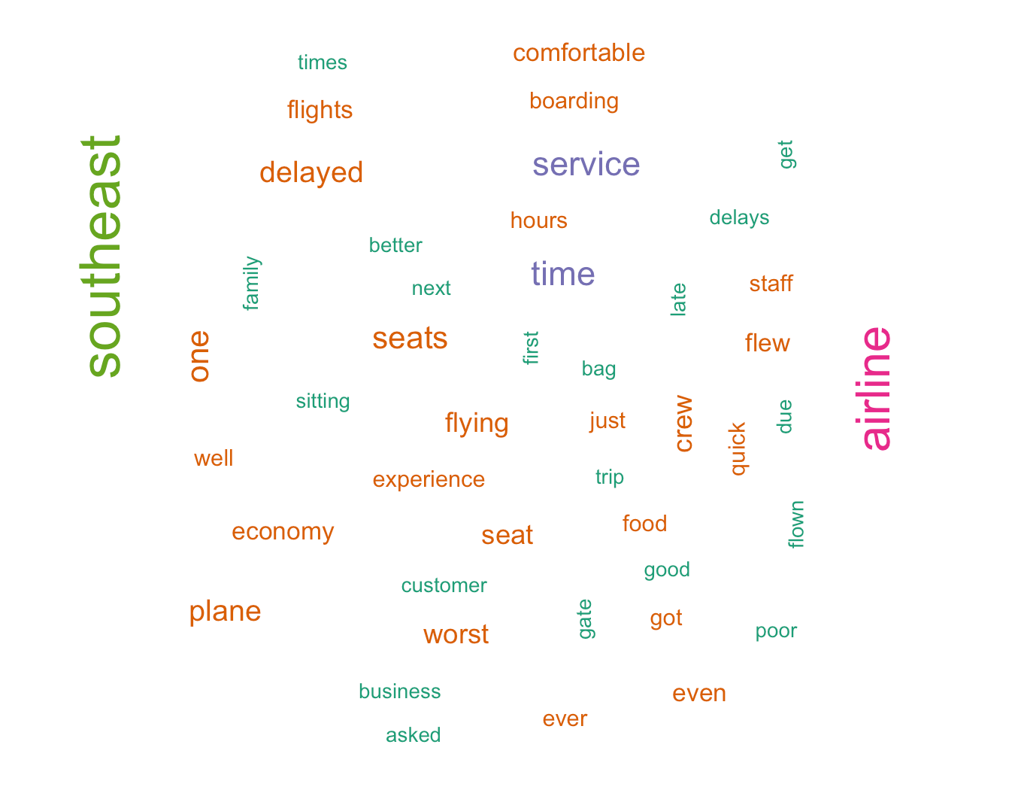
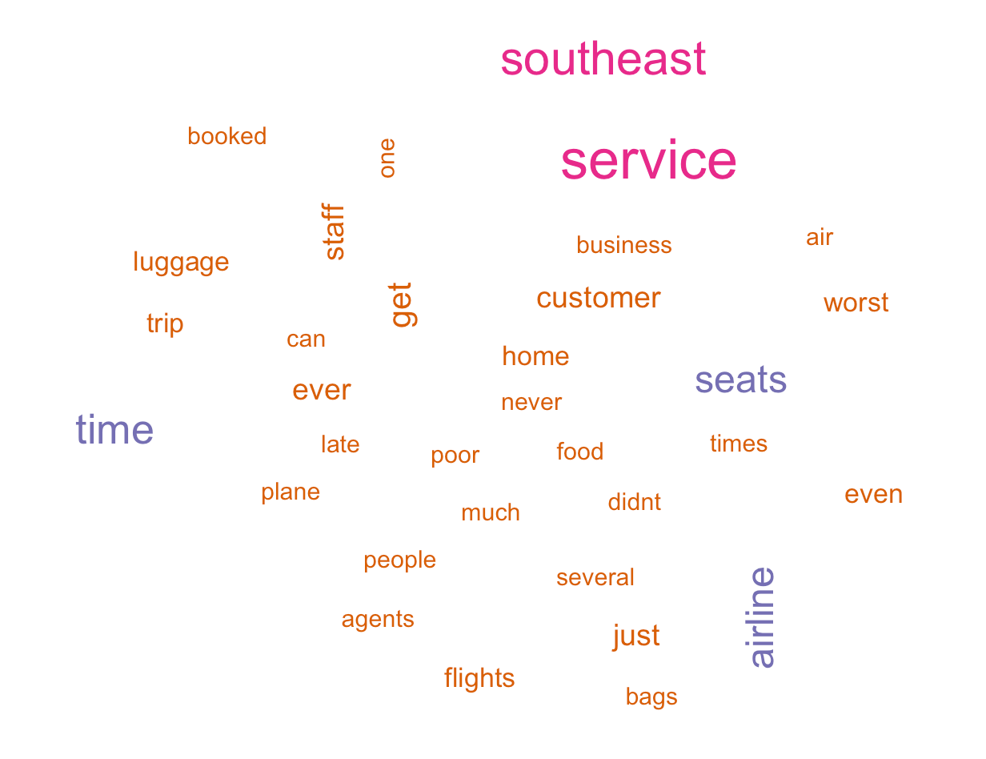
Word Clouds
Cheapseats Airlines Inc.
FlyFast Airways Inc.
Notes:
Southeast, service, seats, time, staff

Slide 13
Conclusion
Goal: Raise NPS Score (Promoters - Detractors)
Method: Analyze Detractor (0-6), Passive (7-8) likely.hood.to.recommend variables to recommend solutions to raising NPS Score
Focus Areas from Analysis:
Linear Model: Market Research: Younger (below 45), Platinum or Silver Airline Status Members, on personal travel
Associated Rules: Airlines need to focus on passengers with Blue Status, and passengers with Personal travel type because they are most frequently detractors
Decision Tree: Airlines should firstly focus on the Eating and Drinking part and then airlines should pay more attention to delay time, Status based on different age groups or types of flight.
Sentiment Analysis: Two airlines with most negative leaning sentiment have complaints related to service, seats, time, and staff; Target those areas of the business to see improvements

Slide 14
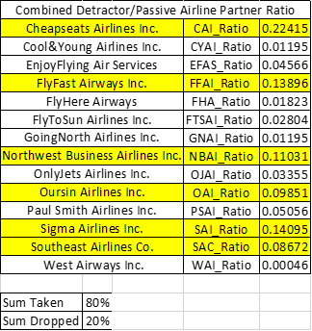
Backup Slide 1
Total Records: 10282
Promoters Records: 3755
Passive Records: 3259
Detractors Records: 3268

