Slide 1
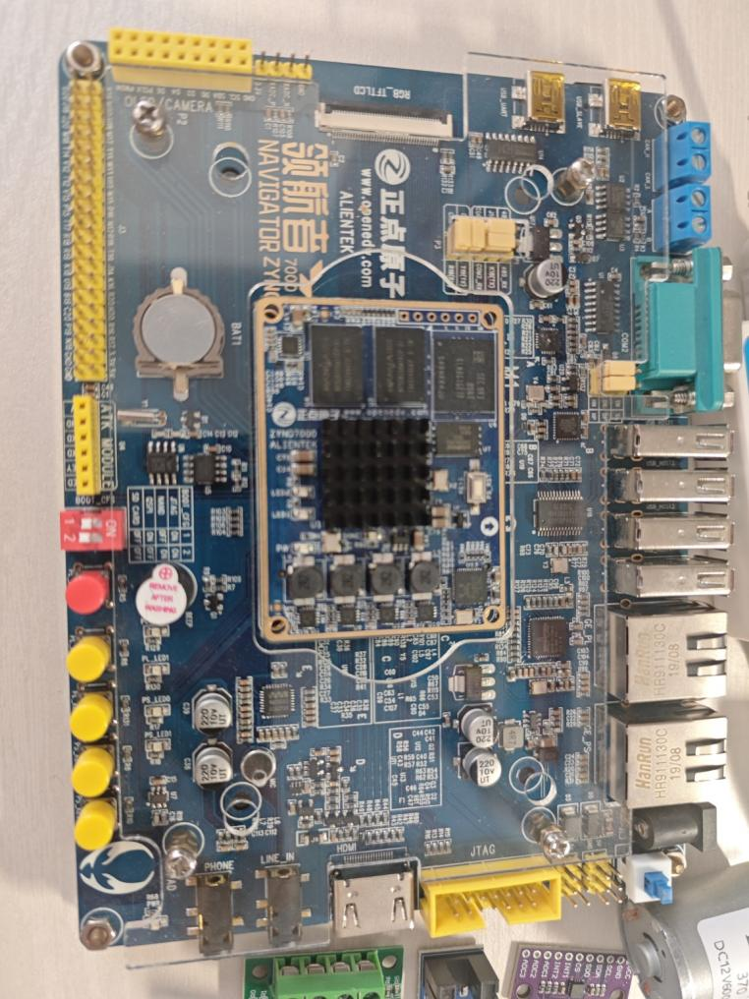

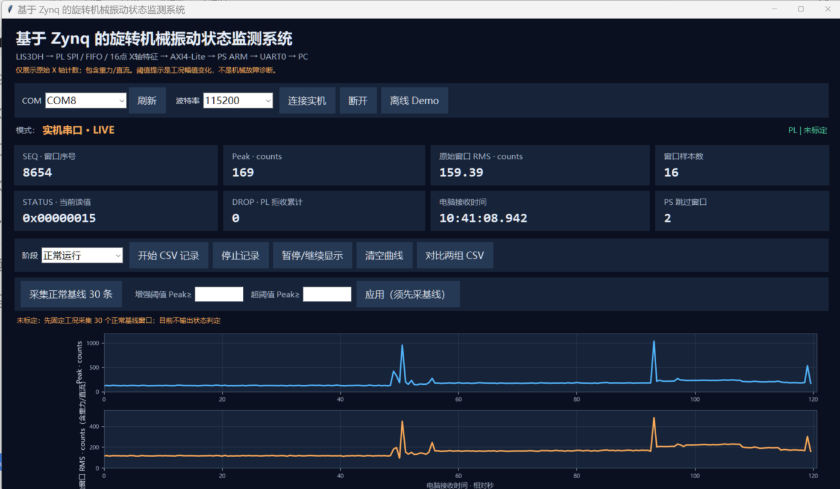
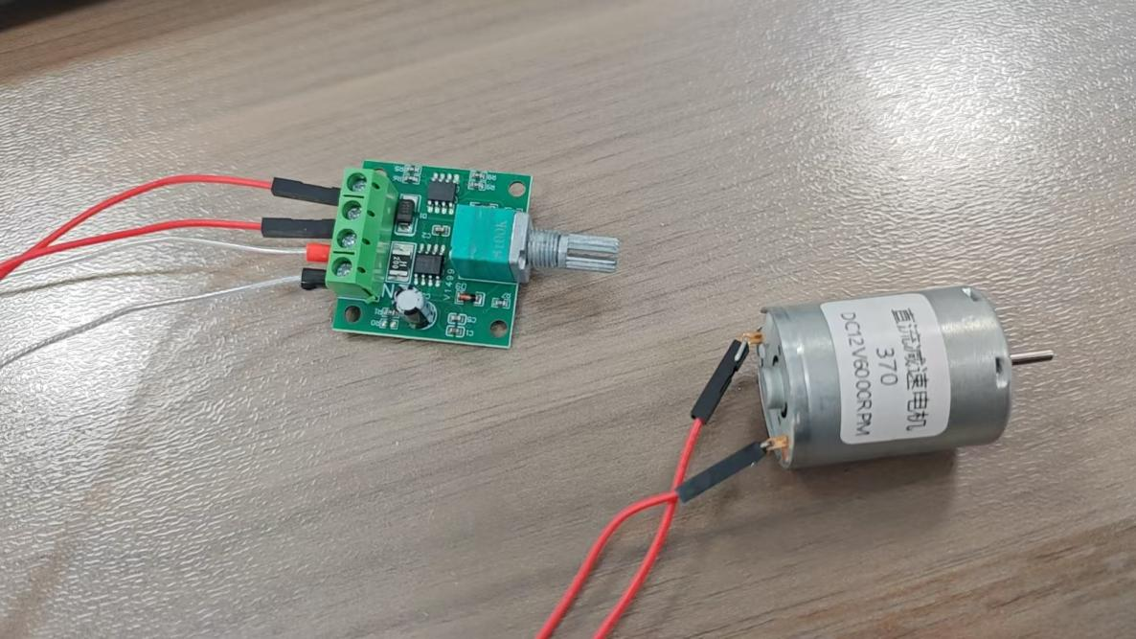
INTRODUCTION
Zynq Motor Vibration Monitoring
LIS3DH / SPI acquisition
Motor vibration monitoring requires a traceable path from sensor acquisition to visual inspection.
This system combines LIS3DH sensing, FPGA window statistics, ARM communication and a Python dashboard.
The PL processes 16-sample X-axis windows. The PC displays peak, raw RMS and trends, and saves CSV for condition comparisons.
Raw RMS includes gravity and DC. Both control and shaft-disturbance runs progress from low to high speed.
Zynq-7000 XC7Z020
PL / FIFO + window statistics
C
R
ARM / AXI snapshot + UART0
R
E
E
A
S
PC / trends + CSV
T
U
I
L
V
T
System architecture
E
PS AND PC
Cortex-A9 checks RESULT_SEQ before and after each window read.
UART0 transmits eight CSV fields at 115200 baud.
Python decodes status, plots trends and records CSV.
D
VALIDATION
Board ID: 0x56494231
Version: 0x00010000
Control / disturbed: 105 / 47 windows.
Whole-run medians (counts)
Peak: 66 / 606. Raw RMS: 35.59 / 464.67.
OPERATING CONDITIONS
Both runs progress from low to high speed. External shaft disturbance in run 3. RPM was not measured.
E
S
I
G
N
PL PROCESSING
100 Hz acquisition, FIFO buffering,
16-sample peak and sum of squares.
50 MHz AXI interface clock.
370 DC motor and manual PWM controller
Notes:
Sources: user-supplied technical document, images 3, 4 and 8; project README and 2026-11-02 validation report. Board screenshot from the recorded project session. No claim of calibrated motor thresholds or fault classification. Template: AMD_poster_template.pptx. Anonymous edition.

