Slide 1
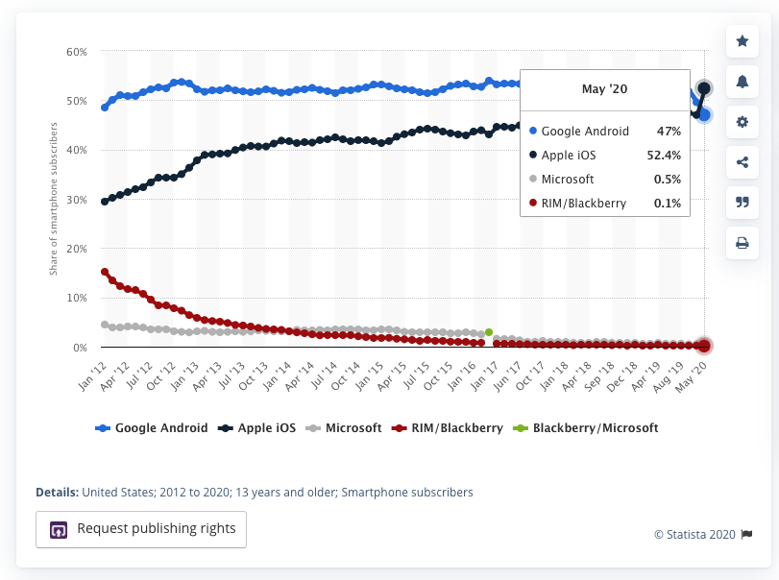
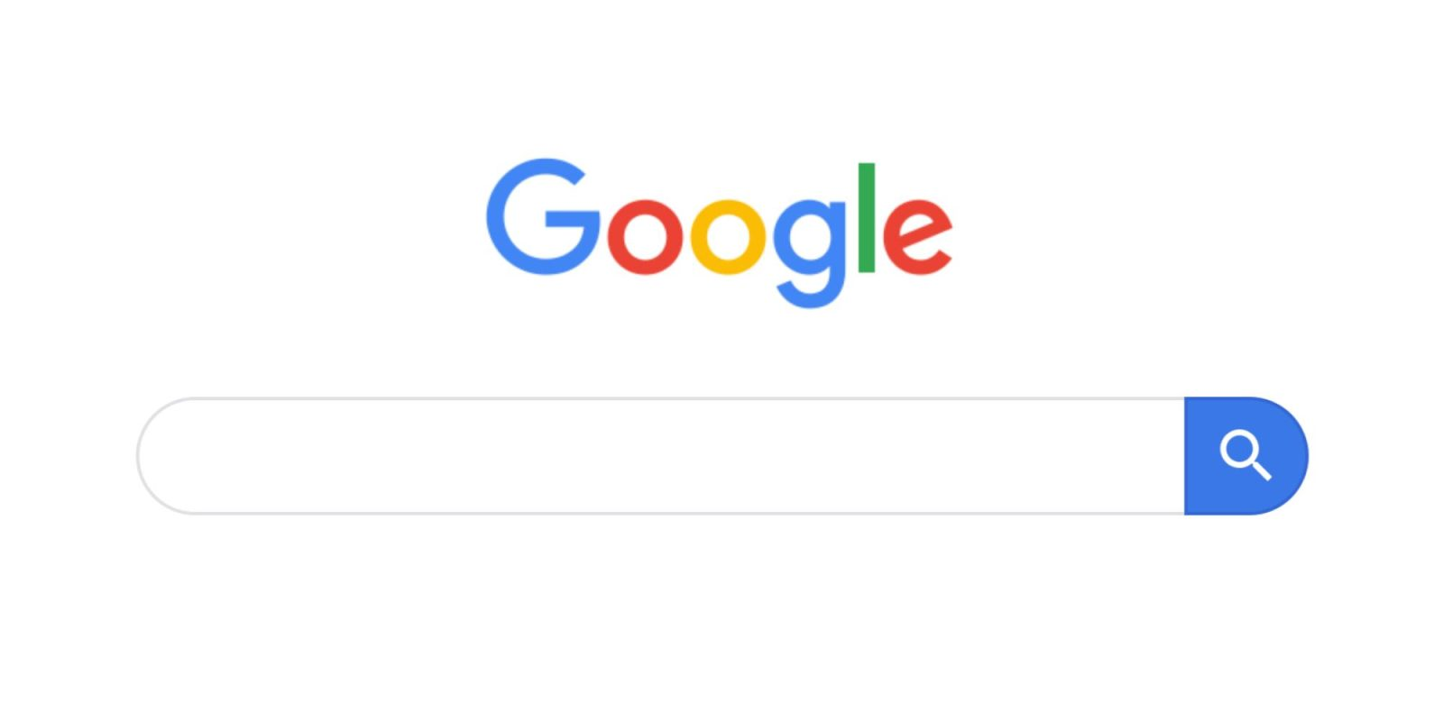
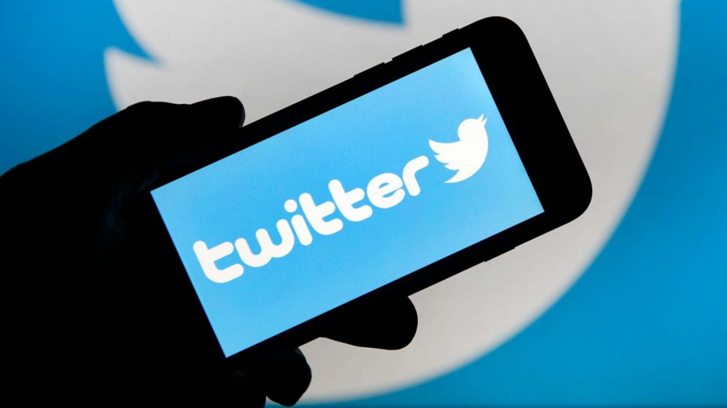
Big Tech
99.4% of mobile phones in the US are made by either Apple or Google [1]
Google receives 83% of all search engine queries across all platforms, browsers and devices [2]
Twitter is known for being the center for public discourse

Slide 2
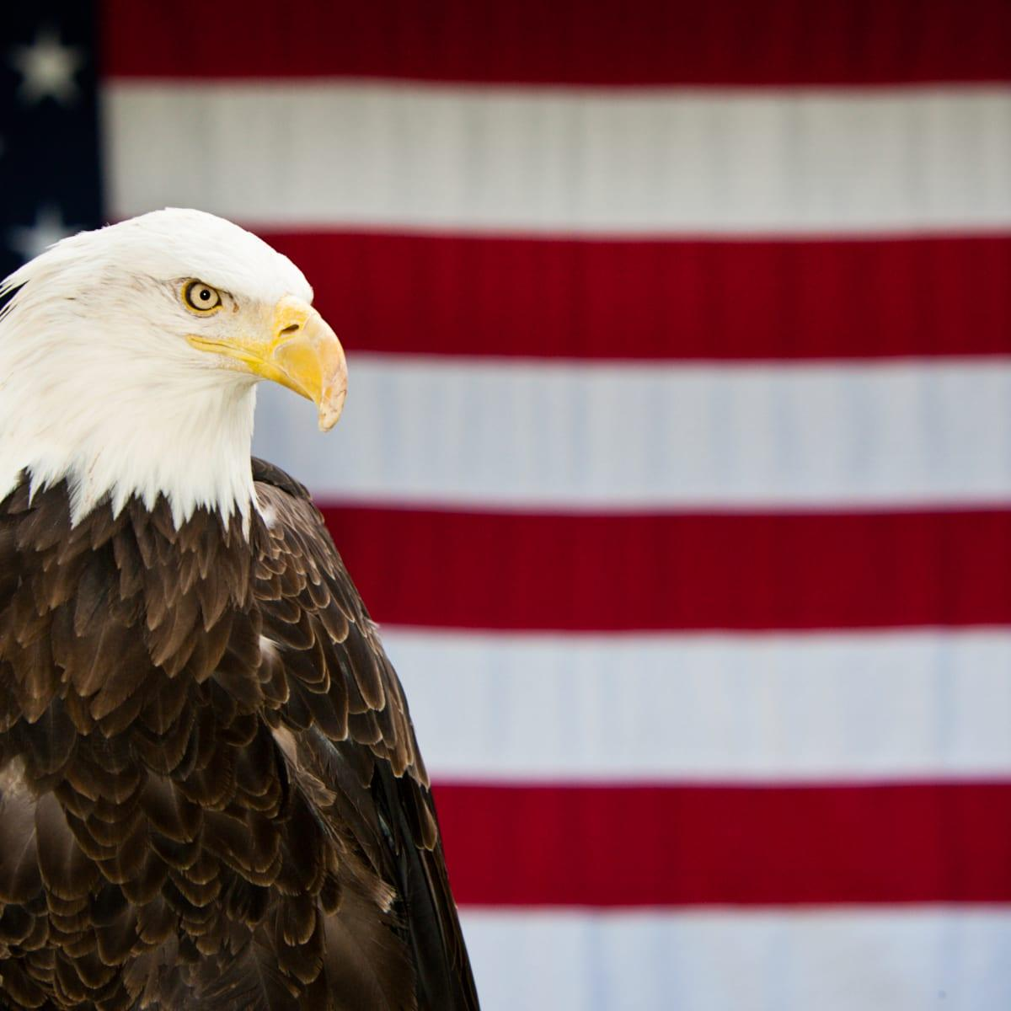
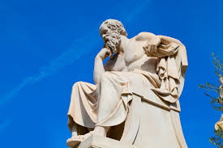
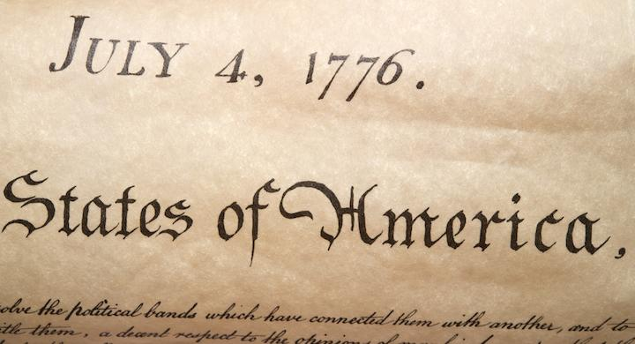
Human Rights
Freedom from discrimination, the right to own property, the right to no cruel or unusual punishment...
Socrates died for exercising his right to freedom of speech
The US is the only place in the world that protects its citizens with the right to free speech

Slide 3
Cultural Issues
Public discourse has made a shift from face-to-face dialogue, to the world wide web, of the internet
  3.6 billion worldwide users on social media in 2020
  Predict that 4.41 billion by 2025
United State law protects all forms of speech, no matter how controversial, without punishable consequences
  Cannot advocate violence
  Cannot make threats which incite great bodily harm or death
  Obscenities; child pornography
Hate speech is a protected form of speech ruled by the United States supreme court
  Includes racial slurs
  Other distasteful language
Freedom of association
  Terms and conditions that extend further restrictions that what is legally protected
  Joe Rogan podcast with Jack Dorsey, Vijaya Gadde & Tim Pool on the enforcement of company policy

Slide 4
Ethical Issues
If social media platforms and are considered the ‘town square’ form public discourse of our time, is if ethical for these companies to removes citezens from exersising thier human rights to free speech?
Robert Epstein, a San Diego-based psychologist, reported to the New York Times that Google search manipulation resulted in the mass numbers of converted voters
Tim pool, on the JRE podcast claimed Twitter is making a protected class by silencing speech that they oppose.
If speech is a human right and technology is the most popular form to express that right, then there must be a need for ethics in CS
  Who is responsible for regulating speech
3 possible solutions
  Allow all speech
  Allow US protected free speech
  Enforce restrictions that reflect beliefs

Slide 5
O'Dea, S. “Mobile OS Market Share in the U.S. 2019.” Statista, 17 Aug. 2020, www.statista.com/statistics/266572/market-share-held-by-smartphone-platforms-in-the-united-states/.
“Search Engine Market Share.” Net MarketShare, NetApplications, 2017, netmarketshare.com/search-engine-market-share.aspx?options=%7B%22filter%22%3A%7B%7D%2C%22dateLabel%22%3A%22Trend%22%2C%22attributes%22%3A%22share%22%2C%22group%22%3A%22searchEngine%22%2C%22sort%22%3A%7B%22share%22%3A-1%7D%2C%22id%22%3A%22searchEnginesDesktop%22%2C%22dateInterval%22%3A%22Monthly%22%2C%22dateStart%22%3A%222019-08%22%2C%22dateEnd%22%3A%222020-07%22%2C%22segments%22%3A%22-1000%22%7D.
“Robert Epstein.” Wikipedia, Wikimedia Foundation, 28 July 2020, en.wikipedia.org/wiki/Robert_Epstein.
Halper, Evan. “This Psychologist Claims Google Search Results Unfairly Steer Voters to the Left. Conservatives Love Him.” Los Angeles Times, Los Angeles Times, 22 Mar. 2019, www.latimes.com/politics/la-na-pol-google-search-bias-elections-20190322-story.html.
“United States Free Speech Exceptions.” Wikipedia, Wikimedia Foundation, 16 Aug. 2020, en.wikipedia.org/wiki/United_States_free_speech_exceptions.
Rogan, Joe. “Joe Rogan Experience #1258 - Jack Dorsey, Vijaya Gadde & Tim Pool.” Youtube, 5 Mar. 2019, www.youtube.com/watch?v=DZCBRHOg3PQ.

