Slide 1
Diversity in CS (Gender Gap in STEM)
River Kelly

Slide 2
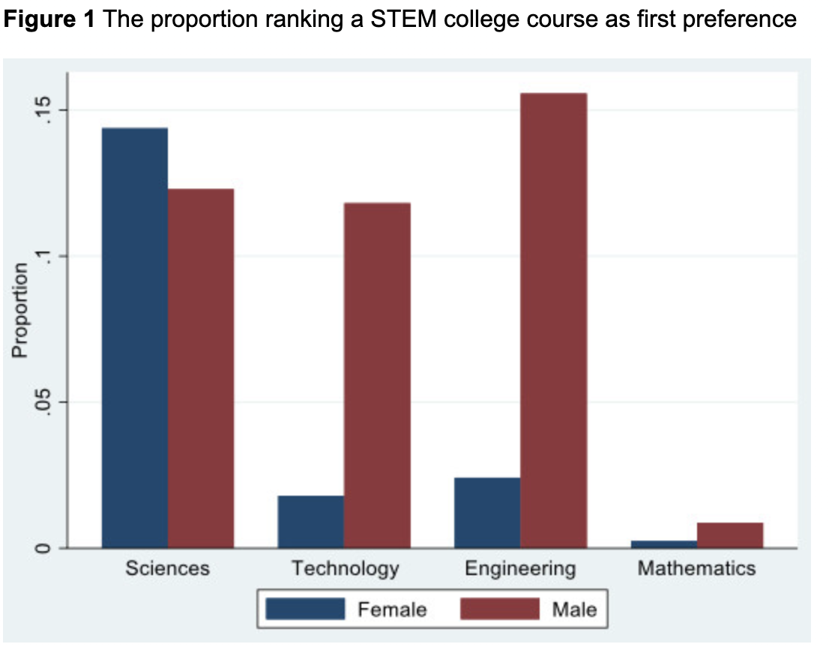
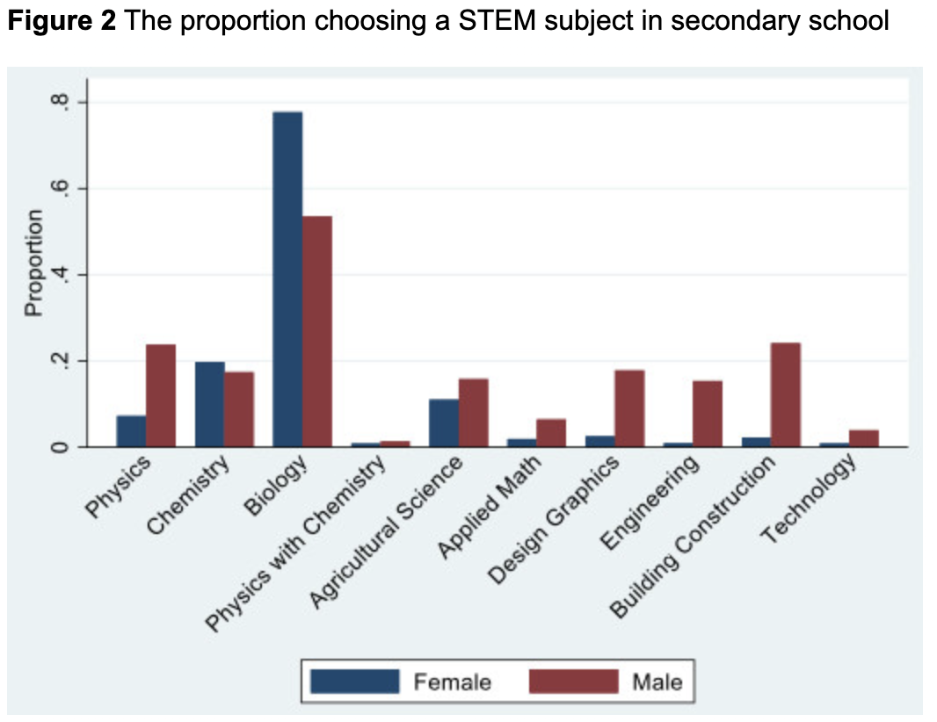
Gender in STEM
“just over 40% of men listing a STEM course compared with roughly 19% of women.” (1)

Slide 3
Gender in STEM
Explaining the Gender Gap in STEM
Differential general achievement
(1)-All info taken from VoxEU

Slide 4
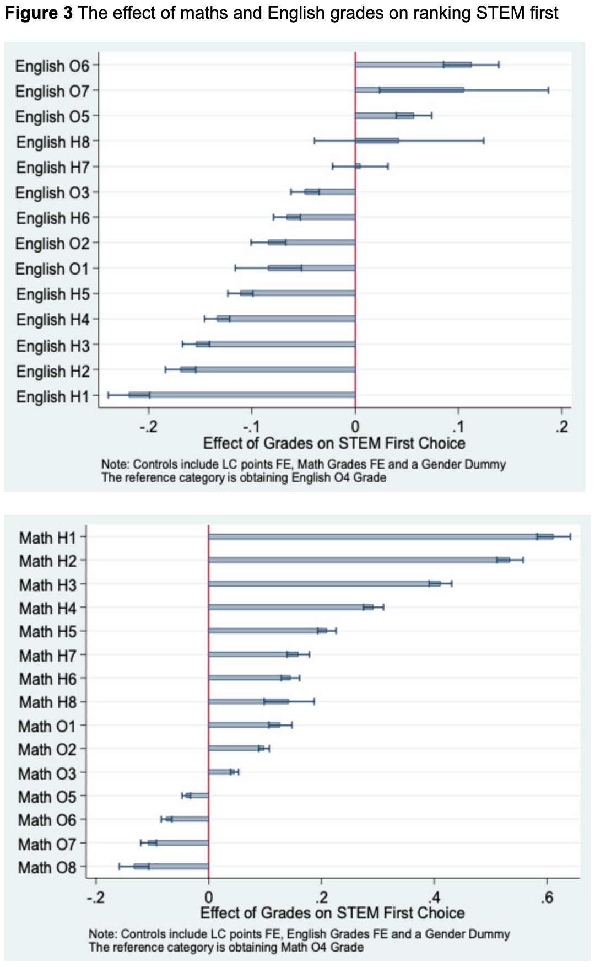
Gender in STEM
Explaining the Gender Gap in STEM
Differential general achievement
Comparative advantage
(1)-All info taken from VoxEU

Slide 5
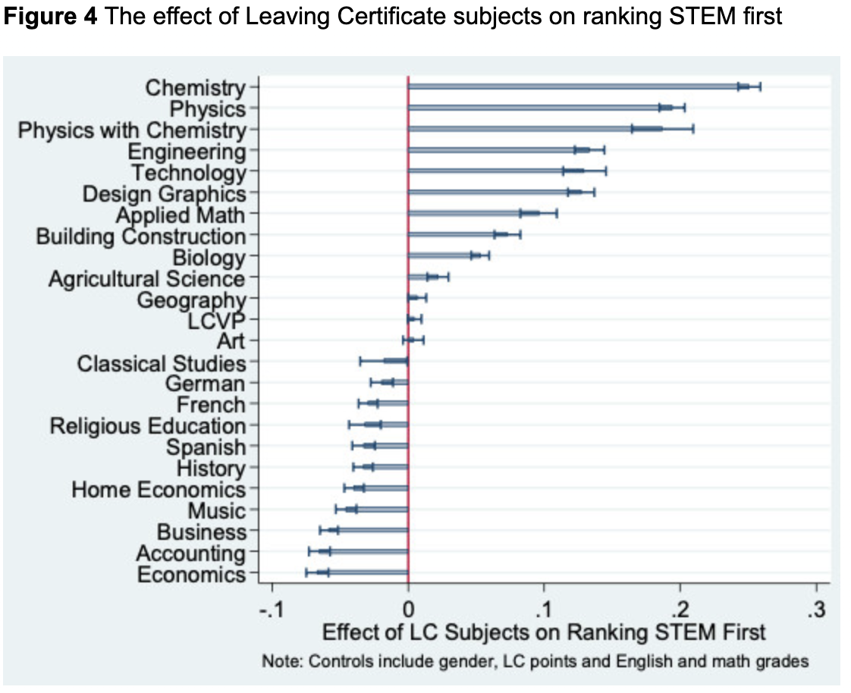
Gender in STEM
Explaining the Gender Gap in STEM
Differential general achievement
Comparative advantage
Subject choices in secondary school
(1)-All info taken from VoxEU

Slide 6
Closing the Gender Gap in STEM
Equality of Opportunity
  “take affirmative action to ensure that applicants are employed, and employees are treated [fairly] during employment, without regard to their race, creed, color, or national origin". (2)
Equality of Outcome
  Scandinavia, and other gender-equal countries

Slide 7
Unintended Consequences
Affirmative action
  “alleged that Harvard discriminated against Asian-American applicants by favoring black and Hispanic applicants in their admissions process.” (3)
Scandinavia experiment
  “more gender-equal countries produce comparatively fewer women in the STEM fields” (5)

Slide 8
Closing the Gap
We still do not have a clear answer to how to close the gender gap in STEM fields.
Jordan Peterson
  Men like things
  Women like people

Slide 9
Work Cited
Delaney, Judith, and Paul Devereux. Understanding Gender Differences in STEM. 19 Apr. 2019, voxeu.org/article/understanding-gender-differences-stem.
“Affirmative Action.” Wikipedia, Wikimedia Foundation, 10 Sept. 2020, en.wikipedia.org/wiki/Affirmative_action.
“Judge Rules in Favor of Harvard in Divisive Affirmative Action Lawsuit.” The Stanford Daily, 4 Oct. 2019, www.stanforddaily.com/2019/10/03/judge-rules-in-favor-of-harvard-in-divisive-affirmative-action-lawsuit/.
Stoet, Gijsbert, and David C. Geary. “The Gender-Equality Paradox in Science, Technology, Engineering, and Mathematics Education.” Psychological Science, vol. 29, no. 4, 2018, pp. 581–593., doi:10.1177/0956797617741719.
Peterson, Jordan. “The Gender Scandal: Part One (Scandinavia) and Part Two (Canada).” Jordan Peterson, 24 Feb. 2019, www.jordanbpeterson.com/political-correctness/the-gender-scandal-part-one-scandinavia-and-part-two-canada/.

