Slide 1
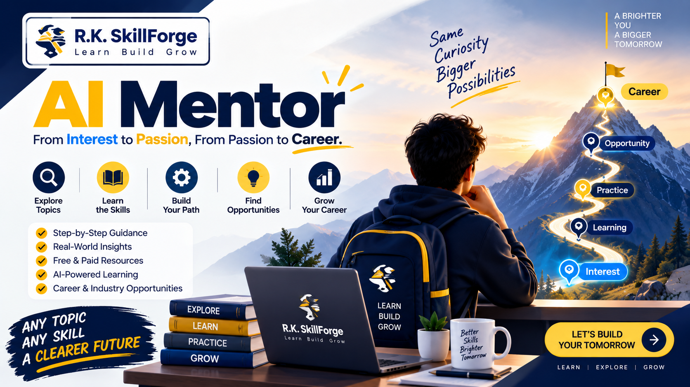
🚀 R.K. SKILLFORGE PRESENTS
AI MENTOR
The Complete Master Curriculum Overview
Transforming Vague Curiosity into Informed Action
Interest ➔ Passion ➔ Career
🎓 100% Free Lifetime Masterclass
Instructor: R.K. SKILLFORGE
Modules: 5 Comprehensive Lessons
Format: Complete YouTube & GitHub Suite
Produced & Engineered by R.K. SKILLFORGE
A complete blueprint to navigate the modern AI-driven career landscape.
Notes:
SPEAKER SCRIPT / COURSE TRAILER INTRO:
"Welcome to the master orientation of AI Mentor, proudly produced by R.K. SKILLFORGE!
In a world where new AI tools drop every single week, thousands of tutorials flood YouTube, and job descriptions feel like impossible wishlists, self-learning has become overwhelming.
AI Mentor is a comprehensive, 100% free masterclass designed to take you from a spark of raw curiosity to real-world career mastery.
In this overview video, we will walk you through our complete curriculum, our philosophy, and how this course will transform the way you learn and work forever.
Let's get started!"

Slide 2
R.K. SKILLFORGE | MASTER COURSE OVERVIEW
Course Overview & Key Metadata
COURSE TITLE
AI Mentor: Masterclass Series
TAGLINE / SUBTITLE
From Interest to Passion, From Passion to Career
INSTRUCTOR & CREATOR
R.K. SKILLFORGE
DIFFICULTY LEVEL
Beginner to Career-Ready (No prior code needed)
TEACHING LANGUAGES
English / Hindi / Hinglish
TOTAL MODULES
5 Comprehensive Master Modules + Skill Jars
TUITION / PRICING
100% Free (YouTube & GitHub Open Source)
ACCESS DURATION
Lifetime Free Access with Continuous Updates
© R.K. SKILLFORGE • AI Mentor Masterclass Series
Slide 2
Notes:
SPEAKER SCRIPT:
"Here is what makes AI Mentor unique:
Created by R.K. SKILLFORGE, this entire course is completely open and free. There is no $2,000 paywall, no hidden subscription, and no locked Discord channel.
Whether you speak English, Hindi, or Hinglish, and whether you are a high school student, a university graduate, or a professional looking to switch into tech, this course is tailored for you.
You don't need an engineering degree to start. All you need is curiosity and the discipline to follow our frameworks."

Slide 3
R.K. SKILLFORGE | MASTER COURSE OVERVIEW
What You'll Learn: 6 Master Capabilities
01. Deep Topic & Role Exploration
Uncover the real-world value, hiring industries, and actual daily duties of any technical domain.
02. Fundamentals Over Fleeting Hype
Isolate timeless principles that last 20+ years from temporary weekly software trends.
03. Practical Step-by-Step Roadmaps
Engineer milestone-driven paths from beginner fundamentals to production deployments.
04. Critical AI Literacy Without Dependency
Leverage AI for rapid research and coding while protecting independent thinking and debugging grit.
05. Human Mentorship Integration
Master authentic professional outreach to connect with experienced veterans who have walked the path.
06. Commercial Monetization & Employment
Package your skills into high-ticket freelance retainers or dominate technical hiring pipelines.
© R.K. SKILLFORGE • AI Mentor Masterclass Series
Slide 3
Notes:
SPEAKER SCRIPT:
"By the time you complete this course, you will possess 6 superpower capabilities:
You will know how to evaluate any skill, separate enduring principles from temporary fads, build a customized learning roadmap, use generative AI without becoming mentally dependent on it, network with real industry mentors, and turn that skill into cold hard cash or a high-paying job offer.
These are the meta-skills that will keep you ahead of the curve for the rest of your career."

Slide 4
R.K. SKILLFORGE | MASTER COURSE OVERVIEW
The Master Learning Journey: From Curiosity to Career
1. INTEREST
Curiosity & initial spark
2. EXPLORE
Market & role analysis
3. UNDERSTAND
Core responsibilities & duties
4. LEARN
Curated primary docs & theory
5. PRACTICE
Sandboxes & isolated drills
6. CONNECT
Real human industry mentors
7. OPPORTUNITY
Portfolios & personal brand
8. CAREER
Freelance contracts or job offers
© R.K. SKILLFORGE • AI Mentor Masterclass Series
Slide 4
Notes:
SPEAKER SCRIPT:
"Look at the 8-step journey on this screen.
Most self-taught learners fail because they try to jump from Step 1 directly to Step 8. They see an interesting technology, watch two videos, and start applying for senior jobs.
When you follow this sequence—Interest, Explore, Understand, Learn, Practice, Connect, Opportunity, Career—every step builds natural momentum.
You never feel lost, because you always know the exact next milestone to conquer."

Slide 5
R.K. SKILLFORGE | MASTER COURSE OVERVIEW
Why Self-Learning Fails: The 6 Fatal Pitfalls
😵 1. Lack of Knowledge
Learners don't know which industries hire for a skill or what practitioners do day-to-day.
📚 2. Resource Overload
Thousands of bootcamps and conflicting roadmaps cause severe decision paralysis.
✨ 3. FOMO & Hype
Constant release of new tools makes learners feel obsolete, causing chronic burnout.
🗺️ 4. Roadmaps Without Context
Generic topic checklists that fail to explain real production problems and constraints.
🤝 5. Lack of Human Mentors
AI cannot provide personal feedback, lived career wisdom, or professional judgment.
⚠️ 6. Blind Trust in AI
AI hallucinates confident errors; learners accept incorrect answers without verification.
© R.K. SKILLFORGE • AI Mentor Masterclass Series
Slide 5
Notes:
SPEAKER SCRIPT:
"Here are the 6 traps that kill 95% of self-learning journeys:
Lack of knowledge, resource overload, FOMO, disconnected roadmaps, lack of real mentorship, and blind trust in AI.
If you have ever started an online course and quit after three weeks, or felt overwhelmed by the sheer volume of tutorials on YouTube, you have been a victim of these exact traps.
AI Mentor was engineered specifically to solve every single one of them."

Slide 6
R.K. SKILLFORGE | MASTER COURSE OVERVIEW
The SkillForge Solution: 10 Architectural Pillars
01. Right Direction
Match skills directly to your strengths and market demand.
06. Structured Roadmap
Milestone-driven path from initial sandbox to deployment.
02. Research & Depth
Deeply dissect domain value and commercial applications.
07. Curated Resources
Handpick high-signal free documentation and top courses.
03. Durable Fundamentals
Anchor your competence in principles that will never expire.
08. AI With Verification
Use AI to 10x output while enforcing rigorous fact-checking.
04. Roles & Responsibilities
Map out real day-to-day duties and hiring manager expectations.
09. Real Human Mentors
Connect with verified professionals who have battle scars.
05. Real-World Challenges
Expose difficult edge cases and production constraints early.
10. Career Opportunities
Bridge competence into paying clients, retainers, and jobs.
© R.K. SKILLFORGE • AI Mentor Masterclass Series
Slide 6
Notes:
SPEAKER SCRIPT:
"Look at the 10-part solution from R.K. SKILLFORGE.
Instead of giving you a random playlist of videos, AI Mentor gives you a complete operating system.
We show you what direction to take, what fundamentals to focus on, how to verify AI answers, how to reach out to real human mentors, and how to position yourself for career opportunities.
This is how you build an unshakeable career foundation."

Slide 7
R.K. SKILLFORGE | MASTER COURSE OVERVIEW
The Philosophy: Human + AI Synergy & The 8 Principles
📜 THE AI MENTOR CREED
1. Don't learn everything.
2. Understand what matters.
3. Build strong fundamentals.
4. Use AI wisely.
5. Verify important information.
6. Learn from real people.
7. Take action.
8. Keep improving.
🤝 HUMAN + AI: THE GOLDEN FORMULA
AI + Fundamentals + Real People + Practice
• AI Accelerates Speed:
Synthesizes documentation, translates syntax, and generates instant drills in seconds.
• Humans Provide Reality:
Lived experience, battle-tested intuition, corporate context, and emotional empathy.
• The Verification Loop:
Ask ➔ Research ➔ Verify ➔ Compare ➔ Understand ➔ Decide.
© R.K. SKILLFORGE • AI Mentor Masterclass Series
Slide 7
Notes:
SPEAKER SCRIPT:
"Take a close look at this slide.
The AI Mentor Creed on the left is our central philosophy: 'Don't learn everything. Understand what matters. Build strong fundamentals. Use AI wisely. Learn from real people. Take action. Keep improving.'
And remember our core equation: AI can help you learn faster, but real people help you understand reality.
When you pair the incredible research velocity of AI with the lived wisdom of experienced human mentors, you become unstoppable."

Slide 8
R.K. SKILLFORGE | MASTER COURSE OVERVIEW
The 5-Module Master Curriculum Suite
Module 00: Introduction [STARTS HERE]
Lesson 0.1: What is AI Mentor? Foundations, mindset & beating FOMO.
Module 01: Find Your Way [FOUNDATIONAL]
Lesson 1.1: The 9-pillar diagnostic analysis, roadmaps & real mentors.
Module 02: Online Presence [CREDIBILITY]
Lesson 2.1: Turn daily learning into content on LinkedIn, X & video.
Module 03: Make Money [MONETIZATION]
Lesson 3.1: Freelancing, client acquisition, proof portfolios & retainers.
Module 04: Job Hunting [EMPLOYMENT]
Lesson 4.1: Role dissection, ATS resumes, whiteboards & interview mastery.
© R.K. SKILLFORGE • AI Mentor Masterclass Series
Slide 8
Notes:
SPEAKER SCRIPT:
"Here is the complete five-module curriculum:
Module 00: Introduction — mindset and philosophy.
Module 01: Find Your Way — skill diagnostic and roadmap construction.
Module 02: Make an Online Presence — content creation and personal branding.
Module 03: Make Money With Your Skills — freelancing, contracts, and retainers.
Module 04: Preparation For Job Hunting — resumes, technical interviews, and offer letters.
Every module has its own dedicated video walkthrough and open-source materials ready for you!"

Slide 9
R.K. SKILLFORGE | MASTER COURSE OVERVIEW
Autonomous AI Tooling: Claude Skills & Universal Prompts
📦 PRE-PACKAGED SKILL JARS (.skill)
Autonomous AI Mentors
• ai-mentor.skill:
Full skill diagnostic, anti-hallucination guardrails & roadmaps.
• content-creating.skill:
Platform post generator, video scripting & habit tracking.
• make-money.skill:
Proposal generator, contract templates & pricing models.
• job-hunting.skill:
Mock interview simulator, ATS auditor & readiness rubrics.
📄 UNIVERSAL PROMPT ARCHITECTURE
Copy-Paste In Any AI Model
• ChatGPT & OpenAI:
Drop system instructions directly into ChatGPT chats or custom GPTs.
• Claude.ai Projects:
Paste into Project Instructions for permanent context memory.
• Google Gemini:
Works seamlessly across free and Advanced Gemini models.
• Antigravity & Local LLMs:
Compatible with local CLI agents and autonomous workflows.
© R.K. SKILLFORGE • AI Mentor Masterclass Series
Slide 9
Notes:
SPEAKER SCRIPT:
"We wanted to make sure you have direct access to AI assistance right inside your favorite tools.
That is why every module in AI Mentor includes two ready-to-use assets:
First, pre-packaged .skill jars for Claude Projects and Antigravity agents.
Second, universal copy-paste markdown prompts that work inside ChatGPT, Gemini, Claude, or local offline LLMs.
You can turn any AI into your personal career coach in 30 seconds!"

Slide 10
R.K. SKILLFORGE | MASTER COURSE OVERVIEW
Frequently Asked Questions (FAQs)
Q: Who is AI Mentor for?
Anyone wanting to explore a topic, skill, or career direction without getting lost in tutorial hell.
Q: Do I need prior coding skills?
No. The course starts at absolute zero and guides you systematically to production competence.
Q: Does AI Mentor replace real mentors?
Never. It equips you with the exact framework to find, approach, and learn from real industry mentors.
Q: Is this course really 100% free?
Yes! All video lessons, prompts, and skill packages are free on YouTube and GitHub under open-source licenses.
© R.K. SKILLFORGE • AI Mentor Masterclass Series
Slide 10
Notes:
SPEAKER SCRIPT:
"Here are the most common questions learners ask us:
Do you need a computer science degree? Absolutely not. Basic internet knowledge is enough.
Does this replace a human mentor? No! AI accelerates your research, but human mentors give you perspective and trust.
And yes, this entire curriculum is 100% free forever from R.K. SKILLFORGE. No upselling, no gatekeeping."

Slide 11
R.K. SKILLFORGE | MASTER COURSE OVERVIEW
How to Get Started: The 3-Step Launch Checklist
STEP 01
⭐ Star & Clone The Repo
─────────────────────
Head over to our GitHub repository. Star the repo to save it in your library and clone or download the prompt files.
STEP 02
🎥 Watch Lesson 0.1
─────────────────────
Begin with Module 00: Introduction to calibrate your learning mindset, defeat FOMO, and adopt our core philosophy.
STEP 03
🧭 Deploy Module 01
─────────────────────
Open Module 01: Find Your Way, load your target skill into our prompt, and generate your custom career roadmap.
© R.K. SKILLFORGE • AI Mentor Masterclass Series
Slide 11
Notes:
SPEAKER SCRIPT:
"Ready to begin? Here is your exact 3-step action plan:
Step 1: Star and clone our GitHub repository so you have all the prompt files on your machine.
Step 2: Watch Lesson 0.1 to lock in your mindset.
Step 3: Dive into Module 01: Find Your Way and generate your personal roadmap.
Stop waiting for the 'perfect time'. Start today!"

Slide 12
WELCOME TO THE FUTURE OF LEARNING
Start Your Journey With Module 00 Today
Presented with Pride & Passion by R.K. SKILLFORGE
👍 Like this video & Subscribe with notifications on for the full masterclass series
⭐ Star the GitHub Repository to download all slides, prompts, and skill packages
💬 Drop your current target career interest in the comments below—we reply to everyone!
➡️ Click the next video to begin Module 00: Introduction to AI Mentor
© R.K. SKILLFORGE | AI Mentor Masterclass Series | 100% Free Lifetime Access
Notes:
SPEAKER SCRIPT / FINAL MASTER OUTRO:
"Thank you for watching the master overview of AI Mentor, brought to you by R.K. SKILLFORGE.
This course represents hundreds of hours of research, synthesis, and real-world engineering experience—delivered 100% free to empower learners worldwide.
If you're excited about this journey, hit the Like button, Subscribe to the channel, and star our GitHub repository.
Leave a comment with what topic or skill you want to master first.
I will see you in Module 00: Introduction to AI Mentor!"

