Slide 1
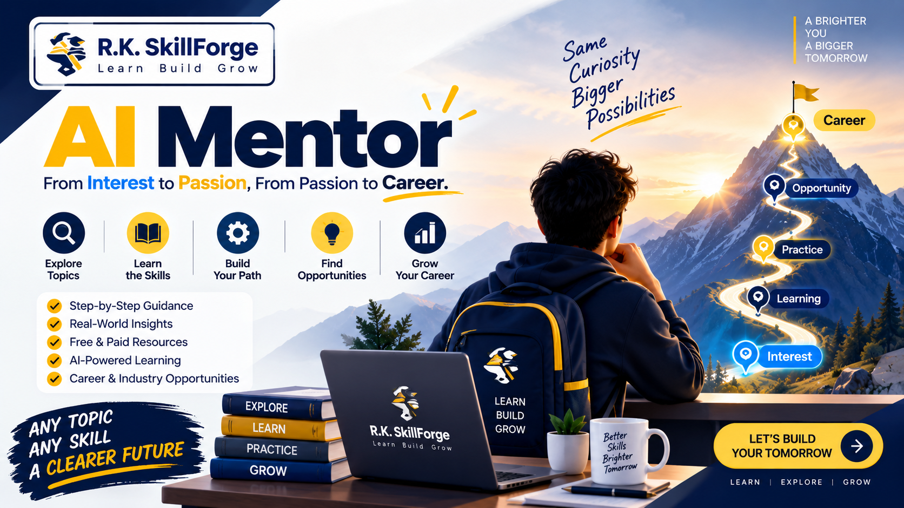
🚀 R.K. SKILLFORGE PRESENTS
AI MENTOR
Module 00: Introduction to AI Mentor
Lesson 0.1 — What is AI Mentor?
Transforming Vague Curiosity into Informed Action:
Interest ➔ Passion ➔ Career
🎓 100% Free Lifetime Masterclass
Instructor: R.K. SKILLFORGE
Full Curriculum: GitHub & YouTube
Skill Level: Beginner to Career-Ready
Produced & Engineered by R.K. SKILLFORGE
A complete blueprint to navigate the modern AI-driven career landscape.
Notes:
SPEAKER SCRIPT / VIDEO INTRO:
"Hello everyone, and welcome to AI Mentor, brought to you by R.K. SKILLFORGE.
If you've ever had a spark of curiosity about a new technology, field, or career path, but didn't know where to start—or felt completely overwhelmed by tutorials—this course is built specifically for you.
Today in Lesson 0.1, we're breaking down the foundational philosophy: How to turn vague curiosity into informed action, moving from raw Interest, to deep Passion, to a sustainable Career.
Let's dive right in!"

Slide 2
R.K. SKILLFORGE | LESSON 0.1 • WHAT IS AI MENTOR?
The Reality of Modern Self-Learning
Most people fail to turn an interest into a career NOT because they lack talent...
😵 Information Overload
Paralyzed by Content
Thousands of tutorials, bootcamps, and conflicting roadmaps lead to analysis paralysis. Learners spend months watching videos without building actual competence.
✨ Chasing Shiny Trends
The FOMO Trap
Jumping to every newly launched framework or AI hype cycle. Without deeply rooted core fundamentals, learners burn out as trends shift overnight.
🗺️ Disconnected Roadmaps
Checkbox Learning
Following generic checkbox lists that are divorced from industry hiring standards, real production problems, and collaborative workflows.
⚡ AI Mentor by R.K. SKILLFORGE bridges the gap between raw information and practical, career-defining mastery.
© R.K. SKILLFORGE • AI Mentor Video Masterclass
Slide 2
Notes:
SPEAKER SCRIPT:
"Look around the tech space today. There has never been more free information available. Yet why do so few people successfully make the transition from someone who is 'interested' in tech to someone who is actually hired?
It's not a lack of talent. It's three specific traps:
First, Information Overload. You spend hours bookmarking tutorials you'll never finish.
Second, Trend-Chasing. Every time a new library or tool drops, you abandon your current project to chase the hype.
Third, Disconnected Roadmaps. Checking off items on a checklist is not the same as solving real client or company problems.
AI Mentor exists to solve this exact bottleneck."

Slide 3
R.K. SKILLFORGE | LESSON 0.1 • WHAT IS AI MENTOR?
The 3-Stage Progression: Interest ➔ Passion ➔ Career
STAGE 01
💡 Interest
Curiosity & Exploration
─────────────────────
• Discovering exciting domains & tools
• Broad initial exposure & research
• Asking: 'What is this field really about?'
• Zero pressure, low-risk exploration
STAGE 02
🔥 Passion
Deep Understanding & Practice
─────────────────────
• Moving past the novelty phase
• Consistent hands-on building & debugging
• Mastering foundational core mechanics
• Building personal, authentic projects
STAGE 03
💼 Career
Value Creation & Opportunities
─────────────────────
• Translating skills into commercial value
• Solving real-world, messy constraints
• Learning directly from human mentors
• Demonstrated proof-of-work portfolio
© R.K. SKILLFORGE • AI Mentor Video Masterclass
Slide 3
Notes:
SPEAKER SCRIPT:
"Here is the core framework that guides our entire course at R.K. SKILLFORGE:
Stage 1 is Interest. Everyone starts here. You see an AI demo or web app and get curious. That's exploration.
Stage 2 is Passion. Passion isn't something you just 'find' lying on the street—it's forged when you push through the initial frustration, understand how the engine works under the hood, and build something of your own.
Stage 3 is Career. Career is where passion meets economic utility. You stop asking 'what is fun for me' and start asking 'what problem can I solve for a team, an employer, or a customer?'
Our mission is to escort you across all three stages smoothly."

Slide 4
R.K. SKILLFORGE | LESSON 0.1 • WHAT IS AI MENTOR?
What AI Mentor Does: 6 Core Pillars of Mastery
01. Deep Topic Exploration
Discovers real-world commercial value, active applications, and industries hiring for this skill.
02. Role & Responsibility Mapping
Deconstructs what practitioners actually do daily, separating job title hype from day-to-day work.
03. Fundamentals vs. Fast Tools
Isolates core architectural principles that last 20+ years from fleeting weekly tool fads.
04. Practical Roadmaps
Engineers clear step-by-step milestones from zero fundamentals to full production execution.
05. Human Mentorship Bridge
Provides battle-tested frameworks to connect with and learn from verified industry veterans.
06. Critical AI Literacy
Harnesses generative AI for rapid learning while preventing dependency, laziness, and hallucinations.
© R.K. SKILLFORGE • AI Mentor Video Masterclass
Slide 4
Notes:
SPEAKER SCRIPT:
"Whenever you want to learn ANY technical topic—whether it's Python, Machine Learning, Cloud Architecture, or UI Design—AI Mentor gives you a 6-pillar framework.
We don't just dump a list of links. We map out who hires for it, what a senior engineer does at 10 AM on a Tuesday, which fundamentals will never become obsolete, and how to verify AI answers against real industry mentors.
This turns you from a passive consumer into an agile, strategic professional."

Slide 5
R.K. SKILLFORGE | LESSON 0.1 • WHAT IS AI MENTOR?
The 5 Obstacles Every Learner Faces (Part 1)
OBSTACLE 01
Lack of Knowledge
⚠️ The Challenge:
Learners are curious about a skill without knowing who hires for it, real industry challenges, or daily workflows.
✅ How AI Mentor Solves It:
Conducts deep research into industries, business applications, and daily role responsibilities.
OBSTACLE 02
Too Many Resources
⚠️ The Challenge:
Thousands of courses and YouTube playlists create severe analysis paralysis and decision fatigue.
✅ How AI Mentor Solves It:
Curates a razor-sharp roadmap isolating essential fundamentals from optional side distractions.
OBSTACLE 03
FOMO & Constant Change
⚠️ The Challenge:
Pressure to learn every newly hyped library or AI model creates chronic learner burnout.
✅ How AI Mentor Solves It:
Anchors learning in timeless fundamentals that remain relevant regardless of tool trends.
© R.K. SKILLFORGE • AI Mentor Video Masterclass
Slide 5
Notes:
SPEAKER SCRIPT:
"Now let's examine the first three obstacles that derail 90% of self-taught students:
Obstacle 1: You don't know what you don't know. You might learn Python syntax, but not know what a backend engineer actually builds.
Obstacle 2: Resource overload. When you have 50 tabs open, you make zero progress. We filter the noise down to the essential 20% that drives 80% of results.
Obstacle 3: FOMO. Don't stress every time a new library comes out. If your core fundamentals are rock solid, picking up a new tool takes days, not months."

Slide 6
R.K. SKILLFORGE | LESSON 0.1 • WHAT IS AI MENTOR?
The 5 Obstacles Every Learner Faces (Part 2)
OBSTACLE 04
Roadmaps Without Context
⚠️ The Challenge:
Generic online roadmaps treat learning like a checklist of topics. They never explain real production workflows, edge cases, or client expectations.
✅ How AI Mentor Solves It:
Directly connects learning to real-world projects, industry constraints, and verifiable competence proofs.
OBSTACLE 05
Lack of Mentorship & Over-Reliance on AI
⚠️ The Challenge:
AI models can hallucinate convincingly and lack lived human experience, personal feedback, or professional intuition.
✅ How AI Mentor Solves It:
Combines AI research speed with systematic methods to find, connect with, and learn from experienced human practitioners.
© R.K. SKILLFORGE • AI Mentor Video Masterclass
Slide 6
Notes:
SPEAKER SCRIPT:
"Now let's tackle the two biggest modern obstacles:
Obstacle 4 is Roadmaps Without Context. How many times have you seen a GitHub roadmap with 200 boxes? You check off 'Docker', but you don't know how to debug a failing container in production. We solve this by rooting every topic in real projects.
Obstacle 5 is the trap of our time: Blindly trusting AI. AI will give you an answer with complete confidence even when it's wrong. AI does not have 10 years of production scars. That is why human mentorship remains irreplaceable."

Slide 7
R.K. SKILLFORGE | LESSON 0.1 • WHAT IS AI MENTOR?
The AI Mentor Philosophy
THE 8 PRINCIPLES OF MASTERY
1. Don't learn everything.
2. Understand what matters.
3. Build strong fundamentals.
4. Use AI wisely.
5. Verify important information.
6. Learn from real people.
7. Take action.
8. Keep improving.
🎯 Core Takeaways
• Focus over Exhaustion
Stop trying to drink from the firehose. Master the durable 20% that underpins 80% of real work.
• Action over Consumption
Passive watching creates the illusion of competence. Active building creates actual problem-solving ability.
• Human + AI Synergy
Use AI as a supersonic research accelerator, and use real human mentors for strategic direction and sanity checks.
© R.K. SKILLFORGE • AI Mentor Video Masterclass
Slide 7
Notes:
SPEAKER SCRIPT:
"Here is our eight-line manifesto at R.K. SKILLFORGE.
Take a screenshot of this slide right now.
'Don't learn everything. Understand what matters. Build strong fundamentals. Use AI wisely. Verify important information. Learn from real people. Take action. Keep improving.'
Whenever you feel stuck, lost in tutorial hell, or overwhelmed, come back to these 8 lines. They will instantly re-center your energy on what actually works."

Slide 8
R.K. SKILLFORGE | LESSON 0.1 • WHAT IS AI MENTOR?
Golden Rule: AI as an Accelerator, Not an Oracle
⚠️ THE GOLDEN RULE OF THE AI ERA
“AI can synthesize information in seconds, but it does NOT replace judgment, rigorous practice, or human insight.”
Always verify critical technical, architectural, or career decisions against authoritative documentation and experienced practitioners.
✅ What AI Is Best Used For
• Rapid exploration of new concepts & complex syntax
• Generating structured roadmaps & practice exercises
• Debugging cryptic errors & brainstorming solutions
❌ What AI Cannot Replace
• Lived professional wisdom & battle-tested experience
• Personal empathy, team leadership, and trust
• Hands-on intuition earned by fixing real production bugs
© R.K. SKILLFORGE • AI Mentor Video Masterclass
Slide 8
Notes:
SPEAKER SCRIPT:
"If you take only one rule away from this lesson, make it this one:
AI is an Accelerator, not an Oracle.
Treat AI like a brilliant junior intern who works at lightspeed. They can gather data, write drafts, and explain code in seconds.
But YOU are the senior architect. You must review the work, verify the facts, test the edge cases, and exercise judgment.
Those who treat AI as an oracle become dependent and fragile. Those who use it as an accelerator become 10x more productive."

Slide 9
R.K. SKILLFORGE | LESSON 0.1 • WHAT IS AI MENTOR?
Master Curriculum Progression & Next Steps
Module 00: Introduction to AI Mentor
Foundations, mindset, and overcoming self-learning traps. [CURRENT LESSON]
Module 01: Find Your Way
Deep skill analysis, custom career roadmaps, and your first AI Skill Jar. [UP NEXT]
Module 02: Explore The Domain
Industry landscape, hiring profiles, workflows, and market opportunities. [UPCOMING]
Module 03: Actionable Frameworks
Structured prompt systems, hands-on building, and verification loops. [UPCOMING]
Module 04: The Human Bridge
Finding real mentors, authentic networking, and landing career roles. [UPCOMING]
© R.K. SKILLFORGE • AI Mentor Video Masterclass
Slide 9
Notes:
SPEAKER SCRIPT:
"Now that you know the foundation, where are we heading next?
In Module 01, 'Find Your Way', we'll roll up our sleeves and show you the exact step-by-step process to analyze any domain, create a personalized career roadmap, and build your very own AI Skill Jar.
Then in Module 02, we'll map real hiring profiles; in Module 03, we'll tackle hands-on technical frameworks; and in Module 04, we'll build your human mentorship network.
The full journey is mapped and ready for you."

Slide 10
READY TO TRANSFORM YOUR LEARNING JOURNEY?
Next Lesson: Module 01 — Find Your Way
Empowering Learners Worldwide • R.K. SKILLFORGE
👍 Like this video & Subscribe to our channel for the full AI Mentor series
⭐ Star the GitHub Repository to download slides, templates & prompt jars
💬 Drop your current target skill or career question in the comments below
➡️ Click the next video to begin Module 01: Find Your Way
© R.K. SKILLFORGE | AI Mentor Course | 100% Free Lifetime Access
Notes:
SPEAKER SCRIPT / OUTRO:
"Thank you so much for watching Lesson 0.1 of AI Mentor, brought to you by R.K. SKILLFORGE.
If this philosophy resonated with you, hit the Like button and make sure to Subscribe with notifications on so you don't miss any part of this masterclass.
Check the description below for links to the GitHub repository where you can download these slides, templates, and guides for free.
Leave a comment with what skill or technology you want to master next.
I'll see you in Module 01: Find Your Way!"

