Slide 1
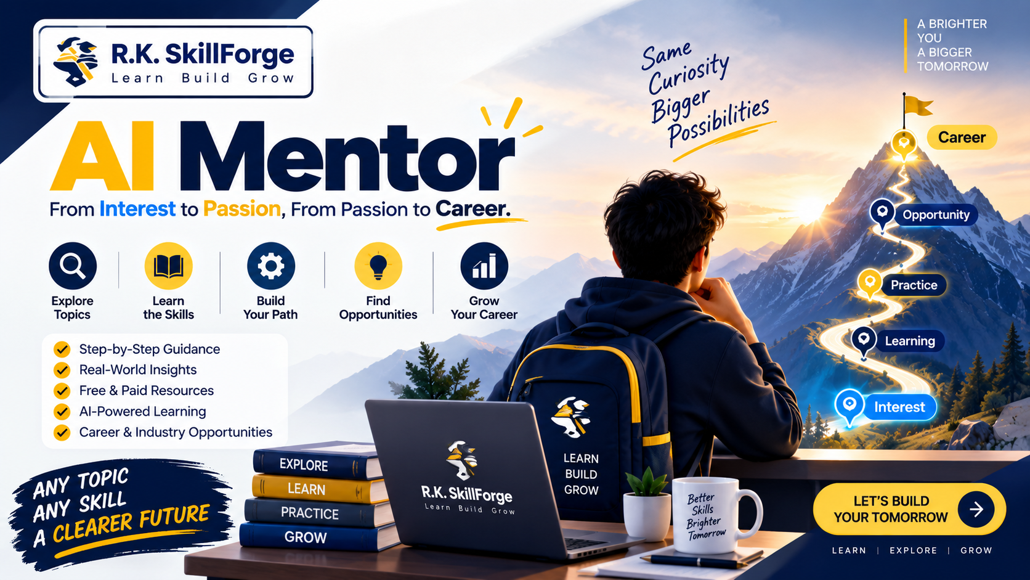
🚀 R.K. SKILLFORGE MASTERCLASS
AI MENTOR
Module 01: Find Your Way
Lesson 1.1 — From Vague Interest to Concrete Mastery
Honest Skill Analysis • Custom Roadmaps • Real Mentorship
🧭 The 9-Pillar Decision Framework
Presented by R.K. SKILLFORGE
Includes: Prompt Jar & Custom Frameworks
Outcome: Crystal Clear Career Blueprint
Engineered by R.K. SKILLFORGE
How to evaluate any skill, build actionable roadmaps, and avoid AI traps.
Notes:
SPEAKER SCRIPT / INTRO:
"Welcome back to AI Mentor by R.K. SKILLFORGE! Today we are diving into Module 01: 'Find Your Way'.
In our introduction, we looked at why traditional learning fails. In this video, we're giving you the exact 9-pillar engine to take ANY idea, topic, or career interest and turn it into a battle-tested, step-by-step reality.
Whether you want to learn AI Engineering, Cloud Architecture, Full-Stack Development, or Data Science, this framework will give you radical clarity.
Let's get started!"

Slide 2
R.K. SKILLFORGE | LESSON 1.1 • FIND YOUR WAY
The Core Mission: Interest ➔ Passion ➔ Career
THE TRANSFORMATION FORMULA
INTEREST ➔ PASSION ➔ CAREER
💡 1. Stop Vague Guessing
Most learners waste 6-12 months learning tools they will never use in production. We replace guesswork with rigorous diagnostic research before writing a single line of code.
🔬 2. Honest Market Analysis
We analyze the actual hiring landscape: Which industries pay for this skill? What does a practitioner actually do on an average morning? What are the hard failure points?
🚀 3. Measurable Progression
Transition from passive tutorial watching to building authentic projects, receiving blunt critique, and connecting with real industry professionals.
© R.K. SKILLFORGE • AI Mentor Masterclass Series
Slide 2
Notes:
SPEAKER SCRIPT:
"Whenever you get excited about a new skill, your instinct is usually to open YouTube and search 'Python Tutorial for Beginners' or 'Docker Crash Course'.
Stop right there. That is how people get stuck in tutorial purgatory.
Before you spend hundreds of hours, you need diagnostic clarity. You need to know: Does this skill lead to real jobs? What will you actually build? What are the daily headaches of that role?
Module 01 provides that compass so you only invest your time where it generates long-term career value."

Slide 3
R.K. SKILLFORGE | LESSON 1.1 • FIND YOUR WAY
The 9 Pillars of the Find-Your-Way Framework
01. Understand Topic
Deep research into real-world applications & daily duties.
02. Fundamentals vs Trends
Isolate timeless principles from temporary tool fads.
03. Career Analysis
Map out industries, job roles, and freelance routes.
04. Learning Roadmap
A milestone-driven roadmap from Start to Mastery.
05. AI Tools & Safe Usage
Harness AI speed while preserving independent thinking.
06. Find a Real Mentor
Bridge AI with authentic human wisdom and networking.
07. Hallucination Defense
Demand blunt honesty over pleasing or fake confidence.
08. Honest Idea Scoring
Get your plan or idea rated out of 10 with direct critique.
09. Practical Action
Convert research into projects, portfolio, and employment.
© R.K. SKILLFORGE • AI Mentor Masterclass Series
Slide 3
Notes:
SPEAKER SCRIPT:
"Here is the complete architecture of our framework. 9 structured pillars.
Notice how this is not a random checklist. It is an end-to-end pipeline.
We start with Topic Exploration, separate Fundamentals from Trends, map Career Opportunities, build a custom Roadmap, apply AI Safely, connect with Human Mentors, defend against Hallucinations, Score the idea out of 10, and commit to Practical Action.
Let's break down how each pillar works in detail."

Slide 4
R.K. SKILLFORGE | LESSON 1.1 • FIND YOUR WAY
Pillars 1 & 2: Topic Clarity & Fundamentals vs Trends
🏛️ PILLAR 01: UNDERSTAND THE TOPIC
The 11 Diagnostic Questions
• 1. What is this fundamentally?
• 2. Why is it commercially important?
• 3. How does it help people / businesses?
• 4. Which exact industries hire for it?
• 5. What are real-world production applications?
• 6. What job roles actually exist?
• 7. What are daily role responsibilities?
• 8. What hard challenges will you face?
🧱 PILLAR 02: FUNDAMENTALS VS. TRENDS
Escaping the FOMO Trap
⭐ Timeless Fundamentals (Focus 80%)
Data structures, system architecture, HTTP/networking, state management, core language semantics. These stay relevant for decades.
⭐ Ephemeral Tool Hype (Focus 20%)
New wrapper libraries, UI buzzwords, and weekly AI tools. If you master fundamentals, picking up any new tool takes 48 hours.
⭐ Rule of Thumb
Avoid spending months chasing fleeting hype. Strong fundamentals give you resilience against technological shifts.
© R.K. SKILLFORGE • AI Mentor Masterclass Series
Slide 4
Notes:
SPEAKER SCRIPT:
"Let's look at Pillars 1 and 2.
In Pillar 1, before writing any code, we ask 11 diagnostic questions. Who uses this? What are daily responsibilities? What are real production headaches?
In Pillar 2, we ruthlessly separate fundamentals from hype. If you spend all your time learning the trendy JavaScript library of the week, you'll be obsolete next year.
Learn the core protocols, databases, and problem-solving principles. Fundamentals never expire."

Slide 5
R.K. SKILLFORGE | LESSON 1.1 • FIND YOUR WAY
Pillars 3 & 4: Career Opportunities & Action Roadmap
💼 PILLAR 03: CAREER & OPPORTUNITY
Where Does This Lead?
• Industry Mapping:
Identify target sectors: Fintech, Healthcare, E-commerce, SaaS, Enterprise.
• Role Specificity:
Target exact titles: Platform Engineer, Backend Architect, AI Solutions Consultant.
• Monetization Paths:
Full-time employment vs. Specialized Consulting vs. High-ticket Freelance.
• Value Longevity:
Focus only on skills that produce measurable economic return for employers.
🗺️ PILLAR 04: LEARNING ROADMAP
The 7-Stage Progression
1. START ➔ Pick 1 core topic & set bounded timeframe.
2. LEARN ➔ Consume high-signal documentation & theory.
3. PRACTICE ➔ Solve isolated sandbox challenges.
4. BUILD ➔ Engineer an end-to-end original project.
5. APPLY ➔ Deploy to production with real users.
6. IMPROVE ➔ Refactor, optimize performance & fix bugs.
7. OPPORTUNITY ➔ Showcase proof-of-work to hiring teams.
© R.K. SKILLFORGE • AI Mentor Masterclass Series
Slide 5
Notes:
SPEAKER SCRIPT:
"In Pillar 3, we map career opportunities. Don't learn a skill in a vacuum. Understand where you will apply it: in a startup, in enterprise tech, or as an independent consultant?
In Pillar 4, we build a 7-stage roadmap:
Start, Learn, Practice, Build, Apply, Improve, Opportunity.
Notice that 'Build' and 'Apply' come before 'Opportunity'. A certificate doesn't get you hired; a deployed project that solves a business problem does."

Slide 6
R.K. SKILLFORGE | LESSON 1.1 • FIND YOUR WAY
Pillar 5: AI Tools & Safe Usage — Avoid AI Dependency
⚠️ MANDATORY PRINCIPLE: NEVER BECOME AI-DEPENDENT
AI is a supersonic assistant and research tool, NOT a substitute for human cognitive capability.
At R.K. SKILLFORGE, we teach how to use AI to 10x your output while rigorously protecting your core problem-solving muscle.
🚀 How AI Accelerates Learning
• Rapid domain research & unfamiliar jargon translation
• Generating realistic mock datasets & coding sandboxes
• Instant code refactoring advice & error diagnostics
• Simulating interview questions and technical reviews
🧠 Skills You Must Never Delegate to AI
• Independent first-principles critical thinking
• Deep foundational problem-solving & debugging grit
• High-level architectural & business decision making
• Human empathy, storytelling, and client communication
© R.K. SKILLFORGE • AI Mentor Masterclass Series
Slide 6
Notes:
SPEAKER SCRIPT:
"Pillar 5 is critical in today's generative AI era: Safe AI Usage.
If you use AI as a crutch—copy-pasting code without understanding how it works—you will fail the first technical interview you sit for.
Use AI to explain hard concepts, generate test data, or debug confusing errors.
Never let AI do your thinking for you. Your value as a professional lies in your ability to reason, architect, and communicate."

Slide 7
R.K. SKILLFORGE | LESSON 1.1 • FIND YOUR WAY
Pillar 6: The Human Mentor Bridge (Human + AI)
Why Mentors Matter
Lived Battle Scars
─────────────────────
• AI has access to text; mentors have lived experience.
• Mentors understand unwritten corporate culture & team dynamics.
• They spot blind spots AI will completely overlook.
• They open doors through personal reputation and referrals.
Where to Connect
High-Signal Spaces
─────────────────────
• Open Source GitHub issues & pull requests.
• Active technical Discord & Slack engineering channels.
• Local developer meetups, conferences, and hackathons.
• LinkedIn (with thoughtful, customized outreach).
How to Reach Out
The Professional Way
─────────────────────
• Never send generic 'please be my mentor' messages.
• Show proof of work: 'I built this and ran into XYZ constraint.'
• Ask 1 specific, high-signal, answerable question.
• Respect their time & report back on what happened.
© R.K. SKILLFORGE • AI Mentor Masterclass Series
Slide 7
Notes:
SPEAKER SCRIPT:
"Now let's talk about Pillar 6: Finding a Real Mentor.
AI is incredible, but AI cannot introduce you to a hiring manager, and AI cannot tell you what it feels like to manage a 3 AM database outage.
Real human mentors provide context, nuance, and encouragement.
Notice how we teach outreach: Never ask someone blindly 'will you mentor me?'. Instead, show what you've already built, ask a specific question about an edge case, and show gratitude. That is how real relationships are forged."

Slide 8
R.K. SKILLFORGE | LESSON 1.1 • FIND YOUR WAY
Pillars 7 & 8: Hallucination Defense & Honest Idea Scoring
🛡️ PILLAR 07: ACCURACY OVER AGREEMENT
Hallucination Defense
“Be direct and honest, not agreeable. If I am wrong, tell me I am wrong and explain why.”
• Never invent fake libraries, certifications, or statistics.
• Clearly distinguish between verified facts and reasonable inference.
• Say 'I don't know' rather than guessing confidently.
• Verify high-stakes career choices with authoritative sources.
⚖️ PILLAR 08: HONEST EVALUATION
The Idea Score: X / 10
• What is Strong: Acknowledge genuine competitive advantages.
• What is Weak: Expose unvalidated assumptions and flaws.
• What is Missing: Highlight blind spots in the technical architecture.
• What Could Fail: Identify catastrophic risks early before wasting money.
• Actionable Fixes: Deliver an immediate next step to upgrade the plan.
© R.K. SKILLFORGE • AI Mentor Masterclass Series
Slide 8
Notes:
SPEAKER SCRIPT:
"Pillars 7 and 8 are what make AI Mentor unique in the industry.
Most AI chat models are 'yes-men'. They praise whatever idea you give them, even if it makes zero sense.
In AI Mentor, we demand honesty over agreement. We instruct the model: 'If I am wrong, tell me I'm wrong.'
And in Pillar 8, we give every plan an honest score out of 10, highlighting what is weak, what is missing, and what could fail before you invest your life savings or 6 months of your time."

Slide 9
R.K. SKILLFORGE | LESSON 1.1 • FIND YOUR WAY
Pillar 9: The Complete 10-Step Execution Pipeline
1. Interest
Curiosity spark
2. Explore
11 diagnostic questions
3. Understand
Real daily duties
4. Fundamentals
Timeless principles
5. Learn
Structured resources
6. Practice
Sandboxes & drills
7. Connect
Real human mentors
8. Build
Production projects
9. Opportunity
Proof of work portfolio
10. Career
Value creation & hiring
© R.K. SKILLFORGE • AI Mentor Masterclass Series
Slide 9
Notes:
SPEAKER SCRIPT:
"Here is Pillar 9 in a single visual: The 10-Step Action Pipeline.
You start with Curiosity. You explore and understand. You isolate fundamentals, learn, practice, connect with real mentors, build real production code, generate market proof, and land the career.
If you skip steps—if you jump from Interest straight to Job Applications without building or connecting—you will get frustrated.
Follow this 10-step pipeline, and success becomes predictable."

Slide 10
R.K. SKILLFORGE | LESSON 1.1 • FIND YOUR WAY
Deploying the Framework: Prompts & Skill Jars
📄 UNIVERSAL PROMPT SYSTEM
AI-MENTOR-PROMPT.md
• Universal Compatibility:
Drop directly into ChatGPT, Claude Projects, Google Gemini, or local models.
• Built-in Guardrails:
Embeds the 9-pillar diagnostic rules, anti-hallucination prompts, and idea scoring out-of-the-box.
• Copy & Paste Ready:
Available inside the Module 01 folder in our GitHub repo.
📦 PRE-PACKAGED SKILL JAR
ai-mentor.skill
• Full Skill Archive:
Contains SKILL.md plus references for real mentors and safe AI usage.
• One-Click Knowledge Base:
Upload directly into Claude Projects or Antigravity agents for permanent intelligence.
• 100% Free & Open Source:
Engineered and maintained by R.K. SKILLFORGE for the global developer community.
© R.K. SKILLFORGE • AI Mentor Masterclass Series
Slide 10
Notes:
SPEAKER SCRIPT:
"Everything we just covered is not just theory. We have built the tools for you.
In the Module 01 repository, you will find two ready-to-use assets:
First, AI-MENTOR-PROMPT.md. You can copy and paste this into ChatGPT, Gemini, or Claude right now, and it will immediately act as your personal AI Mentor.
Second, ai-mentor.skill, which is a pre-packaged skill jar that you can upload to Claude Projects or your custom AI agents.
Both are 100% free and open-source from R.K. SKILLFORGE."

Slide 11
YOU NOW HAVE THE COMPASS
Next: Module 02 — Make an Online Presence
Presented with ❤️ by R.K. SKILLFORGE
👍 Like this video & Subscribe to our channel for Module 02
⭐ Star our GitHub Repo to grab the AI-MENTOR-PROMPT.md & ai-mentor.skill files
💬 Drop your current target skill below—let's evaluate it using the 9 pillars!
➡️ Click the next video to watch Lesson 2.1: Make an Online Presence
© R.K. SKILLFORGE | AI Mentor Masterclass | 100% Free Lifetime Access
Notes:
SPEAKER SCRIPT / OUTRO:
"Thank you for watching Module 01 of AI Mentor, brought to you by R.K. SKILLFORGE.
You now have the exact blueprint to take any vague interest and turn it into a concrete career path.
In our next video, Module 02: Make an Online Presence, we will show you how to build your proof of work, stand out from the crowd, and get noticed by clients and recruiters.
Don't forget to like, subscribe, and star the GitHub repository.
I'll see you in Module 02!"

