Slide 1
Deep Multi-agent Reinforcement Learning for Dynamic Scheduling
May 30, 2023
AIR Center, HMGICS Liu Renke

Slide 2
Research Summary
Project Title | Deep Multi-agent Reinforcement Learning for Dynamic Scheduling
Background and Objectives | Background Traditional Reinforcement Learning frameworks are incompatible with scheduling problem nature. Direct transfer of tradition multi-agent RL further decreases training efficiency. Most existing approaches fail to solve size-agnostic scheduling problem. Objectives Integrate four components: (1) Asynchronous transition; (2) Chronological joint-action; (3) Imitation learning; (4) Strategic idleness (potential). Validate the contribution of components in ablation study. Outperform recent benchmarks.
Project Members | AIR Center: Renke, Waldy, Preethi
Period | Total 6 months( Jun 2022 – Nov 2022)
Deliverables | Deep MARL model: scalable framework that can be generalize to HMGICS systems Technical report: TBD Papers: One journal submission, targeting Clarivate JCR Q1
GitHub Repo | https://github.com/RK0731/DRLforDynamicScheduling

Slide 3
Introduction
Background
Scheduling problem is different from common RL problems, the uneven transition interval and untrivial reward-shaping challenges the capability of traditional algorithms.
Difficulties to apply multi-agent RL architecture: credit assignment is critical in a scheduling problem, especially in large systems.
Most existing approaches fail to solve size-agnostic scheduling problem, thus lacking flexibility and practicality.
Problems to solve
Size-agnostic dynamic scheduling problem with a comprehensive event pool.
Scalable and flexible training framework.
Why does it matter?
Build flexible and robust production scheduling system.

Slide 4
Introduction
To resolve the imitations..
Asynchronous transition: change the reward-building scheme to fit the scheduling problem nature.
Chronological joint-action: identify and isolate the result of actions by retaining an effect-chain span over time.
Imitation learning: mix the learning from experiences (collected by agents themselves) with learning from masters (optimal schedule produced by mathematical optimization model).
Strategic idleness (potential): give agents an option to become idle, to better resemble the optimal scheduling behavior.
Distributed learning (potential): further improve the training stability and efficiency utilizing the power of distributed exploration.

Slide 5
Research Objectives
For this research, our goals to achieve are…
Integrate proposed components, and validate their contribution in the ablation study.
Outperform benchmarks published in recent years.
Build a transferrable training framework, for potential application in HMGICS systems.

Slide 6
Previous works
Some previous works similar to our work are…
A Deep Reinforcement Learning Framework Based on an Attention Mechanism and Disjunctive Graph Embedding for the Job-Shop Scheduling Problem. R. Chen, W. Li and H. Yang. IEEE Transactions on Industrial Informatics 2023 Vol. 19 Issue 2 Pages 1322-1331. DOI: 10.1109/tii.2022.3167380
Dynamic job-shop scheduling in smart manufacturing using deep reinforcement learning. L. Wang, X. Hu, Y. Wang, S. Xu, S. Ma, K. Yang, et al. Computer Networks 2021 Vol. 190. DOI:10.1016/j.comnet.2021.107969
Dynamic scheduling for flexible job shop with new job insertions by deep reinforcement learning. S. Luo. Applied Soft Computing 2020 Vol. 91 Pages 106208. DOI: 10.1016/j.asoc.2020.106208
Limitations of previous works..
Use of static or invariable problem instance, don’t consider scheduling problem on an ongoing basis;
Trivial adoption of traditional framework, pursuing short-term immediate surrogate reward;
Single-agent framework does not support precise decision.

Slide 7
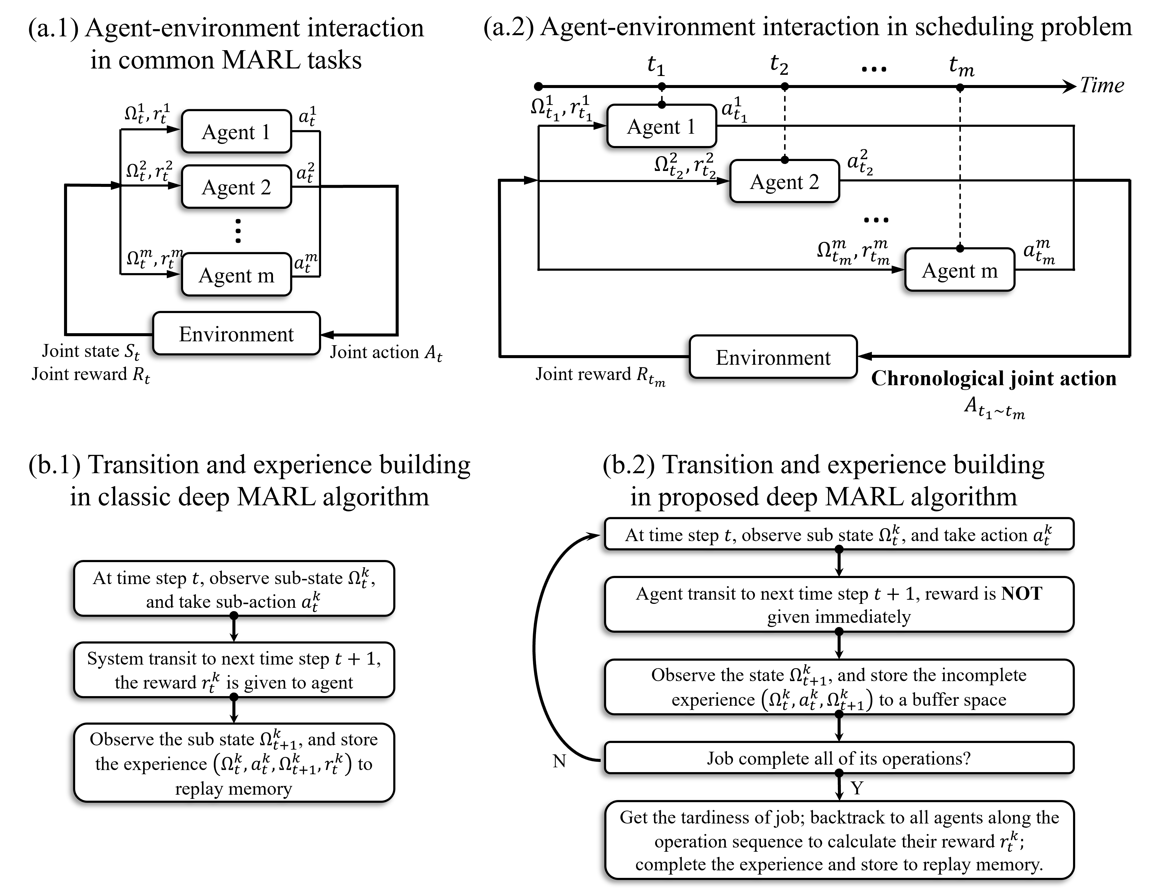
Proposed Method
Our approach

Slide 8
Dataset
Open dataset for the project
OR library: http://people.brunel.ac.uk/~mastjjb/jeb/info.html Unfortunately, this is a very old problem instance collection, developed for static scheduling.
I’ll instead use random problem instances proposed in my publications.

Slide 9
Milestones
Project Milestones
Total 6 months including …
Category | Details | Month(or week) |  |  |  |  |  | Etc
 |  | 6 | 7 | 8 | 9 | 10 | 11
Research Background | Literature review
 | Specifying ideas
Simulator Development | Develop and debug simulator
Experiments | Ex 1) Ablation study and parameter fine-tuning
 | Ex 2) Reproduce benchmarks and comparison
Writing | Write paper
Submission

