Slide 1
Crowdflower + Kaggle
Predict the relevance of search results from eCommerce sites
Julia Dills
1 June 2016

Slide 2
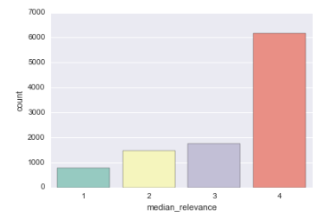
Goal
The challenge in this competition is to predict the relevance score given the product description and product title.
CrowdFlower had their minions evaluate searches from a handful of eCommerce websites. Each rater gave a product search term a score of 1, 2, 3, or 4.
4 = great match
1 = doesn’t match at all
261 unique queries
Train has 10,158 rows
Test has 22,513 rows

Slide 3
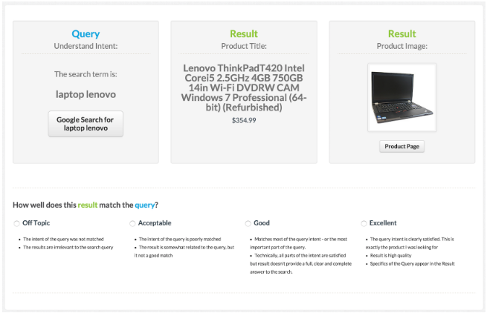
A closer look…

Slide 4
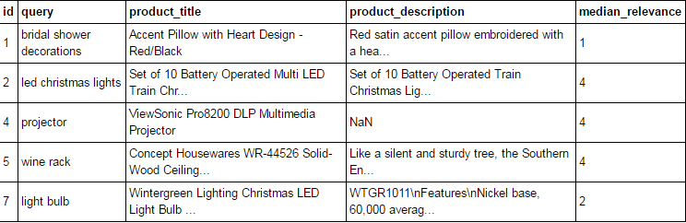
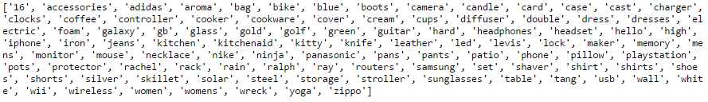
The data

Slide 5
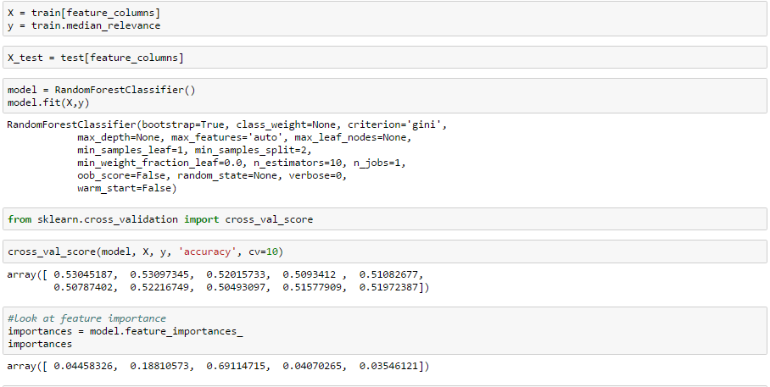
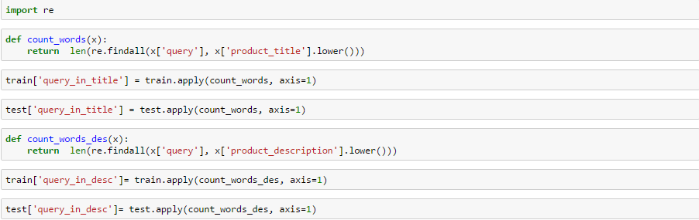
1st try
Remove stop words using NLP list of stop words
Tokenize words and count number of words
Use regex to find and count words that appear in columns
Throw these new feature columns into a random forest classifier

Slide 6
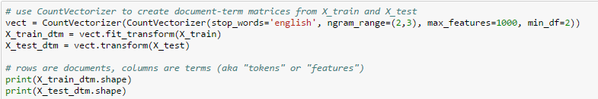
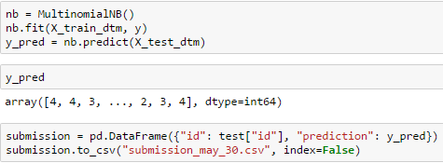
Try 2: Count vectorizer and Multinomial Naïve bayes
Found that n-gram range 2,3 worked best
I got the best kaggle score when only using the query as my feature column, but I did try a combination of query + product title and a combination of query+product title + product description

Slide 7
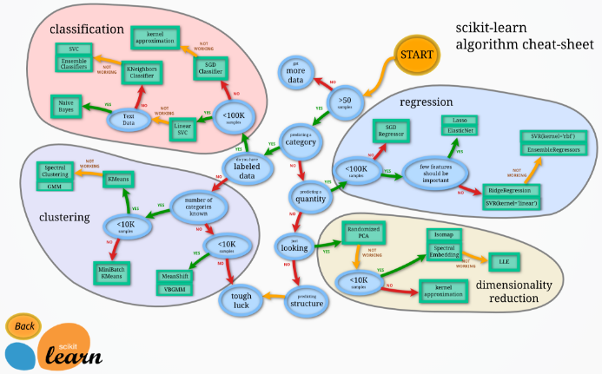
Try 3: using pipeline and feature union
Select classifier for pipeline (random forest from Try 1 wasn’t great anyways)

Slide 8

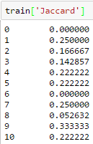
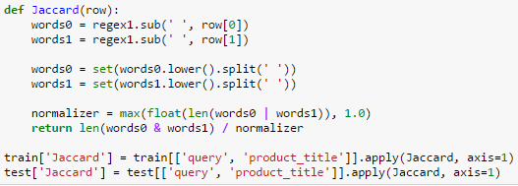
Additional Feature: Jaccard similarity coefficient score
The Jaccard coefficient measures similarity between finite sample sets, and is defined as the size of the intersection divided by the size of the union of the sample sets

Slide 9
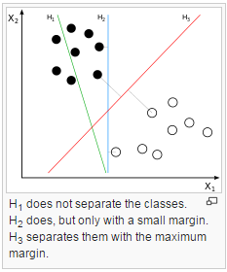
Linear SVC
The objective of a Linear SVC (Support Vector Classifier) is to fit to the data you provide, returning a "best fit" hyperplane that divides (categorizes) your data.

Slide 10
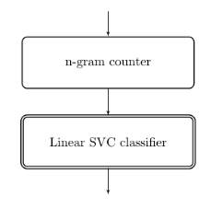
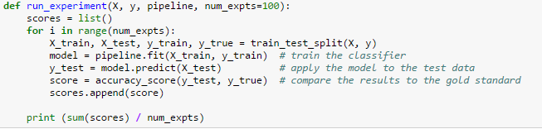




The pipeline

Slide 11
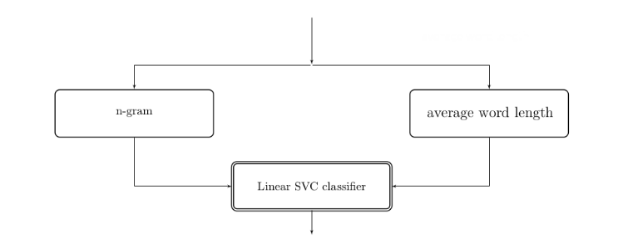
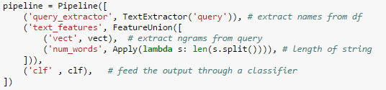
Parallel Transformers and feature union
You have to write your own transformer class to get this to work! Code and resources provided at end of presentation.

Slide 12
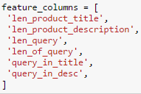
Summary of features in different models
Try 1: random forest classifier
Try 2: count vectorizer
Try 3: pipeline and feature union
Engineered features
Feature: Query
Create document term matrix
No features engineered but n_gram range, max_features, and min_df specified
Features:
Query
Jaccard similarity coefficient
Number of words in Query

Slide 13
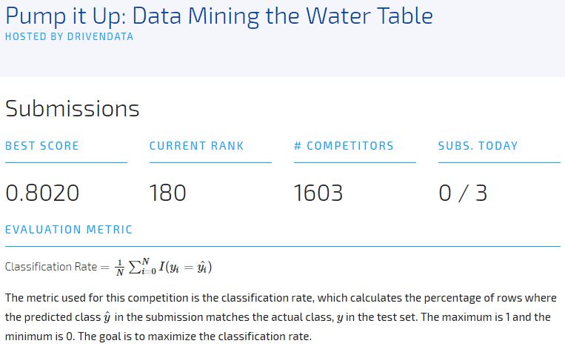
Summary of kaggle scores
Try 1 [regex, counting words, random forest]: 0.22486
Try 2 [count vectorizer using only query column]: 0.38903
Try 3 [pipeline and feature union]: 0.38296
Evaluation metric: quadratic weighted kappa
Winning score on kaggle: 0.72189
Just so I pass this class, I did improve my score
a lot on my other project! → → →
Top score on leaderboard = 0.8280

Slide 14
Summary + Looking ahead
While pipeline and feature union were intriguing to try out, they didn’t improve my score.
I found this search term relevance problem difficult. It was hard to figure out why a particular search result ranks more highly than another result for a given query.
Open to suggestion on how to approach this challenge!
Some future ideas:
TF-IDF
Tweak parameters of models (need to become more familiar with this)
Add some data visualization to this project

Slide 15
resources
My github (for the transformer code and text extractor): jdills26
Awesome blog on pipelines and feature unions: https://michelleful.github.io/code-blog/2015/06/20/pipelines/
What is CrowdFlower?: https://www.crowdflower.com/
And as always, the scripts on kaggle for this competition are a great resource!
Kaggle also has a blog where competition winners describe their methods: http://blog.kaggle.com/2015/07/27/crowdflower-winners-interview-1st-place-chenglong-chen/

