Slide 1
CS 559 Final Project xing Gao
- Predict Adult Income Salary

Slide 2
Content
Introduction
Data explore
Training
Result
Software Demo

Slide 3
1. Introduction
The object of this project is using machine learning technology to generate a classifier which can based on user information, e.g. age, occupation etc. , predict if that user can earn salary greater 50k US dollar or not.
Data Set

Slide 4
1. Introduction
Data Set
http://archive.ics.uci.edu/ml/datasets/Adult
Extraction was done by Barry Becker from the 1994 Census database.
UCI machine learning Archive-Adult Income http://archive.ics.uci.edu/ml/machine-learning-databases/adult/adult.data
Tool
Weka
Weka is a collection of machine learning algorithms for data mining tasks. Made by The University of Waikato
Application Framework
Java servlet
JSP ( java server page )
Maven
Tomcat

Slide 5
2. 1 Data description
Attribute 1: age: continuous.
Attribute 2: workclass: Private, Self-emp-not-inc….
Attribute 3: fnlwgt: continuous.
Attribute 4: education: Bachelors, Some-college, 11th, …
Attribute 5: education-num: continuous.
Attribute 6: marital-status: Married-civ-spouse, Divorced, Never-married…
Attribute 7: occupation: Tech-support, Craft-repair,
Attribute 8: relationship: Wife, Own-child, Husband,
Attribute 9: race: White, Asian-Pac-Islander, Amer-Indian-Eskimo, Other, Black.
Attribute 10: sex: Female, Male.
Attribute 11: capital-gain: continuous.
Attribute 12: capital-loss: continuous.
Attribute 13: hours-per-week: continuous.
Attribute 14: native-country: United-States, Cambodia, England..
Attribute 15(Class Label): >50K, <=50K…

Slide 6
2.2 Remove Problematic Attribute
Attribute 5 education-num and attribute 4 education are same data, they are one to one relationship, we only need keep one.
Since the education level have relation between and we can use this relation to compare them, for example Doctor > bachelor. So we choose continues attribute for education , remove attribute 4: education.
Attribute 3: fnlwgt: continuous.
Description of fnlwgt (final weight):
“The weights on the CPS files are controlled to independent estimates of the civilian noninstitutional population of the US. These are prepared monthly for us by Population Division here at the Census Bureau. “
“the statement only applies within state.””
Based on above information, we considering fnlwgt is not relevant to income, so remove attribute 3

Slide 7
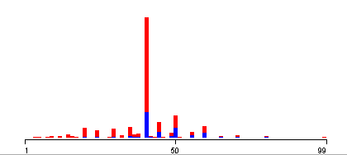
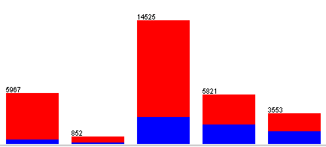
2.3 Discretize data
Many attribute is continues numerical data, if we put them in category, we can get better result for some advance tree classifier.
Example: Hours Per week

Slide 8
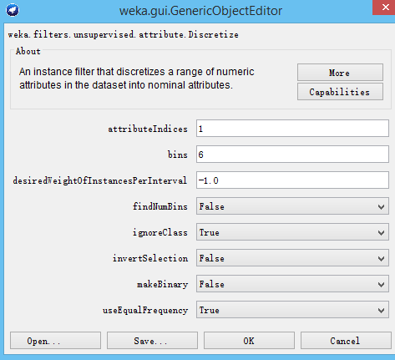
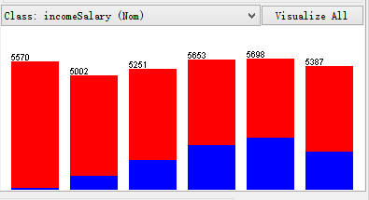
2.3 Discretize data
In weka, the way make numerical data is apply “weka.filters.unsupervised.attribute.Discretize”
attribute 1 age: 6 bins

Slide 9
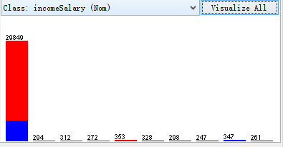
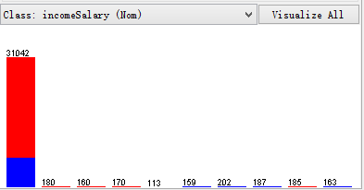
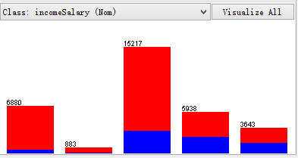
2.3 Discretize data –cont.
Attribute: capital-gain: 10 Bins
Attribute: capital-loss: 10 Bins
Attribute: hours-per-week: 5 Bins

Slide 10
2.4 Process Missing Data
For some reason, some sample missing data
workclass has 1836 missing data,
occupation: has 1843 missing data.
native-country: has 583 missing data.
Could be missing because data is missing when collection, or don’t want provide by data provider’s intent.
If data been is missing
Two option:
Option 1: delete whole sample if some attribute data is missing.
Option 2: replace data with average of that attribute.

Slide 11
2.4 Process Missing Data
Since work class and occupation has great influence on person’s salary, so if work class or occupation is missing, we delete whole instance.
After remove all instance missing work class and occupation, we found out still have 556 instances missing native-country.
In the rest 30718 instance, we have 27504 instances are from United-state, that 89.53%. So for people missing native country attribute, we will set them to United-state.

Slide 12
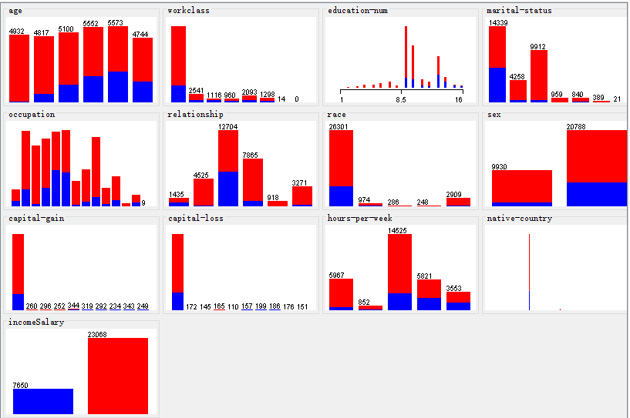

Slide 13
3 Training Classifier
3.1 Simple Classifier
Naive Bayes
KNN
3.2 Advance Classifier
Random Forest
C4.5
3.3 Improve result: Ensemble Methods

Slide 14
3.1 Simple Classifier
parameter estimate (Naive Bayes)
non-parameter classifier (KNN)
Experiment will split data set to 80% for training and 20% for testing.
Naive Bayes
Correctly Classified Instances 5052 82.2266 %
Incorrectly Classified Instances 1092 17.7734 %
For KNN, we will test k = 1, 5, 9, 15, 21, 41, 51(only odd number)
Each classifier will test 10 times and get average error rate.
Based our best result. Choose K=51
Correctly Classified Instances 5178 84.2773 %
Incorrectly Classified Instances 966 15.7227 %

Slide 15
3.2 Advance classifier
Random Forest
Most our attribute are nominal data, so tree decision will get better result than linear regression classifier,eg SVM
Experiment will test different number of trees.
Number of trees = 10 , 20, 30
When we choose 20 we got best result.
Correctly Classified Instances 5202 84.668 %
Incorrectly Classified Instances 942 15.332 %

Slide 16
3.2 Advance classifier-cont.
C4.5
Next we are going to use C4.5, in weka it’s call J48.
Basic idea of C4.5 is generate a decision tree based on data, the parameter we need test is size of the tree.
Correctly Classified Instances 5262 85.6445 %
Incorrectly Classified Instances 882 14.3555 %

Slide 17
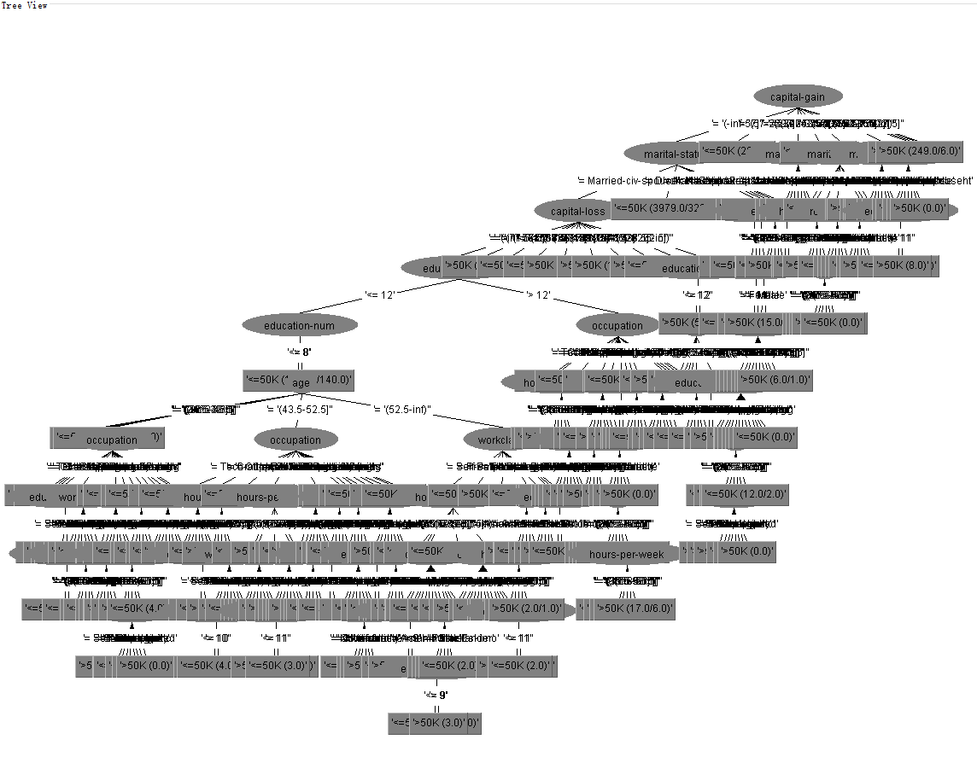

Slide 18
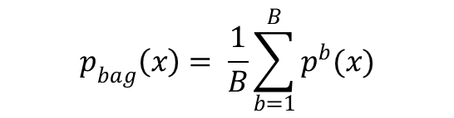
3.3 Improve result: Ensemble Methods
3.3.1 Bagging
Bootstrap aggregating, given a dataset S, sampling it to small size Si ( i is the number of classifier), since we have different training set, we will have different classifier, Ci.
When we classifying a new instance, we run every classifier, and vote based on calls predication.
Advantage:
Improving result, when there has noise in Data set
$$p_{bag}\left(x\right)= \frac{1}{B}\sum_{b=1}^{B}{p^{b}(x)}$$

Slide 19
3.3.1 Bagging-cont.
The classifier we uses for bagging is C4.5, 10 times iteration
Correctly Classified Instances 5285 86.0189 %
Incorrectly Classified Instances 859 13.9811 %
Slightly better than C4.5

Slide 20
3.3.2 Boosting
Goal for Boosting, iteratively make some changes on previous model,
put extra weight on those sample in next training,
so next model will getting better result for the instance we make wrong label at previous model.

Slide 21
3.3.2 Boosting-cont.
Compare two different classifier, Decision Stump and C4.5
Each mother we also test iteration 10, 20 , 50 times
C4.5 is better, but also only have 84%, almost same as single C.45 classifier
Correctly Classified Instances 5190 84.4727 %
Incorrectly Classified Instances 954 15.5273 %

Slide 22
3.3 Conclusion
Which Classifier?
Ensemble or not?
Since we have over 30K instance, the noise won’t effect much.
Based on our experiment, Bagging has better performance than Boosting
Name of classifier | Overall correct rate | correct rate for “>50K” class | correct rate for “<=50K” class
KNN | 84.2773 % | 56.417% | 93.244%
Naive Bayes | 82.2266% | 80.548% | 82.766%
Random Forest | 84.668 % | 63.337% | 91.523%
C4.5 | 85.6445 % | 61.698% | 93.352%
Bagging | 86.0189 % | 62.834% | 93.481%
Boosting | 84.4076 % | 64.171% | 90.921%

Slide 23
3.4 Real world implementation
If we have cost table:
If C1 is greater than C2, we better choose higher correct rate classifier among “>50K”, which is “Naive Bayes”
If C2 is greater than C1, we better choose higher correct rate classifier among “<=50K”, which is “C4.5”.
Real class Assumption class | >50K | <=50K
>50K | 0 | C1
<=50K | C2 | 0

Slide 24
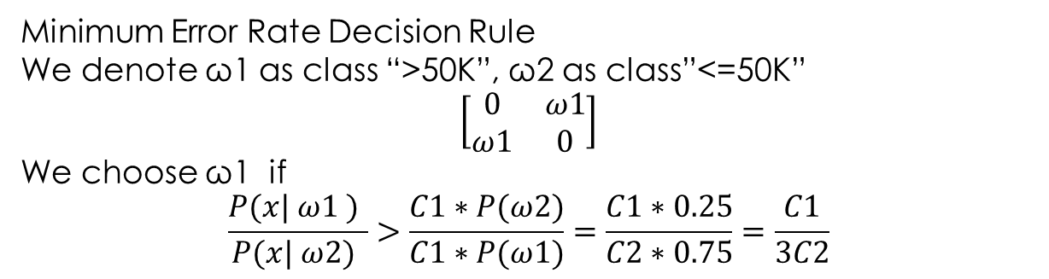
3.4 Real world implementation
Minimum Error Rate Decision Rule
We denote ω1 as class “>50K”, ω2 as class”<=50K”
$$\left[\begin{matrix}0 & ω1 \\ ω1 & 0\end{matrix}\right]$$
We choose ω1 if
$$\frac{P(x| ω1 ) }{P(x| ω2) }>\frac{C1∗P(ω2)}{C1∗P(ω1)}=\frac{C1∗0.25}{C2∗0.75}=\frac{C1}{3C2}$$

Slide 25
3.4 Real world implementation
If we don’t have cost table:
Class “>50K” as ω1, class “<=50K” as ω2
Denote Cc1 as Correct rate of C4.5 in class”>50K”, Cc2 as Correct rate of C4.5 in class”>50K”;
Denote Cn1 as Correct Rate of NaiveBayes in class “>50K”, Cn2 as correct rate in class”<=50K”
Denote Pc1, Pc2 as posterior getting from C4.5,
Denote Pn1, Pn2 as posterior getting from Naive Bayes.
Possibility of class :
P(x|ω1) = Pn1*Cn1 + Pc1*Cc1;
P(x|ω2) = Cc2*Cc2 + Cn2*Cn2;
We choose class 1 if P(x|ω1) > P(x|ω2) , otherwise choose class 2

Slide 26
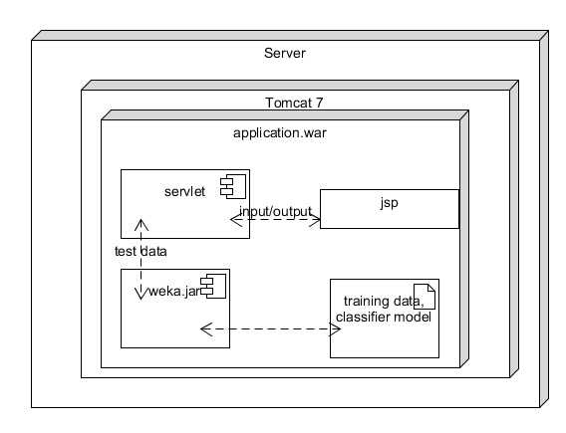
4. Application Demo
Architecture:

Slide 27
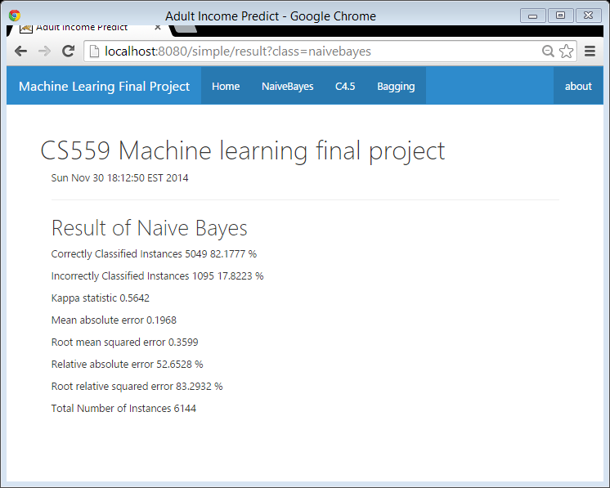
Naive Bayes classifier training and testing

Slide 28
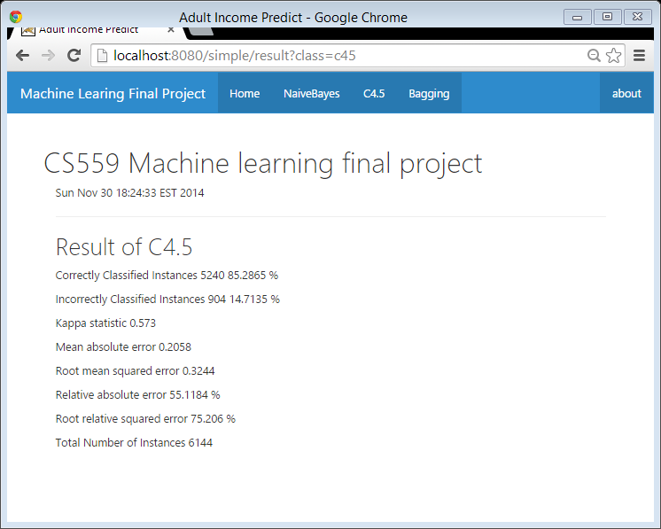
C4.5 classifier training and testing

Slide 29

Bagging classifier training and testing

Slide 30
Single instance predict
This page let user input data for each attribute and getting prediction from Naive Bayes and C4.5

Slide 31
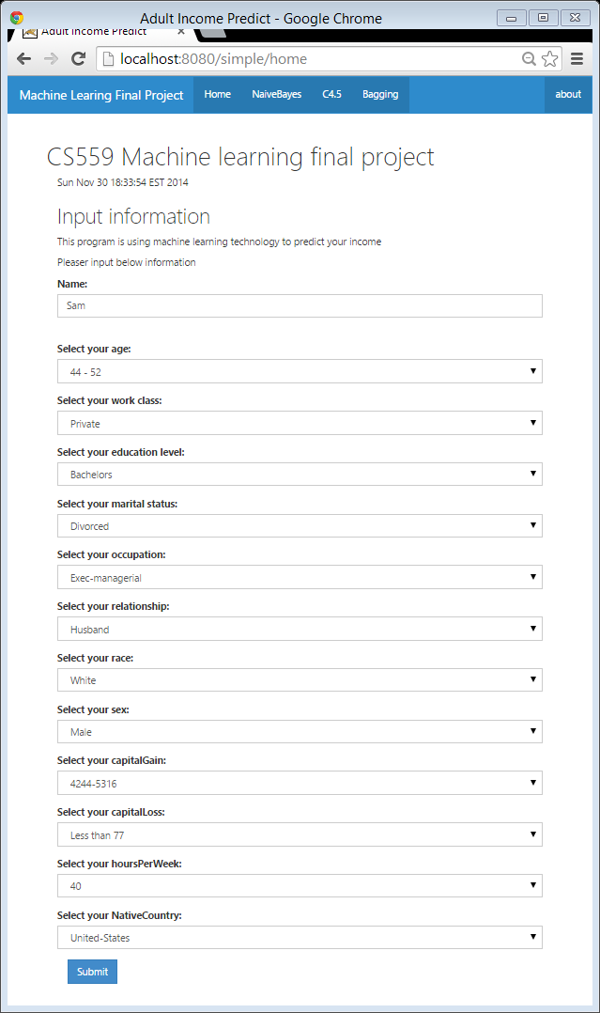

Slide 32
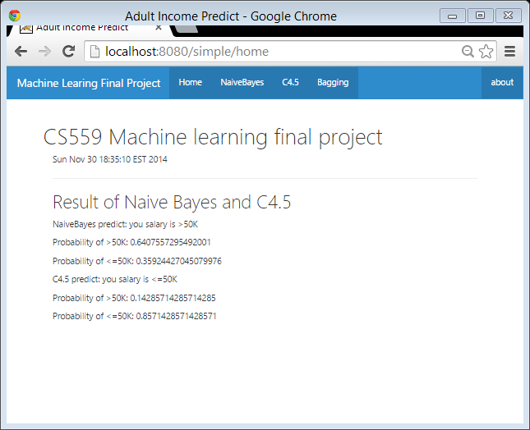
Result
The input actually is a instance from our data set, and that instance is belongs to >50K
The result is matching our conclusion, which is Naive Bayes more like prediction right if that person salary is greater than 50K; C4.5 is more accurate for instance which salary is <=50K.

Slide 33
Thanks!
Any Questions will be welcome

