Slide 1

TED TALKS
SEARCH & CLASSIFICATION

Slide 2
GOAL :
Comparing Information retrieval results of LSA and DOC2VEC
Topic Modeling
Classify documents into their categories

Slide 3
Data Description
Web scraped TED talk transcripts Category wise
835 TED talks
5 Categories:
Technology - 167
Entertainment - 134
Business - 108
Global Issues - 233
Science - 197
No class imbalance

Slide 4
PRE-PROCESS
encoding
Stop words removal and punctuations
Lemmatization
POS tagging and retaining “NN” and “NNP” - helps Topic Modeling

Slide 5
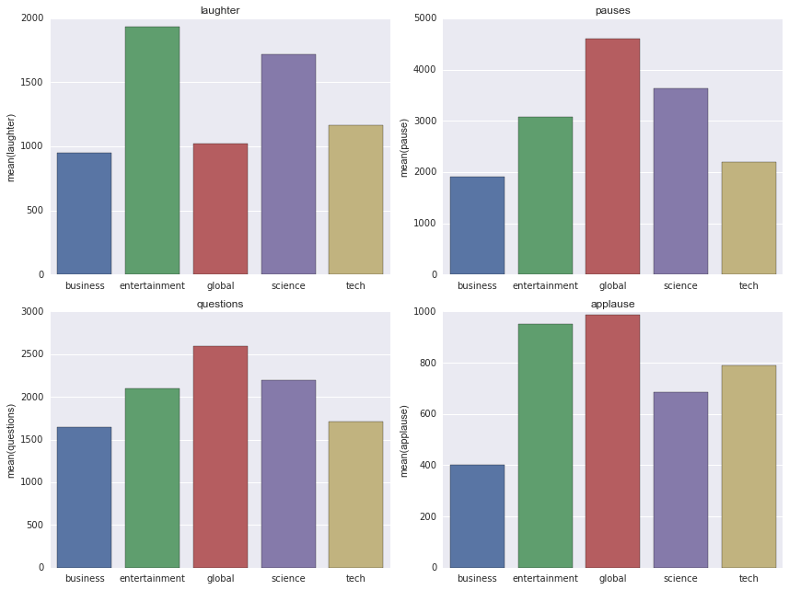
EDA

Slide 6
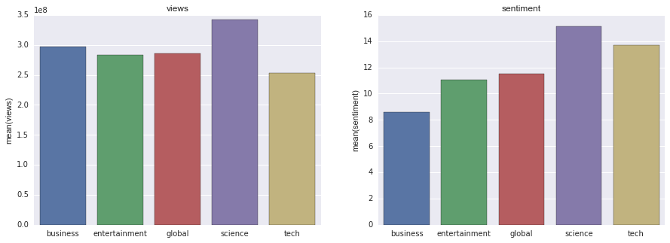
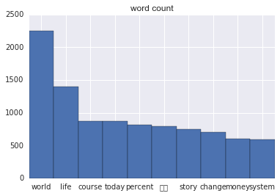
SOME MORE EDA

Slide 7
TOPIC MODELING :
TFIDF/count vectorize
NMF better than LDA
pyLDAvis
Around 40% accuracy after manually labelling the topics and assigning the document to the topic with maximum weight

Slide 8
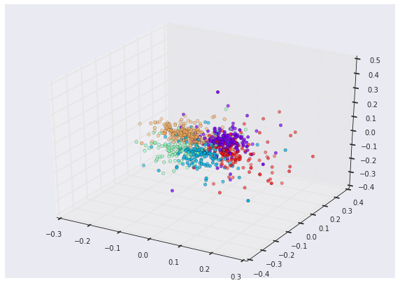
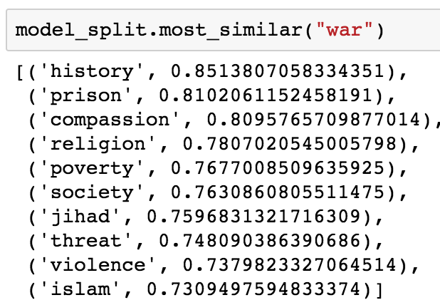
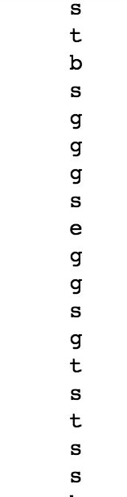
DOC2VEC : vector representation & search
Categories of search :

Slide 9
CLASSIFICATION :
KNN classifier
Random Forest classifier
Linear Discriminant Analysis
Support Vector Machine - classifier

Slide 10
KNN :
Accuracy : 65%
Predicted | b | e | g | s | t | All
True
b | 3 | 3 | 13 | 8 | 2 | 29
e | 0 | 17 | 10 | 3 | 0 | 30
g | 0 | 1 | 52 | 3 | 0 | 56
s | 0 | 2 | 1 | 48 | 3 | 54
t | 0 | 8 | 10 | 8 | 14 | 40
All | 3 | 31 | 86 | 70 | 19 | 209

Slide 11
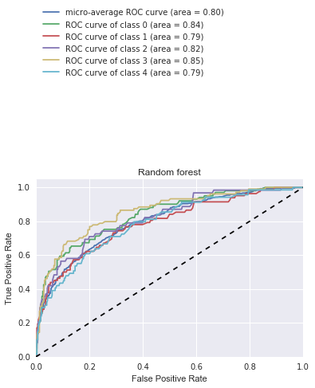
Random Forest :
Accuracy : 64%
Confusion Matrix
Predicted | b | e | g | s | t | All
True
b | 4 | 3 | 14 | 7 | 1 | 29
e | 0 | 17 | 10 | 3 | 0 | 30
g | 0 | 1 | 52 | 3 | 0 | 56
s | 0 | 1 | 4 | 46 | 3 | 54
t | 0 | 8 | 8 | 8 | 16 | 40
All | 4 | 30 | 88 | 67 | 20 | 209

Slide 12
SVM :
Confusion Matrix :
Accuracy : 72%
Predicted | b | e | g | s | t | All
True
b | 15 | 2 | 7 | 5 | 7 | 36
e | 0 | 29 | 3 | 2 | 1 | 35
g | 1 | 3 | 43 | 3 | 4 | 54
s | 0 | 6 | 1 | 29 | 3 | 39
t | 0 | 4 | 9 | 8 | 24 | 45
All | 16 | 44 | 63 | 47 | 39 | 209

Slide 13
Things that did not work out and future plans:
Trying to predict the umber of views using : count of laughter , pauses, questions, applauses, sentiment of the talk.
LDA2Vec

Slide 14
Thank you

