Slide 1
Pneumonia Detection in Chest X-Rays
Interpretable Deep Learning (AI)
for
By: Ratan K Ghosh
08/31/2025
🔗 GitHub Repository:

Slide 2
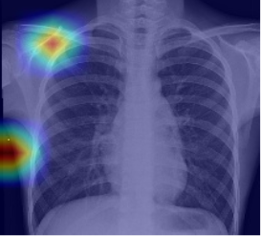
Data Set Source
The dataset used in this project was downloaded from a publicly available GitHub repository. It originates from the NIH Chest X-ray dataset and has been curated for binary classification: Pneumonia vs Normal. It’s widely used in academic and clinical machine learning research.
The dataset is organized into three folders: train, val, and test, each containing chest X-ray images labeled as either ‘Pneumonia’ or ‘Normal’. There are 5,216 training images, 16 validation images, and 624 test images.

Slide 3
Problem Statement
Detecting pneumonia from chest X-ray images is critical for timely treatment, especially in low-resource settings where radiologist availability is limited. Manual examination is time-consuming and prone to human error. This project automates pneumonia detection using deep learning to improve diagnostic efficiency, accuracy, and interpretability.

Slide 4
Dataset
• NIH Chest X-ray Dataset
• 100,000+ labeled images across 14 disease categories
• Publicly available and widely used in medical imaging research
• Includes pneumonia cases

Slide 5
Proposed Techniques
• Convolutional Neural Networks (CNNs) with Transfer Learning
• Pre-trained ResNet50 model fine-tuned for pneumonia detection
• Implemented using TensorFlow and Keras
• Grad-CAM visualizations for model interpretability

Slide 6
Project Steps
1. Data Preprocessing (resize, normalize, augment)
2. Data Splitting (train, validation, test)
3. Model Development (ResNet50 fine-tuning)
4. Model Training (hyperparameter optimization)
5. Evaluation (accuracy, precision, recall, AUC)
6. Visualization (Grad-CAM heatmaps)
7. Reporting (methodology & results)

Slide 7
Expected Results
• Achieve >90% classification accuracy on test data
• Provide an automated pneumonia screening tool
• Reduce radiologist workload and human error
• Improve early detection rates in clinical settings

Slide 8
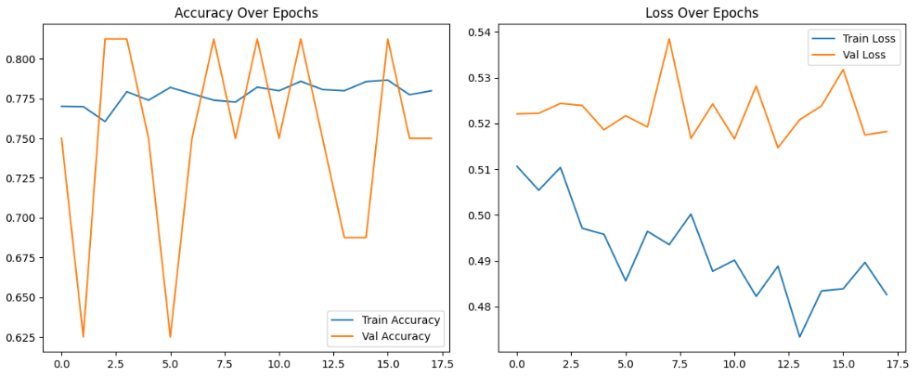

Slide 9
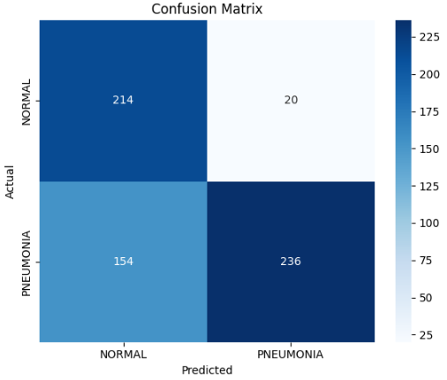

Slide 10
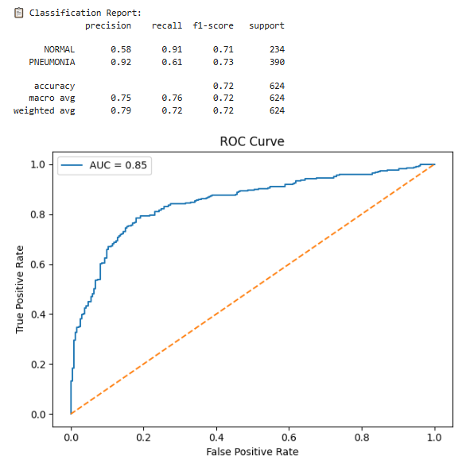

Slide 11
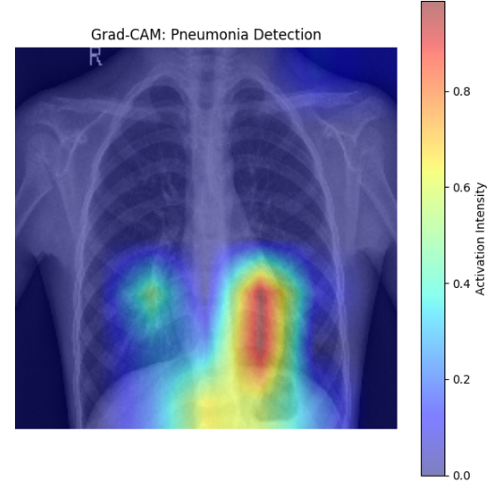

Slide 12
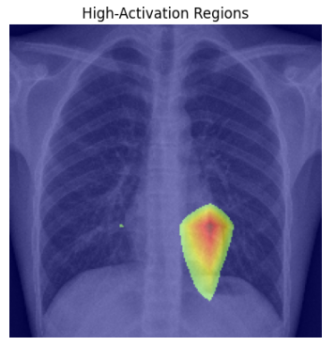

Slide 13
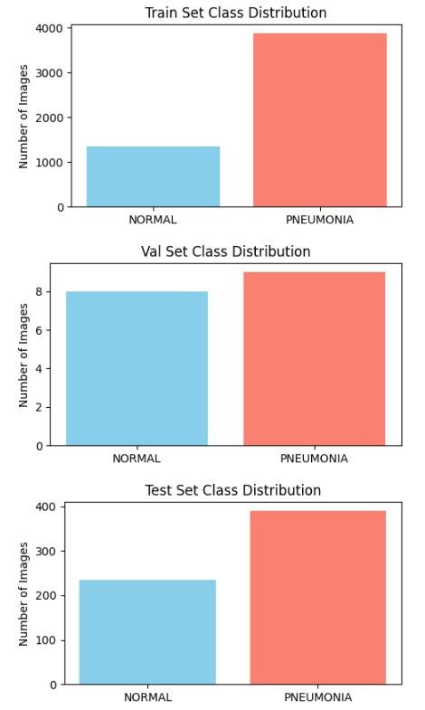
Found 5216 images belonging to 2 classes.
Found 16 images belonging to 2 classes.
Found 624 images belonging to 2 classes.

