Slide 1
Brain Tumor Segmentation
6th February 2023
Abdullah All Mamun, Rezaul Karim Mamun

Slide 2
Agenda
Introduction
Motivation
Dataset
Data visualization
Methodology
Evaluation and Result

Slide 3
Introduction
A Brain tumor is considered as one of the aggressive diseases
The doctors is to detect the tumor which is a time consuming for which they feel burden.
The best technique to detect brain tumors is Magnetic Resonance Imaging (MRI). A huge amount of image data is generated through the scans.
The optimal solution for this problem is the use of Image Segmentation and classification .

Slide 4
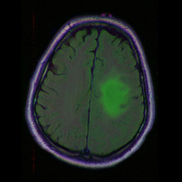

Dataset Description
This dataset contains brain MR images together with manual FLAIR abnormality segmentation masks.
The images were obtained from The Cancer Imaging Archive (TCIA)
All images are provided in tif format
Tumor genomic clusters and patient data is provided in data.csv file.

Slide 5
Simple Workflow
Import MRI Images
Preprocessing
Visualization
Models
Result
Evaluation

Slide 6
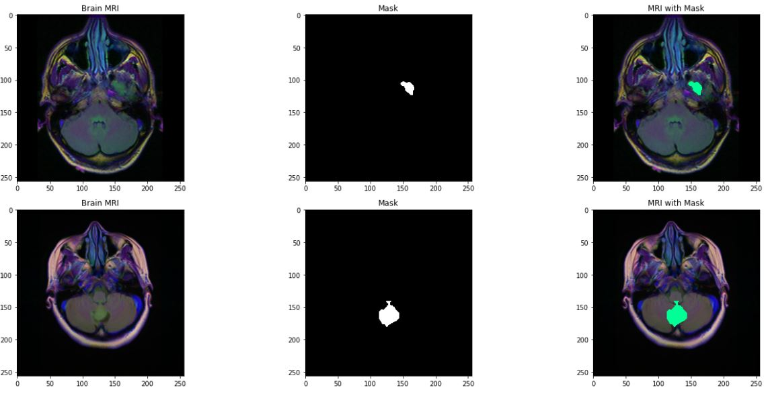
Data visualization
MRI vs mask vs MRI with Mask

Slide 7
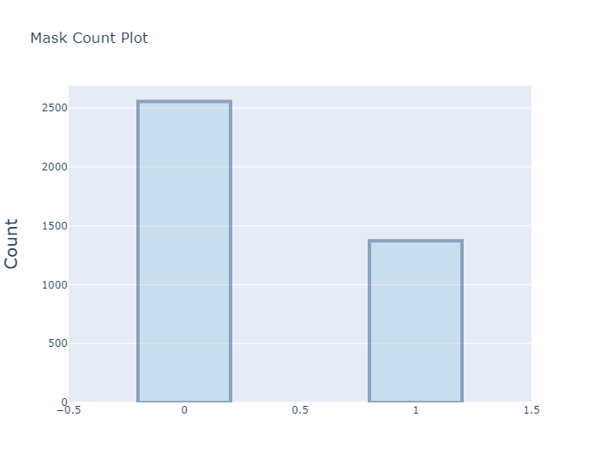
Exploratory Data Analysis

Slide 8
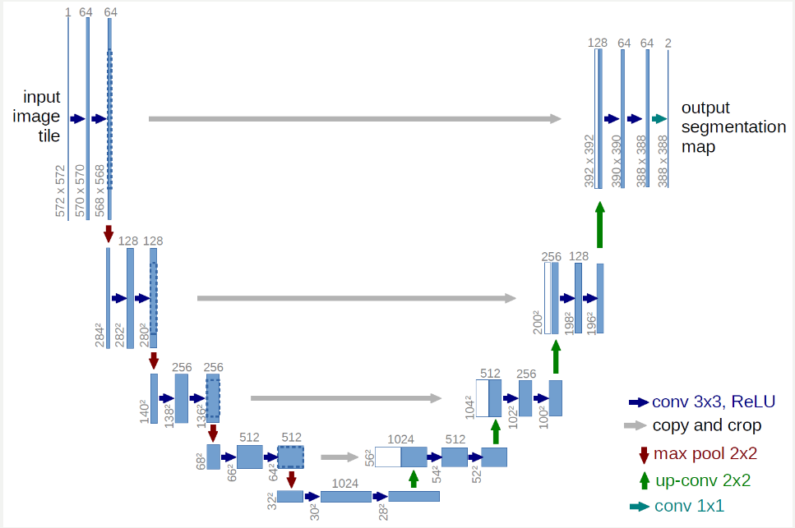
U-net
Encoder (Contracting path)
Decode(Expansion Path)

Slide 9
U-Net Architecture
Input size: 256*256*3
Encoding: 4 block
Each with two convolutional layer, batch normalisation, max polling
Relu activation
Decoding: 4 block
Each with two de-convolutional layer, batch normalisation,
Relu activation

Slide 10
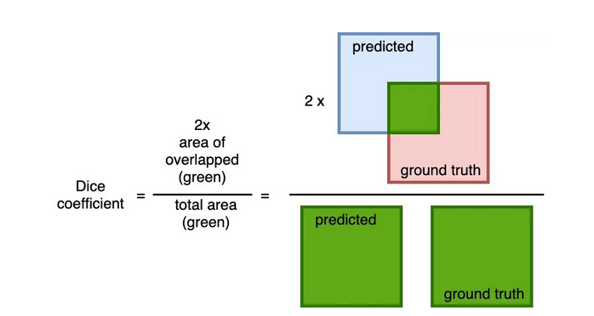
Evaluation

Slide 11
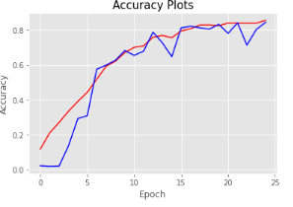
Model
Dataset split
Train:2828
Test : 708
Validation : 239
Image Input Size = 256*256*3
Batch size= 32
Epochs : 25
Red: train loss , Blue: validation loss
Test Dice Coefficient: 0.69

Slide 12
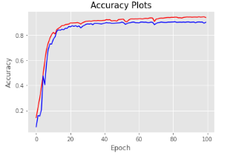
Second-approach
Train: 1029
Val : 172
Test: 172
Test Dice coefficient: 0.82

Slide 13
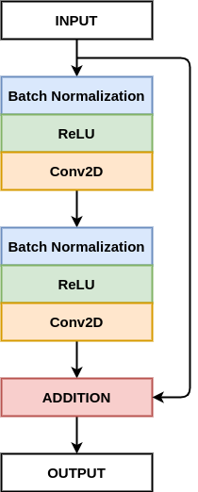
ResUnet
Encoding the input
Pre-activated residual block
Decoder

Slide 14
Training ResUnet
Epoch 1/60:
loss: 0.70 - tversky: 0.1365
val_loss improved from inf to 0.66
Epoch 60/60
loss: 0.24 - tversky: 0.8456
Val_loss did not improved from inf to 0.66

Slide 15
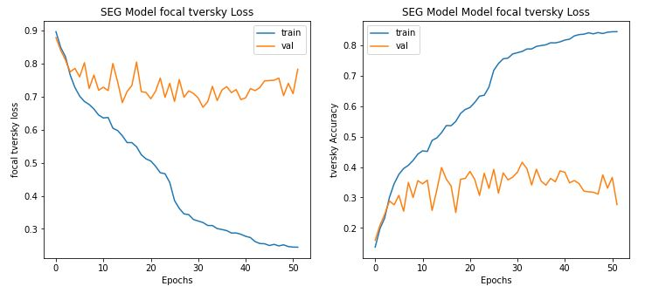
Accuracy and loss

Slide 16
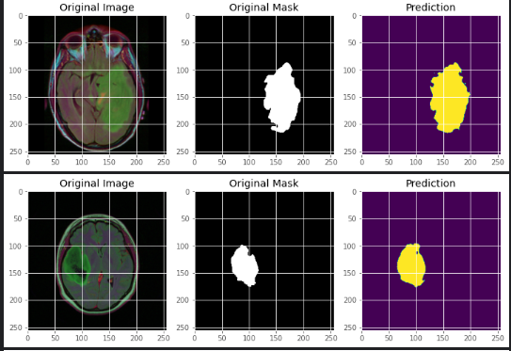
Segmented Tumor

Slide 17
Challenges
Data variability
Image quality
Class imbalance
Time consuming for training
Data scarcity
Difficulties for applying proper model

Slide 18
Reference
https://paperswithcode.com/paper/association-of-genomic-subtypes-of-lower
https://www.kaggle.com/datasets/mateuszbuda/lgg-mri-segmentation
https://towardsdatascience.com/understanding-semantic-segmentation-with-unet-6be4f42d4b47
https://iq.opengenus.org/resnet50-architecture/
https://medium.com/analytics-vidhya/brain-tumor-detection-and-segmentation-model-fc5dc952f6fe
https://www.analyticsvidhya.com/blog/2021/06/brain-tumor-detection-and-localization-using-deep-learning-part-1/
https://www.analyticsvidhya.com/blog/2021/06/brain-tumor-detection-and-localization-using-deep-learning-part-2/

