Slide 1
RNN-Based Voice Stability Monitor
PS-01 · SUDARSHANA SEMICONDUCTORS VLSI HACKATHON
A low-power GRU accelerator, taken from RTL to GDSII on a 0.18 µm library with Cadence Genus, Innovus and Tempus.
Team 18
Magesh · 24BVD1048 R Naga Arjun · 24BVD1102
powerhouse
Notes:
Introduce the team and the problem statement PS-01. Fill in the date.

Slide 2



Detecting a bad call on the device, not in the cloud
Telecom edge devices must spot degraded call quality in real time, without sending audio away.
Live call
Edge device
Alert
16 features per frame arrive as INT8.
A small GRU scores each frame on chip.
A smoothed score raises an interrupt.
Under 1 ms per frame
INT8 weights
INT16 activations
Low-milliwatt power
Team 18 · powerhouse

Slide 3
Architecture
Sequencer FSM
Weight memory: 1552 bytes + 49 INT16 biases
Register file
AXI-Stream in
16 × INT8, tlast on beat 16
Frame buffer
Shared MAC
16×8 MAC + 17×18 gating multiplier
Sigmoid and tanh LUTs
256 entries
Gate update
Hidden state
16 × INT16, flush
Output layer
score
Shift-based EMA
Alert with hysteresis
Interrupt
Arrows show the data flow: left to right on the top row, wrapping from Gate update to Hidden state on the second row. The sequencer drives one time-shared datapath.
Team 18 · powerhouse

Slide 4
Trading speed we do not need for area
Fully parallel GRU
Our time-multiplexed GRU
Many multipliers working at once. Fast, but large and power hungry.
One multiplier path reused for every term. About 1573 cycles per frame.
15.73 µs
23.6 µs
1 ms
at 100 MHz
at the 15 ns signoff clock
budget per frame
Area and power are the primary metrics, so the design spends cycles we have to spare.
Team 18 · powerhouse

Slide 5
Number formats and accuracy
Quantity | Format
Features | INT8
Weights | INT8, Q.6
Biases | INT16, Q.14
Activations | INT16, Q1.14
Accumulator | INT32
LUTs | 256 entries
0.0043
0.026
score rms error vs float
score max error vs float
0.0078
0.031
sigmoid LUT max error
tanh LUT max error
0 of 2000 alert decisions differ from the float model.
Team 18 · powerhouse

Slide 6
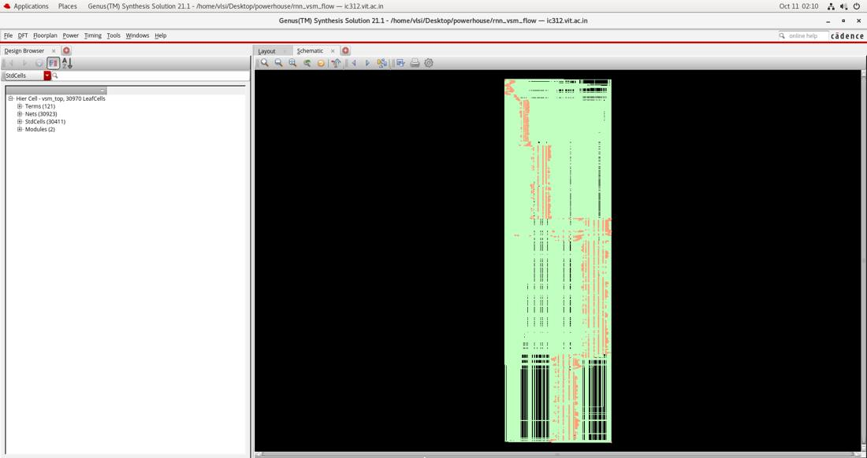
RTL-to-GDSII flow
Golden model + QAT
RTL
Regression
Synthesis
Place and route
Signoff
GLS + SAIF
GDSII
Verilog
ncsim
Genus 21.1
Tempus 22.11
ncsim
Innovus
Python
Innovus 21.15
Genus synthesis result: 30,970 leaf cells across 2 modules.
Team 18 · powerhouse

Slide 7
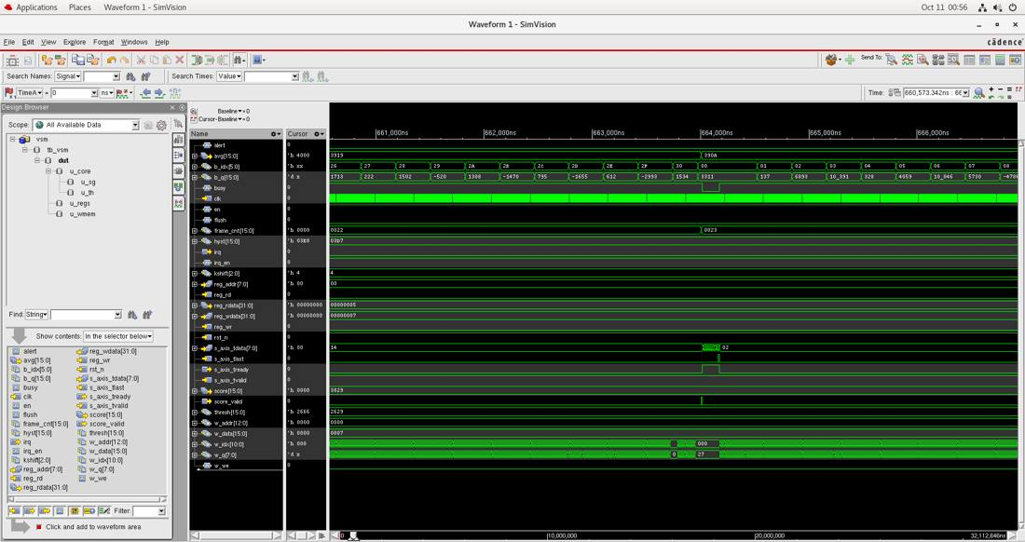
Verification: bit-exact against the model
3 seeds × 2000 frames in ncsim, 0 errors.
200 gate-level frames, 0 errors.
Reset and flush mid-compute
Early tlast
Saturated inputs
Back-to-back frames
Threshold crossed both ways: 5 assertions, 5 deassertions
One-hour stream (360,000 frames) passes in the model with 442 alert assertions. Correlation 0.956 against a synthetic quality label.
Team 18 · powerhouse

Slide 8
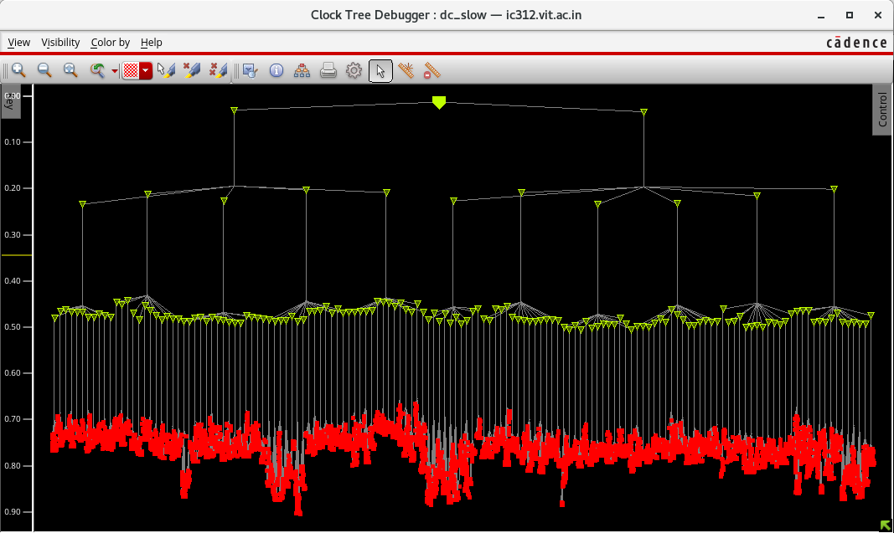
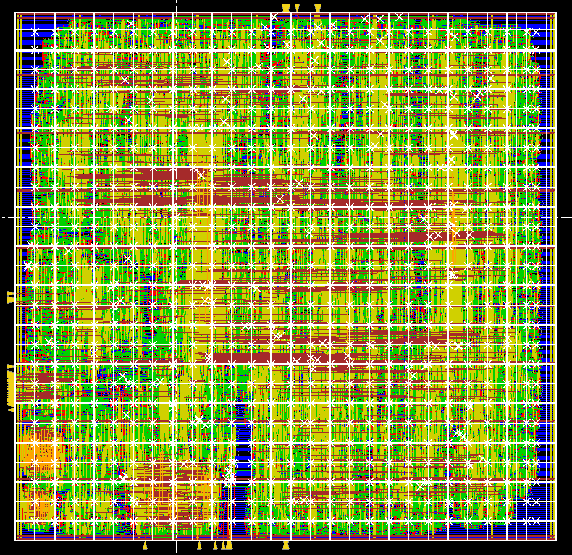
Implementation results
1.255 mm²
30,970
66.7 MHz
23.6 µs
cell area
cells
15 ns, positive slack
latency per frame
Check | Result
Post-route setup WNS | +0.165 ns
Post-route hold WNS | +0.122 ns
Tempus setup | +0.237 ns
Tempus hold | +0.840 ns
DRC | 0
Connectivity | clean
Antenna | 1 violation
Clock tree debugger, dc_slow: 14,398 sinks
Final routed layout
Team 18 · powerhouse

Slide 9
Power: above target, and we say so
Vectorless (Genus): 80.8 mW
Sequential cells draw 73.9% of power.
The weight array is about 92% of the flops.
Fixes: clock gating, a 10 MHz clock, and duty cycling.
One frame keeps the core busy about 0.16% of a 10 ms period at 100 MHz, 1.6% at 10 MHz.
Activity-based (Tempus, SAIF): 23.88 mW
The brief asks for low-milliwatt power. Both numbers sit above that goal. Bar lengths are to scale.
Team 18 · powerhouse

Slide 10
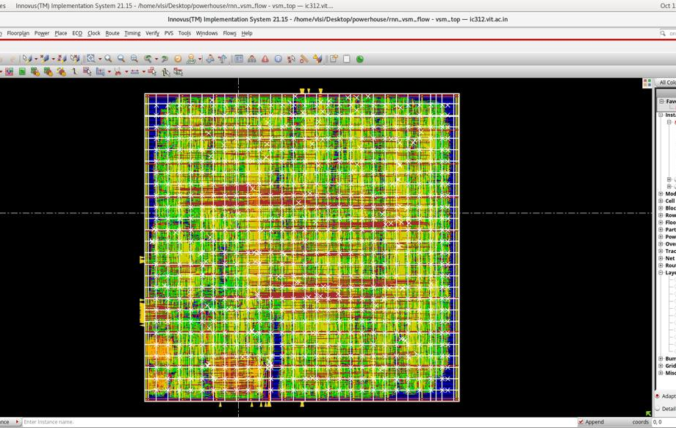
Limitations and next steps
Where we fall short
Next steps
The GDS has no foundry map or standard-cell merge, because the 0.18 µm GDS was not available.
Power is above target.
497 nets exceed the max-fanout limit.
Fault injection and coverage were not run.
Pipeline the multiplier if 100 MHz is required.
Try the RAM macros in the LEF for the weights.
Add clock gating.
Backup: antenna markers, 1 violation in the final run versus 150 in the first.
Team 18 · powerhouse

Slide 11
Thank you
scripts/run_rtl_ncsim.sh
Run the demo with one command. It prints the frames passing, with the alert asserting and clearing.
Source code and scripts
https://github.com/RKNAGA18/vsm-gru-asic
Notes:
Run the script live. Point out the pass count and the alert assert and clear lines.

