Slide 1








TASKTRACK: An Assignment Tracker App
A Web App for Managing Student Assignments and Deadlines
Presented by:
Rayen Leigh C. Elecho
Jerriel Aljamz L. Salih

Slide 2

What is TaskTrack?
TaskTrack is a web app that helps students organize assignments, track deadlines, and manage their tasks more effectively.

Slide 3




Objectives
Organize and store assignments
Track deadlines and task status
Manage tasks efficiently
Support planning with notes and checklists
Improve organization through sorting and custom order

Slide 4
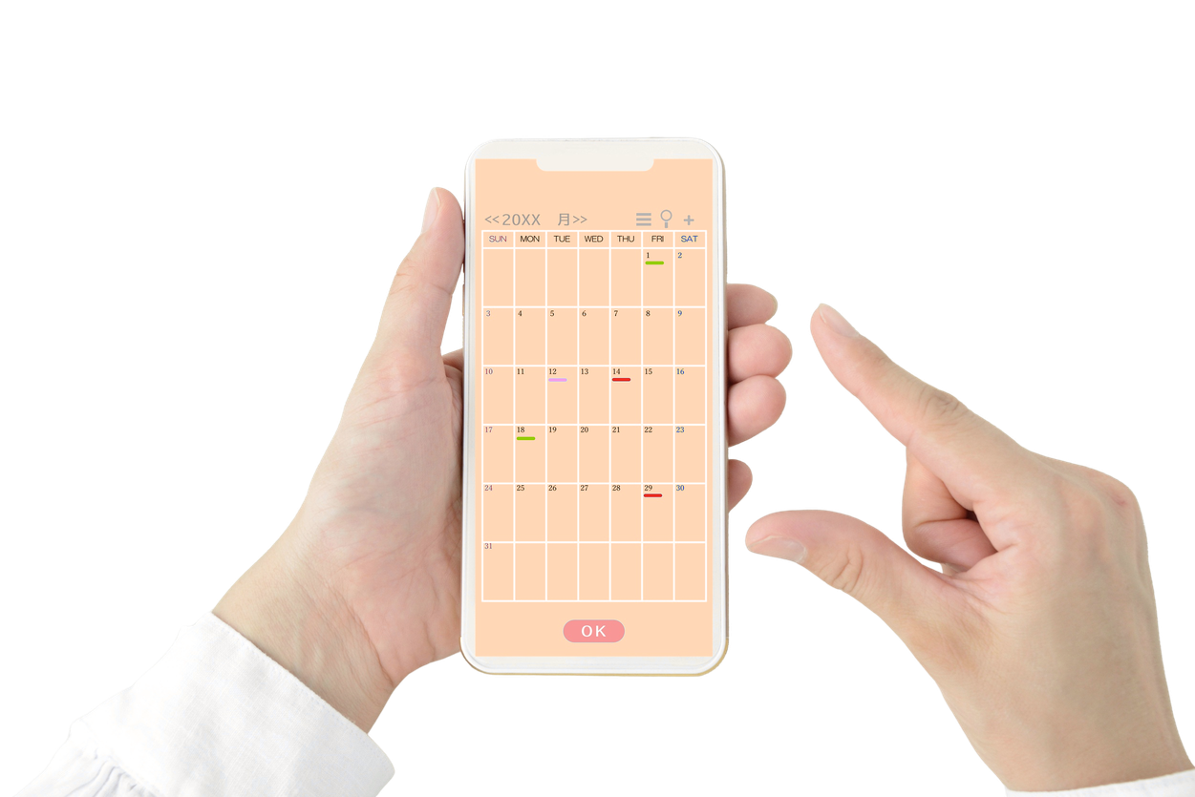






Key Features
Task Management
Add, edit, and delete tasks
Deadline Tracking
Due date, time, and urgency
Status Organization
Pending, Completed, Archived
Notes & Checklist
Extra details and step tracking
Sorting & Custom Order
Auto sort or drag-and-drop

Slide 5
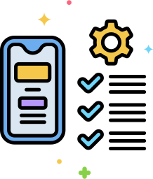

Methodology/Feature Implementation
Built using Flask (Python backend) and HTML, CSS, JavaScript (frontend)
Tasks and settings are stored locally using JSON files
Features follow: Input → Validate → Process → Save
System handles task status, sorting, and urgency automatically
Frontend sends user actions to the backend for processing

Slide 6
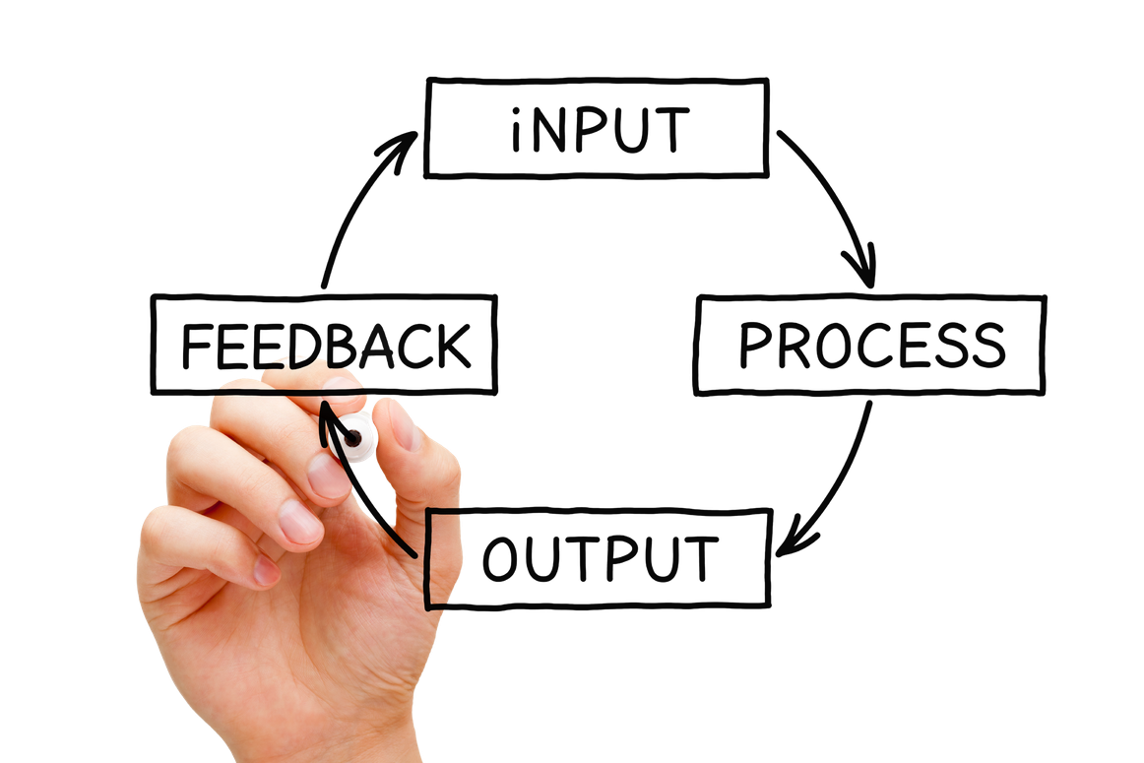



User Inputs & System Outputs
User Inputs
System Outputs
Subject and task description
Due date and time
Priority level and progress
Notes and checklist items
Task actions (add, edit, delete, reorder)
Organized task list (Active, Finished, Archived)
Due status (upcoming, urgent, overdue)
Progress display and task details
Updated task order and sorting
Undo options and confirmation prompts

Slide 7

Process Flow
Load tasks and settings
User selects action
Process action (add, edit, delete, update)
Start
Repeat or Exit
Update and display tasks
Save data to JSON

Slide 8


Conclusion
TaskTrack is a simple and effective web app that helps students organize assignments, track deadlines, and manage tasks efficiently. It provides a clear system for prioritizing work, helping reduce stress and improve productivity.

Slide 9


References:
Barbayannis, G., Bandari, M., Zheng, X., Baquerizo, H., Pecor, K. W., & Ming, X. (2022). Academic stress and mental well-being in college students: Correlations, affected groups, and COVID-19. Frontiers in Psychology, 13, 886344. https://doi.org/10.3389/fpsyg.2022.886344
Ahmady, S., Khajeali, N., Sharifi, F., & Mirmoghtadaei, Z. (2021). Relationship between study skills, stress, and academic performance among students: A systematic review. Journal of Education and Health Promotion, 10, 123. https://pmc.ncbi.nlm.nih.gov/articles/PMC7933620/
Lovin, D., Sandu, A., & Vasile, E. (2022). Stress among students and difficulty with time management. Social Sciences, 11(12), 538. https://www.mdpi.com/2076-0760/11/12/538
Luceño-Moreno, L., Talavera-Velasco, B., García-Albuerne, Y., & Martín-García, J. (2025). Impact of a strategic time management programme on academic stress. Ansiedad y Estrés. https://www.ansiedadyestres.es/art/2025/anyes2025a1

Slide 10




Presented to: Ma’am Dachel Raagas

